Slide 1

Unit 6: Be green
Lesson 6e: Grammar (Cont.)
Page 103

Slide 2
Lesson Outline
Warm-up
Grammar
Consolidation
Wrap-up

Slide 3

Objectives
By the end of this lesson, students will be able to:
know how to use although/however.
Review the use of and/or/but/so/because.

Slide 4

WARM-UP

Slide 5
Choose the word whose underlined part is pronounced differently from that of the others. Practise saying them.
1. A. project B. compost C. protein D. object
/ˈprɒdʒekt/ /ˈkɒmpɒst/ /ˈprəʊtiːn/ /ˈɒbdʒɪkt/
2. A. reduce B. disturb C. rescue D. reuse
/rɪˈdʒuːs/ /dɪˈstɜːb/ /ˈreskjuː/ /ˌriːˈjuːz/
3. A. created B. reduced C. escaped D. attached
/kriˈeɪtɪd/ /rɪˈdʒuːst/ /ɪˈskeɪpt/ /əˈtætʃt/

Slide 6
Work in groups and come up with a sentence with the given words using a conjunction. The first group with the sentence that makes sense gets 1 point. The group with the most points win.
Suggested answer
I love pizza and hamburger.
Because I love to sleep, I am often late to school
It rained yesterday, but we went camping.
I love to go to the cinema with you. But, I have to do homework.
pizza/ hamburger
sleep/ late to school
rained/ went camping
the cinema/ take a test

Slide 7
It rained yesterday, but we went camping.
2. I love to go to the cinema with you. But, I have to do homework.
Although it rained yesterday, we went camping.
I love to go to the cinema with you. However, I have to do homework.

Slide 8

PRESENTATION

Slide 9
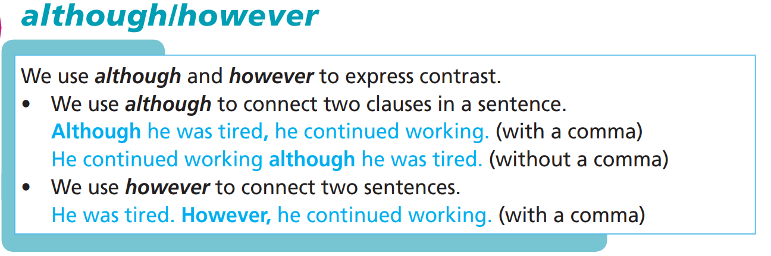
Fill in the blanks with the given conjunctions to complete the sentences.

Slide 10
FORM
Although + clause, clause
However, clause.

Slide 11

PRACTICE

Slide 12
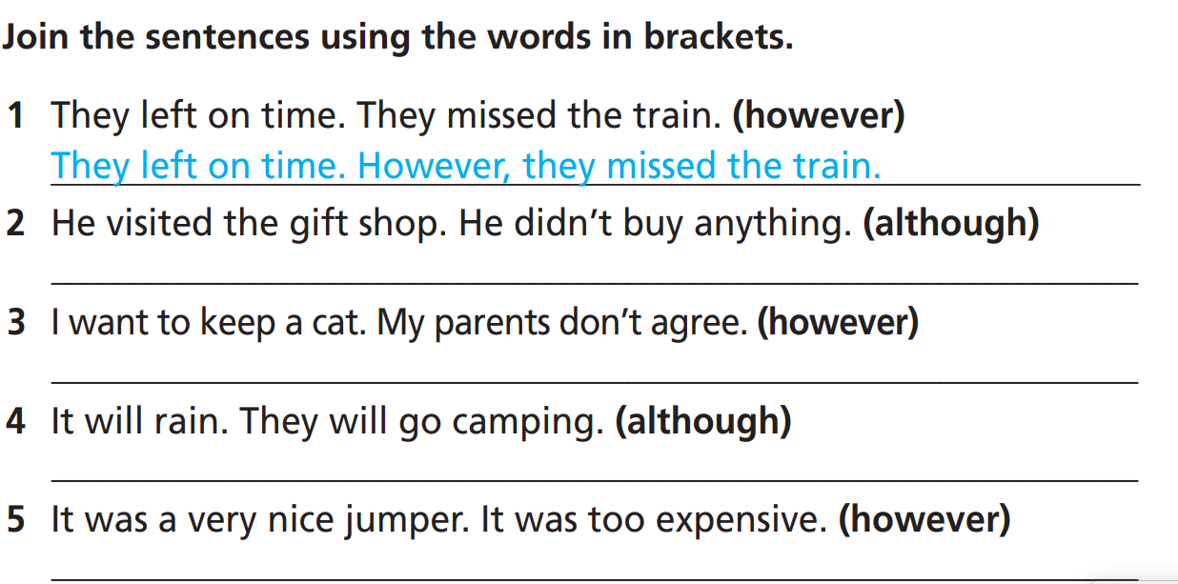
Although he visited the gift shop, he didn’t buy anything.
He didn’t buy anything although he visited the gift shop.
I want to keep a cat. However, my parents don’t agree.
Although it rained, they went camping./ They went camping although it rained.
It was a very nice jumper. However, it was too expensive.

Slide 13
Extra-Practice
WB p. 52
Join the sentences using the words in brackets.
1. It was cold. They went to the park. (although)
________________________________________________
2. Anna wanted to go to the animal shelter. It was closed. (however)
________________________________________________
3. The tickets were very expensive. They bought them. (although)
________________________________________________
4. He didn’t take a map with him. He couldn’t find the way. (so)
________________________________________________
5. Paula wants to volunteer at the national park. She doesn’t have much free time. (however)
________________________________________________
Although it was cold, they went to the park.
Anna wanted to go to the animal shelter. However, it was closed.
Although the tickets were very expensive, they bought them.
He didn’t take a map with him, so he couldn’t find the way.
Paula wants to volunteer at the national park. However, she doesn’t have much free time.

Slide 14
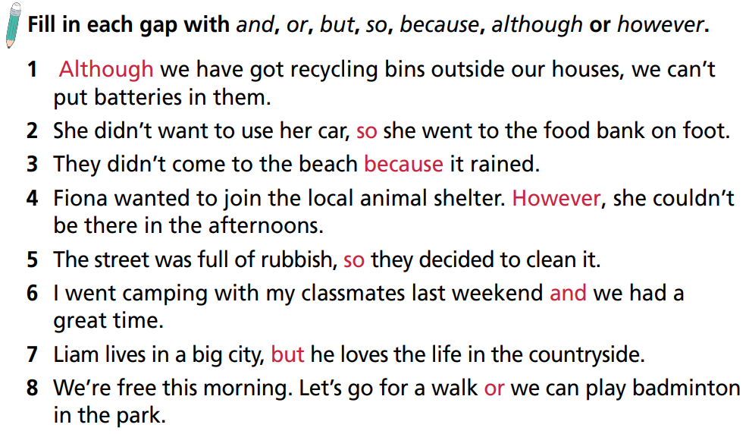

Slide 15
Extra-Practice
Work in groups. Choose the best answer.
10
9
8
7
6
5
4
3
2
1
End
1 They collect banana skins __________ they make compost from them.
and
or
so
although

Slide 16
Extra-Practice
Work in groups. Choose the best answer.
10
9
8
7
6
5
4
3
2
1
End
2 It rained. __________ , they went to the national park.
Although
So
But
However

Slide 17
Extra-Practice
Work in groups. Choose the best answer.
10
9
8
7
6
5
4
3
2
1
End
3 __________ they wanted to keep the parrot, they sent it to the animal shelter.
Because
However
Although
So

Slide 18
Extra-Practice
Work in groups. Choose the best answer.
10
9
8
7
6
5
4
3
2
1
End
4 They recycle their plastic things __________ they want to reduce plastic pollution.
because
however
although
so

Slide 19
Extra-Practice
Work in groups. Choose the best answer.
10
9
8
7
6
5
4
3
2
1
End
5 We can join the clean-up day __________ we can plant trees in the park. Which do you prefer?
because
however
although
or

Slide 20
Extra-Practice
Work in groups. Choose the best answer.
10
9
8
7
6
5
4
3
2
1
End
6 They wanted to start a recycling club, __________ they didn’t know how to do.
but
however
because
so

Slide 21
Extra-Practice
Work in groups. Choose the best answer.
10
9
8
7
6
5
4
3
2
1
End
7 We can put bins in each classroom, __________ we can recycle paper.
so
but
or
however

Slide 22
Extra-Practice
Work in groups. Choose the best answer.
10
9
8
7
6
5
4
3
2
1
End
8 I am saving plastic bottles __________ I want to create art from them.
so
because
but
although

Slide 23
Extra-Practice
Work in groups. Choose the best answer.
9 Dian Fossey fell in love with mountain gorillas, __________ she tried to save them.
because
although
but
so
10
9
8
7
6
5
4
3
2
1
End

Slide 24
Extra-Practice
Work in groups. Choose the best answer.
10 __________ her school is far from her house, she goes there on foot every day.
Although
But
However
Because
10
9
8
7
6
5
4
3
2
1
End

Slide 25
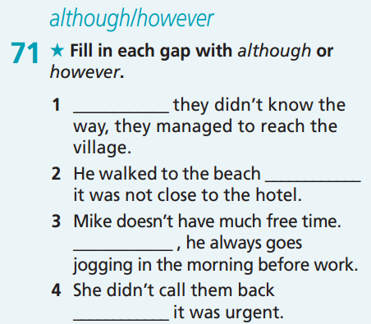
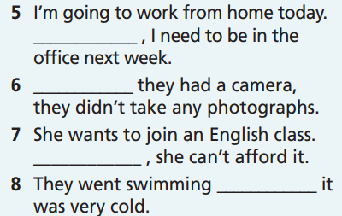
Extra practice
GB-p.77
However
Although
Although
although
However
although
However
although

Slide 26
Extra practice
GB-p.77
Join the sentences using the words in brackets.
He met the famous scientist. He didn’t take photos with her. (however)
_______________________________________________
2. She won’t stay long. She is busy. (because)
_______________________________________________
3. They went to the zoo. Their mum told them not to. (although)
_______________________________________________
4. It was raining. They decided to stay in. (so)
_______________________________________________
He met the famous scientist. However, he didn’t take photos with her.
She won’t stay long because she is busy.
They went to the zoo although their mum told them not to.
It was raining, so they decided to stay in.

Slide 27
PRODUCTION

Slide 28
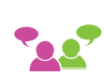
₆
Start to say a sentence. Your partner continues it, using although or however.
A: Tony continued working ...
B: Tony continued working although it was late.

Slide 29

CONSOLIDATION

Slide 30
Write at least 5 sentences about different areas of your life using conjunctions “so, but, although, however, because”.
Suggested ideas
Study: Although I am not good at writing, I am trying to improve this skill.
Hobby:
Friends:
Family:
Your own ideas.

Slide 31

WRAP-UP

Slide 32
Today’s lesson
Grammar
To learn how to use although/however.
Review the use of and/or/but/so/because.

Slide 33
Homework
Practise the grammar points and make sentences using them.
Do homework in WB (page 52).
Prepare the next lesson (page 104 SB).
Complete the grammar notes in TA 7 Right on Notebook (page 48).

Slide 34
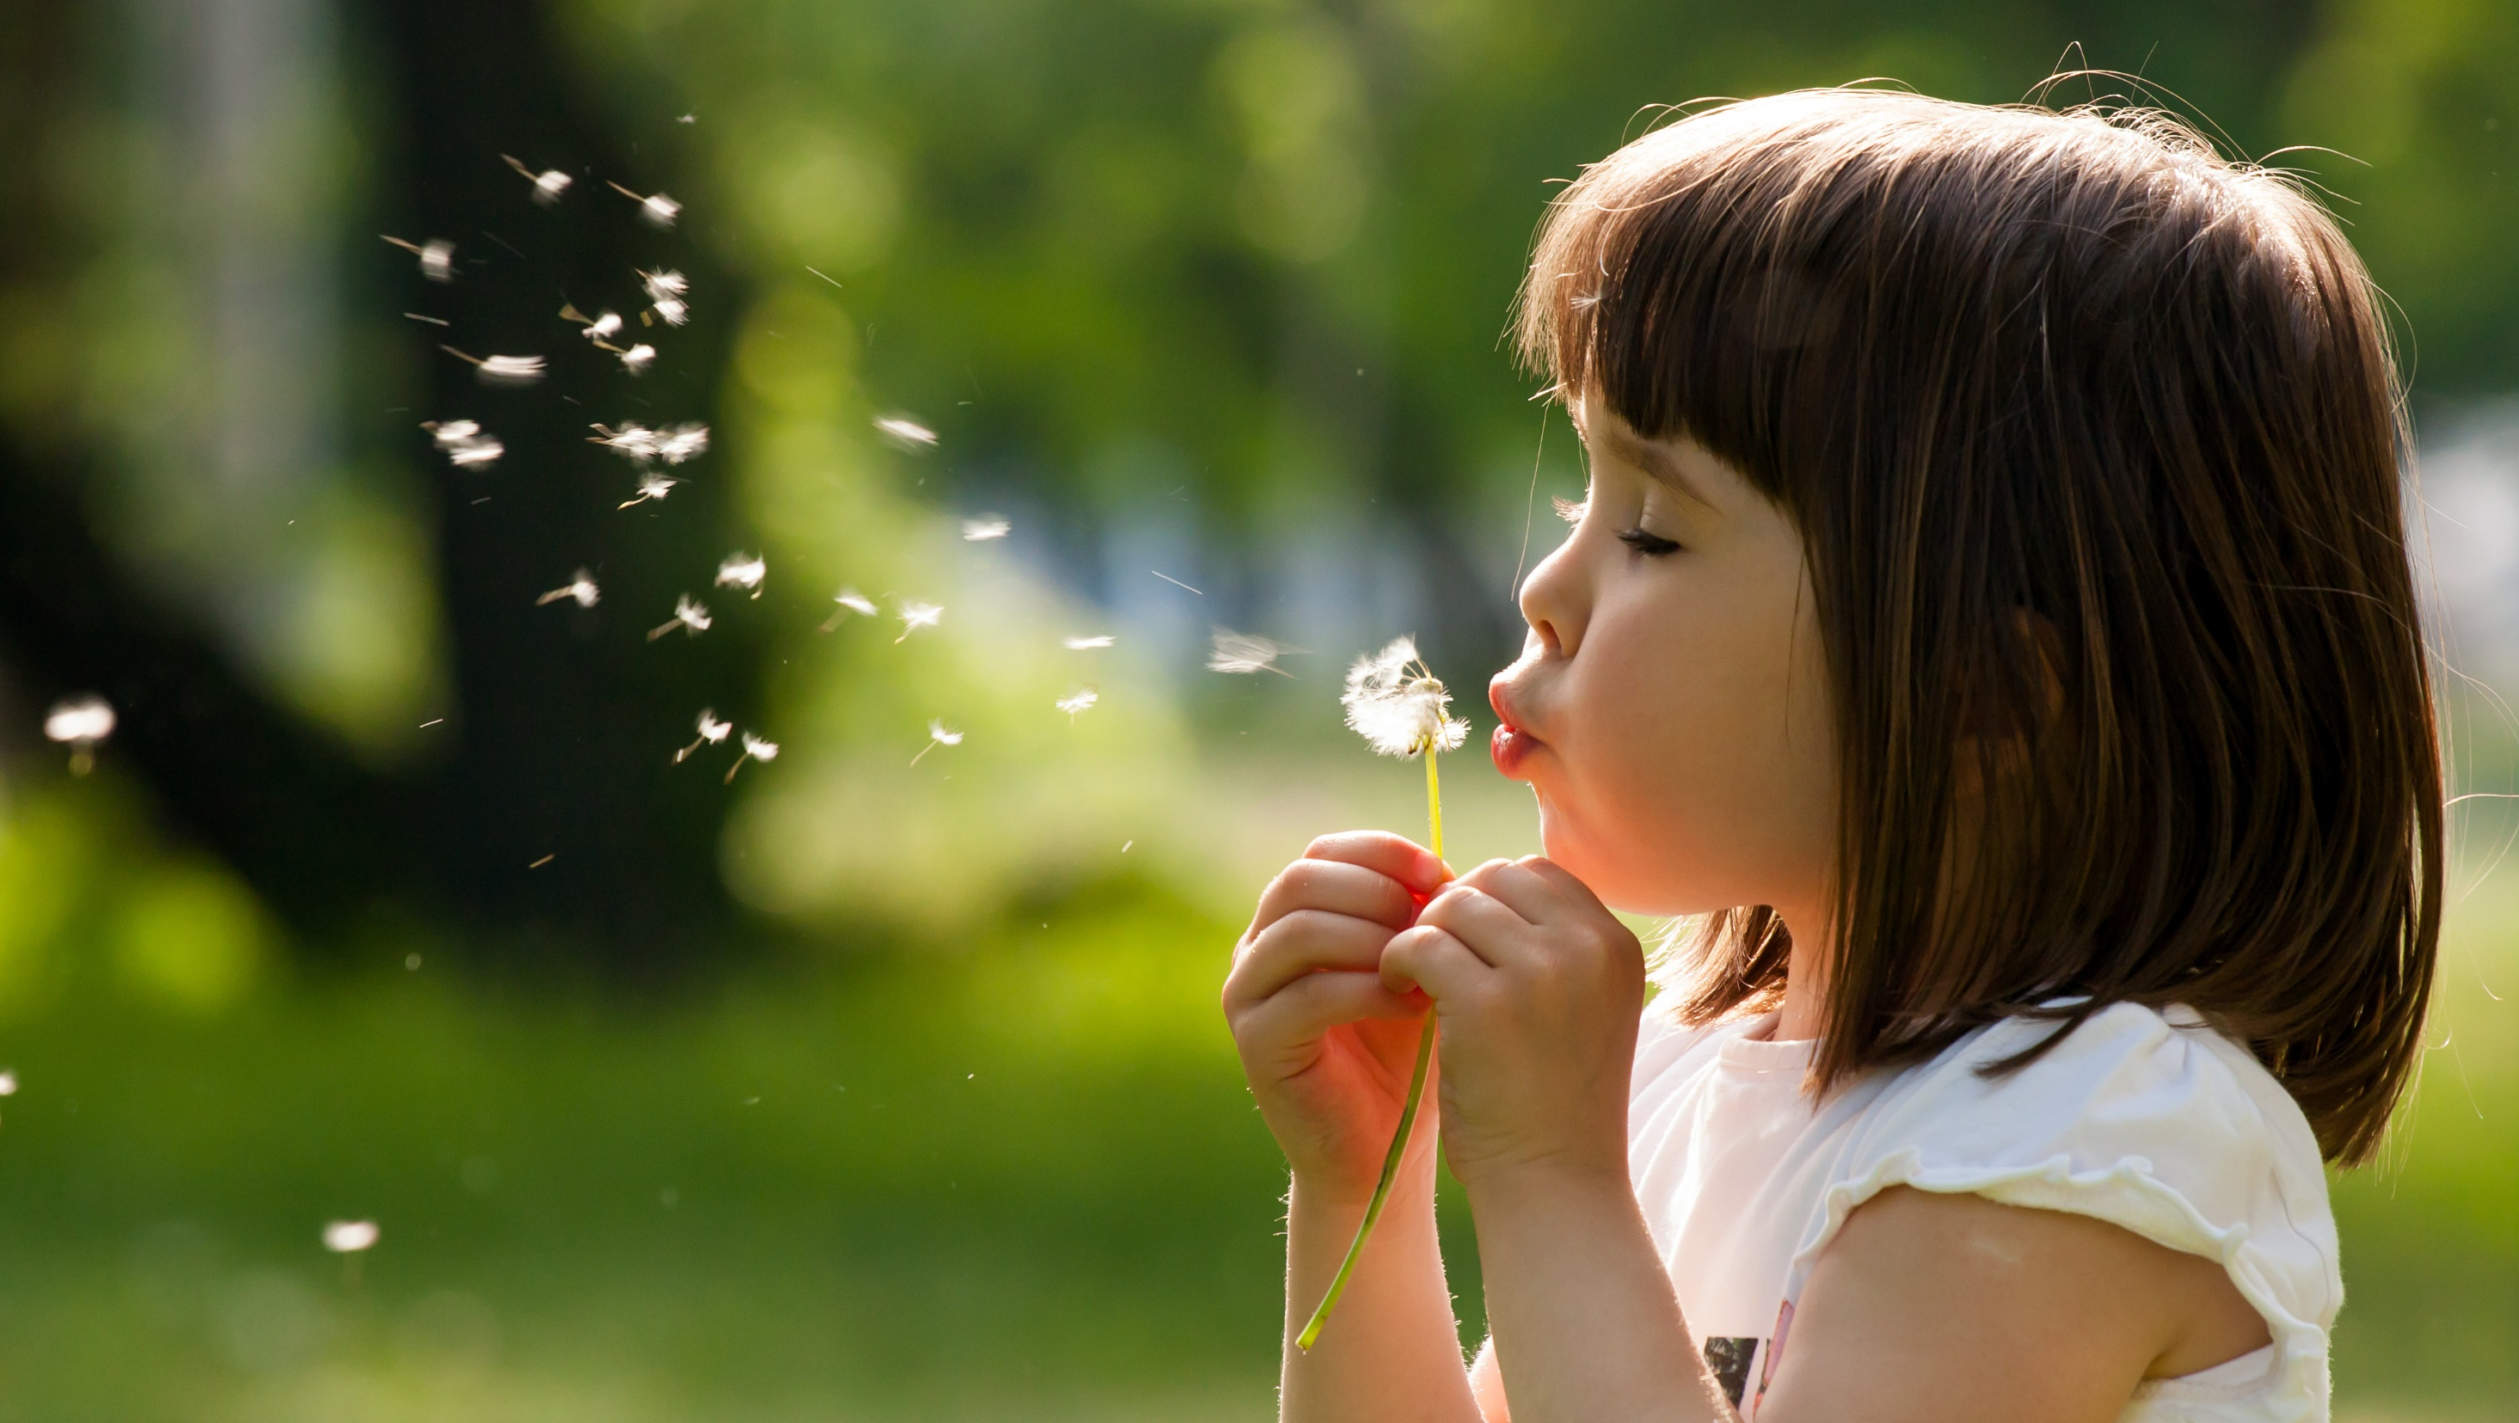
Enjoy your day!

