Slide 1

Unit 1: Home
Lesson 1.1: Vocabulary & Listening
Student’s Book - Page 6

Slide 2
Lesson Outline
Warm-up
Vocabulary
Listening
Consolidation
Wrap-up

Slide 3
Objectives
By the end of this lesson, students will be able to…
ask about people’s homes;
use the Present Simple tense with Yes/No questions;
get someone’s attention.

Slide 4

New words
Pool
Balcony
Garage
Yard
Gym
Apartment
House

Slide 5

WARM-UP

Slide 6

Work in pairs
1. Do you live in a house or an apartment?
2. Does your house have a yard?

Slide 7



Slide 8
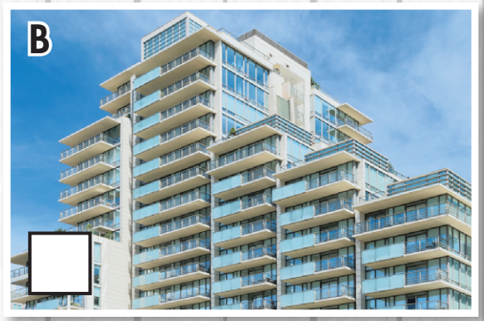
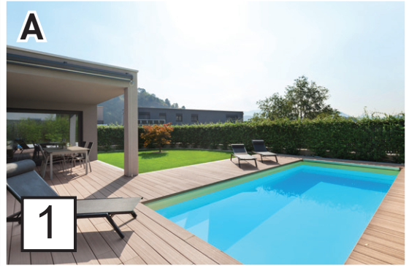
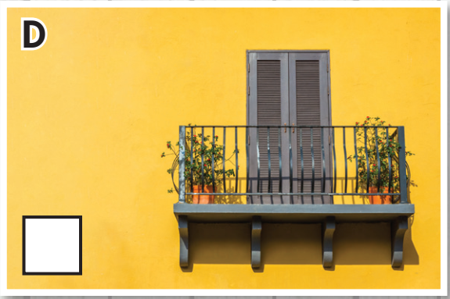
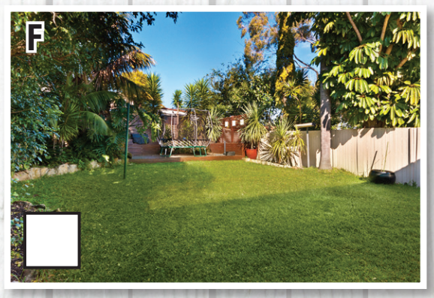
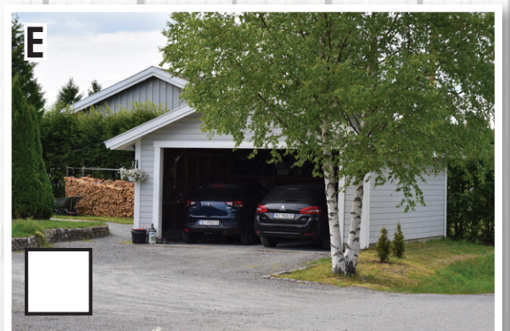
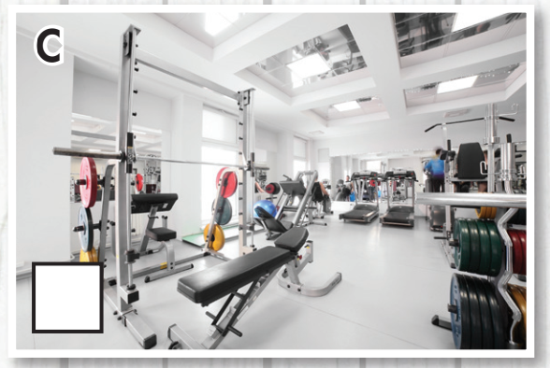

What is it?
pool (n) /pu:l/ bể bơi
apartment (n) /əˈpɑːrtmənt/ chung cư
gym (n) /dʒɪm/ phòng tập thể dục
balcony (n) /ˈbælkəni/ ban công
garage (n) /gəˈra:ʒ/ nhà để xe
yard (n) /ja:rd/ cái sân

Slide 9
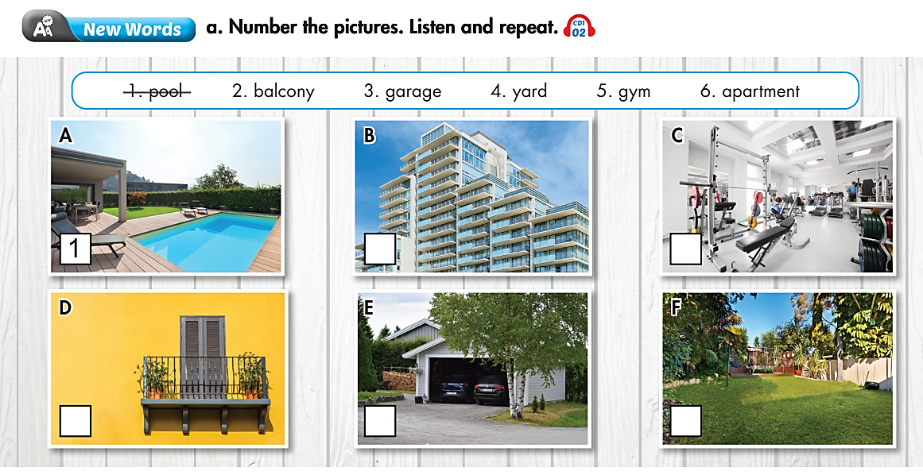
6
5
2
3
4

Slide 10
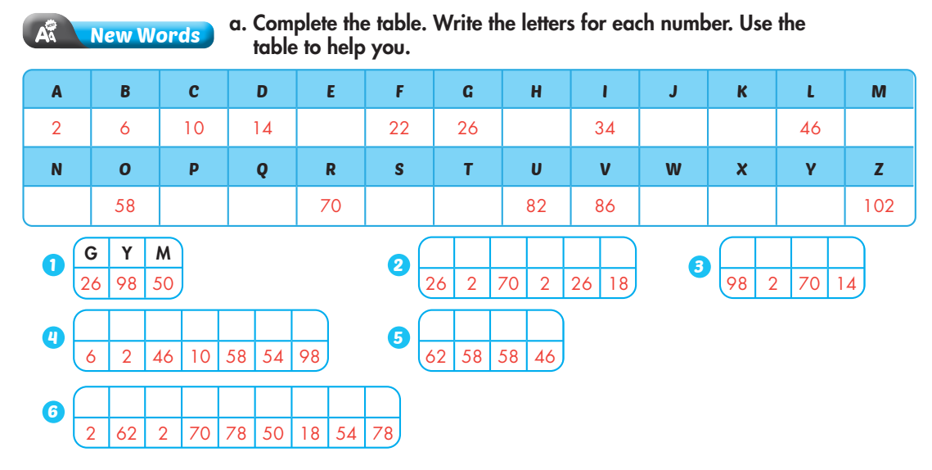
Extra Practice
WB page 2
18 30 38 42 50
54 62 66 74 78 90 94 98
G | A | R | A | G | E
Y | A | R | D
Practice
B | A | L | C | O | N | Y
P | O | O | L
A | P | A | R | T | M | E | N | T

Slide 11

Talk about your home, using the new words
and three other words you know.
There’s a gym in my apartment.
Example:
My house has a yard.

Slide 12
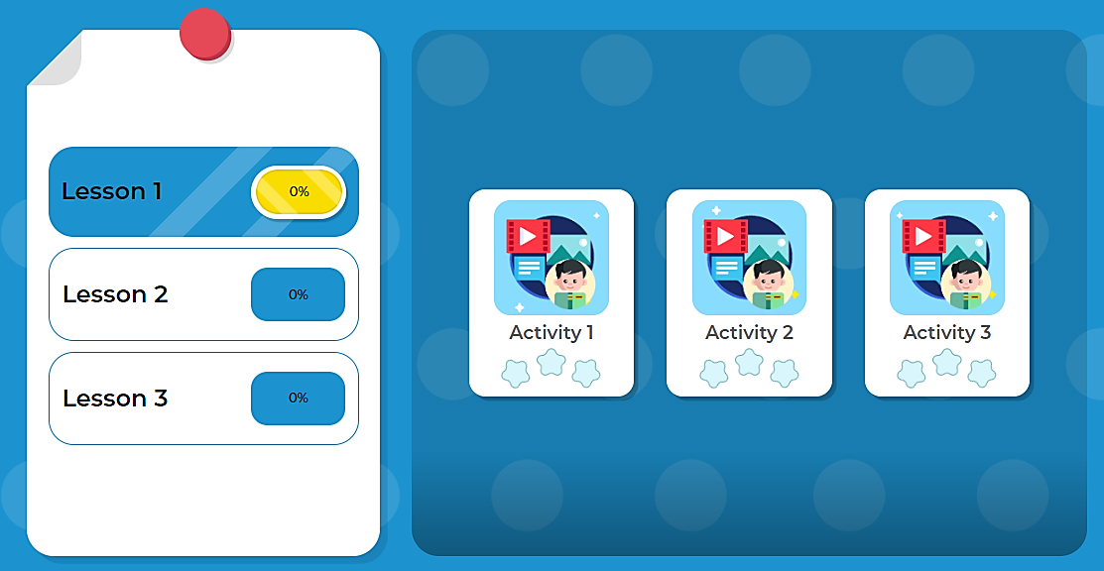
Click here to play the games

Slide 13

Listening

Slide 14


Pre-Listening
Read the instruction quickly. Underline the key words.

Slide 15
While-Listening
Listen and circle Yes or No. Why?
Why?
Jim: Oh, you're in class 6A, aren't you?
Jenny: Yes, that's right. My name's Jenny.

Slide 16
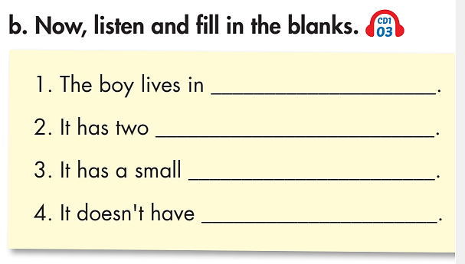
Pre-Listening
Read the statements quickly. Underline the key words.

Slide 17
While-Listening
an apartment
bedrooms
pool
a garage

Slide 18
Post-Listening
Practice the conversation with a partner.
Jenny: Excuse me. Could I ask you some questions?
Jim: Oh, you're in class 6A, aren't you?
Jenny: Yes, that's right. My name's Jenny. I'm doing a survey for my geography class.
Jim: My name's Jim. What do you want to know?
Jenny: Thank you, Jim. Do you live in a house?
Jim: No, I don't. I live in an apartment.
Jenny: How many bedrooms does it have?
Jim: Two.
Jenny: Does it have a pool?
Jim: Yes, a small one.
Jenny: Does it have a garage?
Jim: No, it doesn't.
Jenny: Does it have a gym?
Jim: Yes, it does. There's a gym in the basement.
Jenny: Does it have a balcony?
Jim: Yes, it does. I can see the city from it.
Jenny: Great! Thank you for your help.
Jim: You're welcome.
Jenny: Goodbye.

Slide 19
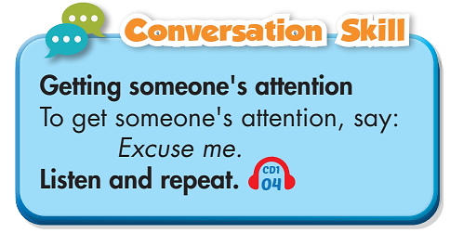

Work in pairs
Make a small conversation,
using “Excuse me”.
Example:
A. Excuse me. Can you show me the way to class 6A?
B. It’s over there.
A. Thanks.

Slide 20

CONSOLIDATION

Slide 21
Write 5 sentences about your house or apartment,
using the information you have learned.
Structures:
  My house/ apartment has ………………….
  There is/ are …………………. in my house/ apartment.

Slide 22

WRAP-UP

Slide 23
Today’s lesson
Vocabularies
Pool
Balcony
Garage
Yard
Gym
Apartment
House
Structures/ Sentence patterns
  - My house/ apartment has ………………….
  - There is/ are ………………….
  in my house/ apartment.

Slide 24
Homework
Review the vocabularies and practice using them.
Do the exercise(s) in Tiếng Anh 6 i-Learn Smart World Workbook (pages 2 & 3).
Do the vocabulary exercise in Tiếng Anh 6 i-Learn Smart World Notebook (page 2).
Play the consolation games in Tiếng Anh 6 i-Learn Smart World DHA App on www.eduhome.com.vn.
Prepare the next lesson (page 7 - SB).

Slide 25

Have a nice day!

