Slide 2
Unit 8:
Sports and games
Lesson 2: A closer look 1

Slide 3
Unit
8
SPORTS AND GAMES
Vocabulary
Pronunciation
1

Slide 4


LESSON 2: A CLOSER LOOK 1
WARM-UP
Brainstorming
Task 1: Write the right words / phrase under the pictures.
Task 2: What sports are these things for? Match each thing in column A with a sport in column B.
Task 3: Fill each blank with the words from the box
VOCABULARY
Task 4: Listen and repeat. Pay attention to the sounds /e/ and /æ/.
Task 5: Listen and repeat. Underline the words having the sounds /e/ and /æ/.
PRONUNCIATION
CONSOLIDATION
Wrap-up
Homework

Slide 5
WARM-UP
BRAINSTORMING
- Teacher divides the class into two teams. One member, in turns, comes to the board and lists all the sports and games
- The team with more correct answers in two minutes is the winner.

Slide 6

WARM-UP
BRAINSTORMING
ball
racket
shoes
SPORTS THINGS
baseball bat
goggles
basket
bicycle
net

Slide 7
Unit
8
SPORTS AND GAMES
I. Vocabulary

Slide 8


VOCABULARY
racket (n)
/ˈrækɪt/
cái vợt

Slide 9

VOCABULARY
goggles (n)
/ˈɡɒɡlz/
kính bơi

Slide 10
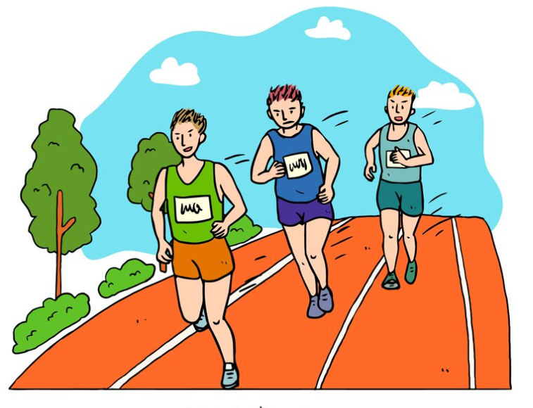
VOCABULARY
competition (n)
/ˌkɒmpəˈtɪʃn/
cuộc đua

Slide 11

VOCABULARY
champion (n)
/ˈtʃæmpiən/
nhà vô địch

Slide 12

VOCABULARY
marathon (n)
/ˈmærəθən/
cuộc chạy đua ma-ra-tông

Slide 13
VOCABULARY
New words | Pronunciation | Meaning
1. racket (n) | /ˈrækɪt/ | cái vợt
2. goggles (n) | /ˈɡɒɡlz/ | kính bơi
3. competition (n) | /ˌkɒmpəˈtɪʃn/ | cuộc đua
4. champion (n) | /ˈtʃæmpiən/ | nhà vô địch
5. marathon (n) | /ˈmærəθən/ | cuộc chạy đua ma-ra-tông

Slide 14

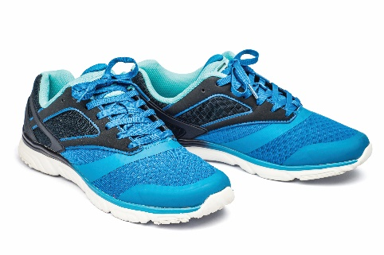


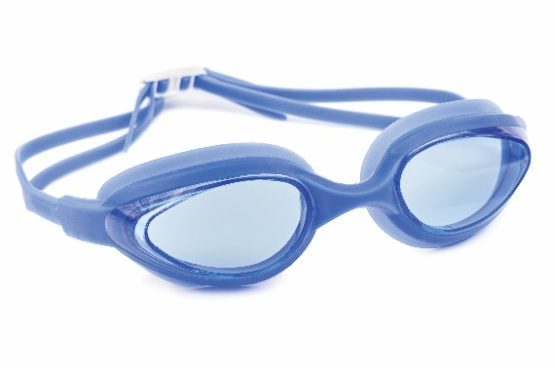
VOCABULARY
1
Write the right words / phrase under the pictures.
ball
boat
boat
2. __________
3. __________
ball
sport shoes
1. __________
racket
goggles
sport shoes
racket
goggles
4. __________
5. __________

Slide 15
VOCABULARY
2
What sports are these things for?
Match each thing in column A with a sport in column B
1. bicycle
a. boating
2. ball
b. swimming
3. boat
c. cycling
4. goggles
d. ball games
5. racket
e. badminton

Slide 16
VOCABULARY
3
Fill each blank with one of the words from the box.
1. She won an international sports ____________.
2. He became the world tennis _____________ when he was very young.
3. “Can you send my _______________ to the winner of the contest?
4. My friend David is very ___________.
He does exercise every day.
5. The first _____________ took place in 1896.
competition
champion
champion
competition
congratulations
sporty
marathon
congratulations
sporty
marathon

Slide 17
Unit
8
SPORTS AND GAMES
II. Pronunciation
/e/ and /æ/

Slide 18

PRONUNCIATION
Notes:
Link: https://www.youtube.com/watch?v=GCzZGeFJTxE&list=PL8_ETpRL2xNbMMSCSok5UNHcQOpjKgvAn&index=8

Slide 19
PRONUNCIATION
4
Listen and repeat. Pay attention the sounds /e/ and /æ/.
/e/ | /æ/
chess tennis exerise contest | racket match marathon active

Slide 20
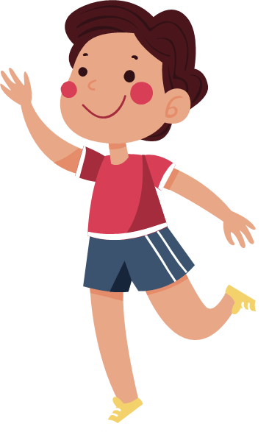
PRONUNCIATION
5
Listen and repeat. Underline the words having the sounds /e/ and /æ/.
1. They cannot take part in this contest.
2. They began the match very late.
3. Please get the racket for me.
4. We play chess every Saturday.
5. My grandpa is old, but he’s active.

Slide 21

CONSOLIDATION
1
Wrap-up
What have we learnt in this lesson?
Use the lexical items related to the topic Sports and Games
Pronounce correctly the sounds /e/ and /æ/

Slide 22

CONSOLIDATION
2
Homework
Do exercises in the workbook.
Find 5 more words with the sound /θ/ and 5 more words with the sound /ð/. Write them down and practice pronouncing the words.

Slide 23






Website: hoclieu.vn
Fanpage: facebook.com/www.tienganhglobalsuccess.vn/

