Slide 1
KEY ENGLISH TEST 2
SPEAKING TEST 4

Slide 2
KET SPEAKING
Time allowed - 8-10 minutes
Normally you will do the speaking test with another candidate. The two of you will meet two examiners. One of the examiners will talk to you, the other does not particpate in the conversations.
There are two parts to the speaking test:
Speaking part 1: short questions and answers between you and the examiner
Speaking part 2: the examiner gives you some information or a card with some ideas for questions. You have to talk with the other candidate and ask or answer questions.
How to prepare for KET Speaking
Speak as much as you can, with your friends
Practise asking and asnwering questions about daily life
Practise giving information about yourself

Slide 3
Part 1:
What is your hobby?
Why did you start your hobby?
How many hours a week do you spend on your hobby?
Are there any dangerous hobbies?Is your hobby safe or dangerous?
Does your hobby interfere with your work/study/personal life?
Talk about your hobby

Slide 4
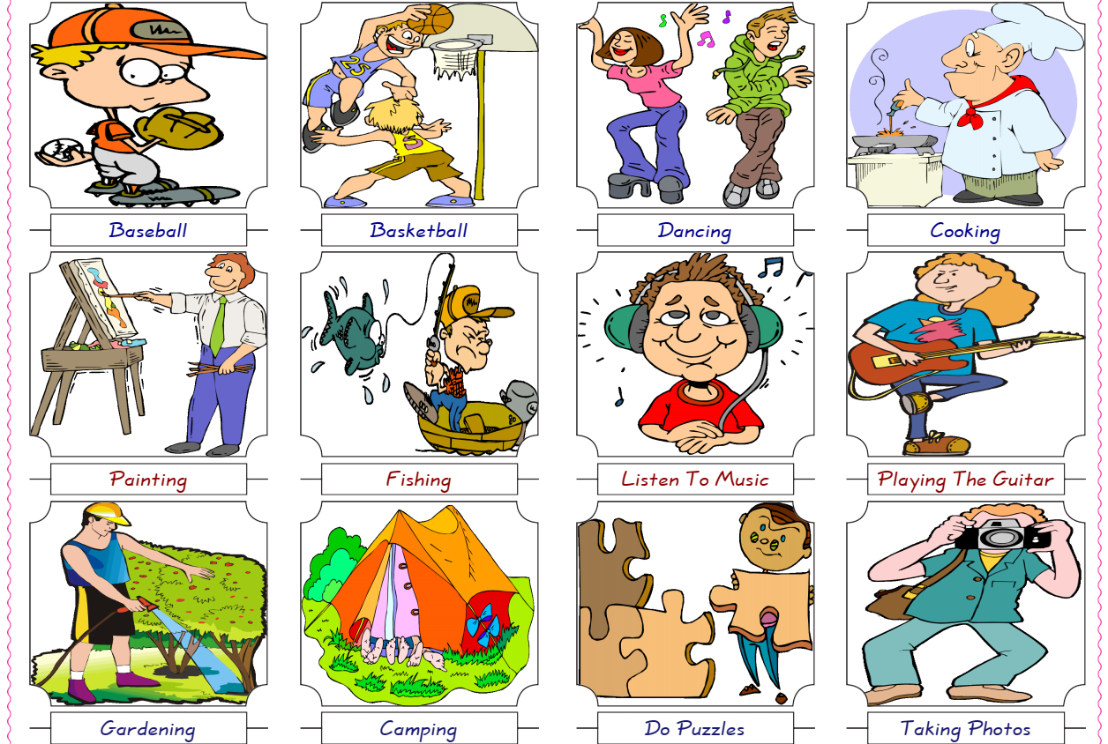
Hobbies

Slide 5
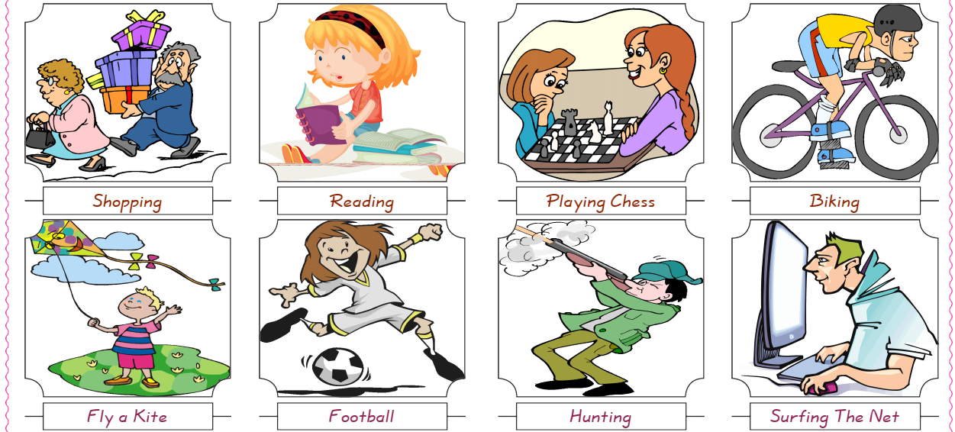

Slide 6
Hobbies
Talking about hobbies in more detail
Saying why you like your hobby
Creative, fascinating, practical, cheap, enjoyable, relaxing, different,…
In my free time I…
When I have some spare time I…
I’m interested in (+ noun / gerund)
I’m keen on (+ noun / gerund)
I’m into (+ noun / gerund)
I enjoy (+ noun / gerund)
I like arts and crafts. I’m a creative / practical person, and like doing things with my hands.”
“I’m an outgoing person, and like socialising / hanging out with friends.”
“I enjoy being physically active, and spend a lot of time playing sports and team games.”
it keeps me fit.
…it gets me out of the house, you know!
…it’s sociable. I’ve met lots of new people.
…it gives me something interesting to do with my time.
…it’s not very expensive, and anyone can do it!

Slide 7
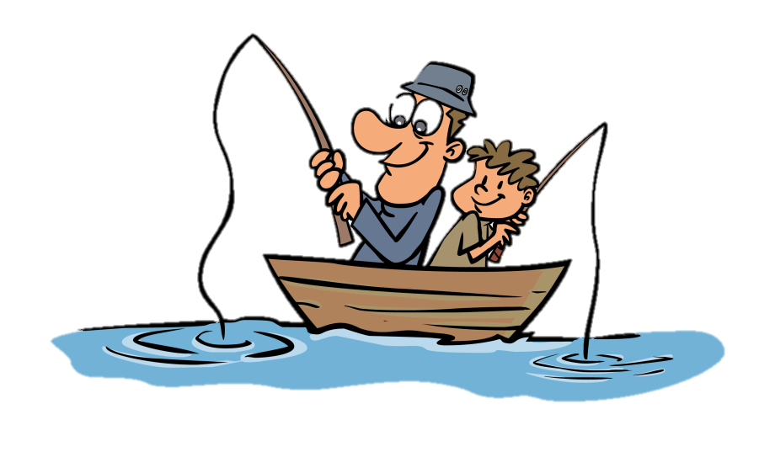
Like doing vs like to do
We use like + gerund (ing form) to talk about general likes:
I like fishing.
We use like + infinitive to talk about more specific likes:
I like to go fishing at the weekend.

Slide 8
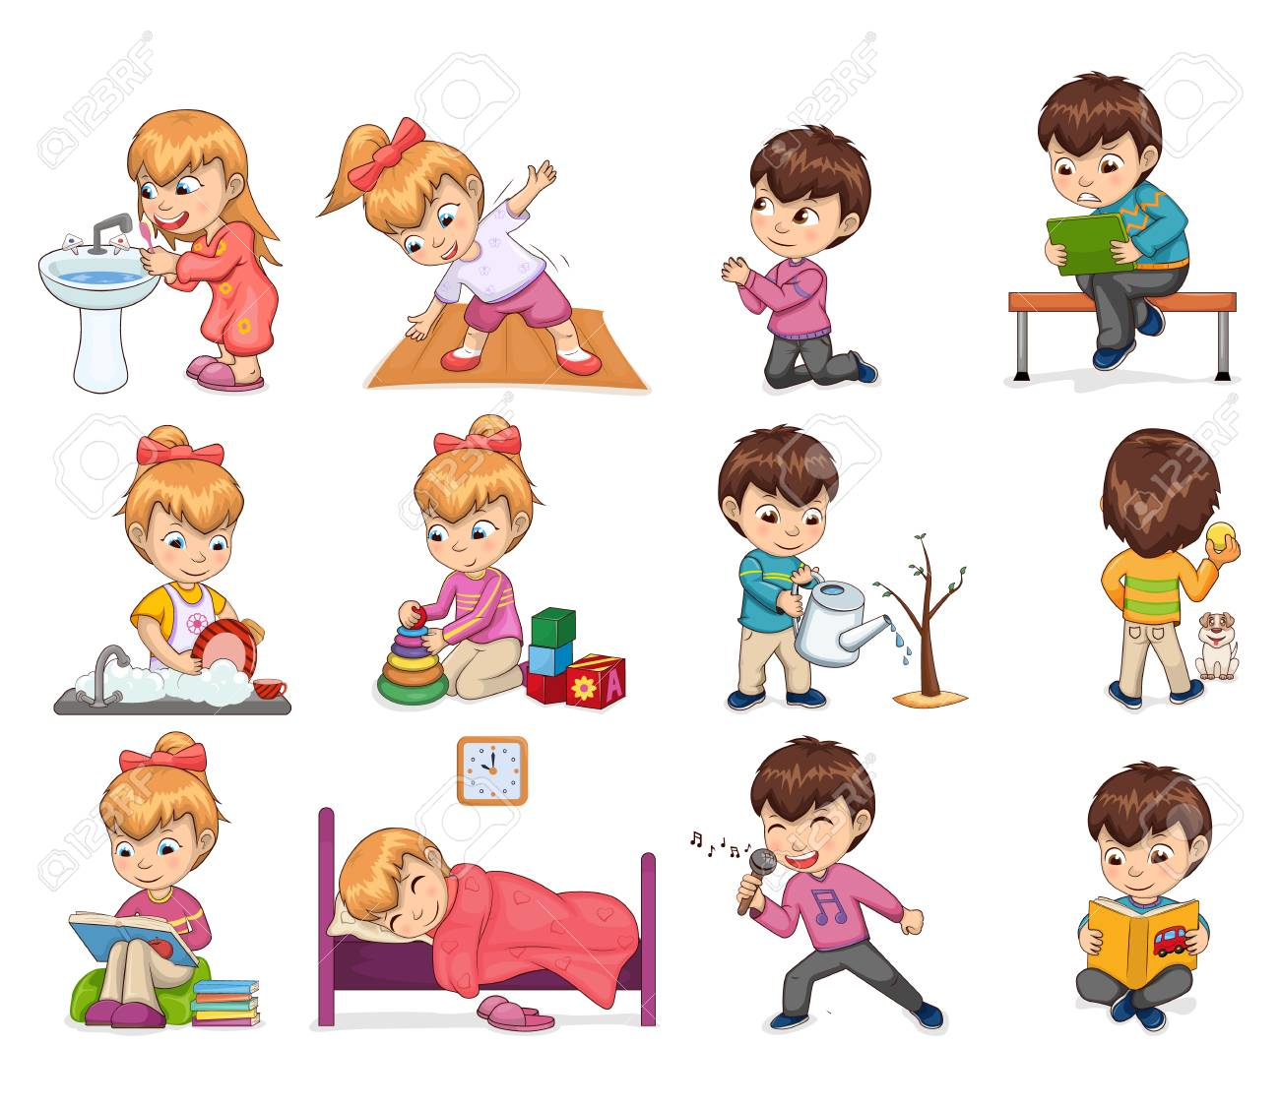
Daily life
The answer should be at least 3 sentences

Slide 9
SPEAKING
PART 2
Asking and answering questions using these prompt cards

Slide 10

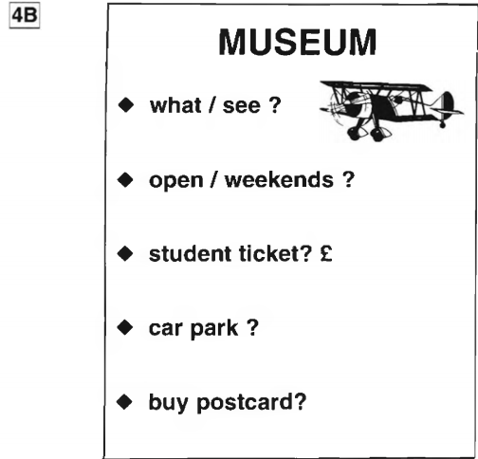
You can see more than 70 aeroplanes
Yes, it does
A student ticket is £5
Yes, there is
You can buy postcards in the shop
What can I see in the museum?
Does it open at the weekends?
How much is the student ticket?
Is there a car park?
Where can you buy postcards?

Slide 11

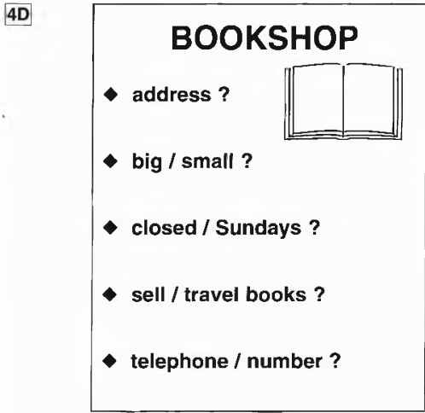
What is the address of the shop?
Is it big or small?
Is it closed on Sundays?
Does it sell travel books?
What is the telephone number?
Ask more questions and answers those questions

Slide 12
Imagine that you are the tour guide. Introduce the musuem based on the given informattion

