Slide 1


Slide 2

Unit
6
1
Unit
FAMILY LIFE
GENDER EQUALITY
LESSON 8
LOOKING BACK AND PROJECT

Slide 3

Unit
1
1
FAMILY LIFE
Family Life
Unit
OBJECTIVES
Review the vocabulary and grammar of Unit 6
Apply what Ss have learnt (vocabulary and grammar) into practice through a project

Slide 4
LESSON 8
LOOKING BACK AND PROJECT
WARM-UP
Game: Last man standing
Pronunciation: Listen and mark the stressed syllables.
Vocabulary: Do the crossword.
Grammar: Underline the mistakes and write the correct word(s).
LOOKING BACK
PROJECT
Students’ future jobs
CONSOLIDATION
Wrap-up
Homework

Slide 5
LESSON 8
LOOKING BACK AND PROJECT
WARM-UP
Game: Last man standing

Slide 6
WARM-UP
Game: Last man standing
Everyone takes turns saying one word/ grammar point learned in Unit 6.
You will be eliminated from the game if you repeat what others said or cannot remember anything else.
The winner is the last person left in the game!

Slide 7
LESSON 8
LOOKING BACK AND PROJECT
WARM-UP
Game: Last man standing
Pronunciation: Listen and mark the stressed syllables.
Vocabulary: Do the crossword.
Grammar: Underline the mistakes and write the correct word(s).
LOOKING BACK

Slide 8

PRONUNCIATION
1
Listen and mark the stressed syllables in the words in bold.
1. The surgeon's job is quite difficult.
2. Soviet cosmonauts learnt how to parachute to safety.
3. I’m proud of my sister. She’s studying at a medical school.
4. We need to continue fighting for equal rights.
1. The surgeon's job is quite ‘difficult.
2. Soviet cosmonauts learnt how to ‘parachute to safety.
3. I’m proud of my sister. She’s studying at a ‘medical school.
4. We need to con’tinue fighting for equal rights.

Slide 9
VOCABULARY
Do the crossword. Use the words you have learnt in this unit.
1
1
K
I
N
D
E
R
G
A
R
T
E
N
1. A ___________ teacher works with small children to prepare them for school.
2. Job adverts should not mention their ideal candidate's ___________.
3. A very experienced ___________ was able to rebuild his nose after the accident.
4. Boys and girls should have ___________ opportunities in education.
5. Parents should not ___________ boys differently from girls.
2
G
E
N
D
E
R
3
S | U | R | G | E | O | N
4
E | Q | U | A | L
5
T | R | E | A | T

Slide 10
GRAMMAR
Each of the following sentences has a mistake. Underline it and write the correct
word(s) in the space given.
1. One paragraph about gender equality ought to write by each student. 2. Action to stop domestic violence must take immediately. 3. Should all people be provide with equal access to information? 4. Young girls mustn’t force into marriage. 5. Can men and women given equal opportunities in the workplace? | ___________________ ___________________ ___________________ ___________________ ___________________
ought to be written
must be taken
be provided
mustn‘t be forced
be given

Slide 11
LESSON 8
LOOKING BACK AND PROJECT
WARM-UP
Game: Last man standing
Pronunciation: Listen and mark the stressed syllables.
Vocabulary: Do the crossword.
Grammar: Underline the mistakes and write the correct word(s).
LOOKING BACK
PROJECT
Students’ future jobs

Slide 12
PROJECT
Work in groups. Choose any class in your school and do a survey to find out:
• the number of boys and girls.
• how many of them would like to work as surgeons, airline pilots, nurses and shop assistants, or do other jobs in the future.
Class:
Number of students | Surgeons | Airline pilots | Nurses | Shop assistants | Others
_______ boys
_______ girls

Slide 13
PROJECT
Report your results to the class.
Which of the jobs is the least popular among the boys and which one the least popular among the girls? Give possible reasons.

Slide 14
LESSON 8
LOOKING BACK AND PROJECT
WARM-UP
Game: Last man standing
Pronunciation: Listen and mark the stressed syllables.
Vocabulary: Do the crossword.
Grammar: Underline the mistakes and write the correct word(s).
LOOKING BACK
PROJECT
Students’ future jobs
CONSOLIDATION
Wrap-up
Homework

Slide 15
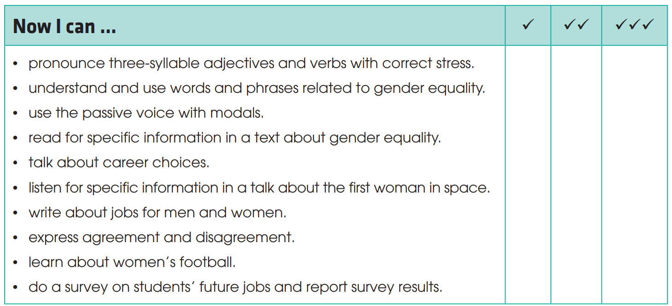
CONSOLIDATION
1
Wrap-up
Check what you have been able to do after this unit!

Slide 16
CONSOLIDATION
2
Homework
Do exercises in the workbook.
Prepare for the next lesson: Unit 7.

Slide 17

Website: hoclieu.vn
Fanpage: facebook.com/www.tienganhglobalsuccess.vn

