Slide 1

Unit 4: Holidays!
Lesson 4d: Everyday English
Page 77

Slide 2
Lesson Outline
Warm-up
Speaking
Grammar
Intonation
Consolidation
Wrap-up

Slide 3
Objectives
By the end of this lesson, students will be able to…
use structures to make suggestions.
use object personal pronouns and possessive pronouns correctly.
use intonation in exclamations in a suitable way.

Slide 4

WARM-UP

Slide 5

Work in pairs.
Choose the word whose main stress is placed
differently from the others.
1. A. suggestion B. dialogue C. recipe D. theory
A. picture B. canteen C. partner D. jacket
3. A. friendly B. funny C. clever D. polite
/səˈdʒestʃən/
/ˈdaɪəlɒɡ/
/ˈresɪpi/
/ˈθɪəri/
/ˈpɪktʃə(r)/
/kænˈtiːn/
/ˈpɑːtnə(r)/
/ˈdʒækɪt/
/ˈfrendli/
/ˈfʌni/
/ˈklevə(r)/
/pəˈlaɪt/

Slide 6
Work in pairs.
Discuss the following questions:
When do you often receive advice from other people?
Who often gives you advice?
Is the advice from other people useful for you?
I often receive advice when I have problems with something, like my study or my clothes.
My parents and my teachers often give me advice.
The advice is usually useful for me, but sometimes I follow my own choices.

Slide 7

It’s time to learn …

Slide 8

Speaking

Slide 9
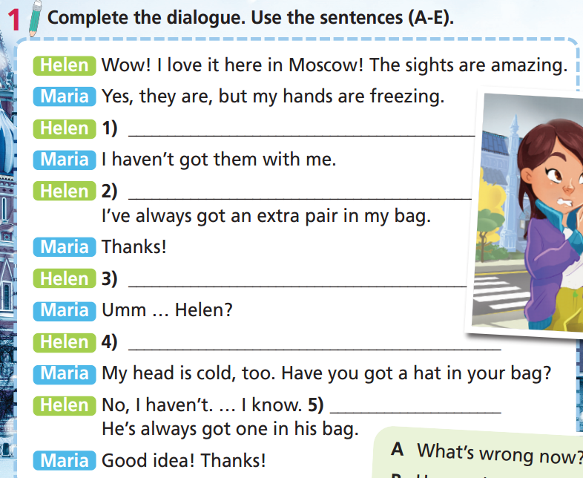
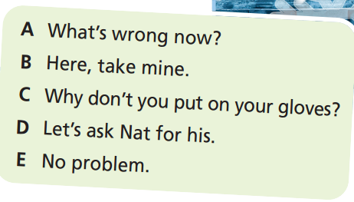
C Why don’t you put on your gloves?
B Here, take mine.
E No problem.
A What’s wrong now?
D Let’s ask Nat for his.

Slide 10
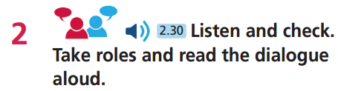

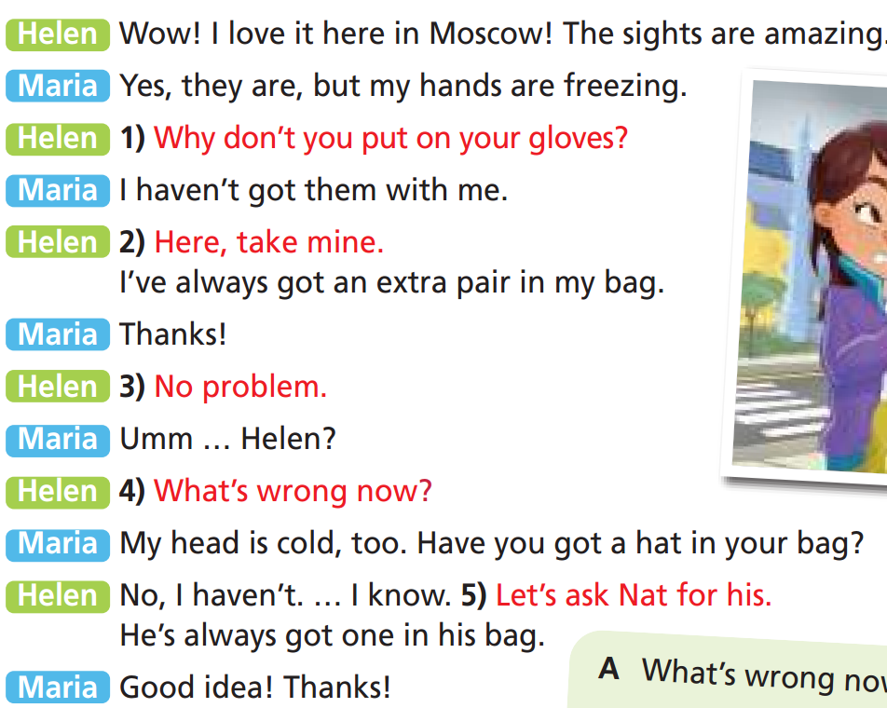
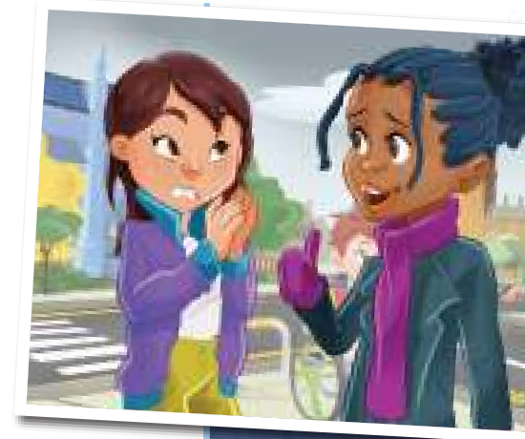

Slide 11
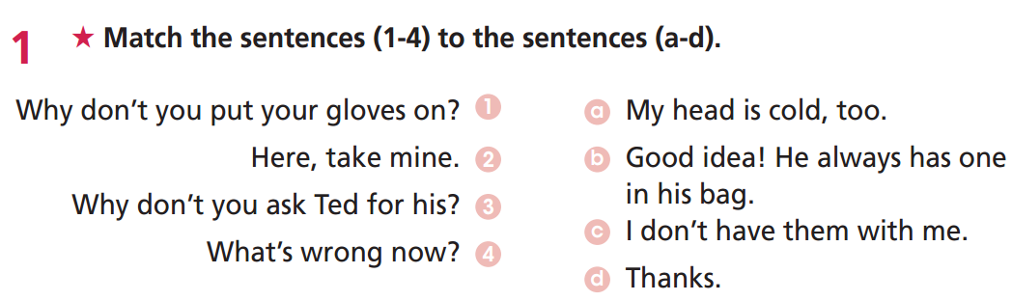
Extra Practice
WB page 41

Slide 12
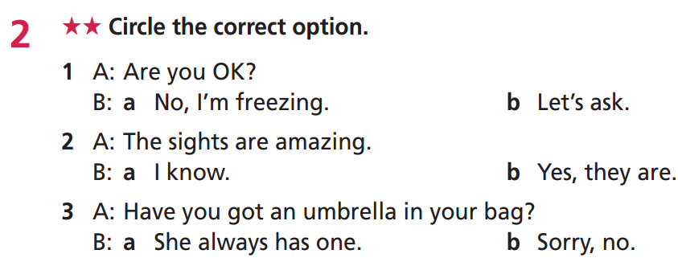
Extra Practice
WB page 41

Slide 13
Structures to make suggestions
Extra Practice
Subject + should + V-inf...
E.g. You should study listening more if you want to improve your English.
Why don’t you + V-inf...?
E.g. Why don't you try eating sushi?
How about + gerund/noun...?
E.g.
How about going to the movies?
How about this film?

Slide 14
Work in pairs.
Extra Practice
Make suggestions for the following situation:
Your friend is looking for an interesting film to watch at the weekend.
Your friend wants to learn both piano and swimming but doesn’t have enough time.
Your friend doesn’t know where to go on holiday.
Your friend is thinking about what birthday present to give his/her close friend.
How about watching Harry Potter and the Order of the Phoenix?
You should choose one thing to study first, then you learn the other thing later.
Why don’t you go to Da Lat for your holiday?
How about giving your close friend a new pencil case?

Slide 15

Object personal pronouns/Possessive pronouns
Presentation

Slide 16
Look at the sentences and fill in the table about Object personal pronouns / Possessive pronouns
Look at me! It’s my cap. It’s mine.
You don’t have to ask him. His keys are always on the table. Those keys are his.
Thank you for helping us. We have finished our project very well. Ours is the best project in our class.
She is very happy about her test results. Hers is much better than she expected.
You should change your bag. Yours is too old now.
I asked them about their homework. Theirs were still not finished.
The dog has a problem with its ears. It cannot hear anything.
Object personal pronouns | me | you | him | her | it | us | you | them
Possessive adjectives | my
Possessive pronouns | mine
your
his
her
its
our
your
their
yours
his
hers
-
ours
yours
theirs

Slide 17
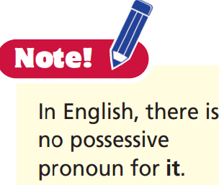
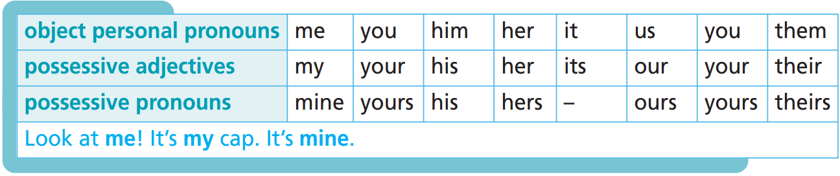
Remember:

Slide 18

Practice

Slide 19
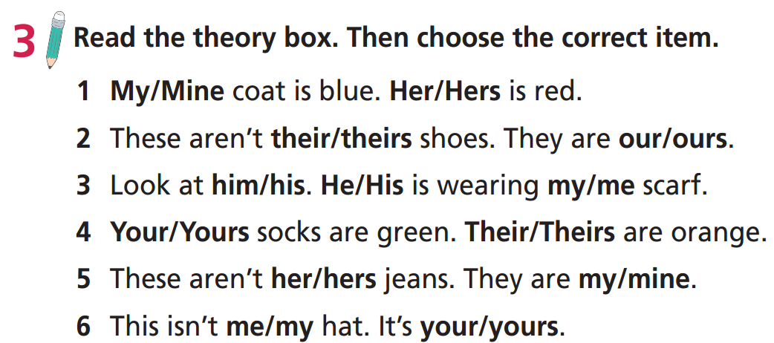

Slide 20
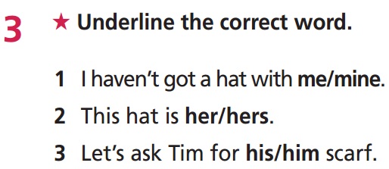
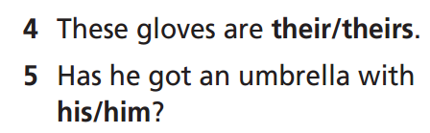
Extra Practice
WB page 41

Slide 21

Production

Slide 22
Who is that?
The teacher asks each student to write 5 sentences about one classmate using object personal pronouns/possessive pronouns. They do this without writing the students' names in the sentences. Students then take turns to read their sentences to the class who listens and tries to guess who the sentences are about.
Students can base on these suggestions:
Have you ever borrowed anything from him/her?
Describe some things he/she has (try to use possessive adjectives/ possessive pronouns). E.g. He has a blue backpack. His is new and very big. His shoes are white and old. etc.

Slide 23
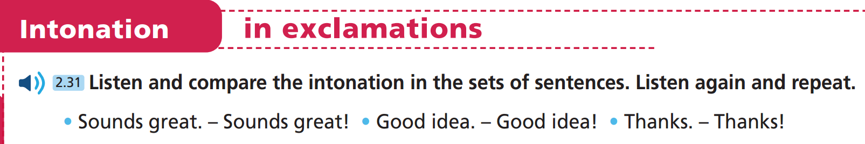

Slide 24
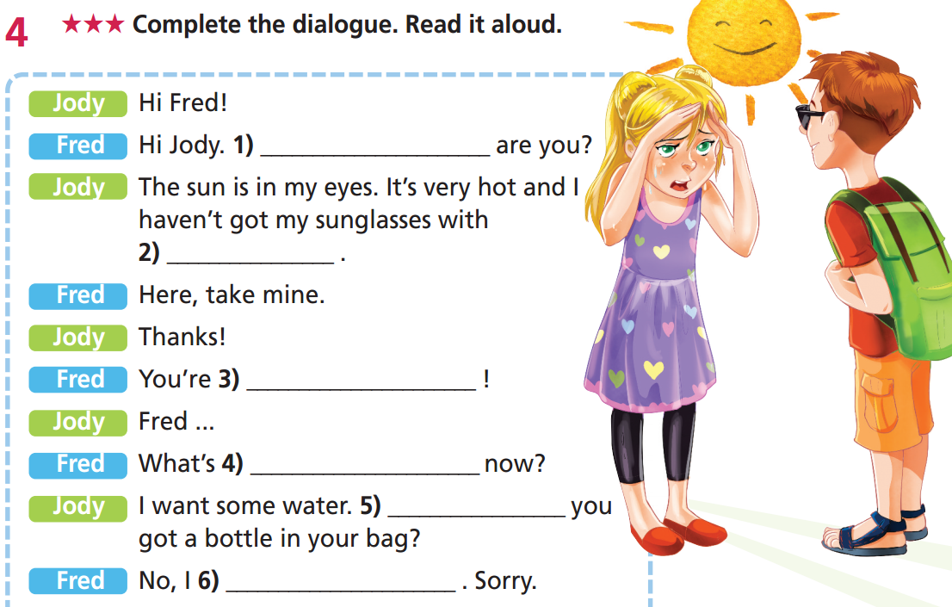
Extra Practice
WB page 41
How
me
welcome
wrong
Have
haven’t

Slide 25

CONSOLIDATION

Slide 26
Imagine you are writing a letter (50-70 words) to make suggestions for your friend who had a bad result in the exam. You can use the following ideas:
Hi……,
I know you are very sad because you had a bad result on the exam. I think you should…… How about….. Why don’t you…?
Hope to hear from you soon.
Cheers,

Slide 27
Imagine you are writing a letter to make suggestions for your friend who is having a problem.
e.g.
Hi An,
I know you are very sad because you had bad results on the exam. I think you should not be worried. You can try to learn more carefully. If there is anything you don’t understand, you can ask me. How about learning together? Why don’t you come to my house and we can talk more easily about the lessons?
Hope to hear from you soon.
Cheers,

Slide 28

WRAP-UP

Slide 29
Today’s lesson
Speaking:
use structures to make suggestions.
Grammar
use object personal pronouns and possessive pronouns correctly.
Intonation:
use intonation in exclamations in a suitable way.

Slide 30
Homework
Practise the vocabulary and make sentences using them.
Do the exercises in TA 6 Right on WB (p. 41).
Prepare for the next lesson (p. 78 SB).

Slide 31

Enjoy your day!

