Slide 1

Unit 10: Energy Sources
Lesson 2.1: Vocabulary & Reading
Page 79

Slide 2



Lesson 2.1
LESSON OUTLINE
Consolidation

Slide 3

By the end of this lesson, students will be able to…
- review energy sources.
- talk about advantages and disadvantages of energy sources.
- practice reading for main ideas and specific information.

Slide 4

New words
nuclear power
dangerous
power plant
solar panel
wind turbine
clean to run
cheap to build
expensive to run
noisy

Slide 5

WARM UP

Slide 6

Work in pairs
1 What types of energy do you use most at home?
2 Which type do you like to use? Why?
3 If you have a choice, which energy sources would you like to change? Why?

Slide 7
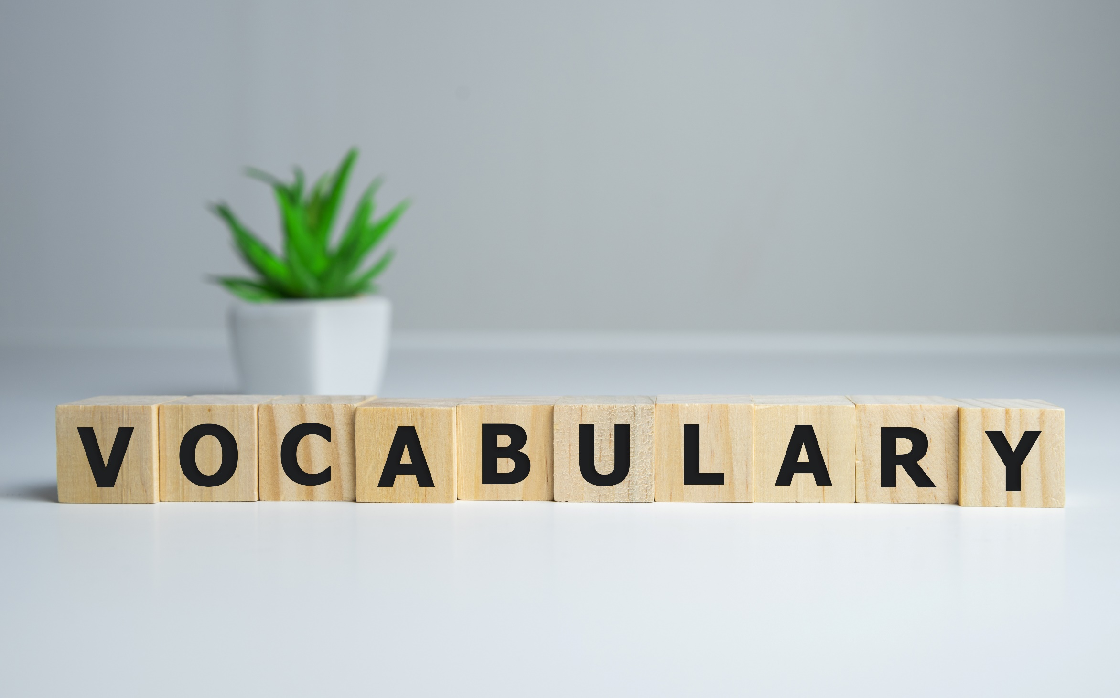


Slide 8

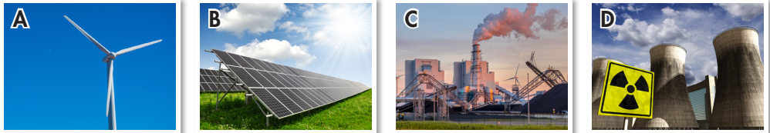
Work in pairs.
What can you see in each picture?

Slide 9
Work in pairs.
a. Match the words with the pictures.
power plant
wind turbine
solar panel
nuclear power

Slide 10

Listen and repeat. Click each phrase to hear the sound.
nuclear power (n) /ˌnuːkliər ˈpaʊər/ năng lượng hạt nhân (nguyên tử)
dangerous (adj) /ˈdeɪndʒərəs/ nguy hiểm
power plant (n) /ˈpaʊər plænt/ nhà máy điện
solar panel (n) /ˌsoʊlər ˈpænl/ tấm pin năng lượng mặt trời
wind turbine (n) /ˈwɪnd tɜːrbaɪn/ tua bin gió
clean to run (phr) /kliːn tu: rʌn/ vận hành sạch sẽ (không gây hại môi trường)
cheap to build (phr) /tʃiːp tu: bɪld/ xây dựng rẻ (chi phí thấp)
expensive to run (phr) /ɪkˈspensɪv tu: rʌn/ vận hành đắt đỏ (chi phí cao)
noisy (adj) /ˈnɔɪzi/ ồn ào
Notes:
GV click vào từng cụm nghe âm thanh

Slide 11
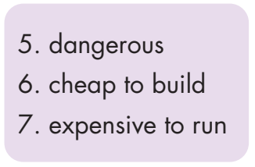
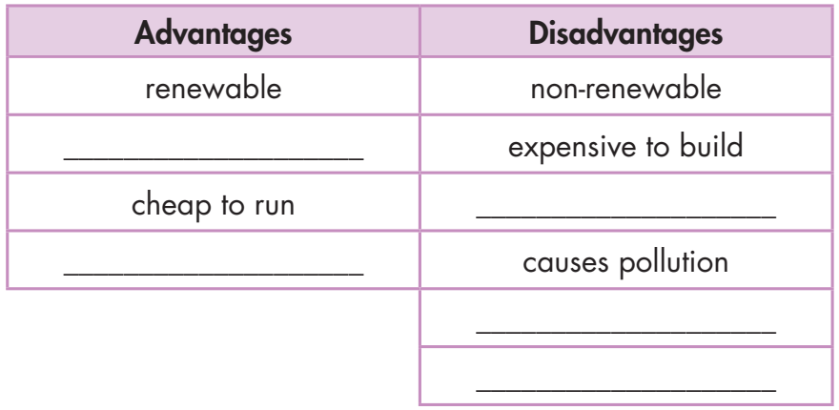
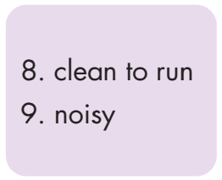
Work in pairs.
b. Add each word/phrase (5-9) to the correct column.
cheap to build
dangerous
clean to run
expensive to run
noisy

Slide 12
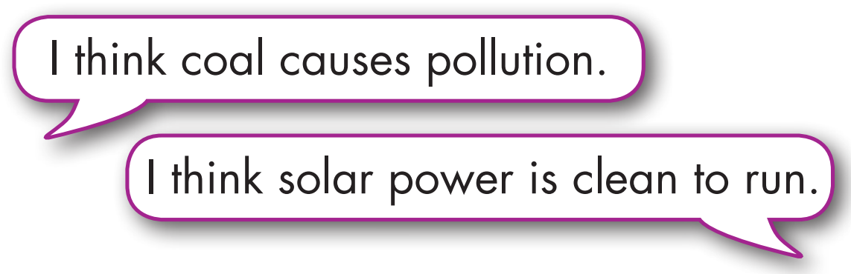
Work in pairs.
c. Discuss which energies you think are clean to run or cause pollution.

Slide 13
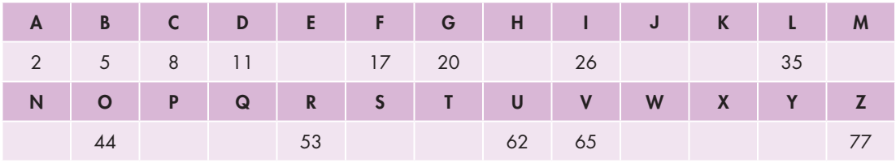
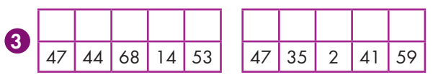
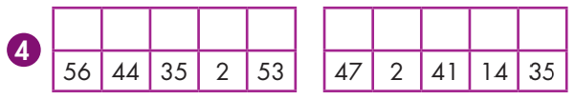
Extra Practice
WB, page 58
Complete the table and write the words.
B = A + 3
14
23
29
32
38
41
47
50
56
59
68
71
74
P O W E R
P L A N T
S O L A R
P A N E L

Slide 14
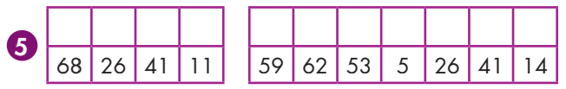
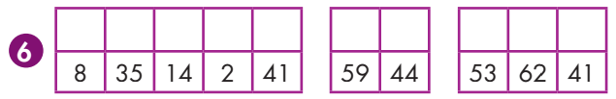
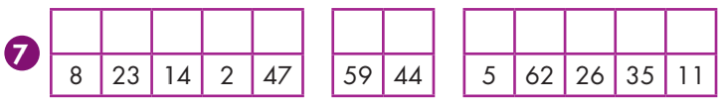
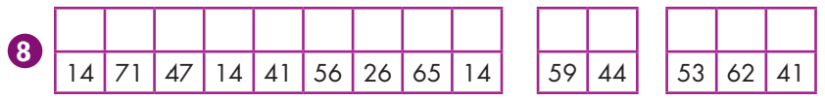
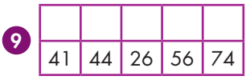
W I N D
T U R B I N E
C L E A N
T O
R U N
C H E A P
T O
B U I L D
E X P E N S I V E
T O
R U N
N O I S Y

Slide 15


It’s reading time….

Slide 16
Pre - reading
Read the instruction quickly. Underline the key words. What are we going to do?
Read and choose the correct title.
Good points
Wind power
Solar power

Slide 17
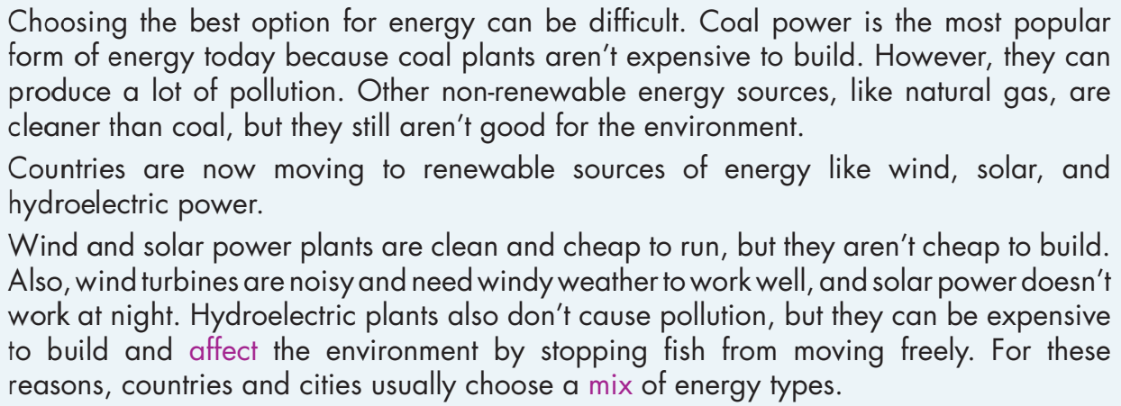
Look at the topic sentence and guess.
Compare things to choose the best?

Slide 18
While - reading
Skim the text. Underline the key words/phrases. Choose the best title.
2 Comparing different energy sources

Slide 19
While - reading
Read the questions. Underline the key words. Scan the text and answer the questions
popular
Why does the article say coal plants are common?
__________________________________________
2. Why is natural gas better than coal?
__________________________________________
3. What are two advantages of wind power plants?
__________________________________________
4. What is a disadvantage of solar power?
__________________________________________
5. What environmental problem does hydroelectric power create?
__________________________________________
Because they aren’t expensive to build.
Because natural gas is cleaner than coal.
Wind power plants are clean and cheap to run.
Solar power doesn’t work at night.
Hydroelectric plants stop fish from moving freely.

Slide 20

Post - reading
Work in pairs.
Talk about advantages and disadvantages of energy sources.

Slide 21

CONSOLIDATION

Slide 22
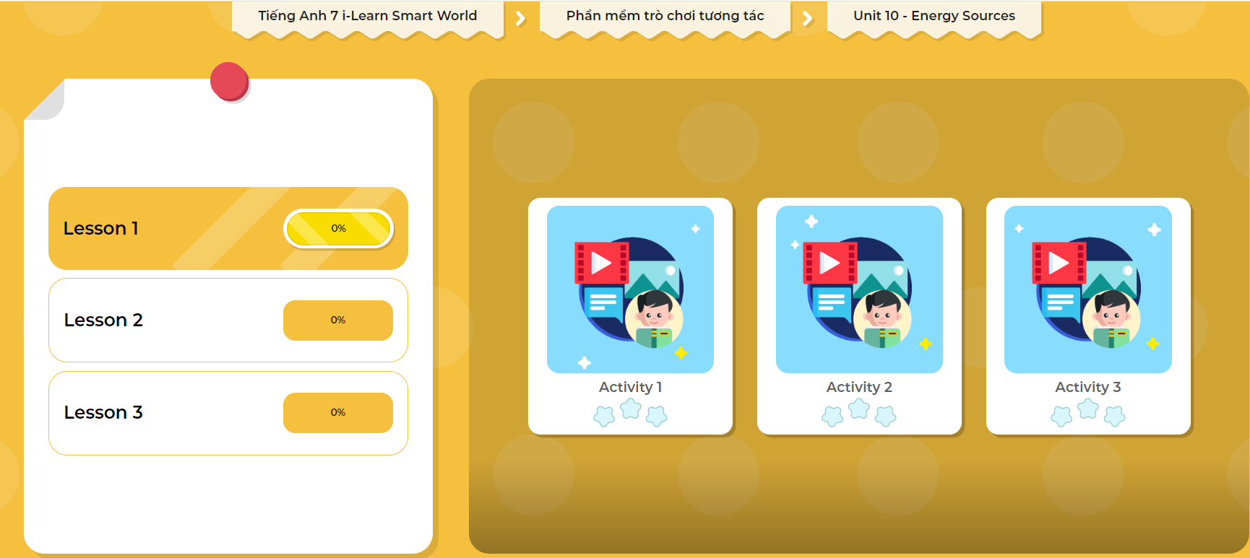
LET’S PLAY!
Click here to play the games

Slide 23
Write about which type of energy sources you like to use at home and the reason why, using the words you learned today. (about 70 words)

Slide 24

WRAP-UP

Slide 25
Today’s lesson
Vocabularies
nuclear power
dangerous
power plant
solar panel
wind turbine
clean to run
cheap to build
expensive to run
noisy

Slide 26
Today’s lesson
Reading:
- Understanding instructions
Skimming and scanning for general and specific information
Speaking:
- Talking about advantages and disadvantages of energy sources

Slide 27
Homework
Learn by heart vocabularies and make sentences using them.
Do the exercises on page 58 WB.
Do the exercises in Tiếng Anh 7 i-Learn Smart World Notebook on page 60.
Prepare the next lesson (page 80 SB)
Play the consolidation games in Tiếng Anh 7 i-Learn Smart World DHA App on www.eduhome.com.vn

Slide 28

Lesson 3
Stay positive and have a nice day!

