Slide 1

Unit 6: Education
Lesson 2.1: Vocabulary & Reading
Page 47

Slide 2



LESSSON OUTLINE
Consolidation

Slide 3
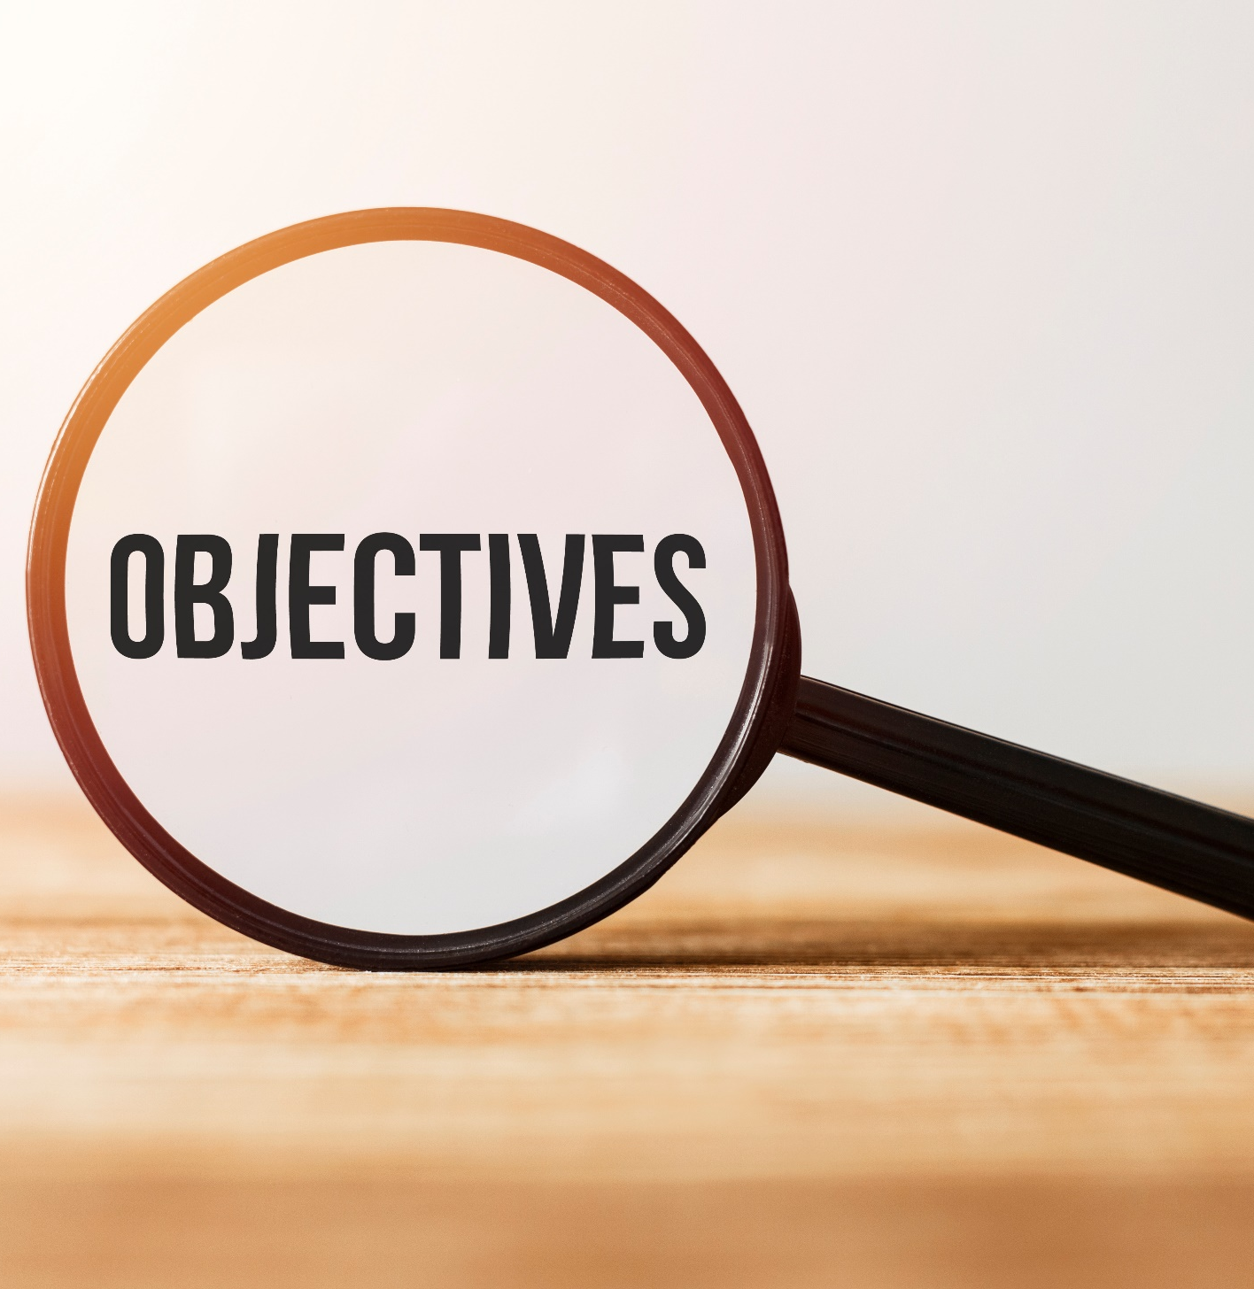
By the end of this lesson, students will be able to…
learn and use vocabulary related to education.
practice reading for main idea and detail.
talk about how you feel about school.

Slide 4
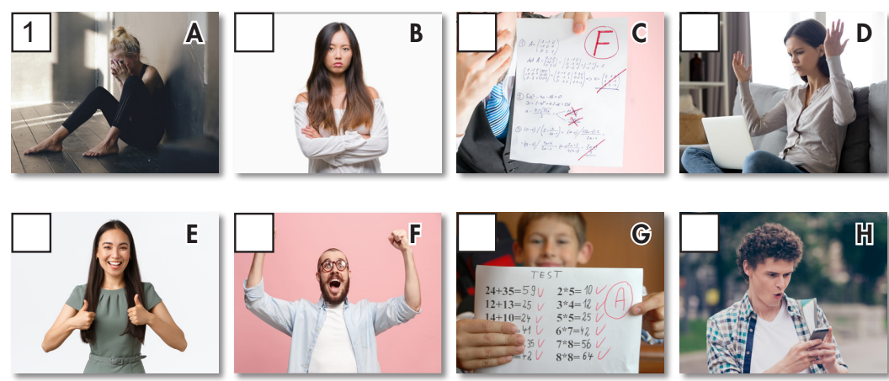
New words
upset fail pleased disappointed
surprised delighted annoyed pass

Slide 5

WARM-UP

Slide 6

Work in pairs
1. Which subjects do you learn at school?
2. What’s your favorite subject?
3. Which subject are you good at and bad at?
4. Do you ever feel sad about your tests?

Slide 7
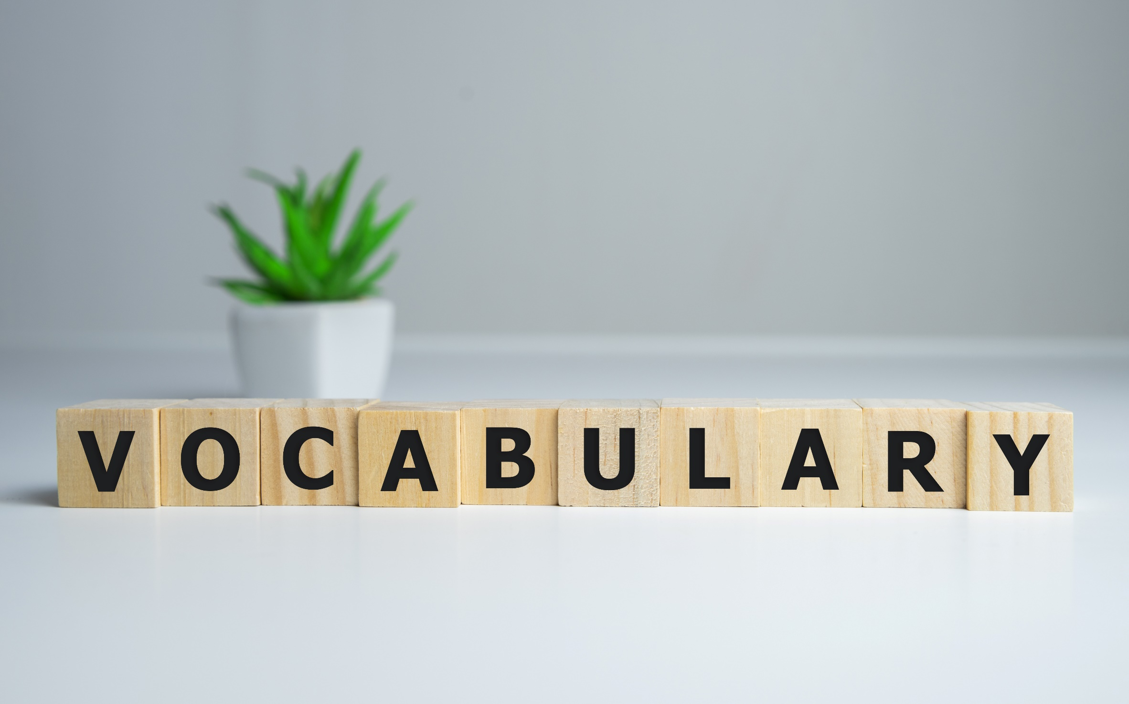


Slide 8
Work in pairs. What can you see in each picture?

Slide 9
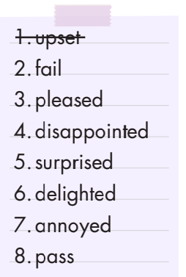
Work in pairs. a. Match each phrase to each picture.
4
2
7
3
6
8
5

Slide 10


(Click each word to hear the sound)
upset (adj) /ˌʌpˈset/ buồn, đau khổ
fail (v) /feɪl/ thi rớt, thi trượt
pleased (adj) /pliːzd/ hài lòng
disappointed (adj) /dɪsəˈpɔɪntɪd/ thất vọng
surprised (adj) /sərˈpraɪzd/ ngạc nhiên
delighted (adj) /dɪˈlaɪtɪd/ vui mừng, hài lòng
annoyed (adj) /əˈnɔɪd/ bực bội, khó chịu
pass (v) /pæs/ thi đậu, qua bài kiểm tra
Notes:
GV click vào từng cụm nghe âm thanh

Slide 11
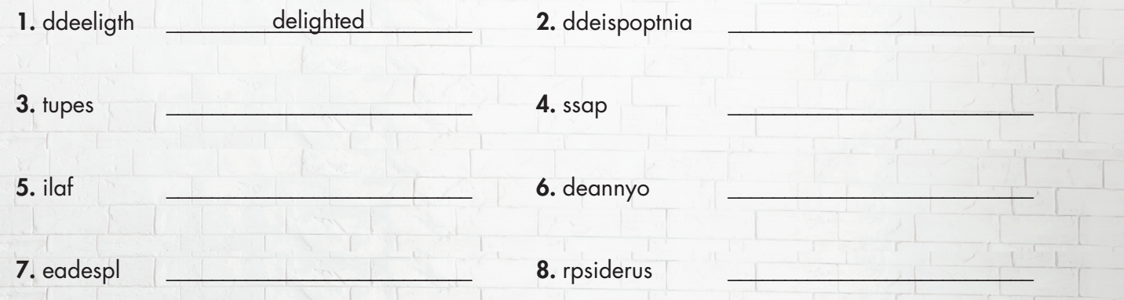
Extra Practice
WB, page 34
Unscramble the words..
disappointed
upset
pass
fail
annoyed
pleased
surprised

Slide 12
Choose the best answer.
I didn’t study hard. So, I ____________ the test. I feel __________ now.
a. passed/ delighted b. failed/ upset

Slide 13
Choose the best answer.
I was really ___________ because I got a good grade on my English test.
a. surprised b. annoyed

Slide 14
Choose the best answer.
I feel really _______________ when I got a present from my aunt. She gave me my favorite book.
a. disappointed b. delighted

Slide 15
Choose the best answer.
I studied a lot before the tests, but I was ___________ because I failed some of the tests.
a. disappointed b. pleased

Slide 16
Choose the best answer.
My teacher was ___________ because my friend came to class late so often.
a. annoyed b. surprised

Slide 17
Choose the best answer.
My dad was happy because I ________ the tests with flying colors.
a. failed b. passed

Slide 18
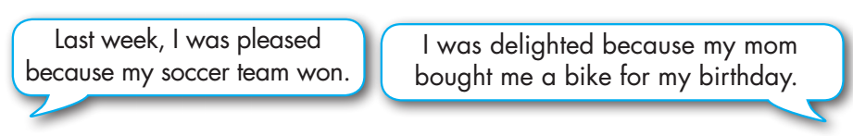

Work in pairs.
When did you feel like the people in the pictures?

Slide 19

It’s reading time….

Slide 20
Pre - reading
Read the instruction quickly. Underline the key words. What are we going to do?
Read the letter from James to his aunt. Is James doing well in school?
1. Yes. 2. No.

Slide 21

Look at the letter. Quickly read the information.
Is James doing well in school?
NO
Dear Aunt Ivy,
I hope you are well. Thank you for the sweater and the gift card for Christmas. Green is one of my favorite colors and the reindeer is very cute. I was going to buy a new game, but Mom won't let me. She is really annoyed because I failed some of my tests. I didn't do well in math, English, history, and biology. I'm so surprised because I studied a lot before the tests. I studied for 30 minutes every day before I played my PC games. I think I failed because the
tests were more difficult this year.
One good piece of news: Dad was delighted because I passed my P.E. test.
I'm not sure, but my teacher might put me on the basketball team.
Can you maybe ask Mom to let me buy a new game?
Have a great week!
James

Slide 22
Pre - reading
Read the letter quickly. What are we going to do?
Read and circle the correct answer.

Slide 23

What did Aunt Ivy give James for Christmas?
a. a game b. a basketball c. a sweater
2. How does his mom feel?
a. surprised b. annoyed c. delighted
3. Why does James think he failed some tests?
a. he didn't study b. he played games c. they were difficult
4. Which test did James pass?
a. math b. P.E. c. biology

Slide 24
While - reading
Scan the text. Circle the correct answer.
What did Aunt Ivy give James for Christmas?
a. a game b. a basketball c. a sweater
Dear Aunt Ivy,
I hope you are well. Thank you for the sweater and the gift card for Christmas. Green is one of my favorite colors and the reindeer is very cute. I was going to buy a new game, but Mom won't let me. She is really annoyed because I failed some of my tests. I didn't do well in math, English, history, and biology. I'm so surprised because I studied a lot before the tests. I studied for 30 minutes every day before I played my PC games. I think I failed because the
tests were more difficult this year.
One good piece of news: Dad was delighted because I passed my P.E. test.
I'm not sure, but my teacher might put me on the basketball team.
Can you maybe ask Mom to let me buy a new game?
Have a great week!
James

Slide 25
While - reading
Scan the text. Circle the correct answer.
2. How does his mom feel?
a. surprised b. annoyed c. delighted
Dear Aunt Ivy,
I hope you are well. Thank you for the sweater and the gift card for Christmas. Green is one of my favorite colors and the reindeer is very cute. I was going to buy a new game, but Mom won't let me. She is really annoyed because I failed some of my tests. I didn't do well in math, English, history, and biology. I'm so surprised because I studied a lot before the tests. I studied for 30 minutes every day before I played my PC games. I think I failed because the
tests were more difficult this year.
One good piece of news: Dad was delighted because I passed my P.E. test.
I'm not sure, but my teacher might put me on the basketball team.
Can you maybe ask Mom to let me buy a new game?
Have a great week!
James

Slide 26
While - reading
Scan the text. Circle the correct answer.
3. Why does James think he failed some tests?
a. He didn't study. b. He played games. c. They were difficult.
Dear Aunt Ivy,
I hope you are well. Thank you for the sweater and the gift card for Christmas. Green is one of my favorite colors and the reindeer is very cute. I was going to buy a new game, but Mom won't let me. She is really annoyed because I failed some of my tests. I didn't do well in math, English, history, and biology. I'm so surprised because I studied a lot before the tests. I studied for 30 minutes every day before I played my PC games. I think I failed because the
tests were more difficult this year.
One good piece of news: Dad was delighted because I passed my P.E. test.
I'm not sure, but my teacher might put me on the basketball team.
Can you maybe ask Mom to let me buy a new game?
Have a great week!
James

Slide 27
While - reading
Scan the text. Circle the correct answer.
4. Which test did James pass?
a. math b. P.E. c. biology
Dear Aunt Ivy,
I hope you are well. Thank you for the sweater and the gift card for Christmas. Green is one of my favorite colors and the reindeer is very cute. I was going to buy a new game, but Mom won't let me. She is really annoyed because I failed some of my tests. I didn't do well in math, English, history, and biology. I'm so surprised because I studied a lot before the tests. I studied for 30 minutes every day before I played my PC games. I think I failed because the
tests were more difficult this year.
One good piece of news: Dad was delighted because I passed my P.E. test.
I'm not sure, but my teacher might put me on the basketball team.
Can you maybe ask Mom to let me buy a new game?
Have a great week!
James

Slide 28
Post - reading
Work in pairs
I think English is the easiest because it is easy to read and understand.
What subjects do you find the easiest?
I think math is the most difficult because it is not easy to understand.
What do you find the most difficult?

Slide 29

CONSOLIDATION

Slide 30
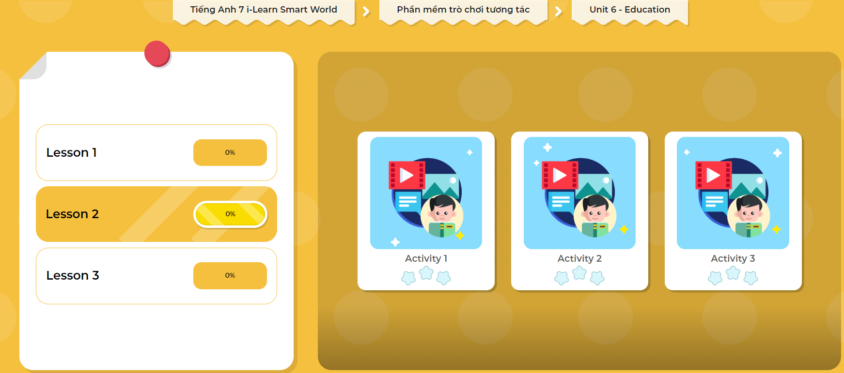
LET’S PLAY!
Click here to play the games

Slide 31
Write a letter to a friend to tell him/ her about how you feel about tests and subjects at school, and how your parents feel about your study.
Write about 60 – 80 words.

Slide 32

WRAP-UP

Slide 33
Today’s lesson
Vocabularies
upset
fail
pleased
disappointed
surprised
delighted
annoyed
pass

Slide 34
Today’s lesson
Reading:
- Understanding instructions.
Skimming and scanning for general and specific information.
Speaking:
- Talk about how you feel about school.

Slide 35
Homework
Learn by hearts the vocabularies and make sentences using them.
Do the exercises in Tiếng Anh 7 i-Learn Smart World Workbook (page 35).
Do the exercise in Tiếng Anh 7 i-Learn Smart World Notebook (page 38).
Prepare the next lesson (page 48 SB).
Play the consolidation games in Tiếng Anh 7 i-Learn Smart World DHA App on www.eduhome.com.vn

Slide 36

Lesson 3
Stay positive and have a nice day!

