Slide 1

UNIT 1: FAMILY LIFE
Lesson 2.1 – Vocabulary & Reading
Page 7

Slide 2



Lesson .
LESSSON OUTLINE
Consolidation

Slide 3

By the end of this lesson,
students will be able to:
define personality trait adjectives in English.
improve their reading skill.
talk about personality.

Slide 4
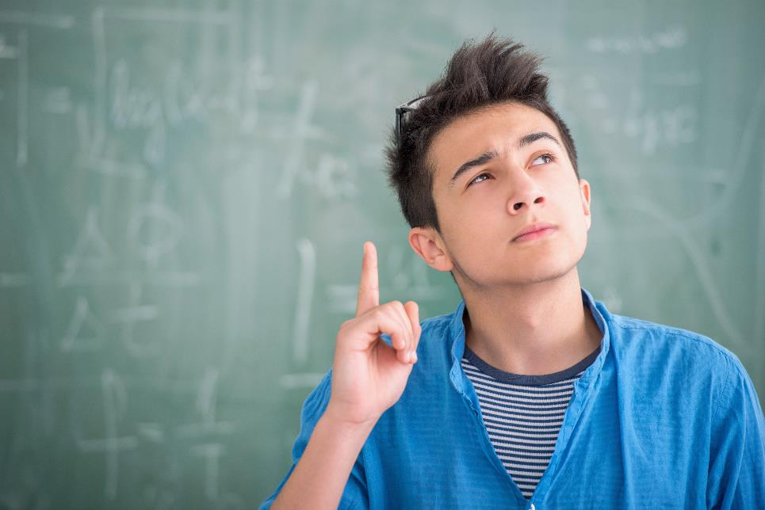


Slide 5

Work in pairs.
Who do like best in your family? Why?

Slide 6

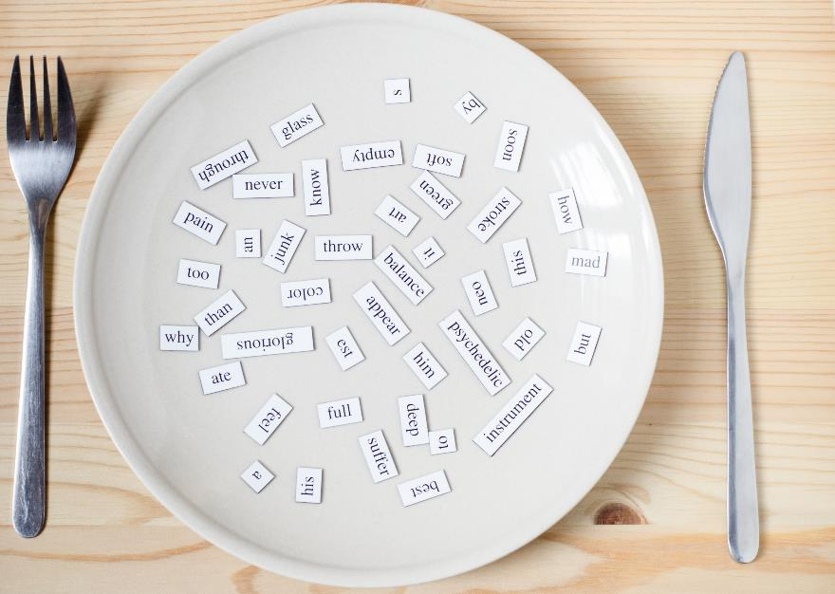
New words
kind
unreliable
easygoing
untidy
helpful
selfish
lazy
intelligent
Listen and repeat.

Slide 7
a. Match the words with the definitions.
1. kind
2. unreliable
3. easygoing
4. untidy
5. helpful
6. selfish
7. lazy
8. intelligent
a. friendly and generous
b. not doing what they say they will do
c. thinking about themselves more than other people
d. relaxed and happy, not worried or angry
e. good at learning and understanding things
f. not keeping their things clean and tidy
g. not wanting to do work or be active
h. happy to do things for other people

Slide 8


PAIR WORK:
Compare your answers. Then listen and repeat.
What does ______ mean?

1. kind
2. unreliable
3. easygoing
4. untidy
5. helpful
6. selfish
7. lazy
8. intelligent
a. friendly and generous
b. not doing what they say they will do
c. thinking about themselves more than other people
d. relaxed and happy, not worried or angry
e. good at learning and understanding things
f. not keeping their things clean and tidy
g. not wanting to do work or be active
h. happy to do things for other people

Slide 9

Listen and repeat.
kind (adj) / kaɪnd / tốt bụng
unreliable (adj) / ˌʌnrɪˈlaɪəbl / không đáng tin cậy
easygoing (adj) / ˌiːziˈgoʊɪŋ / dễ tính, vô tư
untidy (adj) / ʌnˈtaɪdi / bừa bộn, luộm thuộm
helpful (adj) / ˈhelpfəl / hay giúp đỡ người khác
selfish (adj) / ˈselfɪʃ / ích kỉ
lazy (adj) / ˈleɪzi / lười biếng
intelligent (adj) / ɪnˈtelɪdʒənt / thông minh









Slide 10

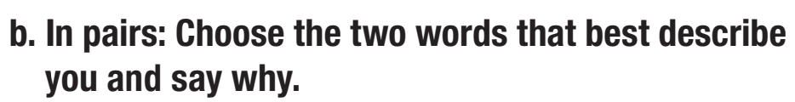
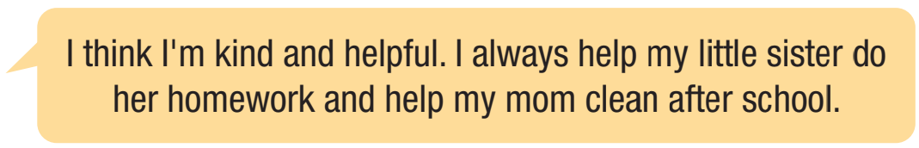
kind
unreliable
easygoing
untidy
helpful
selfish
lazy
intelligent

Slide 11


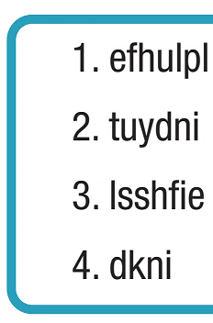
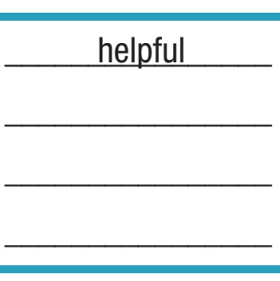
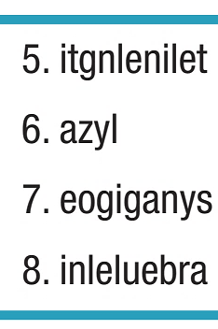
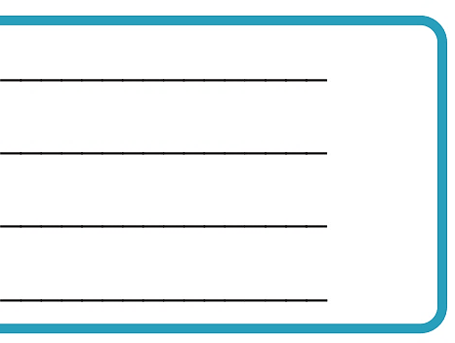
Extra Practice, WB page 4.
intelligent
untidy
lazy
selfish
easygoing
kind
unreliable

Slide 12



Slide 13
Pre-reading
PAIRWORK
What chores do you do? How often?
Who do you think does the most chores in your
family? Who does the fewest chores?

Slide 14
While-reading
a. Read the interview Adam Parker gave about his family.
Who is the least helpful family member?
His sister, Jessie.
Star in Hollywood – Dad in the Suburbs
We sat down for an interview with Adam Parker, son of Hollywood superstar Ranger Parker, to find out what it’s like
to be the child of a famous parent.
What's your dad like?
He's not a star at home. He's just Dad. He washes the dishes and vacuums the living room. He takes me to school every morning. He's very easygoing, so he has a lot of good friends.
Do you want to be an actor when you grow up?
No, I want to be a doctor like my mom. I think she's very kind. She helps so many kids around the world and gives a lot of money to charities. She got top scores on all her medical exams because she's really intelligent.
What about your sister?
Jessie wants to be an actor because she thinks all actors do is sit around and then act a little bit. But my dad sometimes has
to get up at 5 a.m. to work. Jessie's pretty lazy to be honest. She's very unreliable as well. She rarely keeps her promises.
What do you and your dad do for fun?
We help out at a local children's hospital. We know everyone there, and they're all really nice. I always go even when my
dad isn't here. The children get upset if I don't go. They think I'm helpful because I do a lot of things for them.

Slide 15
While-reading
b. Underline the key words in each question.
Now, read and answer the questions.
1. Why does Adam's dad have a lot of friends? __________________________________________
2. Why did Adam's mom get top scores on all her medical exams? __________________________________________
3. Why does Adam think Jessie is unreliable? __________________________________________
4. What do the children at the hospital think about Adam? __________________________________________

Slide 16
Star in Hollywood – Dad in the Suburbs
We sat down for an interview with Adam Parker, son of Hollywood superstar Ranger Parker, to find out what it’s like to be the child of a famous parent.
What's your dad like?
He's not a star at home. He's just Dad. He washes the dishes and vacuums the living room. He takes me to school every morning. He's very easygoing, so he has a lot of good friends.
Do you want to be an actor when you grow up?
No, I want to be a doctor like my mom. I think she's very kind. She helps so many kids around the world and gives a lot of money to charities. She got top scores on all her
medical exams because she's really intelligent.
What about your sister?
Jessie wants to be an actor because she thinks all actors do is sit around and then act a
little bit. But my dad sometimes has to get up at 5 a.m. to work. Jessie's pretty lazy to be honest. She's very unreliable as well. She rarely keeps her promises.
What do you and your dad do for fun?
We help out at a local children's hospital. We know everyone there, and they're all really nice. I always go even when my dad isn't here. The children get upset if I don't go. They think I'm helpful because I do a lot of things for them.

Slide 17
While-reading
Compare your answers. Then, check them with the class.
1. Why does Adam's dad have a lot of friends? __________________________________________
2. Why did Adam's mom get top scores on all her medical exams? __________________________________________
3. Why does Adam think Jessie is unreliable? __________________________________________
4. What do the children at the hospital think about Adam? __________________________________________

Slide 18
1. Why does Adam's dad have a lot of friends?
_______________________________________
2. Why did Adam's mom get top scores on all her medical exams?
_______________________________________
Because he’s very easygoing.
Because she’s really intelligent.
We sat down for an interview with Adam Parker, son of Hollywood superstar Ranger Parker, to find out what it’s like to be the child of a famous parent.
What's your dad like?
He's not a star at home. He's just Dad. He washes the dishes and vacuums
the living room. He takes me to school every morning. He's very easygoing,
so he has a lot of good friends.
Do you want to be an actor when you grow up?
No, I want to be a doctor like my mom. I think she's very kind. She helps so many kids around the world and gives a lot of money to charities. She got top scores on all her medical exams because she's really intelligent.

Slide 19
3. Why does Adam think Jessie is unreliable?
___________________________________
4. What do the children at the hospital think about Adam?
___________________________________
Because she rarely keeps her promises.
They think he’s helpful.
What about your sister?
Jessie wants to be an actor because she thinks all actors do is sit around and then act a little bit. But my dad sometimes has to get up at 5 a.m. to work. Jessie's pretty lazy to be honest. She's very unreliable as well. She rarely keeps her promises.
What do you and your dad do for fun?
We help out at a local children's hospital. We know everyone there, and they're all really nice. I always go even when my dad isn't here. The children get upset if I don't go. They think I'm helpful because I do a lot of things for them.

Slide 20


Post-reading
Listen and repeat.
suburb (n) / ˈsʌbɜːrb / ngoại ô
personality (n) / pərːsəˈnælɪti / tính cách
charity (n) /ˈtʃerɪti / tổ chức từ thiện




Slide 21

Post-reading

Slide 22
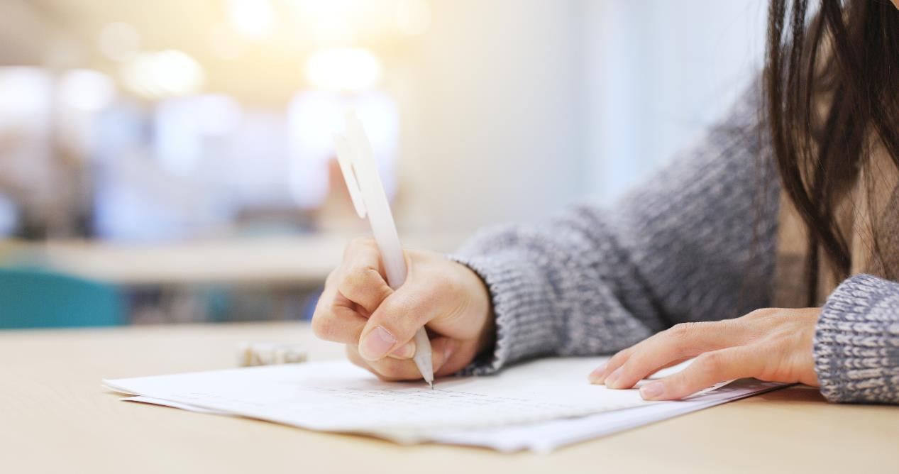
Consolidation

Slide 23
Extra Practice, WB page 4.
Fill in the blanks with the vocabulary you have learned in today’s lesson.
1. I like my mom because she is never angry or stressed. She is always relaxed and _______________.
2. Lucy is _______________, so she always thinks about other people.
3. James learns Spanish very quickly and speaks it much better than all his friends. I think he's very _______________.
4. Martin only thinks about himself and what makes him happy. I think he's quite _______________.
5. My brother is really _______________. His bedroom is messy, and he doesn't clean it up.
6. He doesn't do his homework because he's _______________.
7. My friend said he would meet me at 7 p.m., but he never came or called me. He's just so _______________.
8. When I can't do my homework, my friend, David, shows me what to do. I think he is very _______________.
easygoing
kind
intelligent
selfish
untidy
lazy
unreliable
helpful

Slide 24
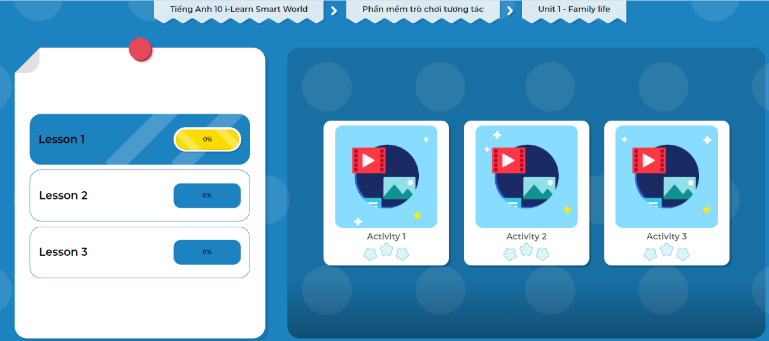
Click the picture below to play the games.

Slide 25
Today’s lesson
Wrap-up
Vocabulary: matching words about personality traits with their definitions.
Reading: reading for gist and specific information.
Speaking: talking about personality traits.

Slide 26
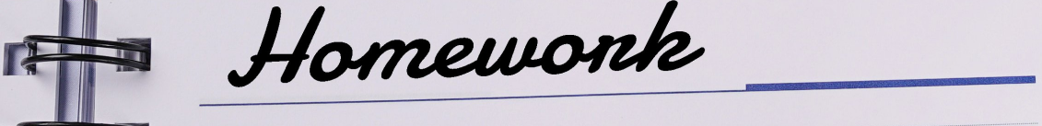
Finish the Listening Exercise on page 4, WB.
Do the exercises in Tiếng Anh 10 i-Learn Smart World Notebook on page 4.
Prepare the next lesson on page 8, SB.
Play the consolidation games in Tiếng Anh 10 i-Learn Smart World DHA App on www.eduhome.com.vn

Slide 27
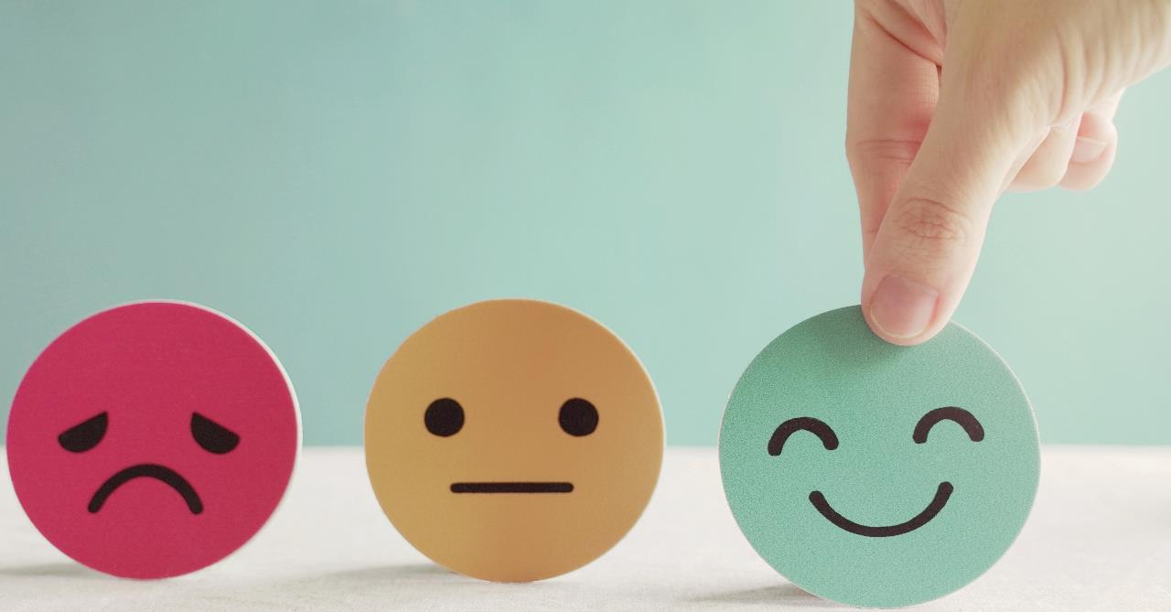
Have a nice day!

