Slide 1
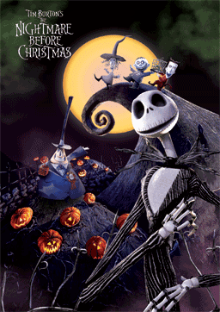
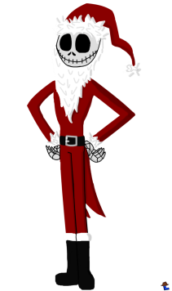
THE
NIGHTMARE
BEFORE
CHRISTMAS

Slide 2
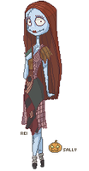
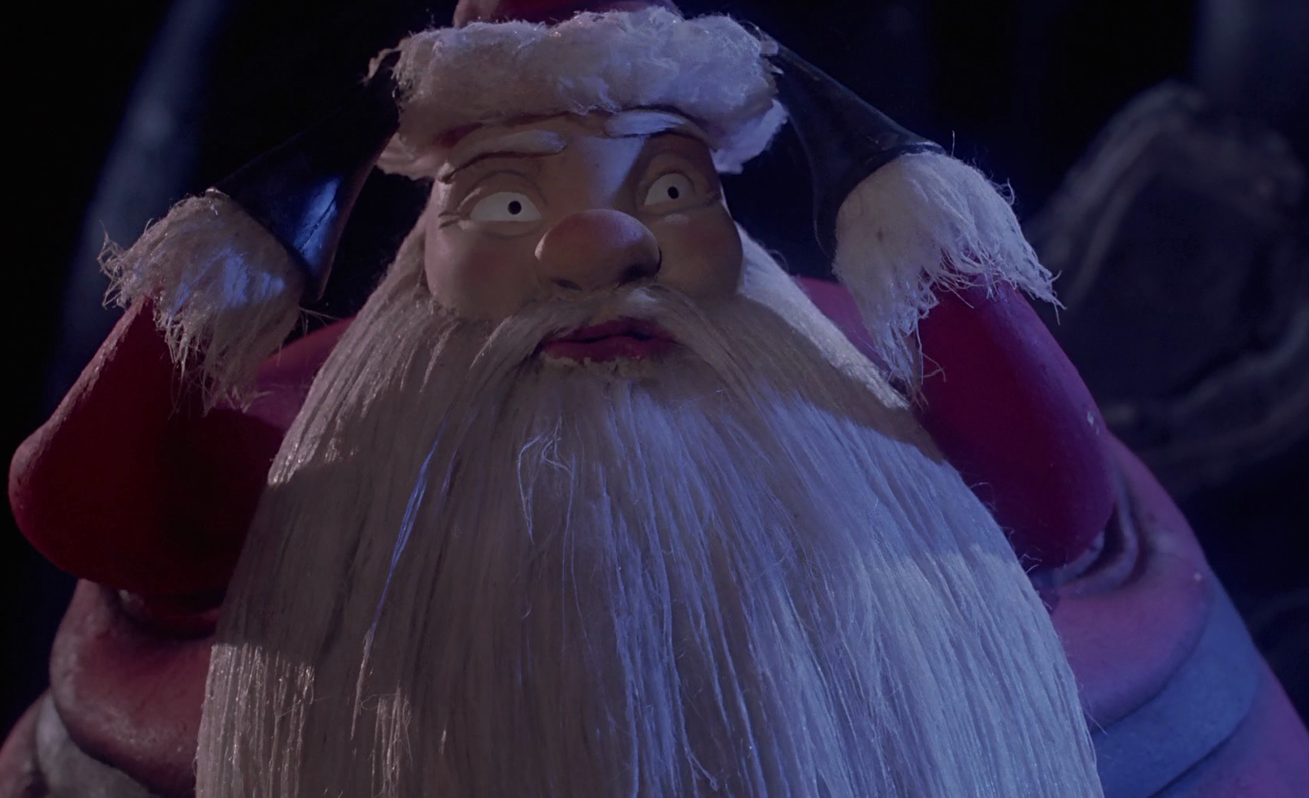
How to play?
5
3
2
4
1

Slide 3
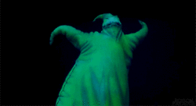
All teams lose all points

Slide 4
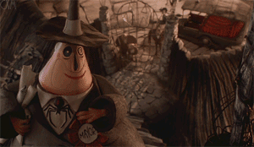
Change points

Slide 5
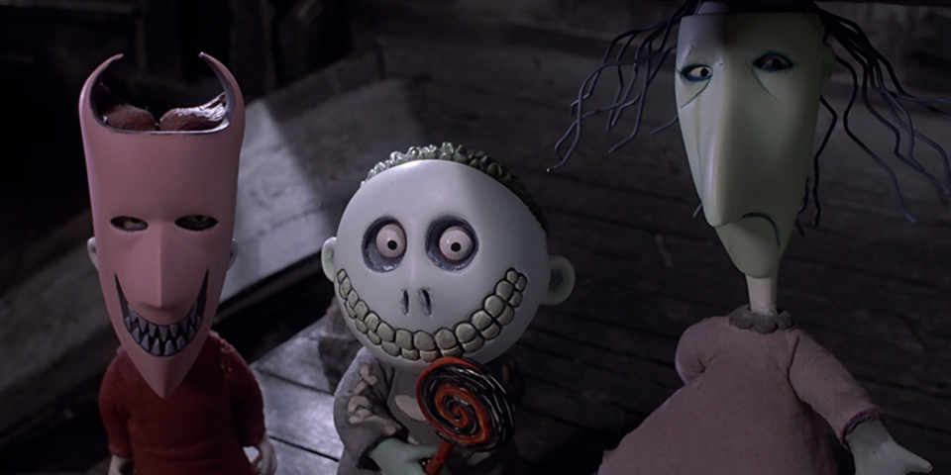
Steal points

Slide 6
A
B
C
D
E
F
G
H
I
J
K
L
M
N
O
P
Q
R
S
T

Slide 7
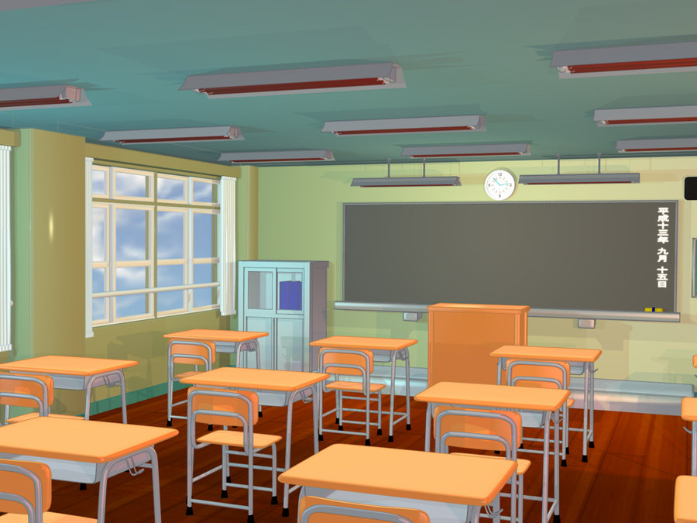
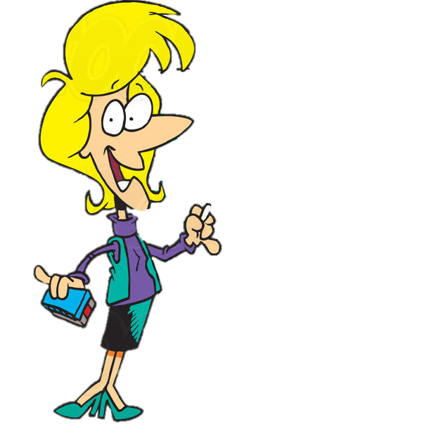
Where’s the teacher?
She’s in the classroom

Slide 8
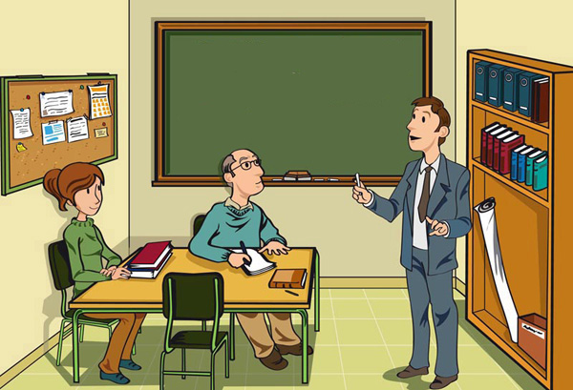
Where’s the teacher?
He’s in the teachers’ office.

Slide 9
Where’s the teacher?
She’s in the computer room.

Slide 10
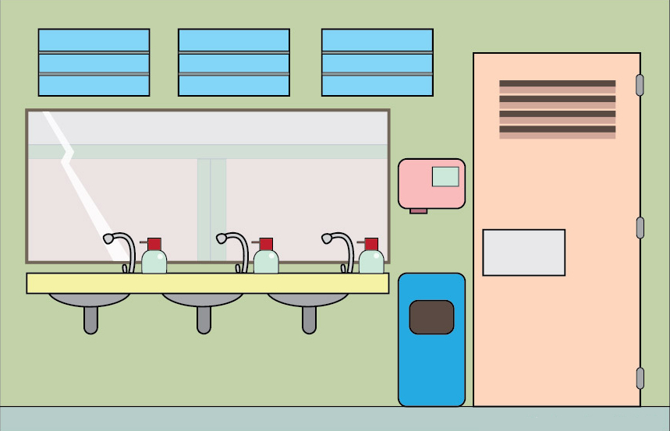
Where’s the teacher?
She’s in the toilet

Slide 11
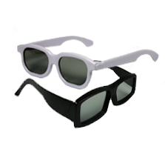
What would you like?
I’d like some glasses

Slide 12
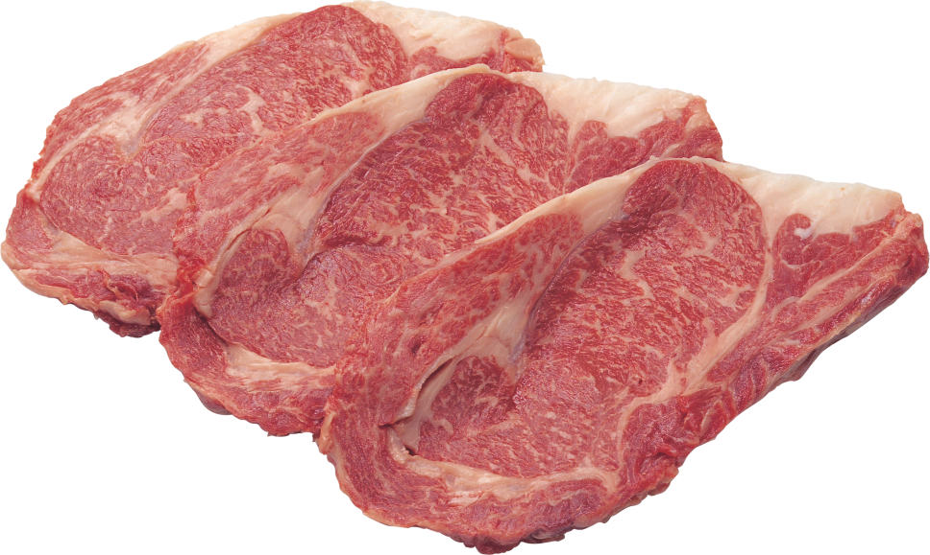
What would you like?
I’d like some meat.

Slide 13
What would you like?
I’d like some tomatoes.

Slide 14
What would you like?
I’d like some carrots.

Slide 15
Where’s the mouse?
It’s under the box.

Slide 16
Where’s the mouse?
It’s behind the box

Slide 17
Where’s the mouse?
It’s in the box.

Slide 18
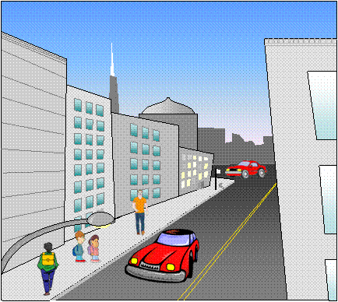
What is it?
It’s a street.

Slide 19
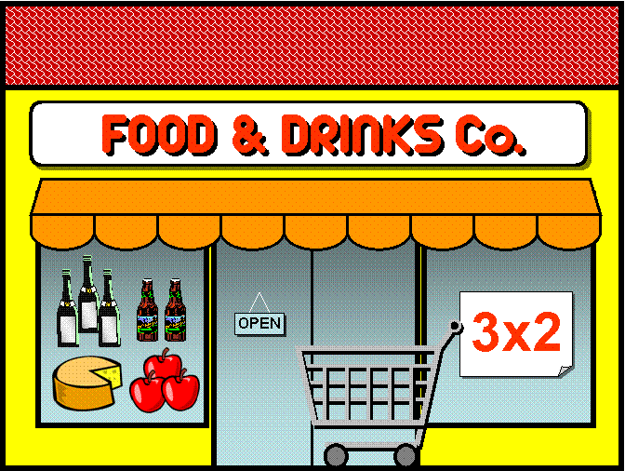
What is it?
It’s a supermarket.

Slide 20
What is it?
It’s a restaurant.

Slide 21
What is it?
It’s a park.

Slide 22
Look at my biscuit. It’s a _ _ _ _ _
It’s a square.

Slide 23
Look at my biscuit. It’s a _ _ _ _ _
It’s a rectangle.

Slide 24
Look at my biscuit. It’s a _ _ _ _ _
It’s a triangle.

Slide 25
Look at my biscuit. It’s a _ _ _ _ _
It’s a circle.

Slide 26
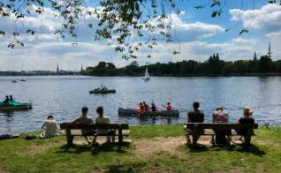
What’s the weather like?
It’s sunny and hot.

Slide 27
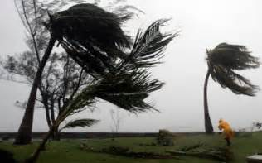
What’s the weather like?
It’s windy and cold.

Slide 28
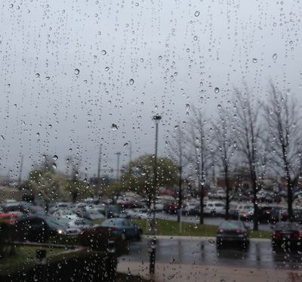
What’s the weather like?
It’s rainy and cold.

Slide 29
1 point

Slide 30
2 points

Slide 31
3 points

Slide 32
4 points

Slide 33
5 points

Slide 34
Change points

Slide 35
Steal points

Slide 36
Oogie Boogie bomb!All team lose all points

