Slide 2
Unit 10
Lifelong learning
LESSON III
READING
Head teacher’s message to school-leavers

Slide 3
LESSON III
READING
WARM-UP
Watch a video
Task 1: Work in pairs. Discuss the following questions
Vocabulary
PRE-READING
Task 2: Read a letter written by a head teacher to her students on the school website. Circle the phrases with the closest meaning to the highlighted words.
Task 3: Read the letter again. Choose the correct answer A, B, C, or D.
WHILE-READING
POST-READING
Task 4: Work in pairs. Discuss the following questions.
CONSOLIDATION
Wrap-up
Homework

Slide 4
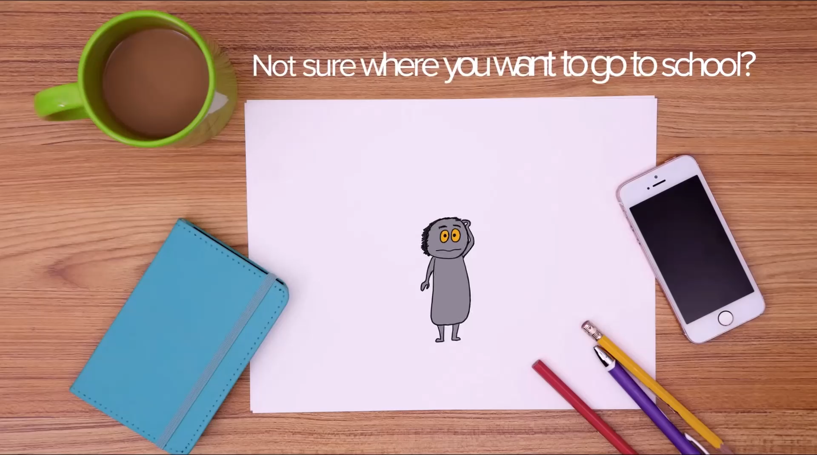
WARM-UP
What is the video about?
Notes:
https://www.youtube.com/watch?v=0WYz7TnmjpY

Slide 5
PRE-READING
1
Work in pairs. Discuss the following questions
1. Have you ever thought of continuing learning after finishing your secondary education?
2. If yes, how will you continue your learning?

Slide 6
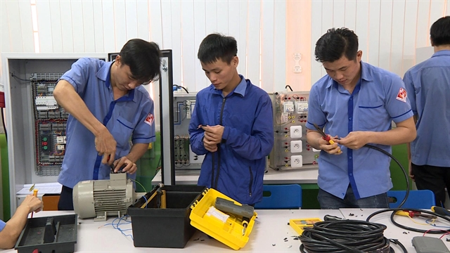

PRE-READING
vocational school (n)
/vəʊˈkeɪʃənl skuːl/
a school that teaches skills that are necessary for particular jobs

Slide 7
PRE-READING
enrol (v)
to arrange for yourself or for somebody else to officially join a course, school, etc.
/ɪnˈrəʊl/

Slide 8
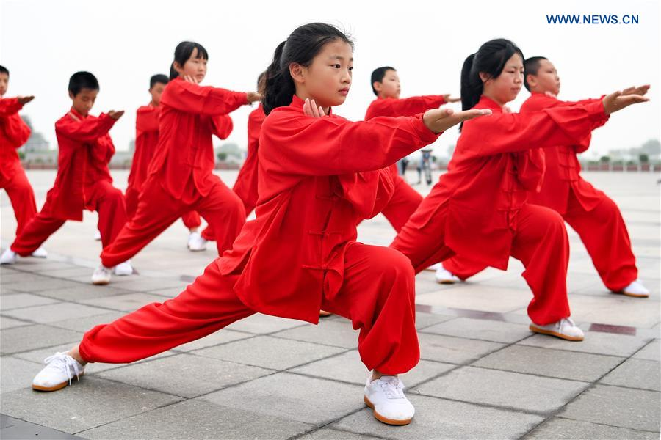
PRE-READING
martial art (n)
ˌmɑːʃl ˈɑːt/
any of the fighting sports that include judo and karate

Slide 9
PRE-READING
Form | Pronunciation | Meaning | Vietnamese equivalent
1. vocational school (n) | /vəʊˈkeɪʃənl skuːl/ | a school that teaches skills that are necessary for particular jobs | trường dạy nghề
2. enrol (v) | /ɪnˈrəʊl/ | to arrange for yourself or for somebody else to officially join a course, school, etc. | đăng ký học
3. martial art (n) | ˌmɑːʃl ˈɑːt/ | any of the fighting sports that include judo and karate | võ thuật

Slide 10
WHILE-READING
2
Read a letter written by a head teacher to her students on the school website. Circle the phrases with the closest meaning to the highlighted words.
A. to think about something and try to guess what is true or will happen
1. wonder
B. to walk slowly around an area without a clear purpose
A. relatively close
2. relevant
B. valuable and useful
A. makes something larger in degree or range
3. widens
B. makes something smaller in degree or range
4. hardships
A. large boats that are hard to operate
B. conditions of life that cause difficulty and suffering
A. released from a prison
5. imprisoned
B. put in a prison

Slide 11
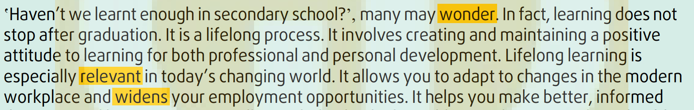
WHILE-READING
2
Read a letter written by a head teacher to her students on the school website. Circle the phrases with the closest meaning to the highlighted words.
A. to think about something and try to guess what is true or will happen
1. wonder
B. to walk slowly around an area without a clear purpose
A. relatively close
2. relevant
B. valuable and useful
A. makes something larger in degree or range
3. widens
B. makes something smaller in degree or range

Slide 12
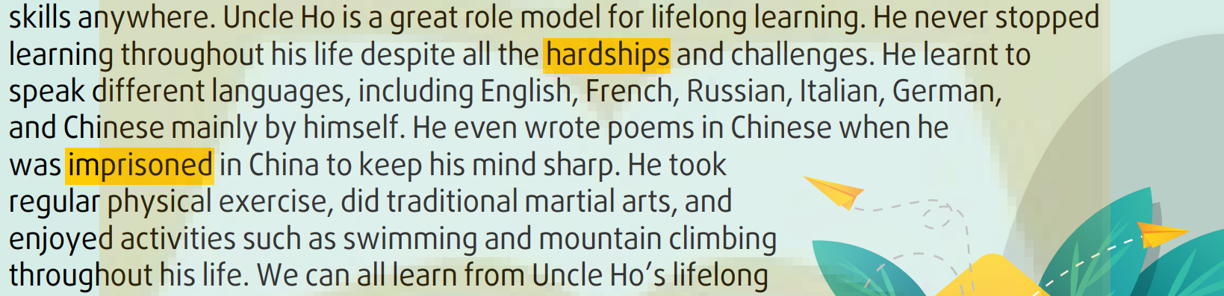
WHILE-READING
2
Read a letter written by a head teacher to her students on the school website. Circle the phrases with the closest meaning to the highlighted words.
4. hardships
A. large boats that are hard to operate
B. conditions of life that cause difficulty and suffering
A. released from a prison
5. imprisoned
B. put in a prison

Slide 13
WHILE-READING
2
Look at the answers again.
1. wonder | A. to think about something and try to guess what is true or will happen | thắc mắc, băn khoăn
2. relevant | B. valuable and useful | phù hợp, thích hợp
3. widens | A. makes something larger in degree or range | mở rộng, tăng thêm
4. hardships | B. conditions of life that cause difficulty and suffering | sự khó khăn, vất vả
5. imprisoned | B. put in a prison | giam cầm, cầm tù

Slide 14
WHILE-READING
Read the letter again. Choose the correct answer A, B, C, or D.
3
1. What is the main message of the letter?
A. Continue your studies at university or night school after leaving school.
B. Continue learning after leaving school to improve yourself and career.
C. Don’t be afraid of the challenges of lifelong learning.
D. It’s important to get a degree for your professional development

Slide 15
WHILE-READING
Read the letter again. Choose the correct answer A, B, C, or D.
3
2. Which of the following options is NOT mentioned as a choice for school-leavers?
A. Going to university.
B. Finding a job.
C. Going to a vocational school.
D. Volunteering abroad to learn languages

Slide 16
WHILE-READING
Read the letter again. Choose the correct answer A, B, C, or D.
3
3. Which of the following is NOT mentioned as a benefit of lifelong learning?
A. You have a better understanding of the world and can make good decisions.
B. It helps you to become successful in the present-day world.
C. It keeps your brain healthy and improves your memory.
D. It helps you stay connected with people and current ideas.

Slide 17
WHILE-READING
Read the letter again. Choose the correct answer A, B, C, or D.
3
4. Why do some people choose distance learning according to the letter?
A. They may want to earn a degree, but still have a full-time job.
B. It is easier to enrol on a distance learning course.
C. There are many online courses to choose from.
D. It is the easiest way to stay connected with your friends from school.

Slide 18
WHILE-READING
Read the letter again. Choose the correct answer A, B, C, or D.
3
5. Which of the following is NOT mentioned as an example of Uncle Ho’s lifelong learning?
A. He regularly exercised, did traditional martial arts, and enjoyed outdoor activities.
B. He learnt to use different languages through self-study.
C. He regularly attended evening classes and joined a learning community.
D. He wrote poems in prison to keep his mind sharp.

Slide 19
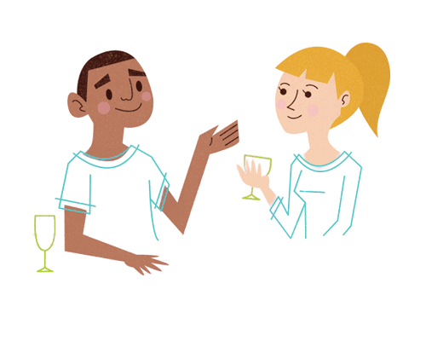
POST-READING
4
Work in pairs. Discuss the following questions.
Imagine this letter is addressed to you. How would you reply to the head teacher? What would you say to her?
If I received such an inspirational letter, I would feel very lucky because I would have a very devoted and experienced person guide me and tell me what I should do after leaving school. I would say thank you to him and ask him for more specific guidelines that may help me see things better.

Slide 20
CONSOLIDATION
1
Wrap-up
What have you learned today?
Some vocabulary in the head teacher’s message to school-leavers.
Reading the head teacher’s message to school-leavers.
Discuss how and what to reply the head teacher’s message.

Slide 21
CONSOLIDATION
2
Homework
Learn by heart vocabulary.
Do exercises in the workbook.
Prepare for the next lesson.

Slide 22
Website: hoclieu.vn
Fanpage: facebook.com/www.tienganhglobalsuccess.vn

