Slide 2
Unit
6
Preserving our heritage
Unit
FAMILY LIFE
LESSON 8
LOOKING BACK AND PROJECT

Slide 3
LESSON 8
LOOKING BACK AND PROJECT
WARM-UP
Who is faster?
- Pronunciation: Intonation
- Vocabulary: Preserving heritage
- Grammar: To-infinitive clauses
LOOKING BACK
PROJECT
Presentation: How can we preserve our heritage?
CONSOLIDATION
- Wrap up
- Homeword

Slide 4
WARM-UP
WHO IS FASTER?
- Ss work in group of four.
- Teacher gives each group a worksheet,
- Ss read and match the paragraphs with appropriate headings.
- The first team which completes correctly is the winner.

Slide 5
WARM-UP
Form a volunteer group
1. Gather fellow residents who care about preserving your community’s recent past places. Working together, you can research and nominate buildings for landmark designation; become your community’s advocate for the recent past and Modern design; create a website and maintain a discussion board.
Offer tours
2. Tours are a tried-and-true method for building a community’s appreciation for its historic resources and significant architecture. Put together a bus tour that takes guests past Modern structures throughout the neighborhood. Create a self-guided driving tour accompanied by a booklet that visitors and residents can continue to use.

Slide 6
WARM-UP
Host special events
3. Special events encourage those interested in mid-century architecture to connect with like-minded people. These can include fundraising events; special exhibits (complete with opening night parties) that feature the architecture and modern heritage of your community; or a lecture series that features local historians, architects, or professors to speaking about the area’s modern architecture.
Conduct community workshops
4. Workshops and seminars can be useful ways to educate specific audiences about buildings and cultural sites from the recent past. These classes can help teach participants the basics of historic preservation, give them an overview of the history of post-war architecture, offer tips on how to identify threats or problems, find appropriate replacement materials to keep mid-century homes looking true to their original architecture, and more. Contact a local preservation group for help or partnership opportunities.

Slide 7
LOOKING BACK
1
Listen and mark the intonation in the following sentences, using falling or level-rising intonation. Then practise saying them in pairs
The trip to Hoi An Ancient Town was amazing .
Please turn off the air-conditioner. It wastes too much electricity.
A boat tour is the best way to experience wildlife habitats.
4. In Ha Long Bay you can go swimming, diving and fishing.

Slide 8
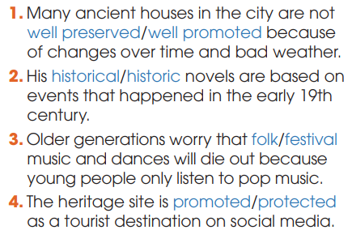
LOOKING BACK
2
Choose the correct word to complete each sentence

Slide 9
LOOKING BACK
3
Circle the underline part that is incorrect in each of the following sentence. Then correct it.
Mai went to Soc Son to attend Giong Festival.
The first place to visit on the trip is Hue Imperial Citadel.
Our music teacher gave lessons in Xoan singing to help us appreciate our cultural heritage.
The most famous site to see is the old bridge across the river.

Slide 10
PROJECT
HOW CAN WE PRESERVE OUR HERITAGE?

Slide 11
CONSOLIDATION
1
Wrap-up
What have you learnt today?
- Review the vocabulary and grammar of Unit 6;
- Apply what you have learnt (vocabulary and grammar) into practice through a project.

Slide 12
CONSOLIDATION
2
Homework
Do exercises in the workbook.
Prepare for Unit 2.

Slide 13
Website: hoclieu.vn
Fanpage: facebook.com/sachmem.vn/

