Slide 1
KET SPEAKING
Time allowed - 8-10 minutes
Normally you will do the speaking test with another candidate. The two of you will meet two examiners. One of the examiners will talk to you, the other does not participate in the conversations.
There are two parts to the speaking test:
Speaking part 1: short questions and answers between you and the examiner.
Speaking part 2: the examiner gives you some information or a card with some ideas for questions. You have to talk with the other candidate and ask or answer questions.
Scoring
The Speaking section is worth 25% of the total score for the exam.
How to prepare for KET Speaking:
Speak as much as you can, with your friends
Practise asking and answering questions about daily life
Practise giving information about yourself

Slide 2
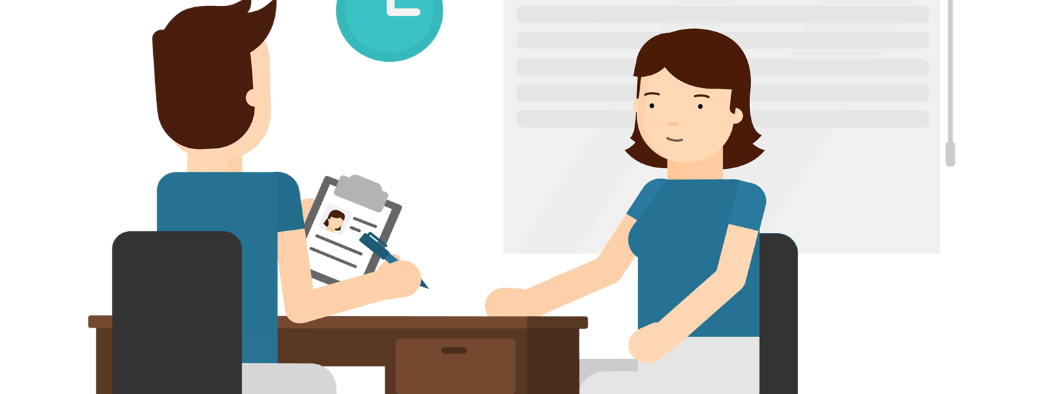
KEY ENGLISH TEST 5
Test 1 - Speaking

Slide 3

Part 1:
Student – examiner interaction
Section 1:
The examiner will ask you:
Your name
Where you come from?
Provide full-sentence answers

Slide 4

Part 1:
Student – examiner interaction
Section 2: You will be asked some questions that require longer answers. For example:
Why you like something
Details about a hobby…

Slide 5
Popular topic
family
best friend
hometown
your house
sport
computer
collecting
music

Slide 6
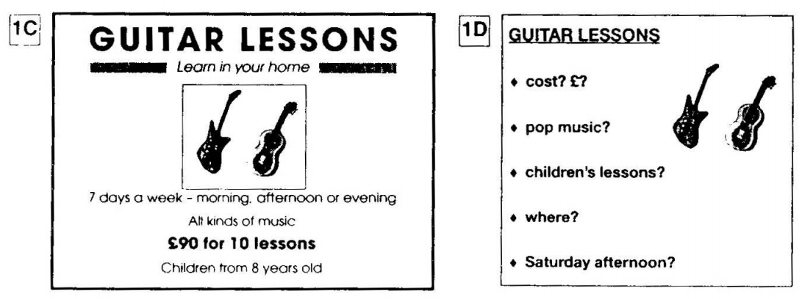
PART 2:
Student – student interaction
Ask and answer questions based on the cue cards
For example:
Do not just read from the cards. Answer in full sentences.
Pay attention to the grammar.

Slide 7

SPEAKING
PART 1

Slide 8
Part 1
What is the weather like today?
Do you trust the weather forecast? How often do they get it right?
Do you feel different because of weather? How do different types of weather affect your emotions?
How do you deal with rain? Do you use an umbrella or raincoat?
Do you worry about global warming? How serious are the earth’s environmental problems?
Which region of your country has the best weather? What is it like there?

Slide 9
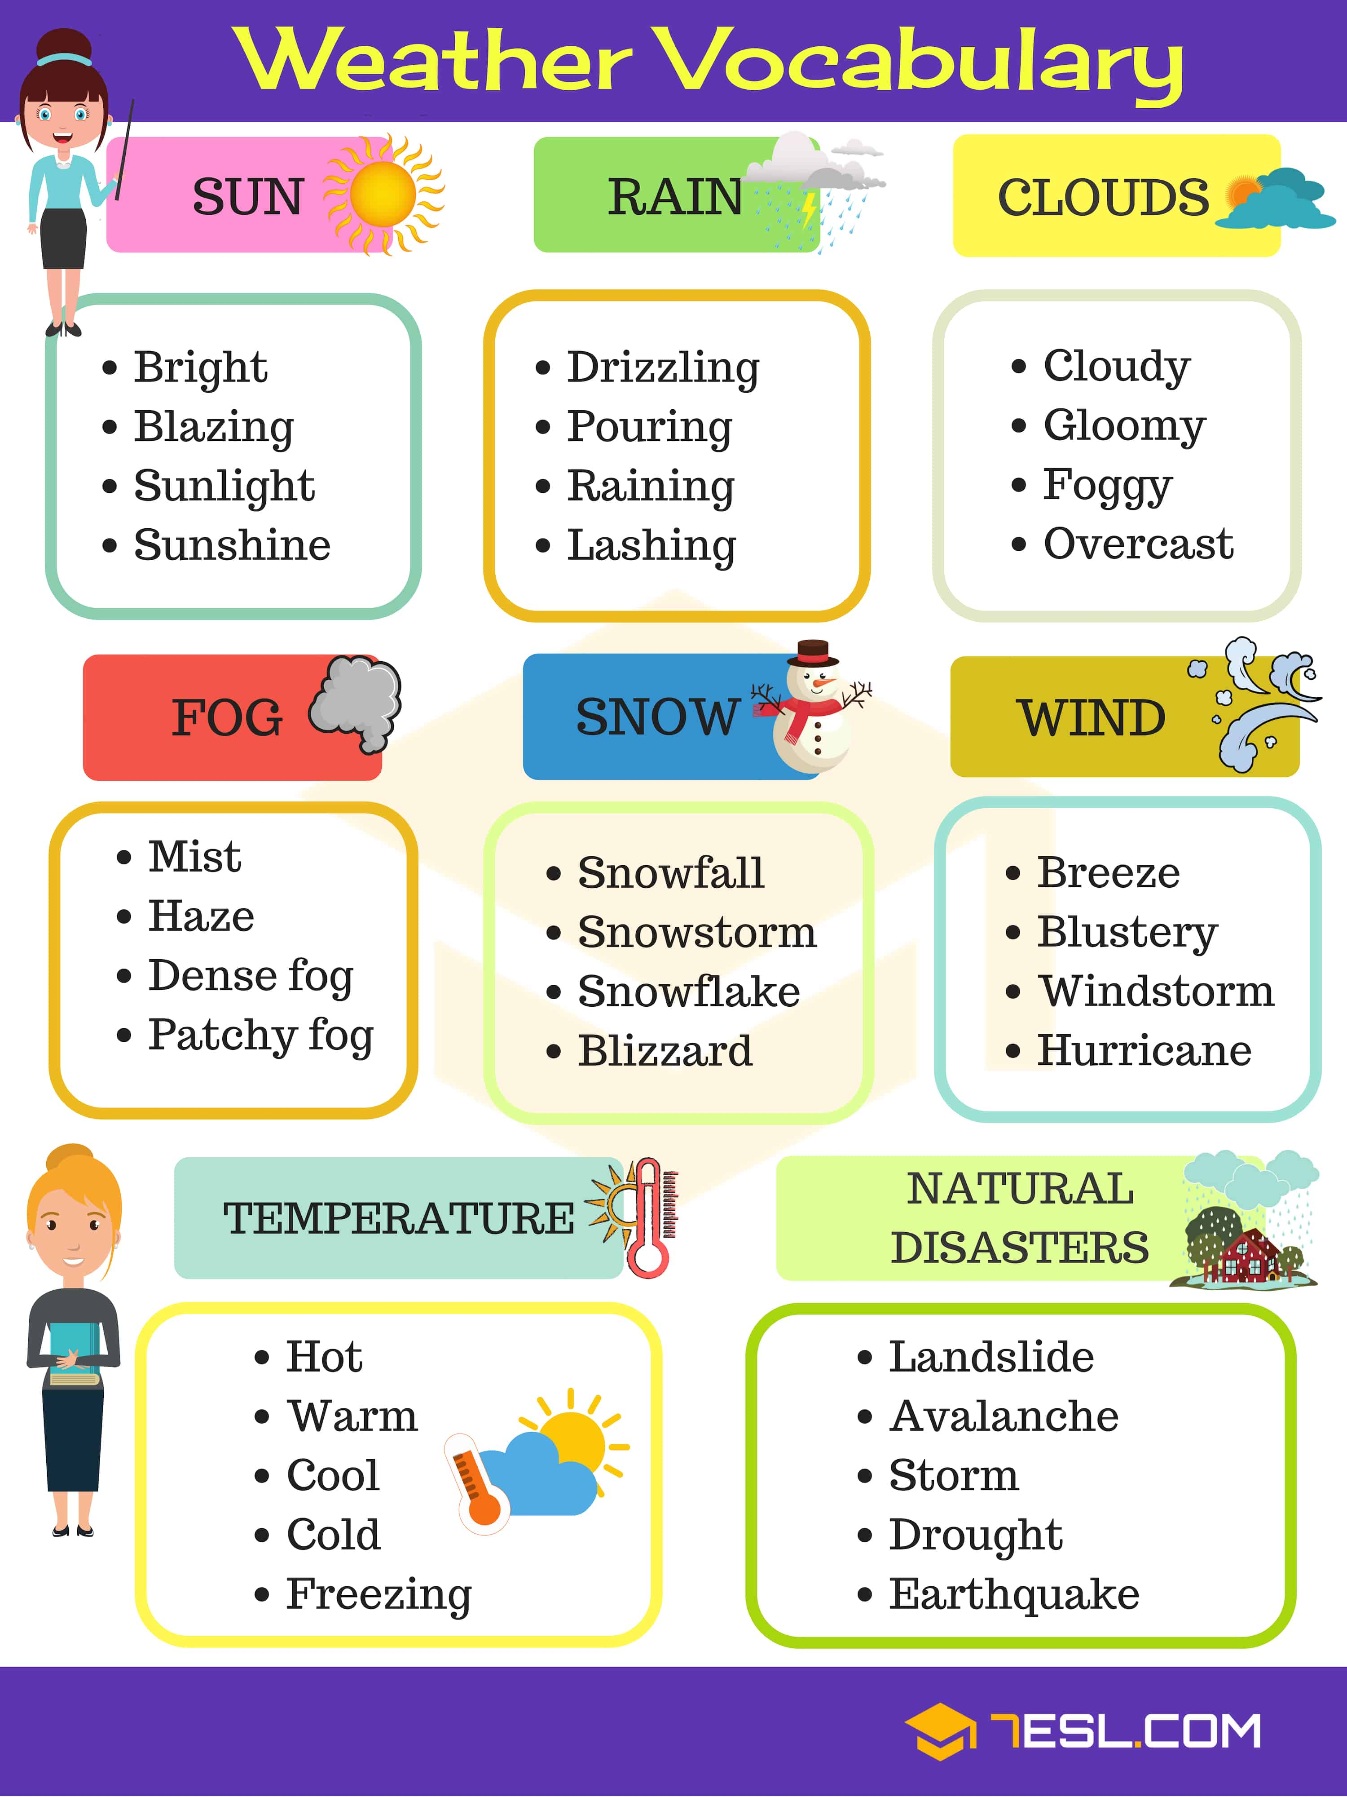

Slide 10
USEFUL VOCABULARY
bitterly cold: very cold and unpleasant
boiling hot: very hot (informal)
changeable: weather that often changes
clear blue skies: a sky without clouds
a cold spell: a short period of cold weather
a drop of rain: a little bit of rain
to get caught in the rain: to be outside when it rains unexpectedly
to get drenched: to get very wet
a heatwave: a period of very hot weather
to pour down: to rain heavily
sunny spells: short periods of sunny weather
thick fog: a dense fog that makes visibility very poor
torrential rain: see ‘heavy rain’ above

Slide 11
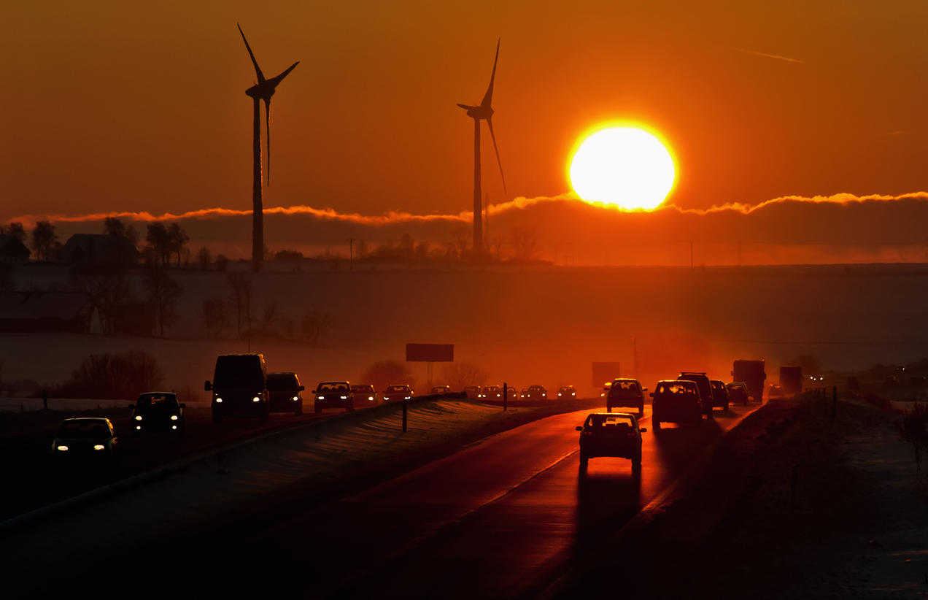
Global warming
a gradual increase in the overall temperature of the earth's atmosphere generally attributed to the greenhouse effect caused by increased levels of carbon dioxide, chlorofluorocarbons, and other pollutants

Slide 12
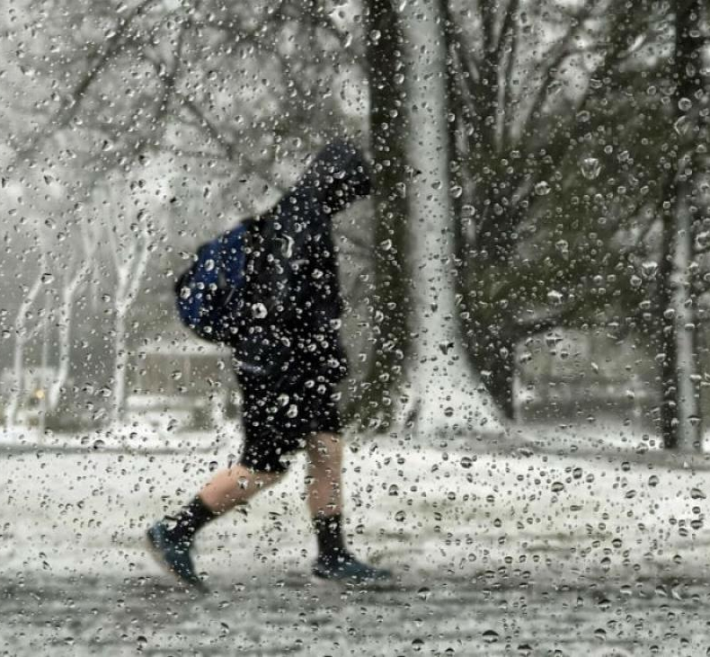
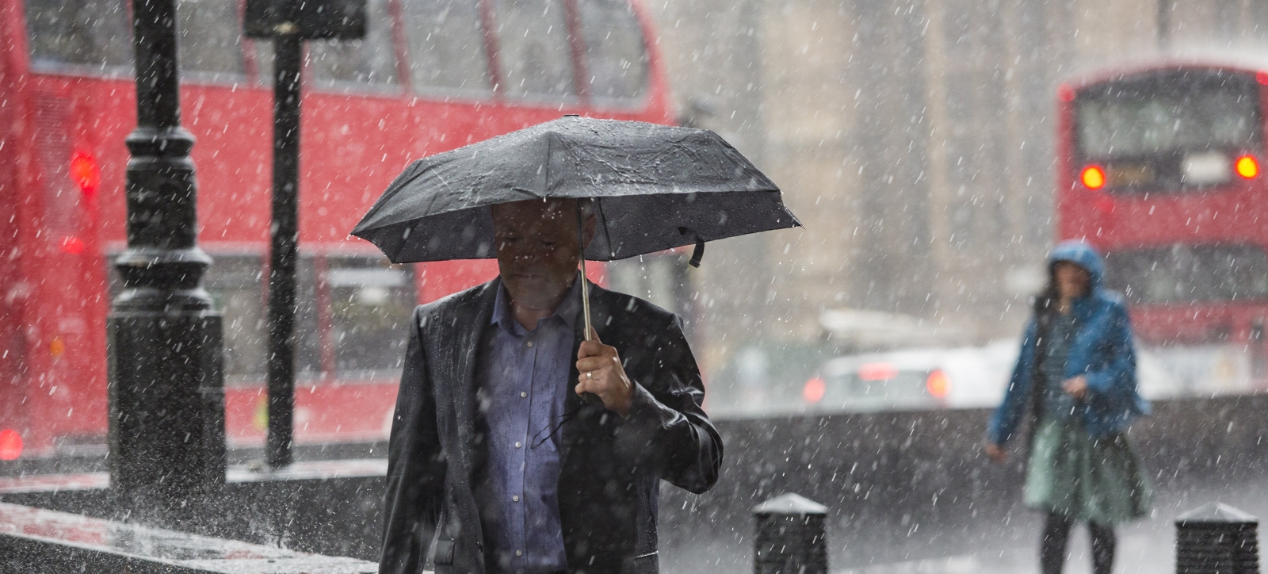
raining cats and dogs
raining very heavily

Slide 13
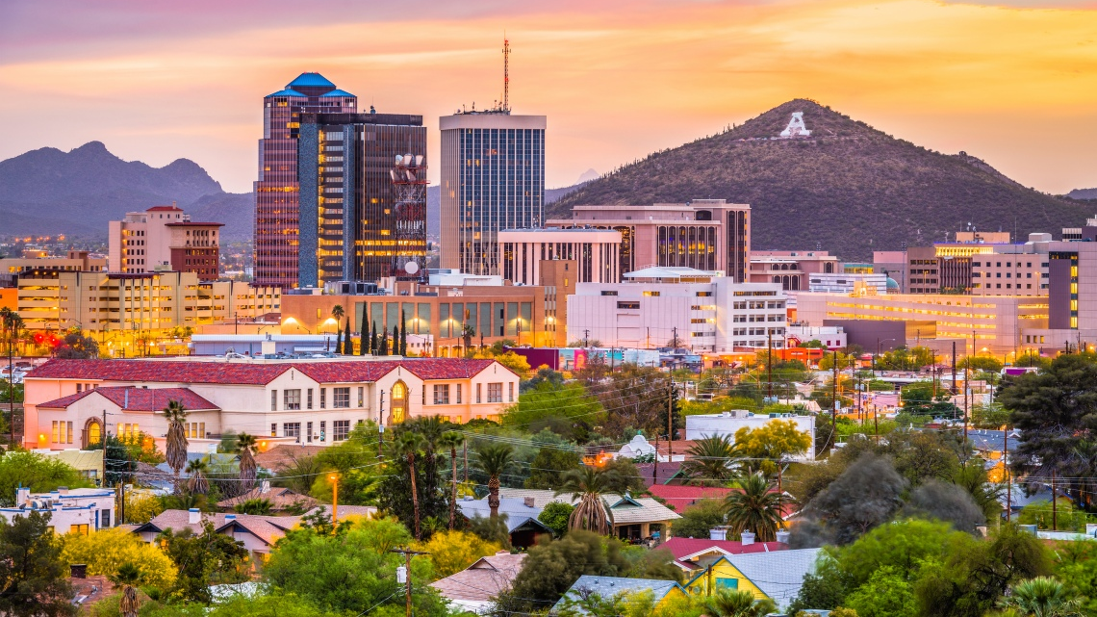
Would you rather live somewhere that is dry and hot all year round or in a place that has clearly different seasons?

Slide 14
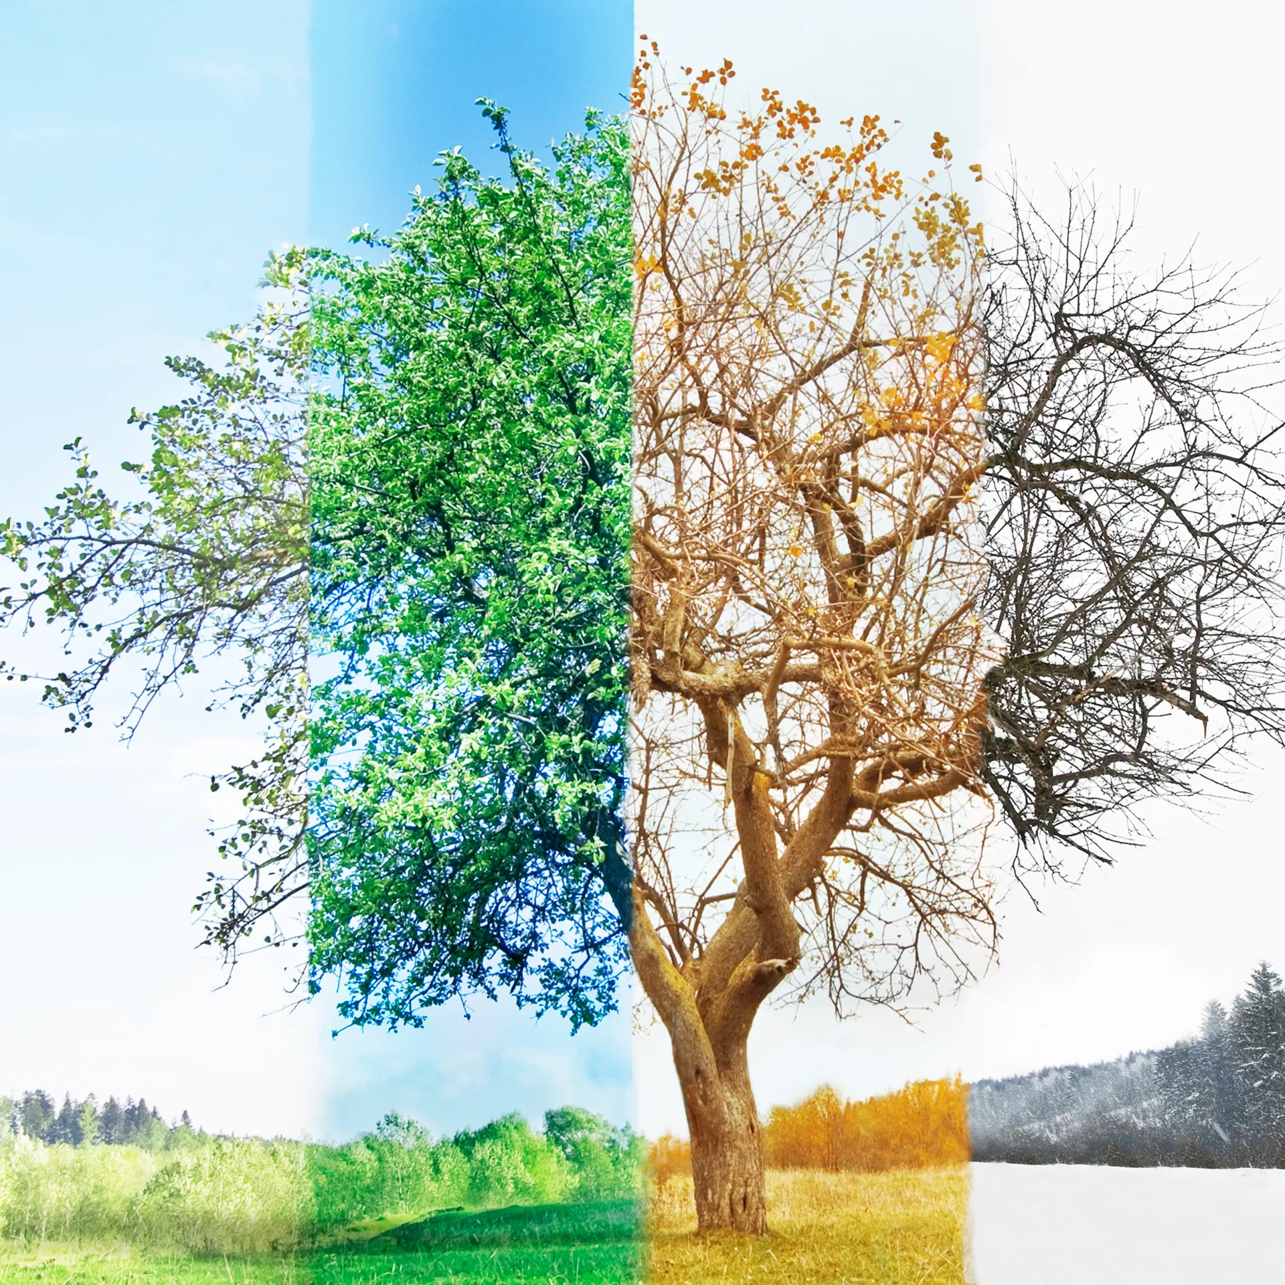
Talk about your favorite season of the year
What the weather is like.
Why you like this season.
What activities you usually do during this season.
How different kinds of weather in this season affect people.

Slide 15
SPEAKING PART 2
Asking and answering questions using these prompt cards

Slide 16
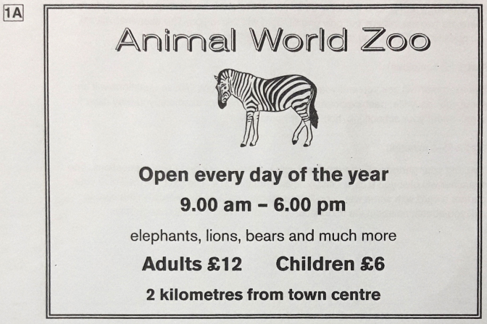
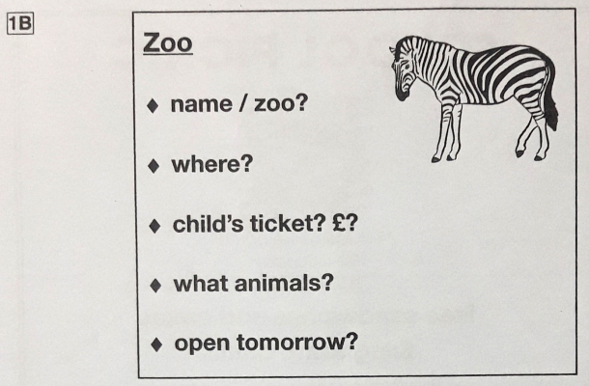
Ask and answer
Ask and answer questions using the words given.

Slide 17
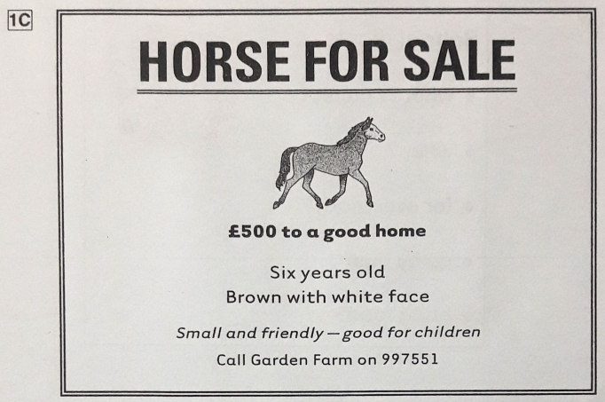
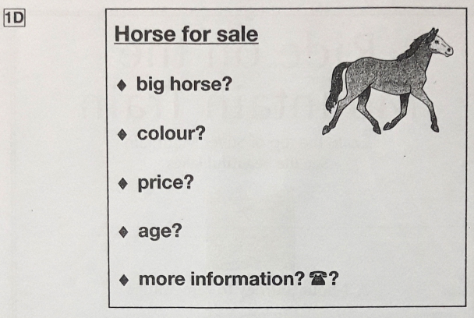
Ask and answer
Ask and answer questions using the words given.
What are other questions and answers you can think of?

Slide 18



Based on the given information, talk about the Central library.

