Slide 1
HAVE FUN + Watch Video = 玩得开心 + 看视频 = Wán dé kāixīn + Kàn shìpín=
Be quiet 安靜 Ānjìng Sit down 坐下 Zuò xià Look at me 看着我 Kànzhe wǒ Listen to me 听我说 Tīng wǒ shuō
Answer me 回答我 Huídá wǒ
.

Slide 2
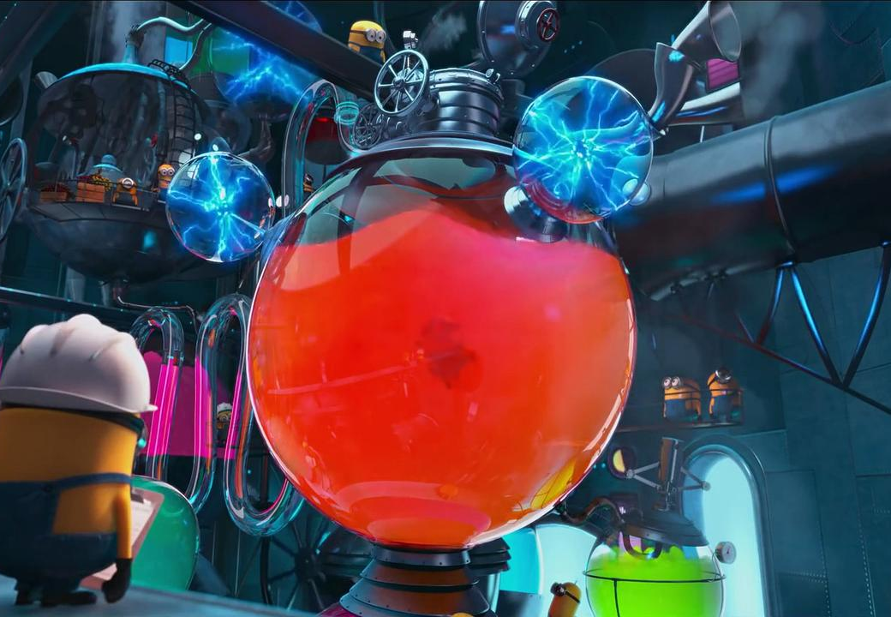
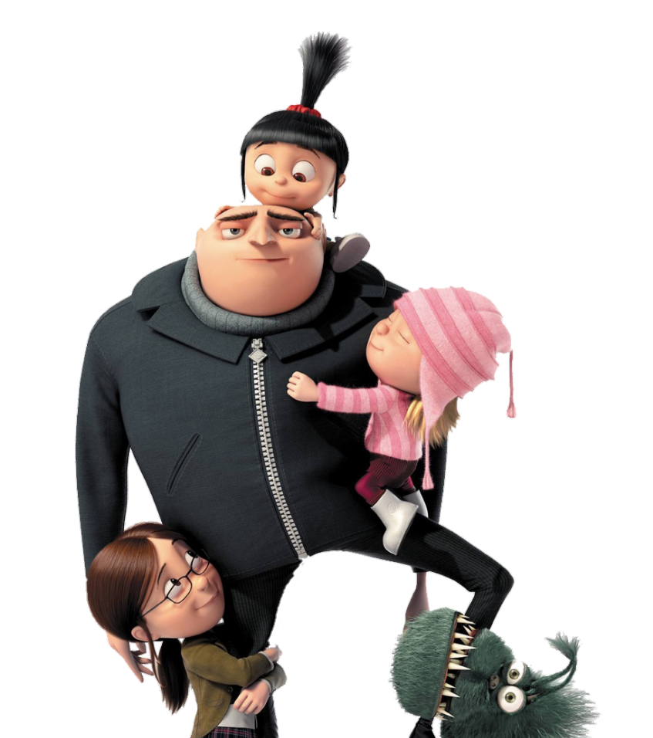
Template Design:
Adam Zero
Gru’s
FACTORY
WITH
ru
the
&
Notes:
NOTE: After clicking a letter on the home screen (slide 3) click anywhere to bring up the question/picture, then click again to bring up the answer, and so on for the reward animations. Once the red ‘ABCDEF’ button appears you may click ANYWHERE on the slide to return to the home screen (an invisible link box will cover the screen after the reward is displayed). There are 5 unique ‘good’ rewards, 5 unique ‘bad’ rewards, and 1 unique ‘good or bad’ reward, each repeated twice.
AUDIO and ANIMATIONS: It seems that the first time this presentation is used on a given computer some of the audio is clipped and some of the animations are rough or delayed. If possible, try to run through it prior to using it in a class setting.
EDITING NOTE: This game uses elaborate animations to display/remove questions, answers, pictures, and rewards. Each slide contains a large number of objects and animations. With this in mind, the default state of each slide has been organized to provide a teacher with easy access to the question text, answer text, and question picture. The question picture, however, should be changed by right-clicking the current image and selecting ‘Change Picture’ (‘그림 바꾸기’), then browsing for your new image, rather than simply deleting the current image and pasting or inserting the new one. This is because the question picture has an exit animation attached to it so that the objects behind it become visible after the question is answered. I’ve found that saving any images you want to use in this game (whether from other PPTs or from the internet) to a single folder makes the ‘Change Picture’ process much more convenient. Also, if you want to use multiple images or text you can place those as desired, select them together, right-click them and save them as an image (그림으로 저장); then delete them and use ‘Change Picture’ as above to place them seamlessly into the presentation.

Slide 3
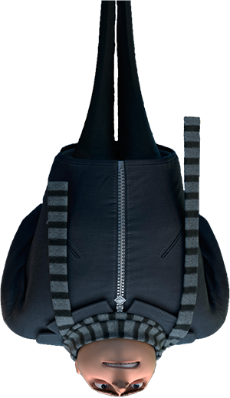
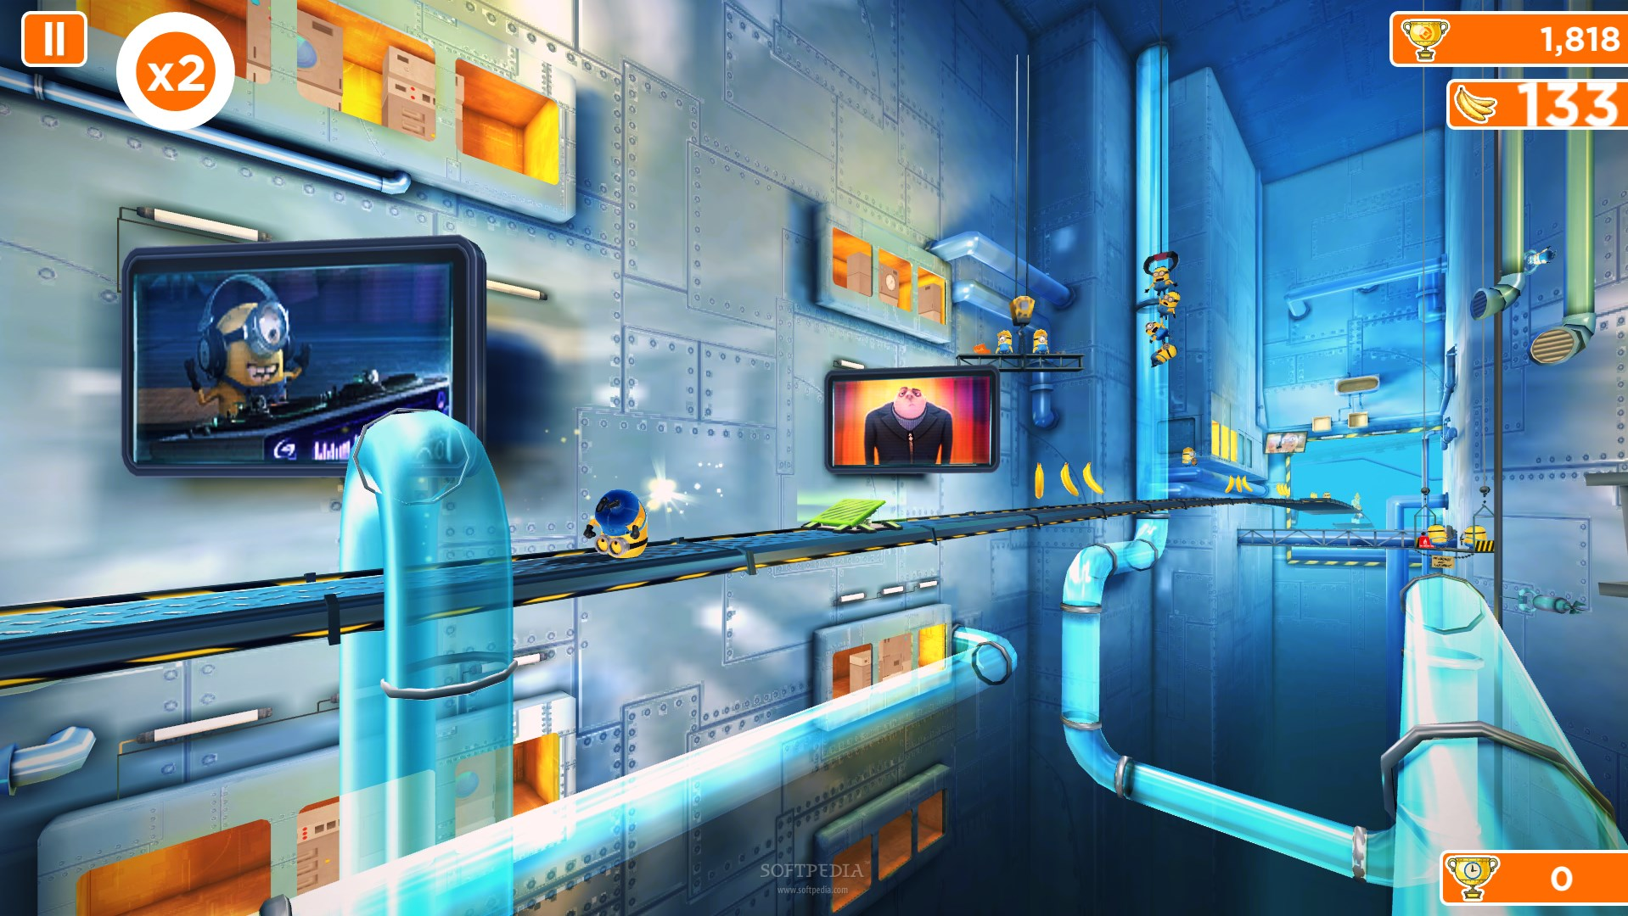
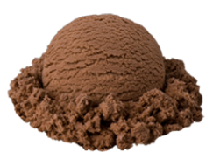
Answer the question, then choose
to use the item on your team ...
There’s a problem at
Gru’s Factory ...
Some are good ...
... and some are bad!
The machines are dropping
random items!
... or use it on one
other team!
Then the item ... good or bad ...
will drop. Good luck!
Notes:
Game explanation sequence. Teams choose a letter on the menu screen (Slide 3), answer the question that appears, then choose if they want to use the reward item that will drop (which they can’t see, yet) on their own team or on one other team of their choosing (similar to the ‘Keep or Give’ choice in the classic ‘Mystery Box’ game). The ‘Your Team? Other Team?’ decision must be made before the reward item ‘drops’ and, once made, is final.

Slide 4
Notes:
EDITING NOTE: Each letter is a picture with a hyperlink attached to it (other than Gru’s ‘G’ logo, which is only decoration). To change the hyperlink to a different question/reward slide, just right-click the letter and select ‘Edit Hyperlink’, then choose a different slide. Simply reordering the question/reward slides will not change which letter links to which slide. Slides 4-25 are the questions/rewards, so you could write those numbers down and check them off as you randomly link to them. If you want a specific letter to link to a specific reward, here is the rundown of rewards for each slide.
4-5: 2 points 6-7: 3 points 8-9: 4 points 10-11: 5 points 12-13: 6 points
14-15: Change points 16-17: -2 points 18-19: -3 points 20-21: Lose next turn
22-23: Give 3 points to next team 24-25: Lose half points

Slide 5
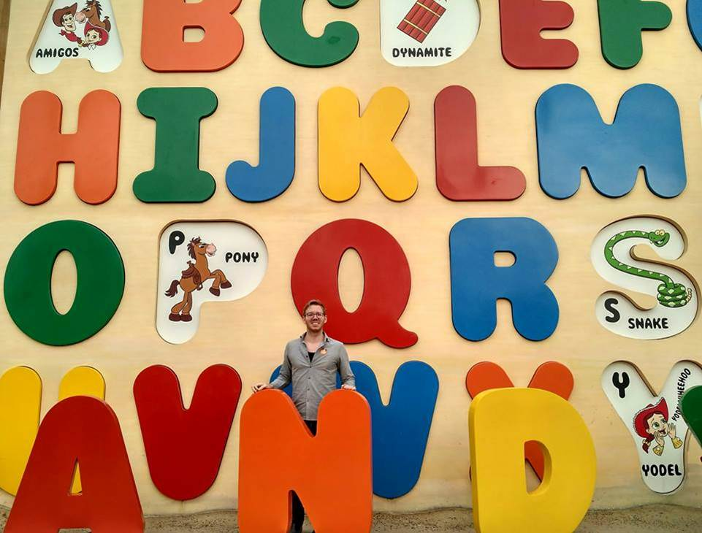
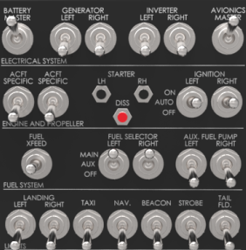
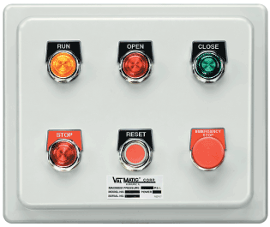
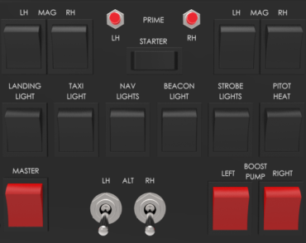
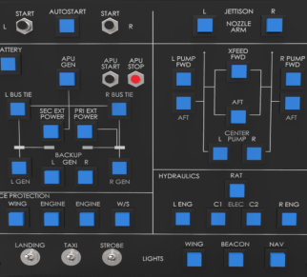
Double Scoop Ice Cream
2 points
What colour letters do you see?
Your Team?
Other Team?
I see red, orange, blue, green and yellow
Notes:
Double Ice Cream = 2 Points. EDITING NOTE: When changing the image for the question, you should right-click the current image and choose ‘Change Picture’ (‘그림 바꾸기’) and select the new image, then resize as desired. This is because the image has an exit animation so that it disappears and the ‘Your Team/Other Team’ and points animations can be seen.
I’ve found that saving any images you want to use in this game (whether from other PPTs or from the internet) to a single folder makes the ‘Change Picture’ process much more convenient. Also, if you want to use multiple images or text you can place those as desired, select them together, right-click them and save them as an image (그림으로 저장); then delete them and use ‘Change Picture’ as above to place them seamlessly into the presentation.
As a final note, the default question image has a ‘soft edge’ (부드러운 가장자리), accessible from picture effects (서식 -> 그림효과), which may look awkward for transparency enabled images (PNGs or GIFs) and can be removed.

Slide 6
Double Scoop Ice Cream
2 points
What colour does he like?
Your Team?
Other Team?
He likes brown.
Notes:
Double Ice Cream = 2 Points. EDITING NOTE: When changing the image for the question, you should right-click the current image and choose ‘Change Picture’ (‘그림 바꾸기’) and select the new image, then resize as desired. This is because the image has an exit animation so that it disappears and the ‘Your Team/Other Team’ and points animations can be seen.
I’ve found that saving any images you want to use in this game (whether from other PPTs or from the internet) to a single folder makes the ‘Change Picture’ process much more convenient. Also, if you want to use multiple images or text you can place those as desired, select them together, right-click them and save them as an image (그림으로 저장); then delete them and use ‘Change Picture’ as above to place them seamlessly into the presentation.
As a final note, the default question image has a ‘soft edge’ (부드러운 가장자리), accessible from picture effects (서식 -> 그림효과), which may look awkward for transparency enabled images (PNGs or GIFs) and can be removed.

Slide 7
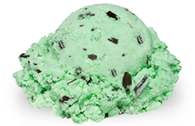
Triple Scoop Ice Cream
3 points
What colour does shelike?
Your Team?
Other Team?
She likes white.
Notes:
Triple Ice Cream = 3 Points. EDITING NOTE: When changing the image for the question, you should right-click the current image and choose ‘Change Picture’ (‘그림 바꾸기’) and select the new image, then resize as desired. This is because the image has an exit animation so that it disappears and the ‘Your Team/Other Team’ and points animations can be seen.
I’ve found that saving any images you want to use in this game (whether from other PPTs or from the internet) to a single folder makes the ‘Change Picture’ process much more convenient. Also, if you want to use multiple images or text you can place those as desired, select them together, right-click them and save them as an image (그림으로 저장); then delete them and use ‘Change Picture’ as above to place them seamlessly into the presentation.
As a final note, the default question image has a ‘soft edge’ (부드러운 가장자리), accessible from picture effects (서식 -> 그림효과), which may look awkward for transparency enabled images (PNGs or GIFs) and can be removed.

Slide 8
Triple Scoop Ice Cream
3 points
What colour does she like?
Your Team?
Other Team?
She likes black.
Notes:
Triple Ice Cream = 3 Points. EDITING NOTE: When changing the image for the question, you should right-click the current image and choose ‘Change Picture’ (‘그림 바꾸기’) and select the new image, then resize as desired. This is because the image has an exit animation so that it disappears and the ‘Your Team/Other Team’ and points animations can be seen.
I’ve found that saving any images you want to use in this game (whether from other PPTs or from the internet) to a single folder makes the ‘Change Picture’ process much more convenient. Also, if you want to use multiple images or text you can place those as desired, select them together, right-click them and save them as an image (그림으로 저장); then delete them and use ‘Change Picture’ as above to place them seamlessly into the presentation.
As a final note, the default question image has a ‘soft edge’ (부드러운 가장자리), accessible from picture effects (서식 -> 그림효과), which may look awkward for transparency enabled images (PNGs or GIFs) and can be removed.

Slide 9
4 Bananas
4 points
What colour does he like?
Your Team?
Other Team?
He likes grey.
Notes:
4 Bananas = 4 Points. EDITING NOTE: When changing the image for the question, you should right-click the current image and choose ‘Change Picture’ (‘그림 바꾸기’) and select the new image, then resize as desired. This is because the image has an exit animation so that it disappears and the ‘Your Team/Other Team’ and points animations can be seen.
I’ve found that saving any images you want to use in this game (whether from other PPTs or from the internet) to a single folder makes the ‘Change Picture’ process much more convenient. Also, if you want to use multiple images or text you can place those as desired, select them together, right-click them and save them as an image (그림으로 저장); then delete them and use ‘Change Picture’ as above to place them seamlessly into the presentation.
As a final note, the default question image has a ‘soft edge’ (부드러운 가장자리), accessible from picture effects (서식 -> 그림효과), which may look awkward for transparency enabled images (PNGs or GIFs) and can be removed.

Slide 10
4 Bananas
4 points
What is it?
Your Team?
Other Team?
taste
Notes:
4 Bananas = 4 Points. EDITING NOTE: When changing the image for the question, you should right-click the current image and choose ‘Change Picture’ (‘그림 바꾸기’) and select the new image, then resize as desired. This is because the image has an exit animation so that it disappears and the ‘Your Team/Other Team’ and points animations can be seen.
I’ve found that saving any images you want to use in this game (whether from other PPTs or from the internet) to a single folder makes the ‘Change Picture’ process much more convenient. Also, if you want to use multiple images or text you can place those as desired, select them together, right-click them and save them as an image (그림으로 저장); then delete them and use ‘Change Picture’ as above to place them seamlessly into the presentation.
As a final note, the default question image has a ‘soft edge’ (부드러운 가장자리), accessible from picture effects (서식 -> 그림효과), which may look awkward for transparency enabled images (PNGs or GIFs) and can be removed.

Slide 11
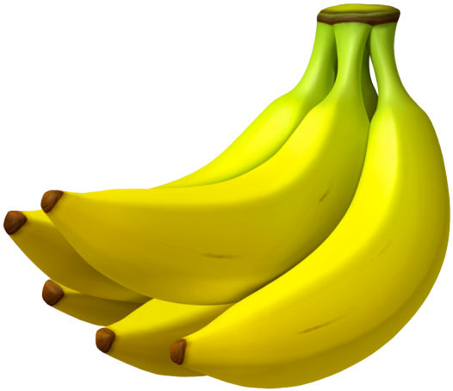
5 Bananas
5 points
What is it? How is it?
Your Team?
Other Team?
It’s candy. It’s sweet.
Notes:
5 Bananas = 5 Points. EDITING NOTE: When changing the image for the question, you should right-click the current image and choose ‘Change Picture’ (‘그림 바꾸기’) and select the new image, then resize as desired. This is because the image has an exit animation so that it disappears and the ‘Your Team/Other Team’ and points animations can be seen.
I’ve found that saving any images you want to use in this game (whether from other PPTs or from the internet) to a single folder makes the ‘Change Picture’ process much more convenient. Also, if you want to use multiple images or text you can place those as desired, select them together, right-click them and save them as an image (그림으로 저장); then delete them and use ‘Change Picture’ as above to place them seamlessly into the presentation.
As a final note, the default question image has a ‘soft edge’ (부드러운 가장자리), accessible from picture effects (서식 -> 그림효과), which may look awkward for transparency enabled images (PNGs or GIFs) and can be removed.

Slide 12
5 Bananas
5 points
What is it? How is it?
Your Team?
Other Team?
It’s a lemon. It’s sour.
Notes:
5 Bananas = 5 Points. EDITING NOTE: When changing the image for the question, you should right-click the current image and choose ‘Change Picture’ (‘그림 바꾸기’) and select the new image, then resize as desired. This is because the image has an exit animation so that it disappears and the ‘Your Team/Other Team’ and points animations can be seen.
I’ve found that saving any images you want to use in this game (whether from other PPTs or from the internet) to a single folder makes the ‘Change Picture’ process much more convenient. Also, if you want to use multiple images or text you can place those as desired, select them together, right-click them and save them as an image (그림으로 저장); then delete them and use ‘Change Picture’ as above to place them seamlessly into the presentation.
As a final note, the default question image has a ‘soft edge’ (부드러운 가장자리), accessible from picture effects (서식 -> 그림효과), which may look awkward for transparency enabled images (PNGs or GIFs) and can be removed.

Slide 13
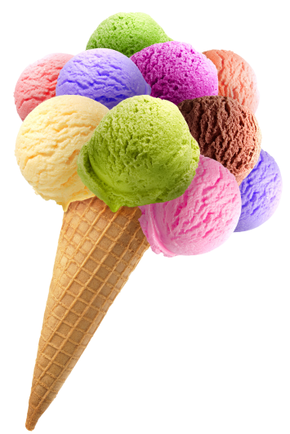
Super Ultra Ice Cream
6 points
What is it? How is it?
Your Team?
Other Team?
It’s ice cream. It’s sweet.
Notes:
Super Ice Cream = 6 Points. EDITING NOTE: When changing the image for the question, you should right-click the current image and choose ‘Change Picture’ (‘그림 바꾸기’) and select the new image, then resize as desired. This is because the image has an exit animation so that it disappears and the ‘Your Team/Other Team’ and points animations can be seen.
I’ve found that saving any images you want to use in this game (whether from other PPTs or from the internet) to a single folder makes the ‘Change Picture’ process much more convenient. Also, if you want to use multiple images or text you can place those as desired, select them together, right-click them and save them as an image (그림으로 저장); then delete them and use ‘Change Picture’ as above to place them seamlessly into the presentation.
As a final note, the default question image has a ‘soft edge’ (부드러운 가장자리), accessible from picture effects (서식 -> 그림효과), which may look awkward for transparency enabled images (PNGs or GIFs) and can be removed.

Slide 14
Super Ultra Ice Cream
6 points
What colour is the ball?
Your Team?
Other Team?
It’s green, red, yellow, blue, purple and violet / pink.
Notes:
Super Ice Cream = 6 Points. EDITING NOTE: When changing the image for the question, you should right-click the current image and choose ‘Change Picture’ (‘그림 바꾸기’) and select the new image, then resize as desired. This is because the image has an exit animation so that it disappears and the ‘Your Team/Other Team’ and points animations can be seen.
I’ve found that saving any images you want to use in this game (whether from other PPTs or from the internet) to a single folder makes the ‘Change Picture’ process much more convenient. Also, if you want to use multiple images or text you can place those as desired, select them together, right-click them and save them as an image (그림으로 저장); then delete them and use ‘Change Picture’ as above to place them seamlessly into the presentation.
As a final note, the default question image has a ‘soft edge’ (부드러운 가장자리), accessible from picture effects (서식 -> 그림효과), which may look awkward for transparency enabled images (PNGs or GIFs) and can be removed.

Slide 15
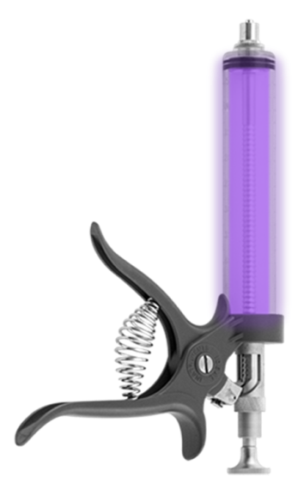
PX-41 Serum: You may
Change Points
It’s sweet, yellow and long. What is it?
Your Team?
Other Team?
It’s a banana.
Notes:
PX-41= MAY Change Points. EDITING NOTE: When changing the image for the question, you should right-click the current image and choose ‘Change Picture’ (‘그림 바꾸기’) and select the new image, then resize as desired. This is because the image has an exit animation so that it disappears and the ‘Your Team/Other Team’ and points animations can be seen.
I’ve found that saving any images you want to use in this game (whether from other PPTs or from the internet) to a single folder makes the ‘Change Picture’ process much more convenient. Also, if you want to use multiple images or text you can place those as desired, select them together, right-click them and save them as an image (그림으로 저장); then delete them and use ‘Change Picture’ as above to place them seamlessly into the presentation.
As a final note, the default question image has a ‘soft edge’ (부드러운 가장자리), accessible from picture effects (서식 -> 그림효과), which may look awkward for transparency enabled images (PNGs or GIFs) and can be removed.

Slide 16
PX-41 Serum: You may
Change Points
It’s a brown, bitter, hot drink. What is it?
Your Team?
Other Team?
It’s coffee.
Notes:
PX-41= MAY Change Points. EDITING NOTE: When changing the image for the question, you should right-click the current image and choose ‘Change Picture’ (‘그림 바꾸기’) and select the new image, then resize as desired. This is because the image has an exit animation so that it disappears and the ‘Your Team/Other Team’ and points animations can be seen.
I’ve found that saving any images you want to use in this game (whether from other PPTs or from the internet) to a single folder makes the ‘Change Picture’ process much more convenient. Also, if you want to use multiple images or text you can place those as desired, select them together, right-click them and save them as an image (그림으로 저장); then delete them and use ‘Change Picture’ as above to place them seamlessly into the presentation.
As a final note, the default question image has a ‘soft edge’ (부드러운 가장자리), accessible from picture effects (서식 -> 그림효과), which may look awkward for transparency enabled images (PNGs or GIFs) and can be removed.

Slide 17
Angry Gru
-2 points
What is it?
Your Team?
Other Team?
It’s a plane.
Notes:
Angry Gru= -2 points. EDITING NOTE: When changing the image for the question, you should right-click the current image and choose ‘Change Picture’ (‘그림 바꾸기’) and select the new image, then resize as desired. This is because the image has an exit animation so that it disappears and the ‘Your Team/Other Team’ and points animations can be seen.
I’ve found that saving any images you want to use in this game (whether from other PPTs or from the internet) to a single folder makes the ‘Change Picture’ process much more convenient. Also, if you want to use multiple images or text you can place those as desired, select them together, right-click them and save them as an image (그림으로 저장); then delete them and use ‘Change Picture’ as above to place them seamlessly into the presentation.
As a final note, the default question image has a ‘soft edge’ (부드러운 가장자리), accessible from picture effects (서식 -> 그림효과), which may look awkward for transparency enabled images (PNGs or GIFs) and can be removed.

Slide 18
Angry Gru
-2 points
What is it?
Your Team?
Other Team?
It’s a bicycle (bike).
Notes:
Angry Gru= -2 points. EDITING NOTE: When changing the image for the question, you should right-click the current image and choose ‘Change Picture’ (‘그림 바꾸기’) and select the new image, then resize as desired. This is because the image has an exit animation so that it disappears and the ‘Your Team/Other Team’ and points animations can be seen.
I’ve found that saving any images you want to use in this game (whether from other PPTs or from the internet) to a single folder makes the ‘Change Picture’ process much more convenient. Also, if you want to use multiple images or text you can place those as desired, select them together, right-click them and save them as an image (그림으로 저장); then delete them and use ‘Change Picture’ as above to place them seamlessly into the presentation.
As a final note, the default question image has a ‘soft edge’ (부드러운 가장자리), accessible from picture effects (서식 -> 그림효과), which may look awkward for transparency enabled images (PNGs or GIFs) and can be removed.

Slide 19
Fart Gun
-3 points
What is it?
Your Team?
Other Team?
It’s a train.
Notes:
Fart Gun= -3 points. EDITING NOTE: When changing the image for the question, you should right-click the current image and choose ‘Change Picture’ (‘그림 바꾸기’) and select the new image, then resize as desired. This is because the image has an exit animation so that it disappears and the ‘Your Team/Other Team’ and points animations can be seen.
I’ve found that saving any images you want to use in this game (whether from other PPTs or from the internet) to a single folder makes the ‘Change Picture’ process much more convenient. Also, if you want to use multiple images or text you can place those as desired, select them together, right-click them and save them as an image (그림으로 저장); then delete them and use ‘Change Picture’ as above to place them seamlessly into the presentation.
As a final note, the default question image has a ‘soft edge’ (부드러운 가장자리), accessible from picture effects (서식 -> 그림효과), which may look awkward for transparency enabled images (PNGs or GIFs) and can be removed.

Slide 20
Fart Gun
-3 points
What is it?
Your Team?
Other Team?
It’s a car.
Notes:
Fart Gun= -3 points. EDITING NOTE: When changing the image for the question, you should right-click the current image and choose ‘Change Picture’ (‘그림 바꾸기’) and select the new image, then resize as desired. This is because the image has an exit animation so that it disappears and the ‘Your Team/Other Team’ and points animations can be seen.
I’ve found that saving any images you want to use in this game (whether from other PPTs or from the internet) to a single folder makes the ‘Change Picture’ process much more convenient. Also, if you want to use multiple images or text you can place those as desired, select them together, right-click them and save them as an image (그림으로 저장); then delete them and use ‘Change Picture’ as above to place them seamlessly into the presentation.
As a final note, the default question image has a ‘soft edge’ (부드러운 가장자리), accessible from picture effects (서식 -> 그림효과), which may look awkward for transparency enabled images (PNGs or GIFs) and can be removed.

Slide 21
Freeze Ray
Same Low Score
What is it?
Your Team?
Other Team?
It’s a plane.
Notes:
Freeze Ray= Miss Next Turn. EDITING NOTE: When changing the image for the question, you should right-click the current image and choose ‘Change Picture’ (‘그림 바꾸기’) and select the new image, then resize as desired. This is because the image has an exit animation so that it disappears and the ‘Your Team/Other Team’ and points animations can be seen.
I’ve found that saving any images you want to use in this game (whether from other PPTs or from the internet) to a single folder makes the ‘Change Picture’ process much more convenient. Also, if you want to use multiple images or text you can place those as desired, select them together, right-click them and save them as an image (그림으로 저장); then delete them and use ‘Change Picture’ as above to place them seamlessly into the presentation.
As a final note, the default question image has a ‘soft edge’ (부드러운 가장자리), accessible from picture effects (서식 -> 그림효과), which may look awkward for transparency enabled images (PNGs or GIFs) and can be removed.

Slide 22
Freeze Ray
Same Low Score
What is it?
Your Team?
Other Team?
It’s a bus.
Notes:
Freeze Ray= Miss Next Turn. EDITING NOTE: When changing the image for the question, you should right-click the current image and choose ‘Change Picture’ (‘그림 바꾸기’) and select the new image, then resize as desired. This is because the image has an exit animation so that it disappears and the ‘Your Team/Other Team’ and points animations can be seen.
I’ve found that saving any images you want to use in this game (whether from other PPTs or from the internet) to a single folder makes the ‘Change Picture’ process much more convenient. Also, if you want to use multiple images or text you can place those as desired, select them together, right-click them and save them as an image (그림으로 저장); then delete them and use ‘Change Picture’ as above to place them seamlessly into the presentation.
As a final note, the default question image has a ‘soft edge’ (부드러운 가장자리), accessible from picture effects (서식 -> 그림효과), which may look awkward for transparency enabled images (PNGs or GIFs) and can be removed.

Slide 23
Lipstick Taser: Give 1 points to other teams.
What is it?
Your Team?
Other Team?
It’s a ship.
Notes:
Lipstick Taser= Give 3 points to next team. EDITING NOTE: When changing the image for the question, you should right-click the current image and choose ‘Change Picture’ (‘그림 바꾸기’) and select the new image, then resize as desired. This is because the image has an exit animation so that it disappears and the ‘Your Team/Other Team’ and points animations can be seen.
I’ve found that saving any images you want to use in this game (whether from other PPTs or from the internet) to a single folder makes the ‘Change Picture’ process much more convenient. Also, if you want to use multiple images or text you can place those as desired, select them together, right-click them and save them as an image (그림으로 저장); then delete them and use ‘Change Picture’ as above to place them seamlessly into the presentation.
As a final note, the default question image has a ‘soft edge’ (부드러운 가장자리), accessible from picture effects (서식 -> 그림효과), which may look awkward for transparency enabled images (PNGs or GIFs) and can be removed.

Slide 24
Lipstick Taser: Give 2 points to other teams.
What can you hear?
Your Team?
Other Team?
I can hear a …
Notes:
Lipstick Taser= Give 3 points to next team. EDITING NOTE: When changing the image for the question, you should right-click the current image and choose ‘Change Picture’ (‘그림 바꾸기’) and select the new image, then resize as desired. This is because the image has an exit animation so that it disappears and the ‘Your Team/Other Team’ and points animations can be seen.
I’ve found that saving any images you want to use in this game (whether from other PPTs or from the internet) to a single folder makes the ‘Change Picture’ process much more convenient. Also, if you want to use multiple images or text you can place those as desired, select them together, right-click them and save them as an image (그림으로 저장); then delete them and use ‘Change Picture’ as above to place them seamlessly into the presentation.
As a final note, the default question image has a ‘soft edge’ (부드러운 가장자리), accessible from picture effects (서식 -> 그림효과), which may look awkward for transparency enabled images (PNGs or GIFs) and can be removed.

Slide 25
Shrink Ray
Lose ½ Points
It’s a round, sweet and sour. What is it?
Your Team?
Other Team?
It’s an orange.
Notes:
Shrink Ray= Lose ½ Points. EDITING NOTE: When changing the image for the question, you should right-click the current image and choose ‘Change Picture’ (‘그림 바꾸기’) and select the new image, then resize as desired. This is because the image has an exit animation so that it disappears and the ‘Your Team/Other Team’ and points animations can be seen.
I’ve found that saving any images you want to use in this game (whether from other PPTs or from the internet) to a single folder makes the ‘Change Picture’ process much more convenient. Also, if you want to use multiple images or text you can place those as desired, select them together, right-click them and save them as an image (그림으로 저장); then delete them and use ‘Change Picture’ as above to place them seamlessly into the presentation.
As a final note, the default question image has a ‘soft edge’ (부드러운 가장자리), accessible from picture effects (서식 -> 그림효과), which may look awkward for transparency enabled images (PNGs or GIFs) and can be removed.

Slide 26
Shrink Ray
Lose ½ Points
Let’s mix blue and red. What colour is it now?
Your Team?
Other Team?
It’s purple.
Notes:
Shrink Ray= Lose ½ Points. EDITING NOTE: When changing the image for the question, you should right-click the current image and choose ‘Change Picture’ (‘그림 바꾸기’) and select the new image, then resize as desired. This is because the image has an exit animation so that it disappears and the ‘Your Team/Other Team’ and points animations can be seen.
I’ve found that saving any images you want to use in this game (whether from other PPTs or from the internet) to a single folder makes the ‘Change Picture’ process much more convenient. Also, if you want to use multiple images or text you can place those as desired, select them together, right-click them and save them as an image (그림으로 저장); then delete them and use ‘Change Picture’ as above to place them seamlessly into the presentation.
As a final note, the default question image has a ‘soft edge’ (부드러운 가장자리), accessible from picture effects (서식 -> 그림효과), which may look awkward for transparency enabled images (PNGs or GIFs) and can be removed.

