Slide 1

Unit 5: Travel & Transportation
Lesson 5a: Reading (Cont.)
Page 81

Slide 2
Lesson Outline
Warm-up
Vocabulary
Speaking
Preposition
Writing
Wrap-up

Slide 3
Objectives
By the end of this lesson, students will be able to…
learn and use some vocabulary related to transportation in the future: hoverboard, self-driving bus, hyperloop train, ﬂying taxi, hoverbike, electric car.
talk about transportation in the future.
learn how to use “by, in, at” to talk about transportation.
learn to write tweets.

Slide 4

WARM-UP

Slide 5

Work in pairs.
Choose the word whose underlined part is
pronounced differently from that of the other words.
1. A. cable B. taxi C. landmark D. apple
2. A. boat B. road C. board D. goal
3. A. cruise B. house C. rose D. cheese
/ˈkeɪbl/
/ˈtæksi/
/ˈlændmɑːk/
/ˈæpl/
/bəʊt/
/rəʊd/
/bɔːd/
/ɡəʊl/
/kruːz/
/haʊs/
/rəʊz/
/tʃiːz/

Slide 6
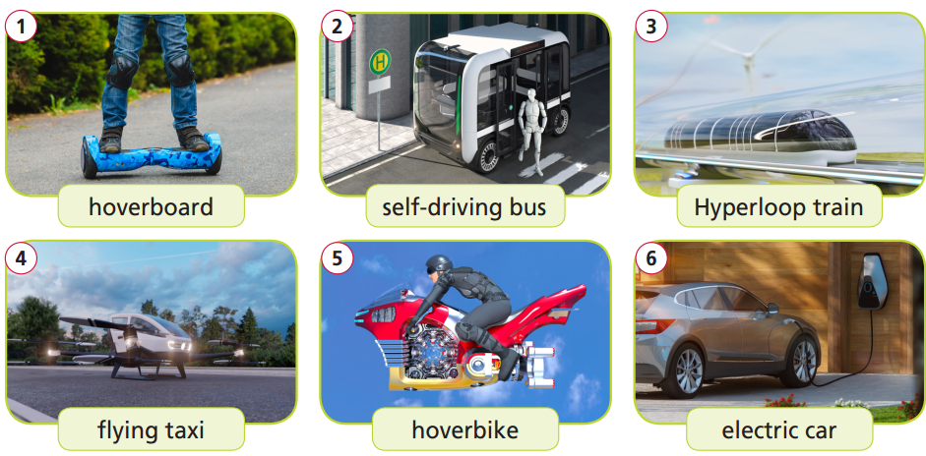
Work in pairs.
Please choose suitable names for each picture.
ﬂying taxi
self-driving bus
hoverbike
electric car
hoverboard
hyperloop train

Slide 7

It’s time to learn …

Slide 8

The means of transport exist nowadays: hoverboard, self-driving bus, and electric car.

Slide 9
Vocabulary
Listen and repeat.
hoverboard /ˈhɒvəbɔːd/ (n) ván trượt thăng bằng
self-driving bus /ˌself ˈdraɪvɪŋ bʌs/ (n. phr) xe buýt tự lái
hyperloop train /ˈhaɪpəluːp treɪn/ (n. phr) tàu siêu tốc chạy bằng cảm ứng điện từ
ﬂying taxi /ˈﬂaɪɪŋ ˈtæksi/ (n. phr) xe taxi bay
hoverbike /ˈhɒvəbaɪk/ (n) xe mô tô bay
electric car /iˈlektrɪk kɑ:/ (n. phr) xe ô tô chạy bằng điện

Slide 10
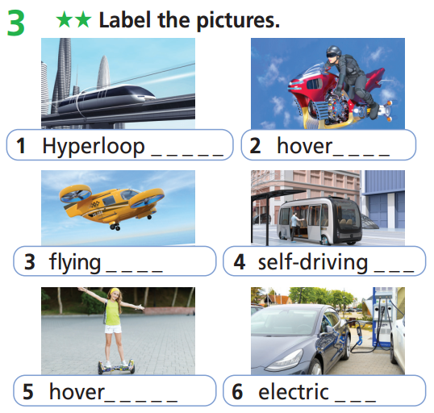
Extra Practice
WB page 42
train
bike
taxi
bus
board
car

Slide 11
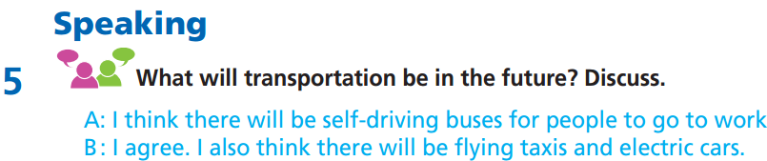

Slide 12
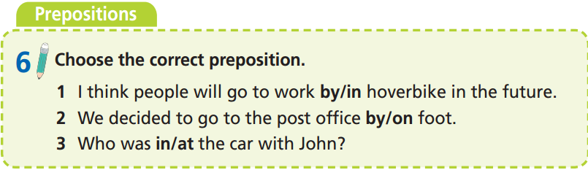

Slide 13
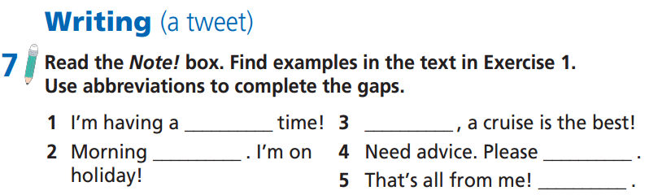
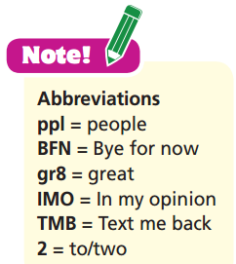
(p. 80)
gr8
IMO
ppl
TMB
BFN

Slide 14
Fill in the gaps with suitable words or abbreviations to complete the tweets about how to get around in Hanoi.
bus * gr8 * IMO * motorbike * ppl * cyclo * #Hanoibycyclo * ppl * BFN * gr8
cyclo
Hello ppl! The best way to see all the sights in Hanoi is on a ________ tour. It’s ________!
________
gr8
#Hanoibycyclo
IMO
bus
gr8
________, the sightseeing ________ tour is better. You’ll get a ________ view of some amazing buildings!
motorbike
Yes, or you can ride a _________ around the city. It’s the most convenient way to travel in this crowded city. Most ________ love that! ________
ppl
BFN

Slide 15
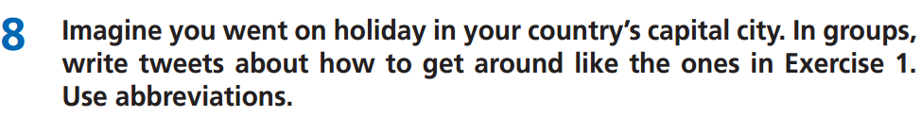
Notice:
• Write about the means of transport in your capital city?
• Use abbreviations and use no more than 140 characters.
E.g.
Hello ppl! The best way to see all the sights in Hanoi is on a cyclo tour. It’s gr8!
#Hanoibycyclo
IMO, the sightseeing bus tour is better. You’ll get a gr8 view of some amazing buildings!
Yes, or you can ride a motorbike around the city. It’s the most convenient way to travel in this crowded city. Most ppl love that! BFN

Slide 16

CONSOLIDATION

Slide 17
Write a paragraph (60-80 words) about what kinds of transportation may be popular in the future in the place you live.
Suggested answer.
I live in Ho Chi Minh City. I guess that hoverbikes and flying taxis may be very popular in the future here because the city is so crowded. With these kinds of transportation, there will be more space for people to travel around. People may also use a lot of electric cars in the future because they are more environmentally-friendly. Electric cars may also help people save more money because electricity is cheaper than oil.

Slide 18

WRAP-UP

Slide 19
Today’s lesson
Vocabularies
hoverboard
self-driving bus
hyperloop train
ﬂying taxi
hoverbike
electric car
Speaking: talk about transportation in the future.
Preposition: learn how to use “by, in, at” to talk about transportation.
Writing: learn to write tweets.

Slide 20
Homework
Practise the vocabularies and make sentences using them.
Do the exercises in TA 7 Right on WB (page 42)
Prepare the next lesson (page 82 SB)
Do the exercise in TA 7 Right on Notebook (page 36)

Slide 21

Enjoy your day!

