Slide 1

Unit 4: All things high-tech
Lesson: CLIL
Page 74

Slide 2
Lesson Outline
Warm-up
Reading
Consolidation
Wrap-up

Slide 3
Objectives
By the end of this lesson, students will be able to…
- learn and talk about Internet safety tips.
- listen and read for specific information.

Slide 4

WARM-UP

Slide 5

Work in pairs.
Choose the word whose main stress is placed
differently the others.
1. A. device B. data C. email D. password
2. A. extra B. real C. clever D. unsafe
3. A. address B. software C. safety D. message
/dɪˈvaɪs/
/ˈdeɪtə/
/ˈiːmeɪl/
/ˈpɑːswɜːd/
/ˈekstrə/
/ˈrɪəl/
/ˈklevər/
/ʌnˈseɪf/
/əˈdres/
/ˈsɒftweər/
/ˈseɪfti/
/ˈmesɪdʒ/

Slide 6
Choose the word whose underlined part is pronounced differently
from that of the other words.
A. citizen B. revival C. festival D. technician
2. A. advise B. permit C. decide D. revise
3. A. class B. game C. date D. clay
/ˈsɪtɪzən/
/rɪˈvaɪvəl/
/ˈfestɪvəl/
/tekˈnɪʃən/
/ədˈvaɪz/
/pəˈmɪt/
/ dɪˈsaɪd/
/rɪˈvaɪz/
/klɑːs/
/ɡeɪm/
/deɪt/
/kleɪ/

Slide 7

It’s time to learn …

Slide 8

Reading

Slide 9
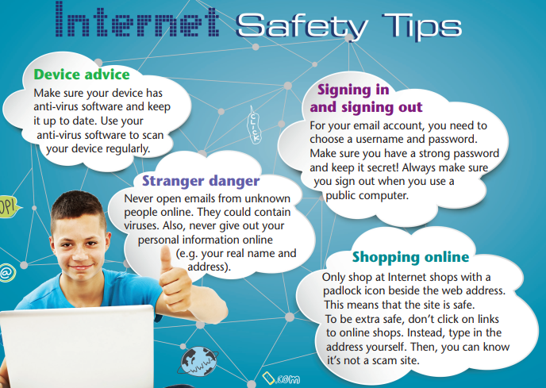
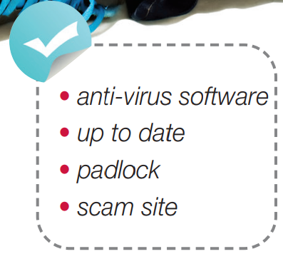
Pre-reading
Find these words in the text, try to guess what are their meanings.

Slide 10

Vocabulary
Listen and repeat. Click each phrase to hear the sound.
anti-virus software /ˌæntiˈvaɪrəs ˈsɒftweər/ (n) phần mềm diệt vi-rút
up to date /ˌʌptə ˈdeɪt/ (adj) cập nhật
padlock /ˈpædlɒk/ (n) ổ khóa
scam site /skæm saɪt/ (n) trang web lừa đảo

Slide 11
Look at the IPA and the meaning of each word to read out the word.
/ˌæntiˈvaɪrəs ˈsɒftweər / (n) phần mềm diệt vi-rút
/ˌʌptə ˈdeɪt/ (adj) cập nhật
/ˈpædlɒk/ (n) ổ khóa
/skæm saɪt/ (n) trang web lừa đảo

Slide 12
While-reading
What do we need to do to stay safe on the Internet? Listen and read to find out.
Device advice
Make sure your device has anti-virus software and keep it up to date. Use your anti-virus software to scan your device regularly.
Stranger danger
Never open emails from unknown people online. They could contain viruses. Also, never give out your personal information online (e.g. your real name and address).

Slide 13
Signing in and signing out
For your email account, you need to choose a username and password. Make sure you have a strong password and keep it secret! Always make sure you sign out when you use a public computer.
Shopping online
Only shop at Internet shops with a padlock icon beside the web address. This means that the site is safe.
To be extra safe, don’t click on links to online shops. Instead, type in the address yourself. Then, you can know it’s not a scam site.

Slide 14
Answer Key
To stay safe online, you should install anti-virus software on your devices, create a safe password for your email account, and be careful about the emails from unknown people and the websites to the shops.

Slide 15
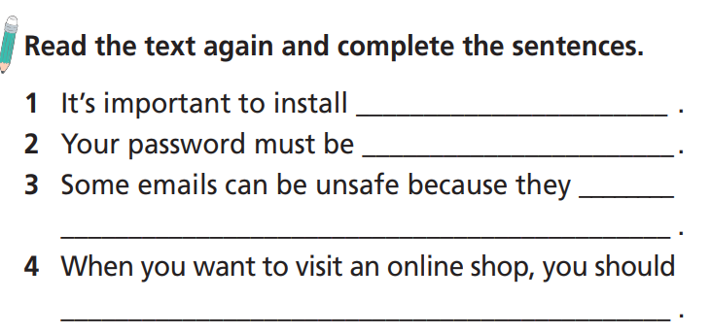
How many sentences are there?
There are four.
What are you going to do?
Read the text again and complete the sentences.

Slide 16
2 Read the text again and complete the sentences.
1. It’s important to install __________________.
2. Your password must be _________________.
3. Some emails can be unsafe because they ________________.
4 When you want to visit an online shop, you should
___________________________________________________.
anti-virus software
strong
could contain viruses
visit shops with a padlock icon and type in the address yourself

Slide 17
2 Read the text again and complete the sentences.
Device advice
Make sure your device has anti-virus software and keep it up to date. Use your anti-virus software to scan your device regularly.
Stranger danger
Never open emails from unknown people online. They could contain viruses. Also, never give out your personal information online (e.g. your real name and address).
(1)
(3)

Slide 18
2 Read the text again and complete the sentences.
Signing in and signing out
For your email account, you need to choose a username and password. Make sure you have a strong password and keep it secret! Always make sure you sign out when you use a public computer.
Shopping online
Only shop at Internet shops with a padlock icon beside the web address. This means that the site is safe.
To be extra safe, don’t click on links to online shops. Instead, type in the address yourself. Then, you can know it’s not a scam site.
(2)
(4)

Slide 19
What are you going to do?
List Dos and Don’ts and then tell the class.

Slide 20
(Red for Dos and Purple for Don’ts)
Device advice
Make sure your device has anti-virus software and keep it up to date. Use your anti-virus software to scan your device regularly.
Stranger danger
Never open emails from unknown people online. They could contain viruses. Also, never give out your personal information online (e.g. your real name and address).

Slide 21
Signing in and signing out
For your email account, you need to choose a username and password. Make sure you have a strong password and keep it secret! Always make sure you sign out when you use a public computer.
Shopping online
Only shop at Internet shops with a padlock icon beside the web address. This means that the site is safe.
To be extra safe, don’t click on links to online shops. Instead, type in the address yourself. Then, you can know it’s not a scam site.

Slide 22
Answer key
Dos
• install anti-virus software on your devices
• keep your anti-virus software up to date
• use your anti-virus software to scan your devices regularly
• choose a strong password and keep it secret
• sign out when you use a public computer
• shop at online shops with a padlock icon
• type in the address for online shops yourself
Don’ts
• open emails from unknown people
• give out your personal information
• click on links to online shops

Slide 23

Post-reading
What did you know about Internet safety? What did you learn from the text? How can these tips help you? Write a few sentences in your notebook. Tell your partner.

Slide 24
Suggested answer key
I knew it’s important to have anti-virus software and to use it regularly to scan my computer. I knew I mustn’t open emails from unknown people and keep personal information private. I also knew I need to have a strong password and to sign out when I use a public computer. I didn’t know about the padlock icon on Internet shops or about clicking on links rather than going to the website directly. I will remember this and use it to stay safe from scam sites in the future.

Slide 25

CONSOLIDATION

Slide 26

Work in pairs.
Ask and answer about how to be safe when using Internet.

Slide 27
STUDENT A
STUDENT B
What do you know about Internet safety?
It’s important to have anti-virus software.
What else?
I mustn’t open emails from unknown people.
I need to have a strong password and to sign out when I use a public computer.
That’s right. What’s more?
That’s good.
Thank you.

Slide 28

WRAP-UP

Slide 29
Today’s lesson
Vocabularies
anti-virus software
padlock
scam site
up to date
Reading: for specific information.

Slide 30
Homework
Practise the vocabularies and structure and make sentences using them.
Prepare the next lesson (page 75 SB)

Slide 31

Have a nice day!

