Slide 2
Unit 2
A multicultural world
LESSON 6
WRITING
An opinion essay on the impacts of world festivals on young Vietnamese people

Slide 3
LESSON 6
WRITING
WARM-UP
Hot seat
PRE-WRITING
- Task 1: Decide the given points are positive or negative.
WHILE-WRITING
- Task 2: Write an opinion essay.
POST-WRITING
Peer review
CONSOLIDATION
- Wrap-up
- Homework

Slide 4
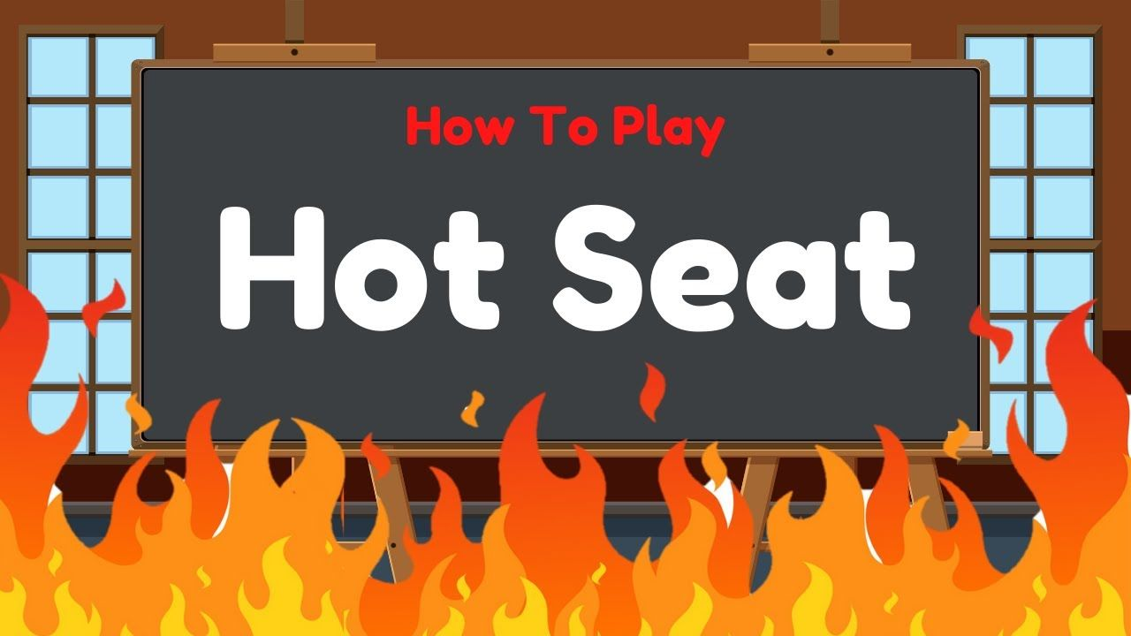
WARM-UP
HOT SEAT

Slide 5
WARM-UP
HOT SEAT
- Work as four teams.
- One student sits on the table and describes the given word using actions and related words
- The teams raise hands to answer.
- The fastest gets the chance
- If the answer is correct ➔ one point for their team.
- If the answer is incorrect ➔ the others get the chance.
- The team with higher score is the winner.

Slide 6
WARM-UP
trick or treat
spring rolls
trend
haunted house
globalisation

Slide 7

PRE-WRITING
1
Work in pairs. Decide whether the following points are positive or negative impacts of celebrating world festivals. Discuss the reasons.
World festivals ... | Positive | Negative
1. encourage people to buy things they don’t need.
2. encourage extracurricular activities.
3. may make people lose their sense of identity.
4. bring a lot of fun, happiness, and joy.
5. may make young people ignore local festivals.
6. help young people learn about other cultures.

Slide 8
PRE-WRITING
Discuss the reasons.
Example:
A: | I think world festivals are expensive to celebrate, which is a negative impact.
B: | I agree with you. Most students don’t have a lot of money, and shouldn’t waste their pocket money on things they don't often use like Halloween costumes or Christmas decorations.

Slide 9
WHILE-WRITING
2
Write an opinion essay (180 words) on the following topic. Use the ideas in 1 and the outline and suggestions below to help you.
Nowadays, more and more young Vietnamese people celebrate festivals such as Christmas and Halloween. Some people think there is nothing wrong with this while others are worried about the influence of foreign cultures. What is your opinion?
Introduction
Nowadays, more and more young people ... In my opinion, this has positive/negative impacts on young Vietnamese people.
Body
Firstly, ... Secondly, ... Finally, ...
Conclusion
In conclusion, I firmly believe that ...

Slide 10
WHILE-WRITING
Suggested answer:
Nowadays, more and more young people celebrate Western festivals in Viet Nam. Some people think there is nothing wrong with this while others are worried about the influence of foreign cultures. In my opinion, celebrating Western festivals has more positive than negative effects on young Vietnamese.
Firstly, festivals are a great way to understand a nation’s culture. Taking part in celebrations can help young people learn more about other people’s traditions and customs. For example, Christmas is a typical holiday in Western countries so when joining the festivities, young people can learn about its origin and history, the tradition of decorating one’s home and getting presents for family and close friends, and puting them under the Christmas tree.

Slide 11
WHILE-WRITING
Secondly, festivals are special events that help bring fun, happiness and joy to young people’s lives. They give an opportunity for young people to relax and spend enjoyable time with their friends and family. They can enjoy the festive spirit by watching performances, dressing up and eating festive food.
Finally, it cannot be denied that Western festivals also encourage extra-curricular activities at schools. Organising special events every year, such as Halloween parties or Christmas fairs, encourages students to discover interesting things about the festivals, socialise with friends from other cultures or create their own performances.
In conclusion, I firmly believe that celebrating Western festivals in Viet Nam does more good than harm to young people. They can have fun, broaden their cultural knowledge and enjoy their school life more.

Slide 12
CONSOLIDATION
1
Wrap-up
What have you learnt today?
Synthesise and summarise information in order to write an opinion essay.

Slide 13
CONSOLIDATION
2
Homework
Rewrite the paragraph in the notebook.
Do exercises in the workbook.
Prepare for Lesson 7 – Communication & Culture.

Slide 14
Website: hoclieu.vn
Fanpage: facebook.com/www.tienganhglobalsuccess.vn

