Slide 2
Unit 8:
Sports and games
Lesson 4: Communication

Slide 3
Unit
8
SPORTS AND GAMES
1
EVERYDAY ENGLISH
Expressing and responding to congratulations

Slide 4


LESSON 4: COMMUNICATION
LESSON 1: GETTING STARTED
WARM-UP
Lucky numbers
Expressing and responding to congratulations
Task 1: Listen and read the conversation
Task 2: Role play
EVERYDAY ENGLISH
Task 3: Work in pairs. Do the quiz
Task 4: Work in groups. Interview your partners using the following questions
THE SPORT / GAME YOU LIKE
CONSOLIDATION
Wrap-up
Homework

Slide 5

WARM-UP
LUCKY NUMBERS
1
2
3
4
5
6
7
END GAME

Slide 6

WARM-UP
Lucky numbers
You have 2 points
GO BACK

Slide 7
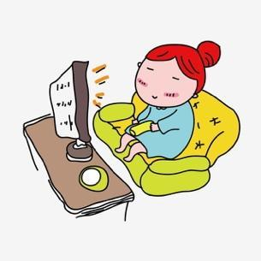
WARM-UP
Lucky numbers
Question 2:
Complete the following imperative:
Don’t
…………. watch TV more than 3 hours a day. It’s bad for your eyes.
GO BACK

Slide 8
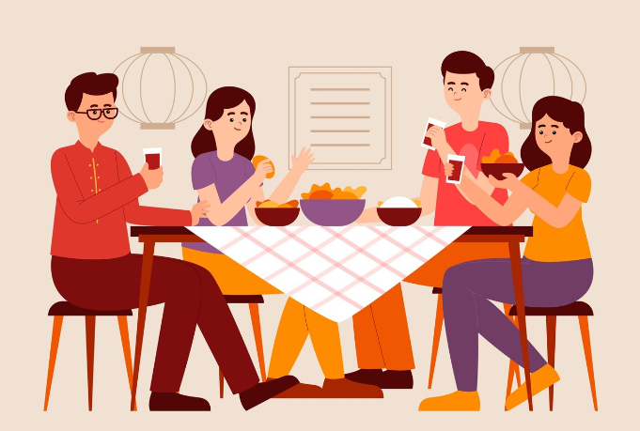
WARM-UP
Lucky numbers
Question 3:
Complete the question:
Did
……….. you have dinner with your parents yesterday?
GO BACK

Slide 9
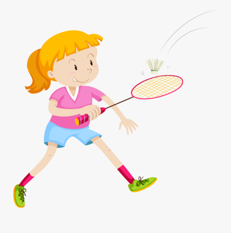
WARM-UP
Lucky numbers
Question 4:
Look at the picture and complete the sentence
played
badminton
Jane ………… ………………… with her brother last weekend.
GO BACK

Slide 10
WARM-UP
Lucky numbers
You have 2 points
GO BACK

Slide 11
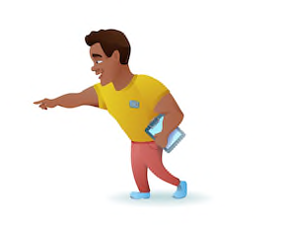
WARM-UP
Lucky numbers
Question 6:
Look at the picture and complete the sentence.
Listen
……..…. to the instructor at the gym.
GO BACK

Slide 12

WARM-UP
Lucky numbers
Question 7:
Translate the following sentence into English:
“Tôi chiến thắng cuộc thi đánh vần Thứ Hai tuần trước.”
→ I won the spelling contest last Monday.
GO BACK

Slide 13

EVERYDAY ENGLISH
1
Listen and read the short conversation below, paying attention to the highlighted parts.
Duong: Last week I played table tennis with Duy, and I won for the first time.
Mai: Congratulations!
Duong: Thank you, Mai.
Mai: So you're our class champion now.
Expressing and responding to congratulations!

Slide 14
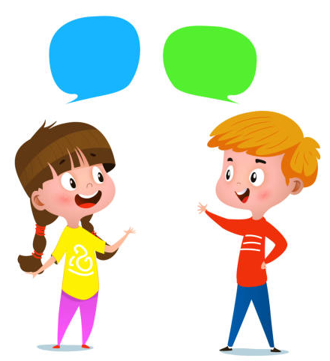
EVERYDAY ENGLISH
2
Work in pairs. Make a similar dialogue.
Student A has won a prize in the school's singing
contest / sports competition.
Student B congratulates him / her.
A: Last week I …
B: Congratulations!
A: Thank you.

Slide 15
Unit
8
SPORTS AND GAMES
1
THE SPORT / GAME YOU LIKE

Slide 16
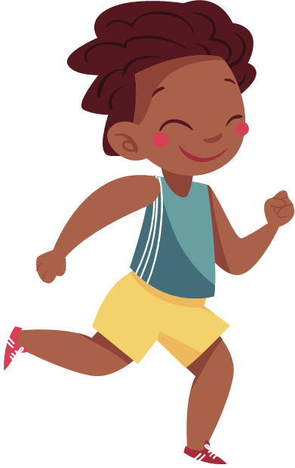
THE SPORT / GAME YOU LIKE
3
Work in pairs. Do the quiz.
1. How many players are there in a football match?
2. How long does a football match last?
3. How often do the Olympic Games take place?
There are usually 22 players.
It normally lasts 90 minutes. (2 halves)
They are held every four year.

Slide 17
THE SPORT / GAME YOU LIKE
3
Work in pairs. Do the quiz.
4. How long is a marathon?
5. Where did the first Olympic Games take place?
A marathon is 42.195 kilometres long.
They were held in Olympia
(in Ancient Greece in 776 BC)

Slide 18
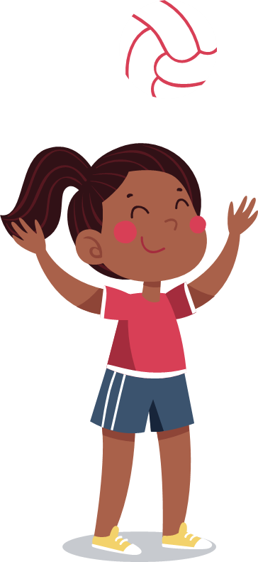
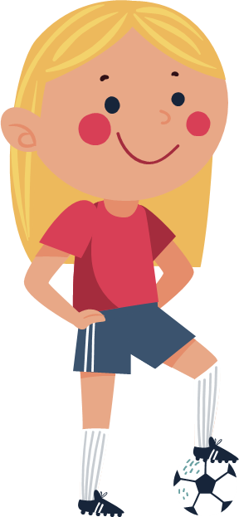
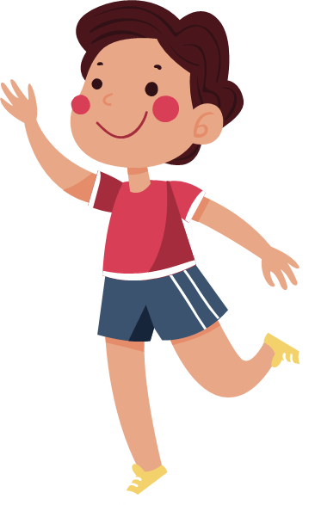
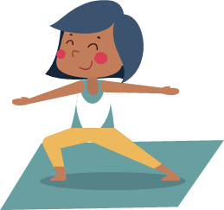
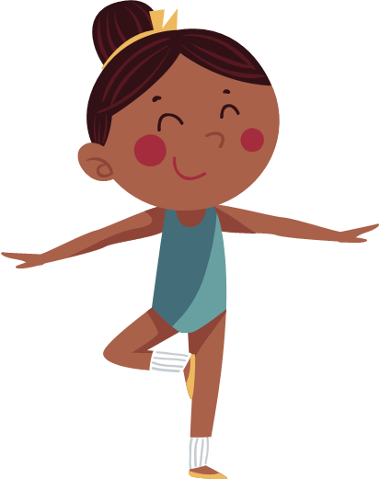
THE SPORT / GAME YOU LIKE
4
Work in groups. Interview your partners using the following questions. You may ask for more information.
1. What sports / games do you play in your free time? Do you play them well? When and how often do you play them?
2. Which sport / game do you like watching on TV?
3. Did you join any clubs?
4. If you don't play sport, what do you often do in your spare time?

Slide 19

CONSOLIDATION
1
Wrap-up
What have we learnt in this lesson?
Use the lexical items related to the topic Sports and games
Express and respond to congratulations
Talk about sports and games that they like

Slide 20

CONSOLIDATION
2
Homework
Write down the results and feedback of the previous interviews.
Prepare for the next lesson: Skills 1

Slide 21






Website: hoclieu.vn
Fanpage: facebook.com/www.tienganhglobalsuccess.vn/

