Slide 2
LESSON II
LANGUAGE
WARM-UP
Mini game
Task 1: Listen and repeat.
Task 2: Mark the intonation in these questions. Then listen and check.
PRONUNCIATION
Task 1: Find five words in the word search and write them next to the correct definition.
Task 2: Complete the sentences using the correct forms of the words.
VOCABULARY
GRAMMAR
Task 1: Connect these sentences, using linking words or phrases.
Task 2: Add more sentences to each item.
Wrap-up
Homework
CONSOLIDATION

Slide 3
WARM-UP
Students work in 4 groups.
You will hear and find the words/ phrases with raised voice in 3 sentences below.
Raise your hands to get turn and answer.

Slide 4
WARM-UP
Listen and find the words/ phrases with raised voice.
Thanks,
Andy.
That’s
really
helpful!

Slide 5
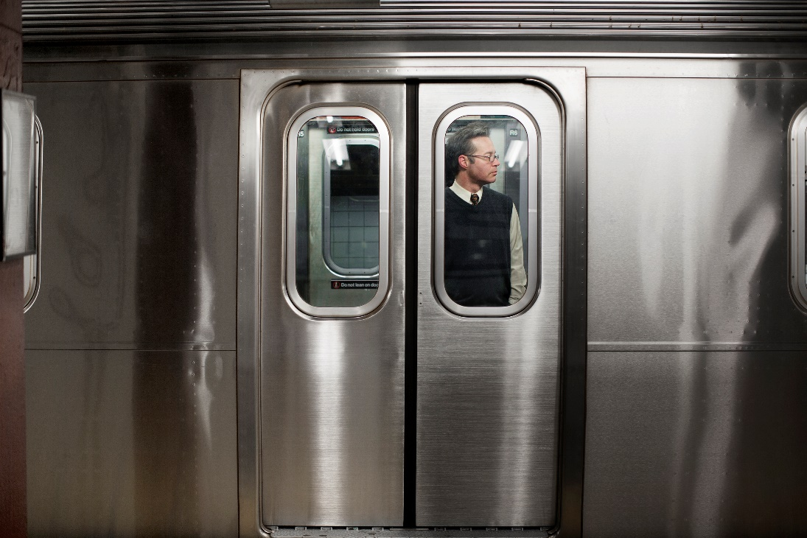
WARM-UP
Listen and find the words/ phrases with raised voice.
Our
train
leaves
in
ten
minutes.

Slide 6
WARM-UP
Listen and find the words/ phrases with raised voice.
You
and
your sister
always
argue
during
dinner.

Slide 7
6TH GRADE
INTONATION IN CHOICE QUESTIONS
LESSON II – LANGUAGE
Unit
9
SOCIAL ISSUES
FAMILY LIFE
Unit

Slide 8
PRONUNCIATION
1
Listen and repeat. Pay attention to the intonation. Practise saying the questions in pairs.

Slide 9
PRONUNCIATION

Slide 10
PRONUNCIATION
2
Mark the intonation in these questions.
Then listen and check. Practise saying them in pairs.
1. Is peer pressure good or bad?
2. Is this a social or environmental issue?
3. Should our campaign focus on crime, overpopulation, or climate change?
4. Do you talk to your parents, share problems with your friends, or ask your teachers for advice?
1. Is peer pressure good or bad?
2. Is this a social or environmental issue?
3. Should our campaign focus on crime, overpopulation, or climate change?
4. Do you talk to your parents, share problems with your friends, or ask your teachers for advice?
up
down

Slide 11
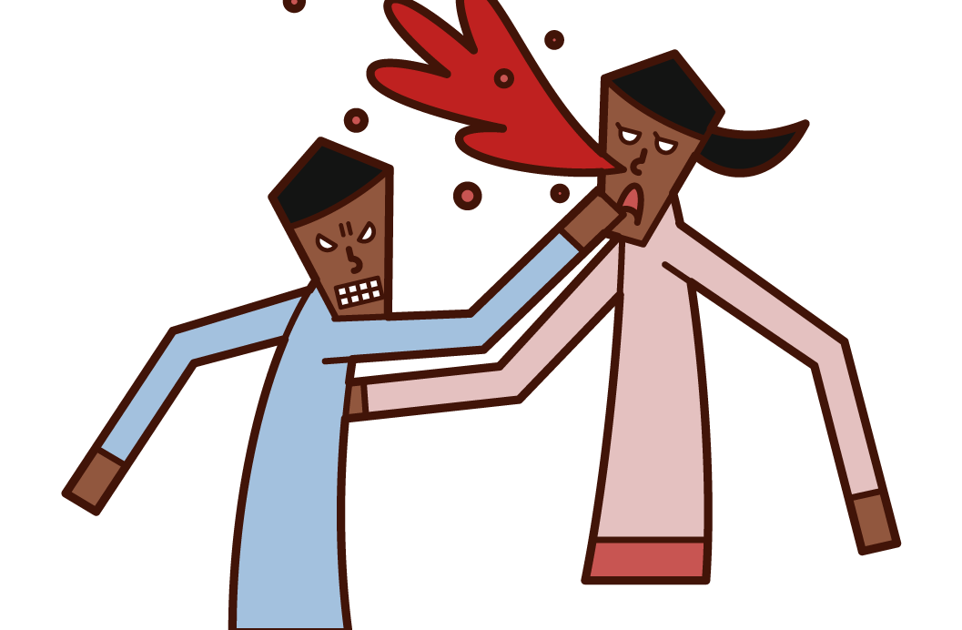
PRONUNCIATION
Violent (adj)
/ˈvaɪə.lənt/
using force to hurt or attack

Slide 12
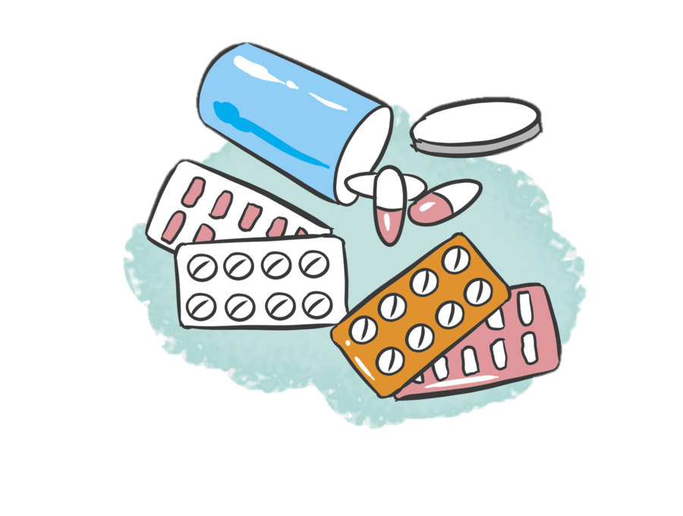
PRONUNCIATION
Drug (n)
/drʌɡ/
any natural or artificially made chemical that is used as a medicine

Slide 13
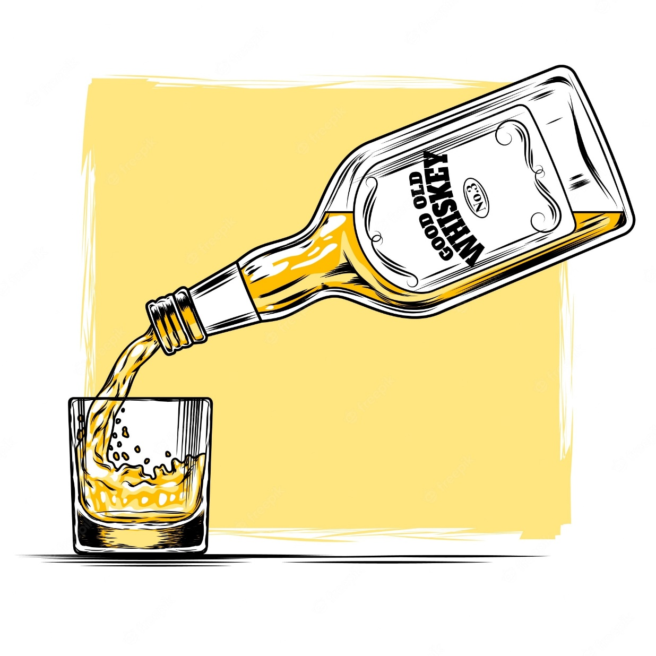
PRONUNCIATION
Alcohol (n)
/ˈæl.kə.hɒl/
a clear liquid that can make you drunk, also used as a solvent (= a substance that dissolves another) and in fuel and medicines

Slide 14
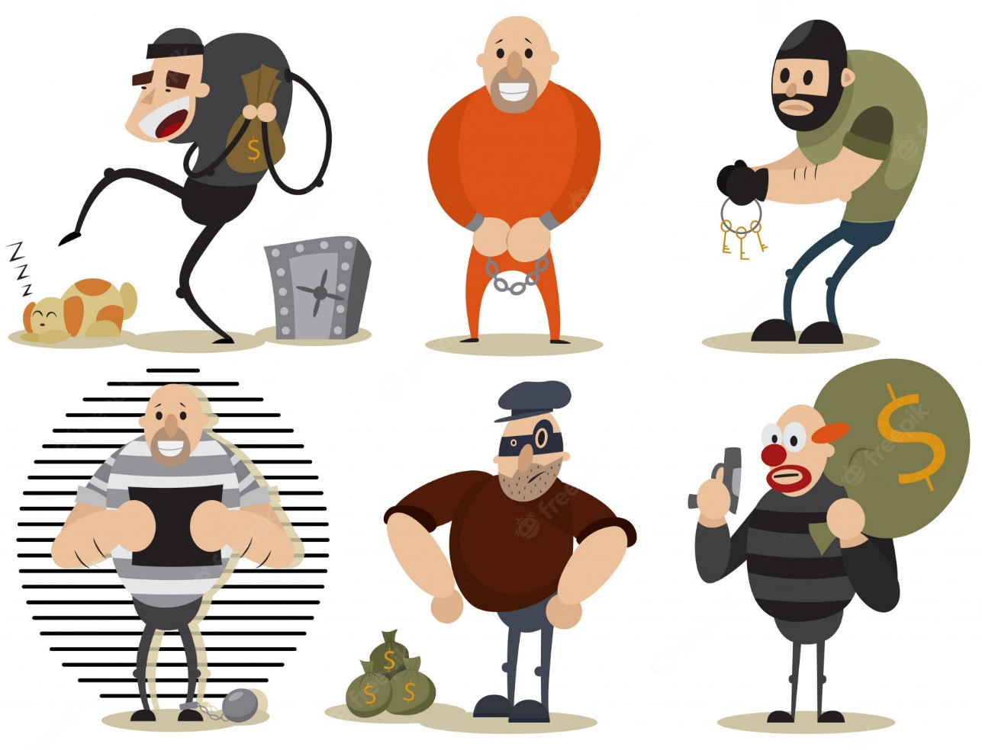
PRONUNCIATION
Crime (n)
/kraɪm/
an action or activity that is against the law, or illegal activity generally

Slide 15
PRONUNCIATION
Form | Pronunciation | Meaning
1. Violent (adj) | /ˈvaɪə.lənt/ | using force to hurt or attack
2. Drug (n) | /drʌɡ/ | any natural or artificially made chemical that is used as a medicine
3. Alcohol (n) | /ˈæl.kə.hɒl/ | a clear liquid that can make you drunk, also used as a solvent (= a substance that dissolves another) and in fuel and medicines
4. Crime (n) | /kraɪm/ | an action or activity that is against the law, or illegal activity generally

Slide 16
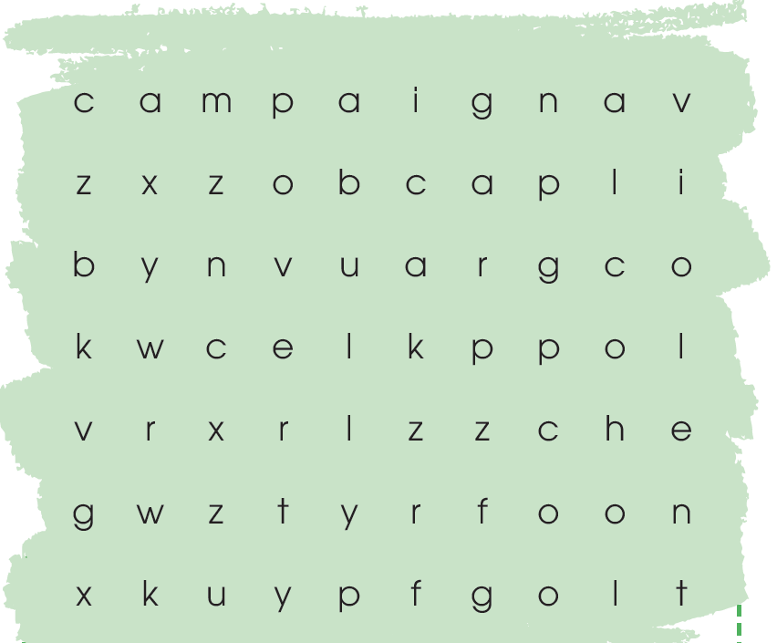
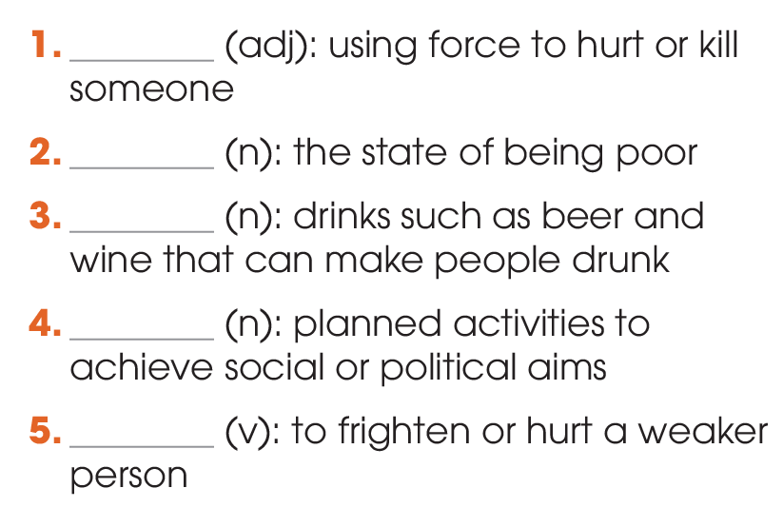
VOCABULARY
1
Find five words in the word search and write them next to the correct definition. Use the glossary (page 130) to help you.
violent
poverty
alcohol
campaign
bully

Slide 17
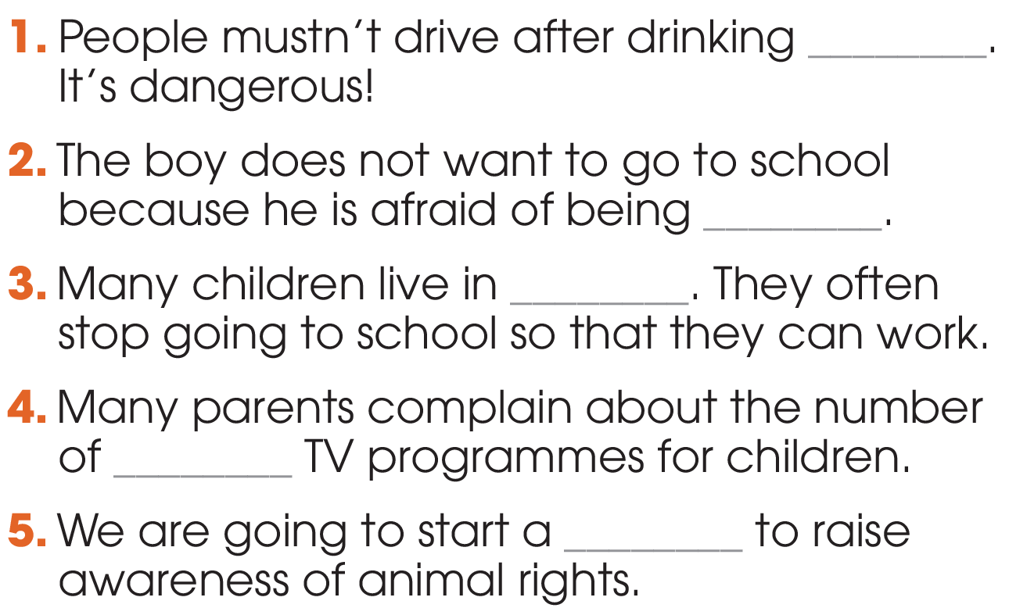
VOCABULARY
2
Complete the sentences using the correct forms of the words in 1.
alcohol
bullied
drugs
violent
campaign

Slide 18
GRAMMAR

Slide 19
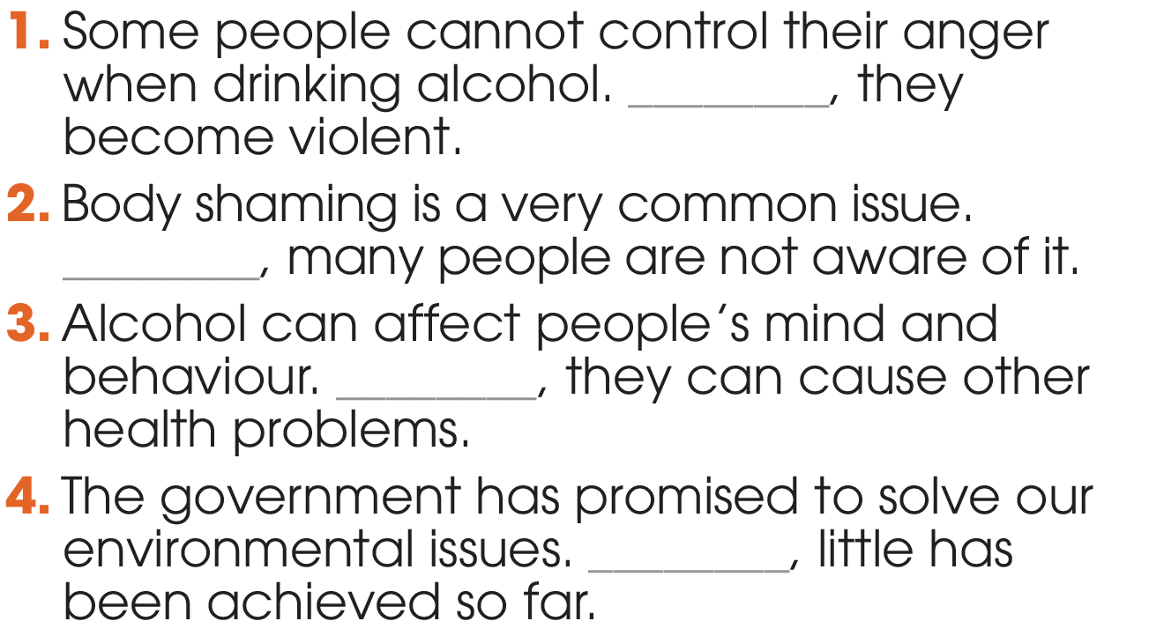
GRAMMAR
1
Connect these sentences, using linking words or phrases.
Therefore
But
Moreover
However

Slide 20
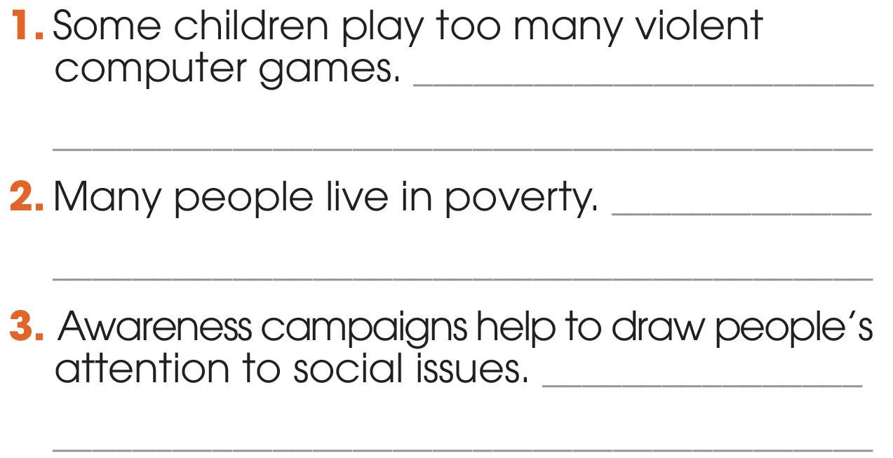
GRAMMAR
2
Work in pairs. Add more sentences to each item. Use different linking words and/or phrases.
As a result/ As a consequence/ Therefore
However
Moreover / In addition/ Besides

Slide 21
1. WRAP-UP
CONSOLIDATION
What have you learnt today?
Use linking words and phrases correctly.
Intonation in Choice question.

Slide 22
2. HOMEWORK
CONSOLIDATION
Do exercises in the workbook.
Prepare for Lesson 3 - Unit 9.

Slide 23
Website: hoclieu.vn
Fanpage: facebook.com/sachmem.vn/

