Slide 1

Unit 8: Festivals around the World
Lesson 3.1: Listening & Reading
Page 66

Slide 2



LESSSON OUTLINE
Consolidation
Wrap-up

Slide 3

By the end of this lesson, students will be able to…
enrich their vocabulary and talk about some festivals around Vietnam.
improve their Listening and Reading skills.

Slide 4

WARM-UP

Slide 5
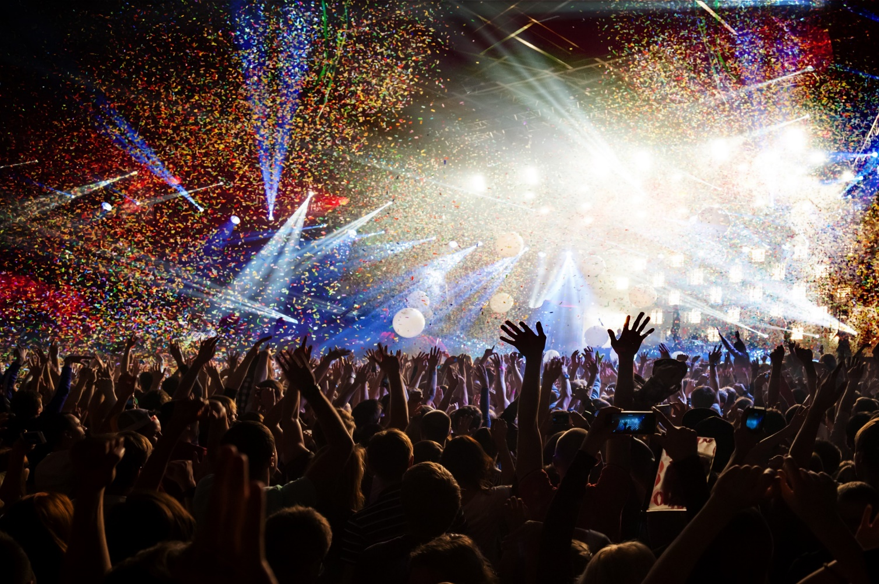
What kind of festival is it?
music festival

Slide 6

What kind of festival is it?
film festival

Slide 7
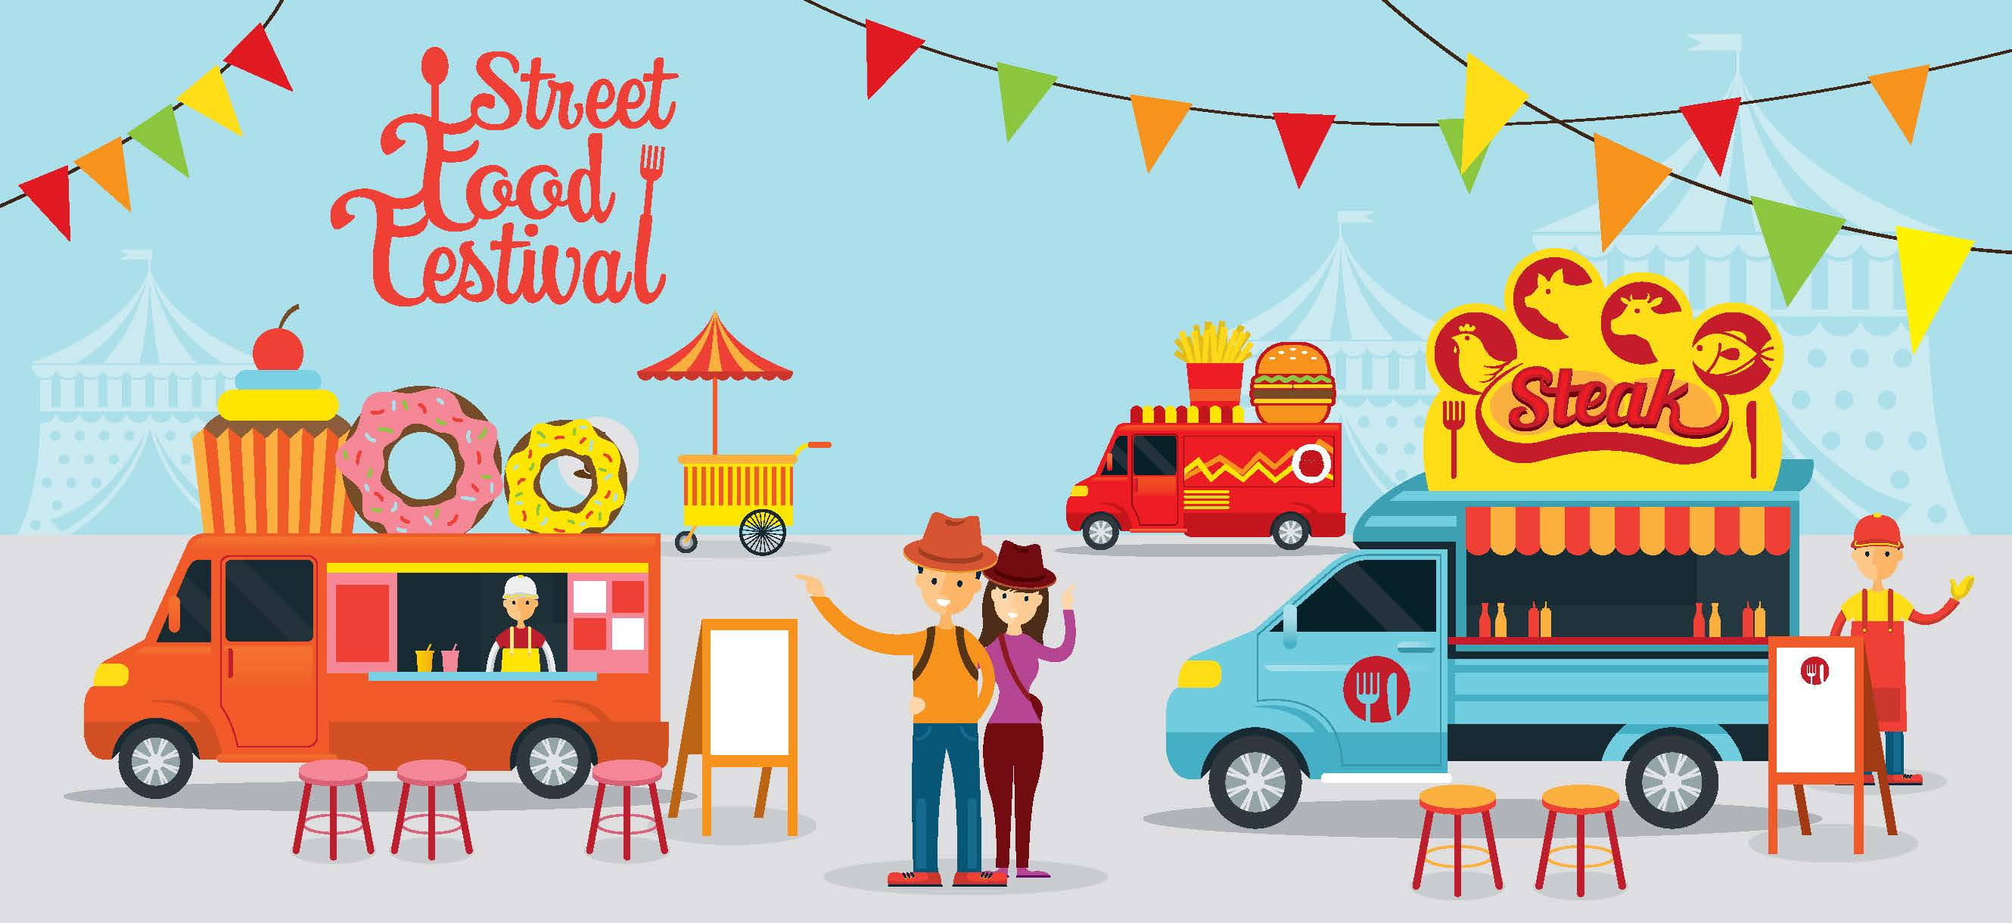
What kind of festival is it?
street food festival

Slide 8

What kind of festival is it?
book festival

Slide 9
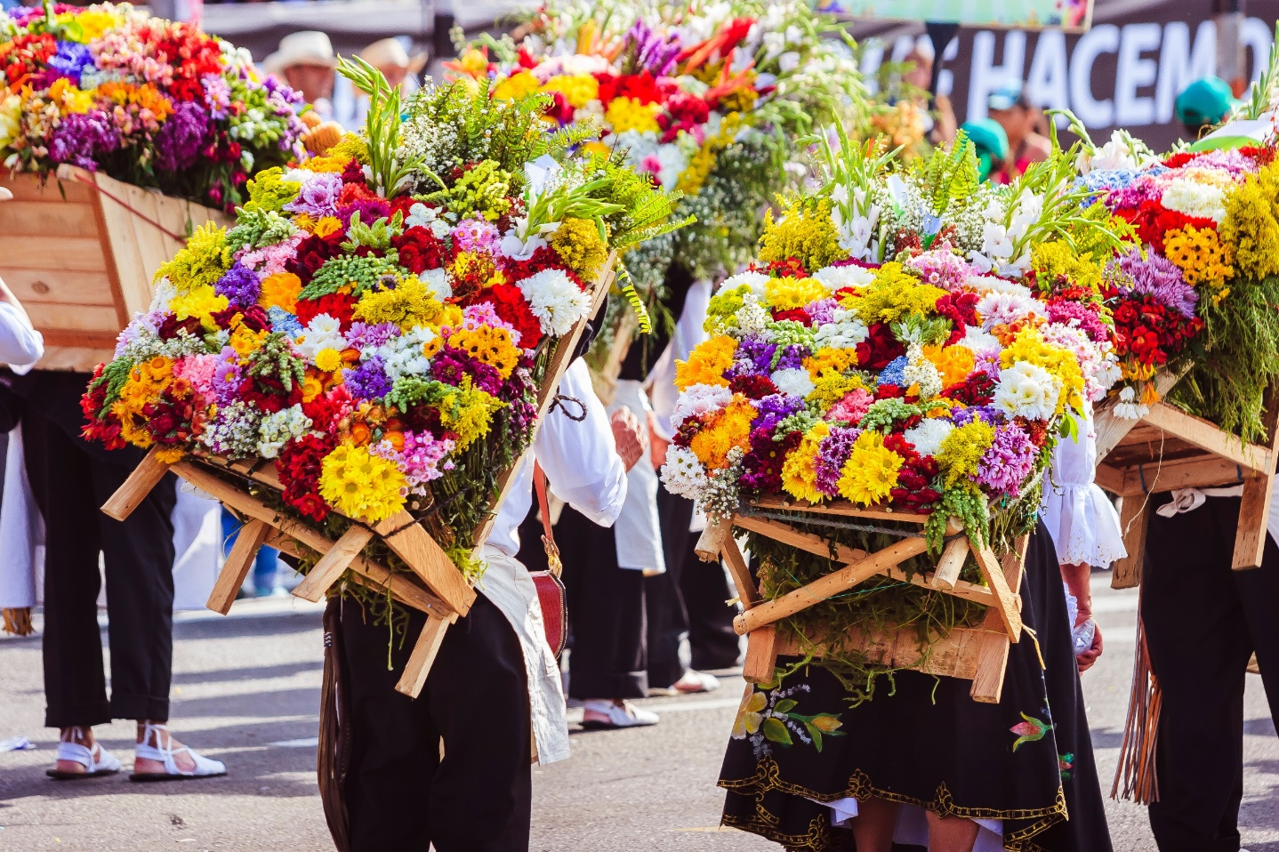
What kind of festival is it?
flower festival

Slide 10
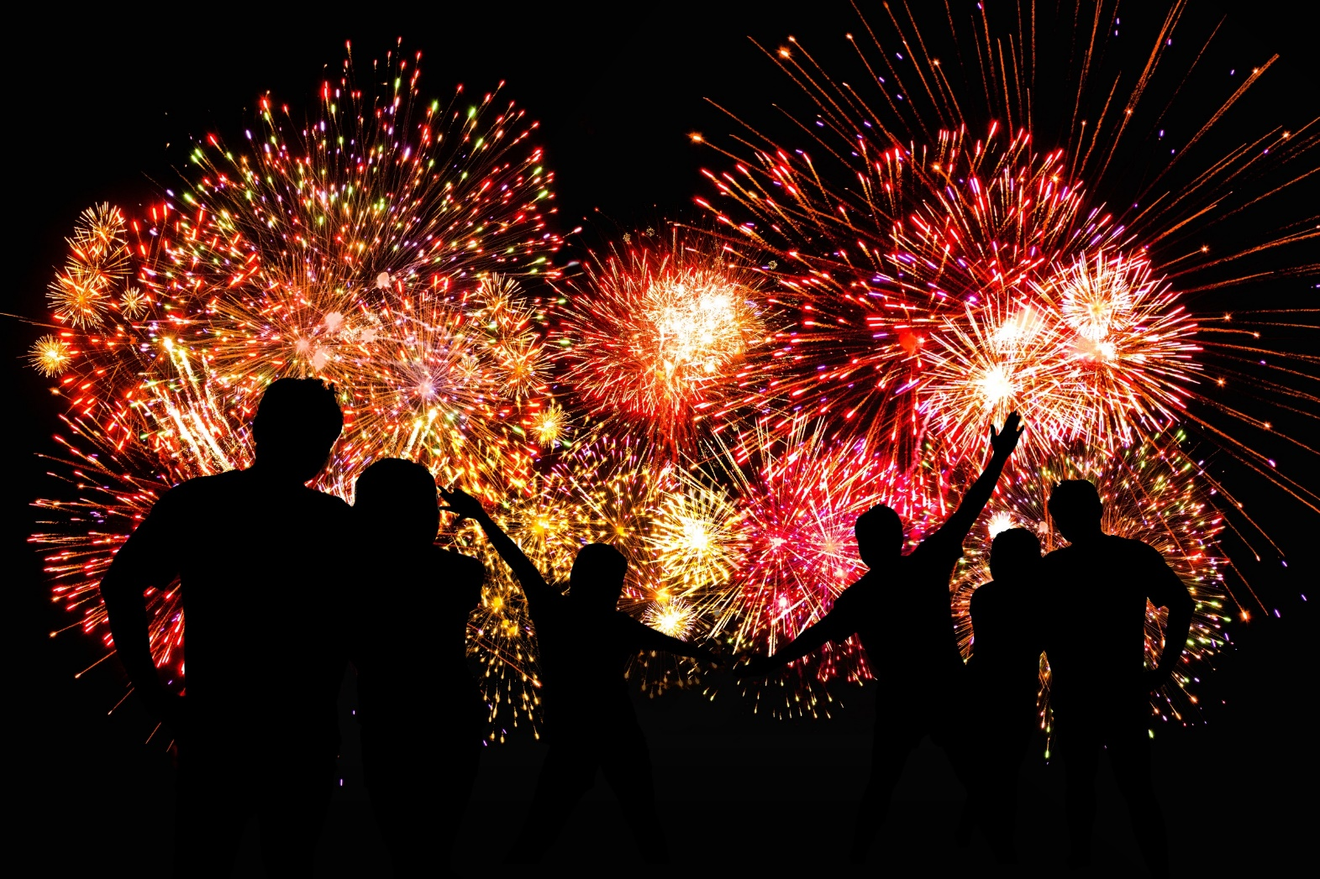
What kind of festival is it?
fireworks festival

Slide 11

What kind of festival is it?
coffee festival

Slide 12
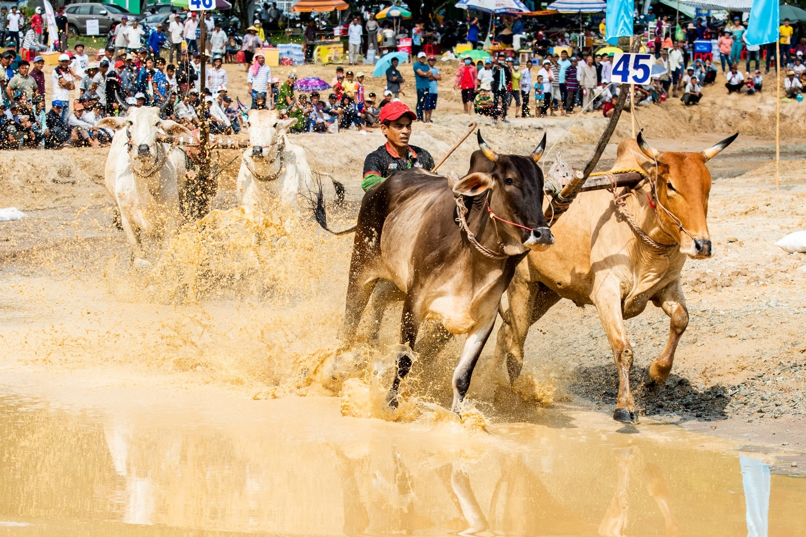
What kind of festival is it?
bull racing festival

Slide 13
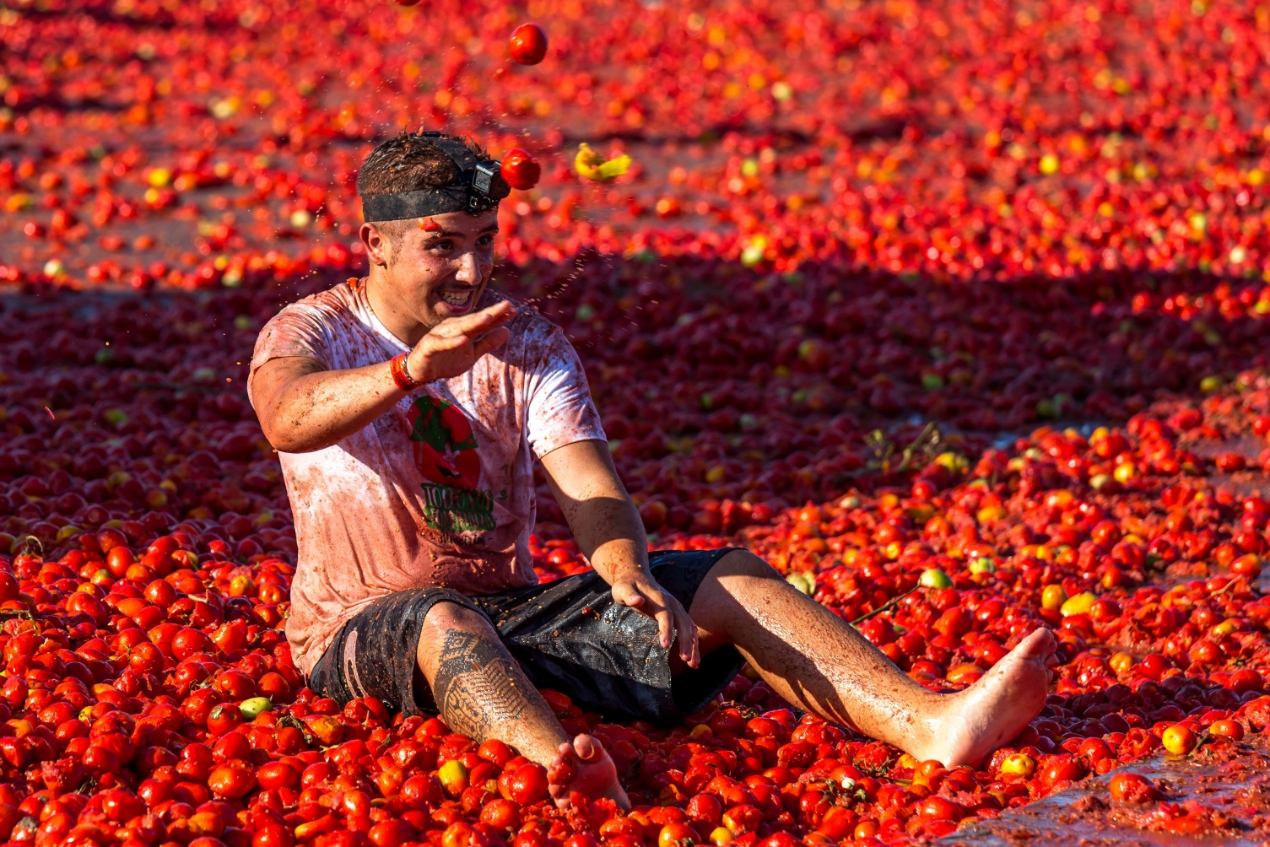
What kind of festival is it?
tomato festival

Slide 14

What kind of festival is it?
beer festival

Slide 15
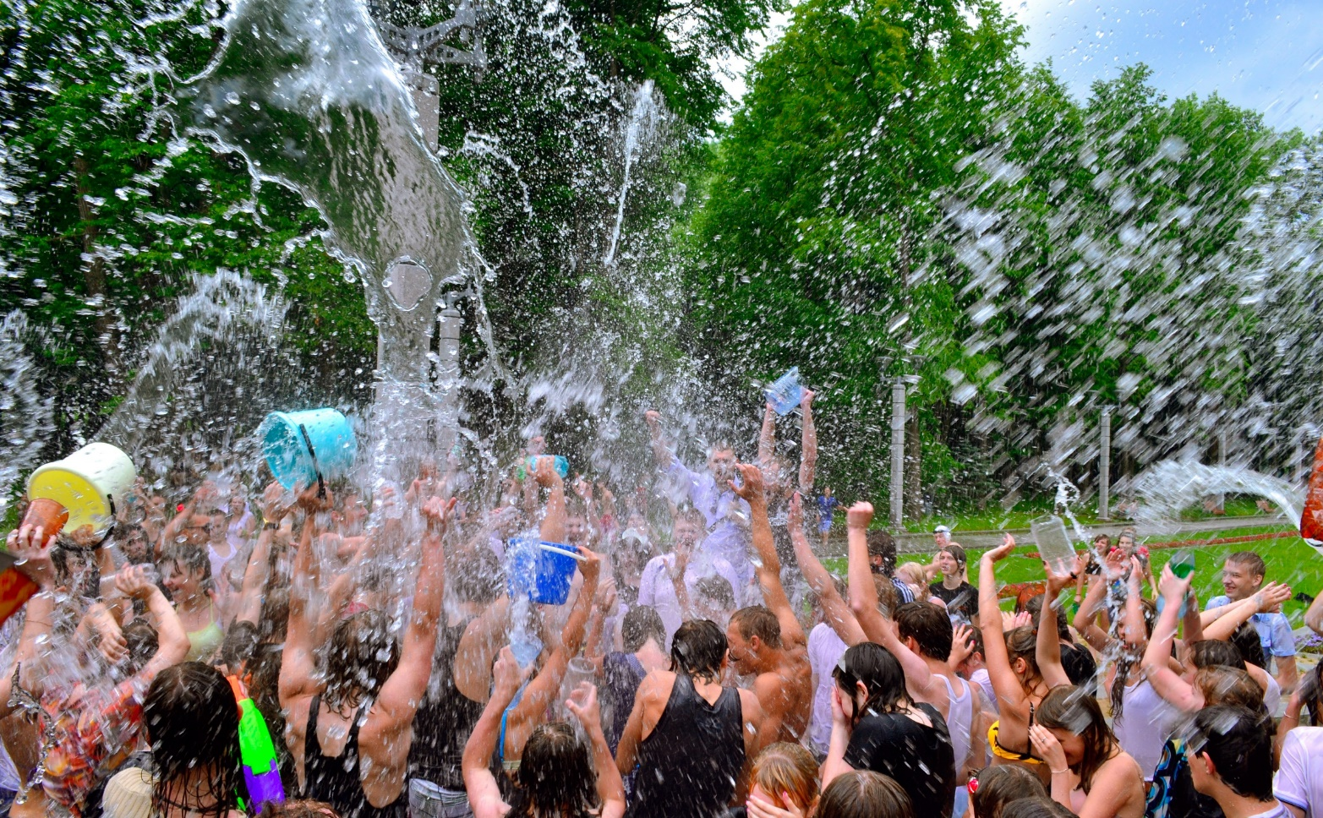
What kind of festival is it?
water festival

Slide 16
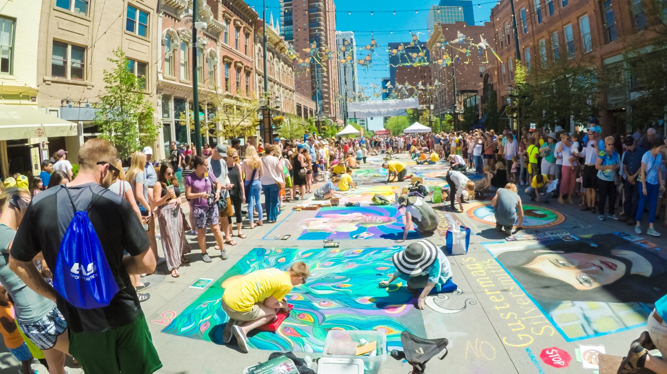
What kind of festival is it?
art festival

Slide 17
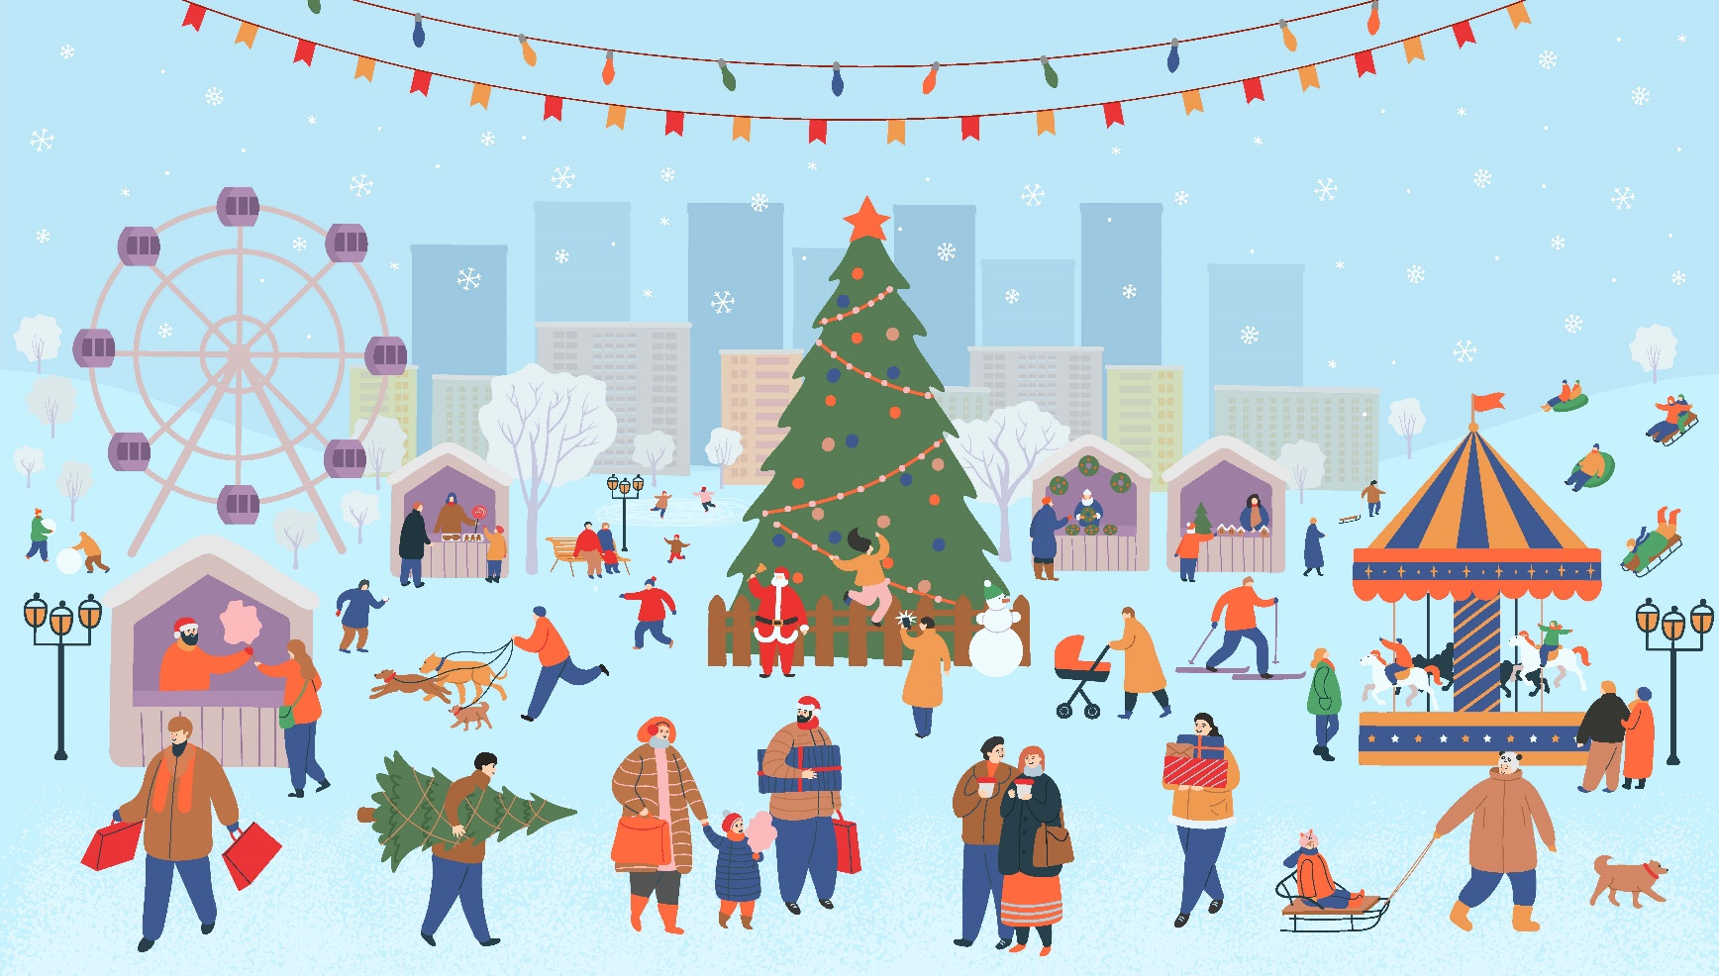
What kind of festival is it?
winter festival

Slide 18

LISTENING

Slide 19
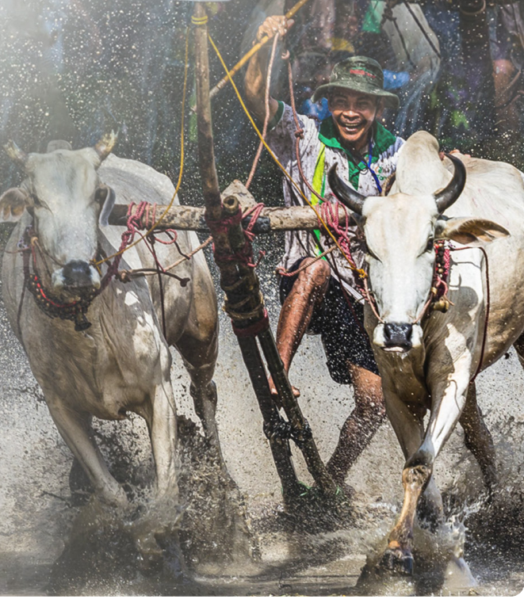
Pre-listening

Slide 20
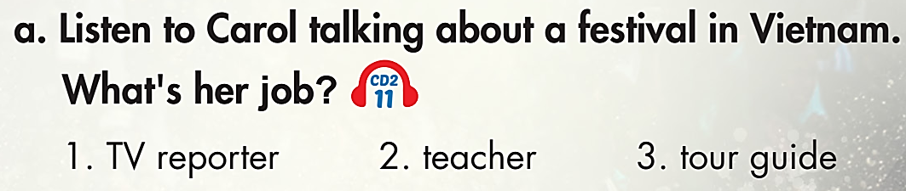

Task a
While-listening
Read the instruction quickly and underline the key words.
Click on the icon to hear the sound

Slide 21
Task b
Read the questions quickly:
Underline the key words.
What are we going to do?
Listen and answer the questions.
While-reading
Click on the icon to hear the sound
1. Where is this festival? ___________________________________
2. What is the most exciting part of the festival? ________________
3. Where do they race? ____________________________________
4. How many people watched the bull racing in 2019? ___________
In An Giang province, Vietnam.
The bull race.
In a field.
Over 30,000.

Slide 22
Now listen again and fill in the blanks.
Click on the icon to hear the sound
Post-listening
Tom: Welcome back to Crazy Culture! Our next story is from Vietnam.
Carol: Thanks, Tom. Visiting Vietnam this October? Don’t 1.___________ the Sene Dolta festival in An Giang Province. It's an important Khmer festival and lasts three days. On Sene Dolta, people go to a 2.___________ and pray.
They also enjoy traditional singing and dancing.
The most exciting part of Sene Dolta is the bull race. People from all over come
to watch this 3.___________ event. Bull racing is different from horse racing. Each rider has two bulls and they race around a field full of water and mud. It’s very 4.___________, but lots of fun! People believe that the winning 5.___________ will bring a good harvest with lots of food for their village. In 2019, over thirty thousand people watched the races. Come take part in Sene Dolta this year!
miss
temple
amazing
messy
bulls

Slide 23
Listen and practice with your partner.
Click on the icon to hear the sound
Post-listening
The most exciting part of Sene Dolta is
the bull race. People from all over come
to watch this amazing event. Bull racing
is different from horse racing. Each rider
has two bulls and they race around a
field full of water and mud. It’s very
messy, but lots of fun! People believe
that the winning bulls will bring a good
harvest with lots of food for their village.
In 2019, over thirty thousand people
watched the races. Come take part in
Sene Dolta this year!
Tom: Welcome back to Crazy
Culture! Our next story is from
Vietnam.
Carol: Thanks, Tom. Visiting Vietnam
this October? Don't miss the Sene
Dolta festival in An Giang Province.
It's an important Khmer festival and
lasts three days. On Sene Dolta,
people go to a temple and pray.
They also enjoy traditional singing
and dancing.

Slide 24
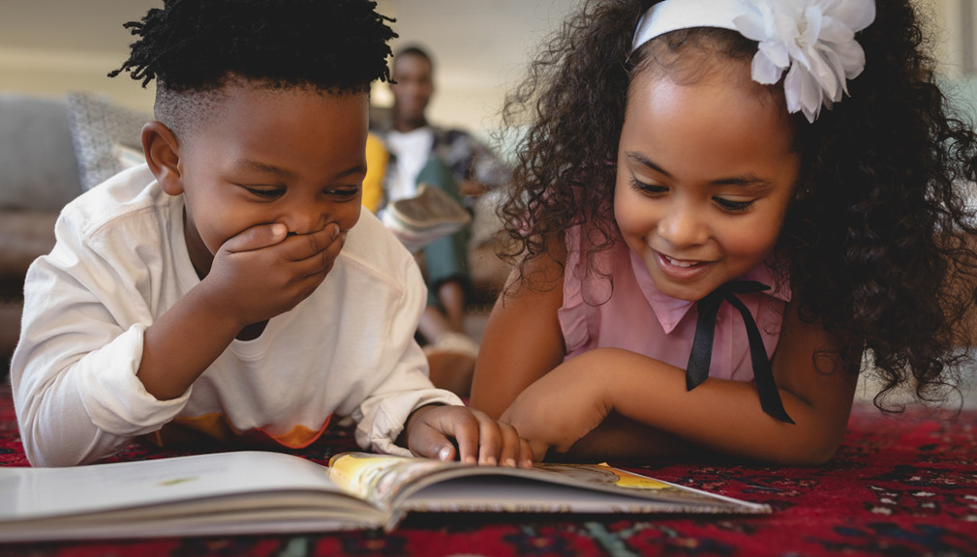
READING

Slide 25
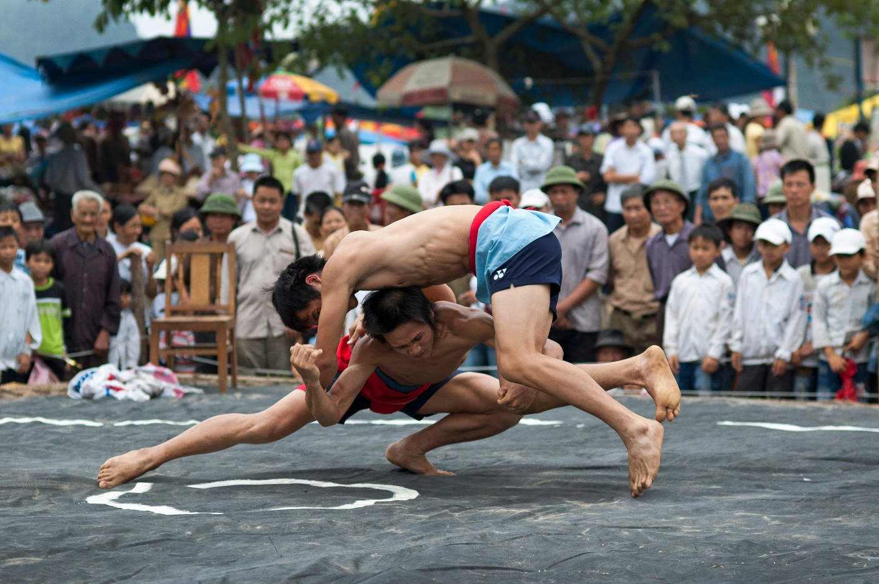
Pre-reading
What kind of festival is it?
wrestling festival

Slide 26
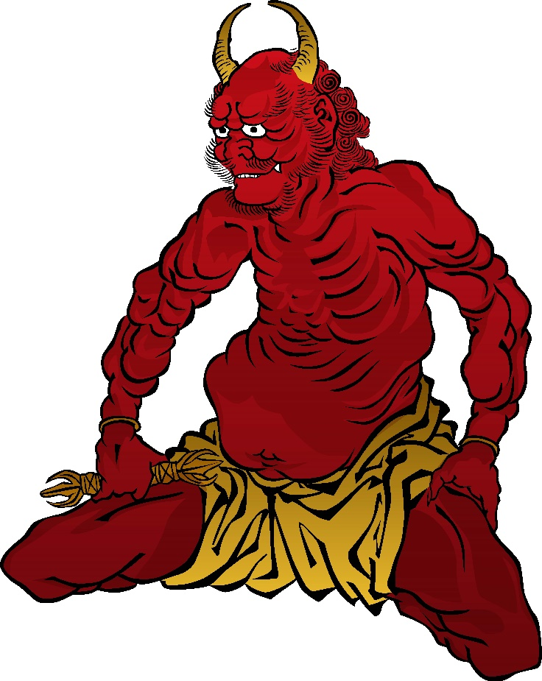
What can you see?
demon

Slide 27
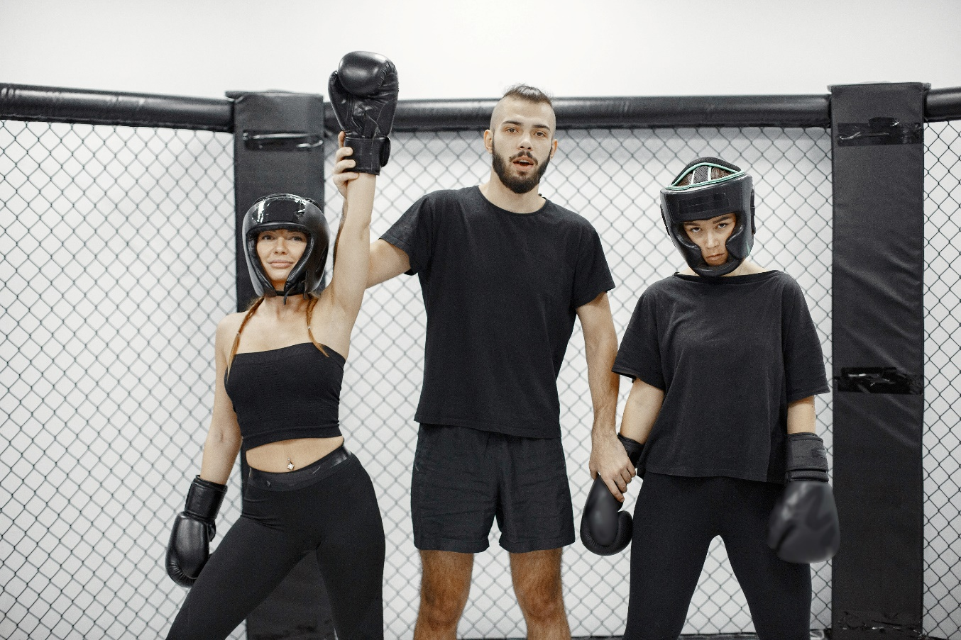
What can you say about the picture?
victory # defeat

Slide 28
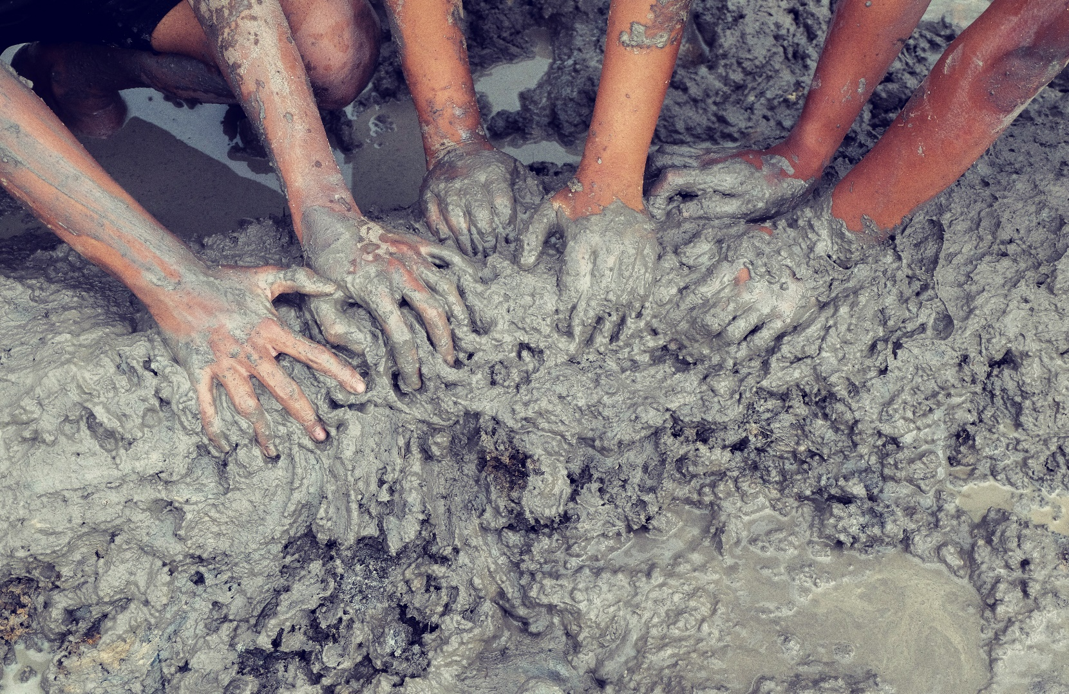
What are the children playing with?
mud

Slide 29
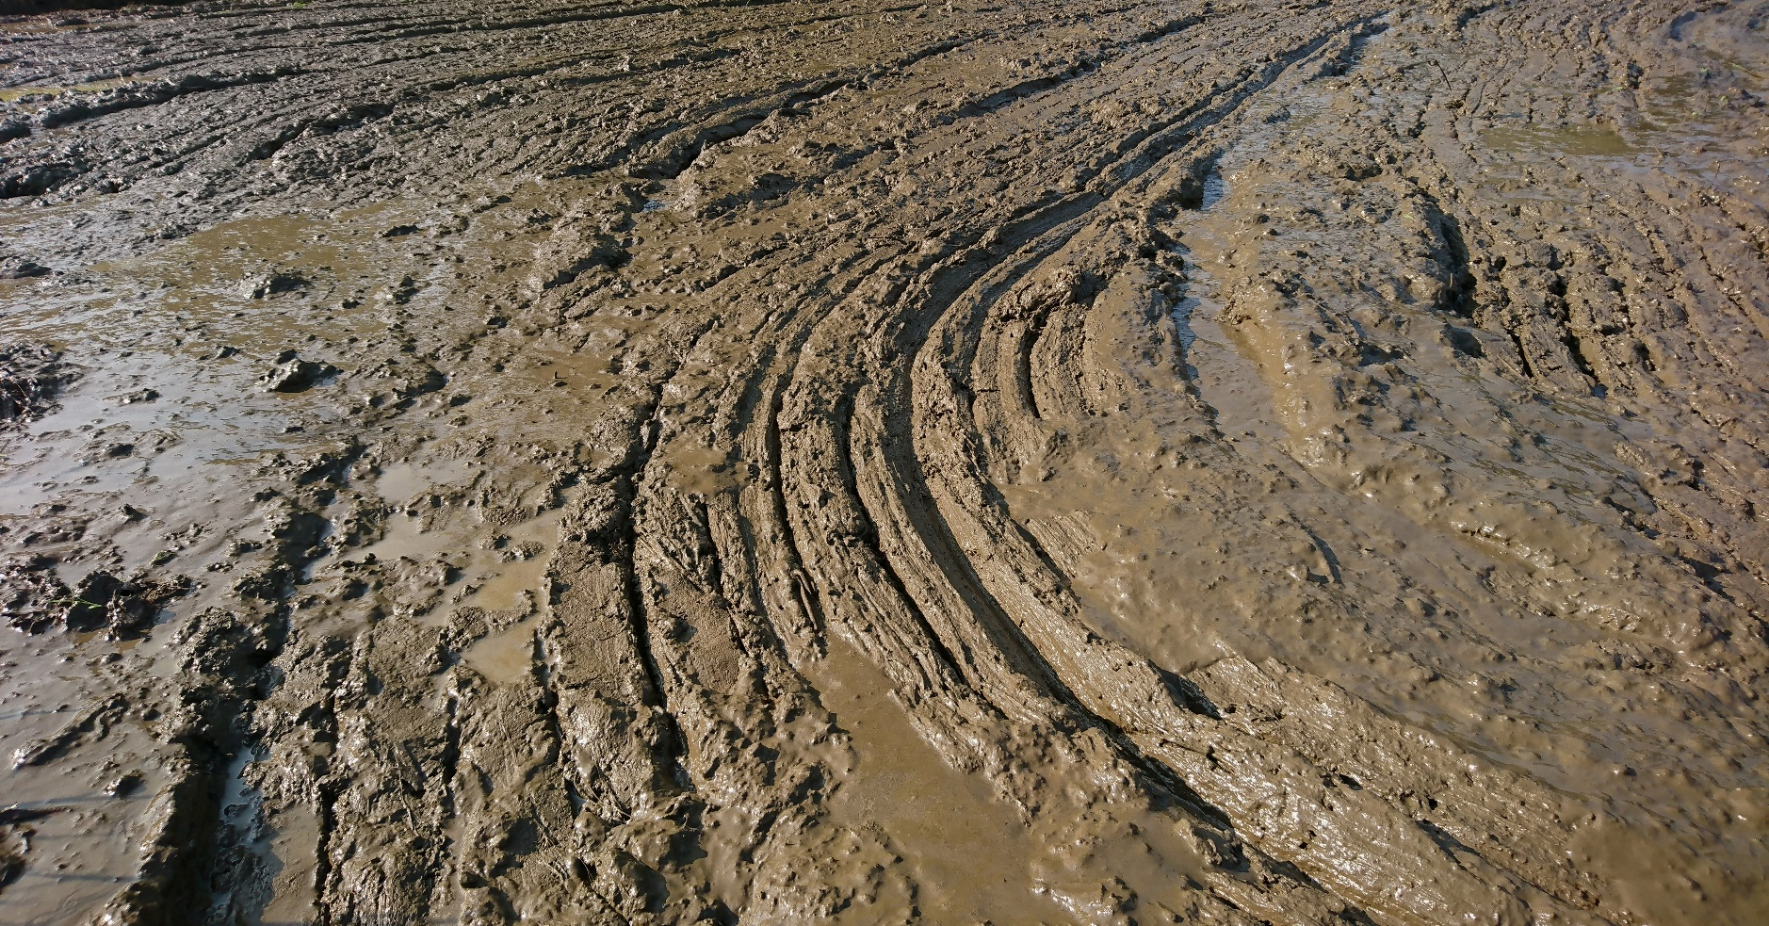
What can you say about the field?
muddy

Slide 30
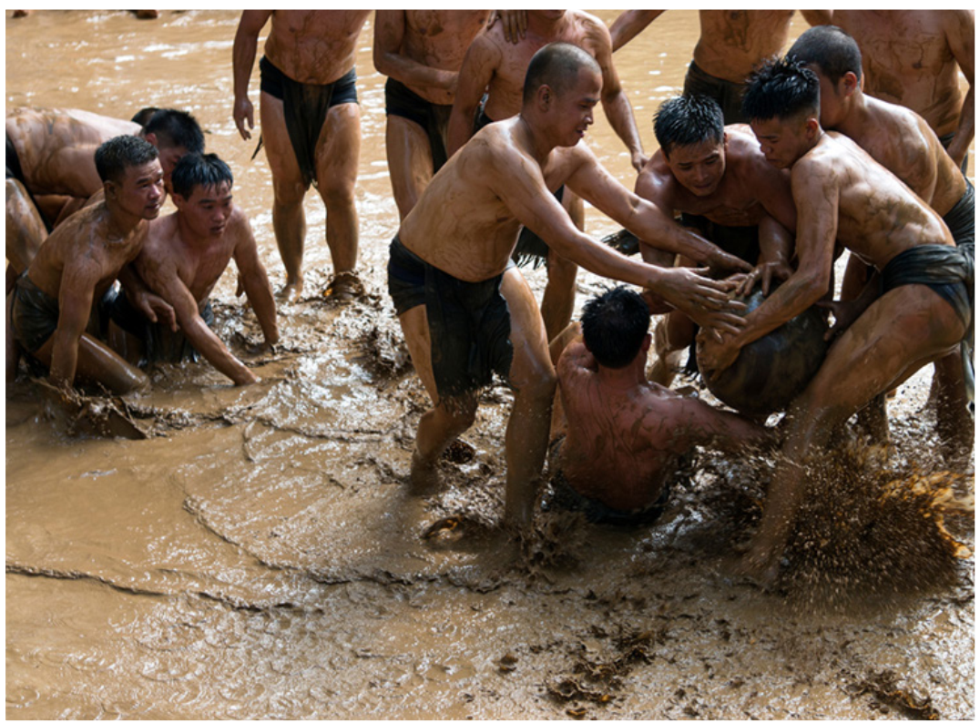
What can you say about the photo?

Slide 31
While-reading
Read the question quickly and underline the key words.
What are we going to do?
Read and answer the questions.

Slide 32
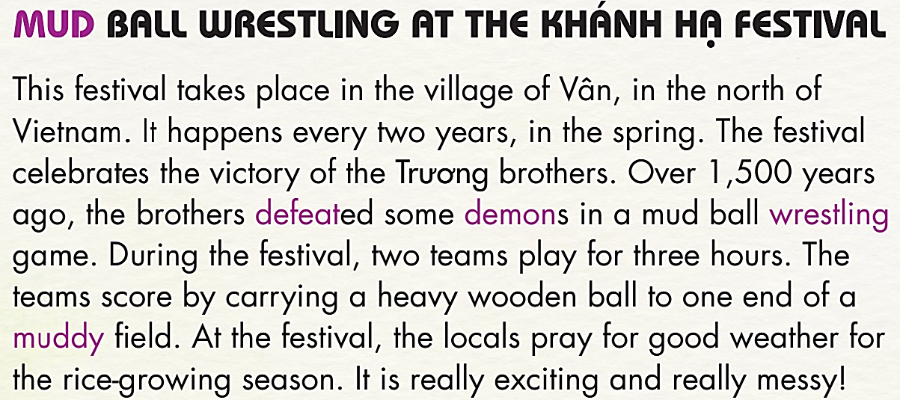

Slide 33
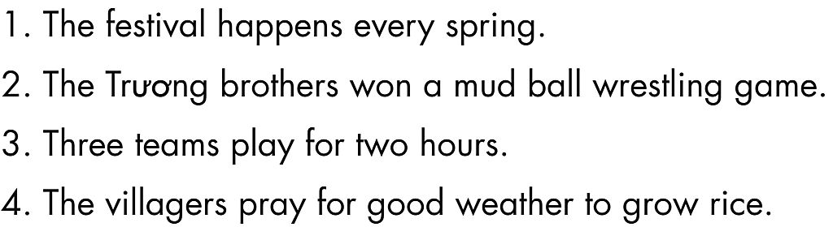
Read the sentences 1-4 quickly and underline the key words.
What are we going to do?
Read and write True or False.

Slide 34
False
The festival happens every spring. __________
The Trương brothers won a mud ball wrestling game. __________
Three teams play for two hours. __________
The villagers pray for good weather to grow rice. __________
True
False
True
This festival takes place in the village of Vân, in the north of Vietnam.
It happens every two years, in the spring. The festival celebrates
the victory of the Trương brothers. Over 1,500 years ago, the brothers defeated some demons in a mud ball wrestling game. During the festival, two teams play for three hours. The teams score by carrying a heavy wooden ball to one end of a muddy field. At the festival, the locals pray for good weather for the rice-growing season. It is really exciting and really messy!

Slide 35
Post-reading
READING VOCABULARY
Listen and repeat.
 temple (n) /ˈtempl/ đền thờ, miếu
 defeat (v) /dɪˈfiːt/ đánh bại
 demon (n) /ˈdiːmən/ ma quỷ, yêu ma
 mud (n) /mʌd/ bùn
 muddy (adj) /ˈmʌdi/ lầy lội, đầy bùn
 wrestling (n) /ˈreslɪŋ/ môn đấu vật

Slide 36
Post-reading

Slide 37

CONSOLIDATION

Slide 38
Complete the sentences using the Vocabulary in today’s lesson:
The _______ _______ is the most exciting part of Sene Dolta festival in An Giang province.
After the game in the field, all the kids were covered in ___________.
If we ___________ that team in the final, we’ll be the champions for the first time!
Don't bring those ___________ boots inside! They’re dirty.
The villagers _______ _______ good weather for the
rice-growing season.
bull race
mud
defeat
muddy
pray for

Slide 39
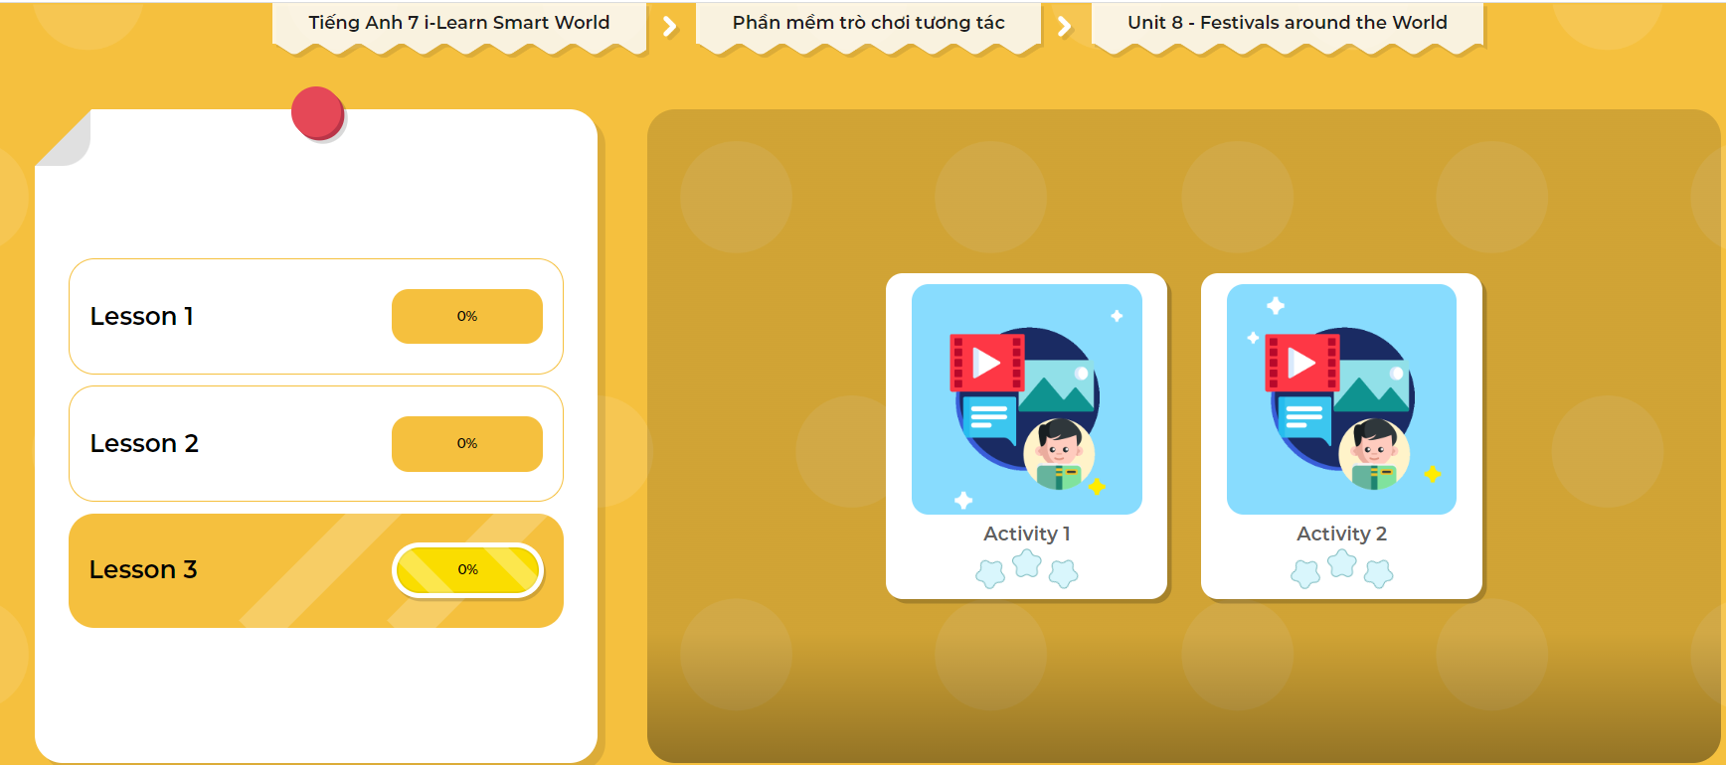
LET’S PLAY!
Click here to play the games!

Slide 40

WRAP-UP

Slide 41
Today’s lesson
Focusing on listening and reading activities about festivals in Vietnam.

Slide 42
Homework
Learn vocabularies in today’s lesson.
Finish exercises in Tiếng Anh 7 i-Learn Smart World Workbook on page 48.
Do the exercises in Tiếng Anh 7 i-Learn Smart World Notebook on page 52.
Prepare the next lesson (page 67 SB).
Play the consolidation game in Tiếng Anh 7 i-Learn Smart World DHA App on www.eduhome.com.vn

Slide 43

Lesson 3
Stay positive and have a nice day!

