Slide 1


Title Slide
Bạn có thể xem hướng dẫn Tiếng Việt từ trang số 4 nhé! KHÔNG THAY ĐỔI THỨ TỰ/XÓA SLIDE
ĐIỂM
$0
$0
$0
TÊN NGƯỜI CHƠI
Player 1
Player 2
Khanh
EDIT PLAYER NAMES
How to play
Credits/rules
PLAY GAME PUZZLE
PLAY GAME FINAL

Slide 2

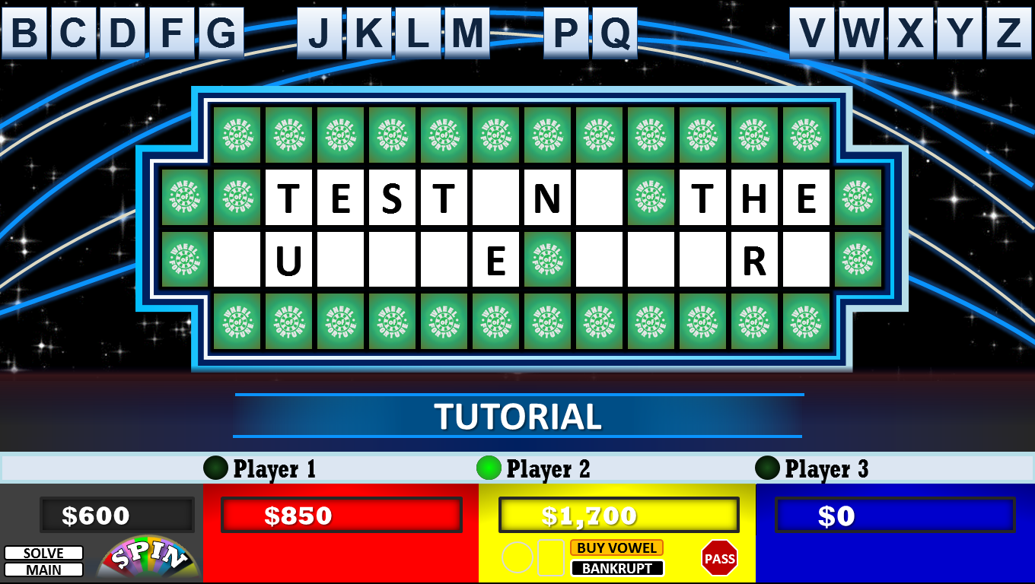
Bạn có thể xem hướng dẫn Tiếng Việt từ trang số 4 nhé!
3
HOW TO PLAY
Click on each of the buttons to learn about each area.
  1. Main controls
  2. Wheel Controls
  3. Letter Buttons
  4. Puzzle Board
  5. Player Controls
  6. Toss Up/Final Rounds
4
CAUTION
Game will return to
Main Menu after 5
minutes of inactivity.
6
1
5
HOW TO PLAY
RULES
2
EDITING
MAIN MENU
3. Letter Buttons – This space displays consonants or vowels for player to choose.
- After player makes a guess, click on the corresponding letter button.
- If any letters are present on the board, they will be highlighted in blue, and you will here a correct answer sound.
- Points will automatically be added to the current active player.
- Letters will only be displayed after you spun the wheel, or bought a vowel.
4. Puzzle Board – This space displays spaces and revealed letters for the puzzle.
- When letter(s) have been revealed, the affected spaces turn blue.
- After adjusting player’s score, click on any one of the blue spaces to display the letters.
6. Toss Up/Final Rounds – This section explains how to operate these puzzles.
- Click on START to begin Toss Up Round. Click SOLVE when player successfully answers the puzzle and reveals puzzle.
- On Final, you must click on R S T L N E first to reveal those letters. Allow for player to pick 3 consonants and 1 vowel.
- After player picked their 4 extra letters to be revealed, the timer will appear. Click the box to start 10 second timer.
- Click on SOLVE to display puzzle, and amount the puzzle was worth. Click WIN to add to players score if successful.
1. Main Controls – This space provides the spun value the player is playing for.
- Click SPIN button to spin the wheel and select a value each letter revealed will be worth.
- Click on SOLVE when player has successfully solved the puzzle. This will reveal a WIN button in the player controls.
- Click on MAIN to return back to main menu. Puzzle progress and scores will be LOST. (Clicking on WIN will also automatically return you to the main menu.)
5. Player Controls – This space contains all buttons that affect the players score or turn.
- Click on the little green light to activate a player as the current player.
- Click the left circle or rectangle to display the FREE SPIN or WILD CARD after a successful guess and spin.
- BUY VOWEL will take away $250 each guess, BANKRUPT clears player score and automatically move to next player.
- Click on PASS when player guesses wrong. WIN appears when player solves puzzle, click it to keep player score.
2. Wheel Controls – These are the buttons and features on the big wheel screen
- Adjust the Strength slider bar for a faster spin or a slower spin. All spins are randomized.
- Click on the player’s spinner base color to display that player’s spinner marker. Only one will display at a time.
- Wheel Sound effect toggle buttons provides an option to turn off the wheel sound.
- After you spin, click on the wheel section that the player landed on to load the cash value onto the puzzle slide.

Slide 3
Game Rules
Quick Stats
1 host (PPT operator)
3 Players or pairs
Unlimited rounds
1 bonus round
The winner of each round keeps their points
The player with the most points at the end of all the rounds goes to play the bonus round.
Gameplay
Players must choose to spin the wheel, buy a vowel ($250) or solve.
Play continues until player makes a wrong guess, or spins on lose a turn or bankrupt.
Only the player who correctly guesses the puzzle can keep the points they’ve earned.
Don’t forget to click on the wedge on the wheel before returning back to the board!
Bonus Round
The winning player spins the bonus wheel to determine prize value
Don’t forget to click on the wedge you selected!
The board reveals if the following letters are present: R S T L N E
Player can choose 3 more consonants, and 1 more vowel to be revealed.
Player has 10 seconds to guess the puzzle
If correct, player wins revealed amount of points
RULES
The rules of the game follow the gameshow on TV. These are not all inclusive, but will give you a good sense of how to use this template.
HOW TO PLAY
RULES
EDITING
MAIN MENU
Credits:
- Design & Layout, Programing, Troubleshooting – rusnakcreative.com
- Special thanks to Tim’s Slideshow Games for inspiration.
- Sound effects, logo, and theme are property of Sony Pictures
- This is an unofficial Wheel of Fortune Game template.
- Official site: wheeloffortune.com
This work is licensed under a Creative Commons Attribution-NonCommercial-ShareAlike 4.0 International License.

Slide 4
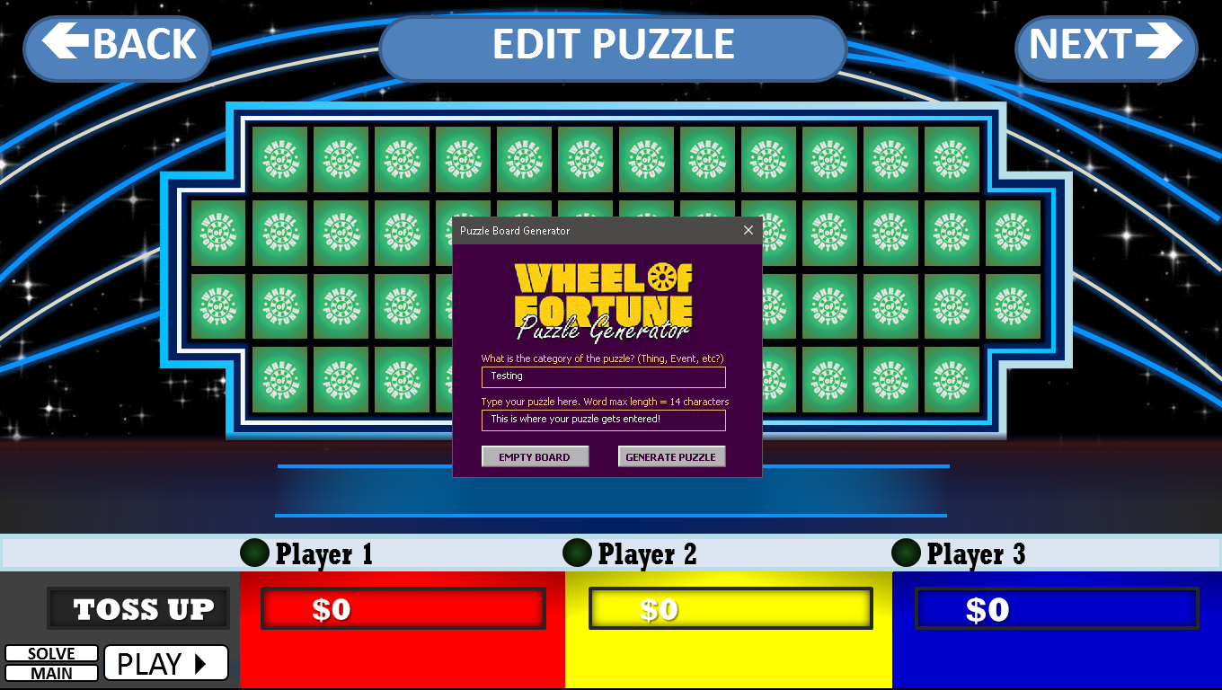
Editing
SỬA ĐÁP ÁN CÂU HỎI
1. Mở Slide số 2 ở dạng trình chiếu. Chọn Editing \ Mode On, sau đó bấm mũi tên NEXT để vào Slide 5, 6, 7. Edit Puzzle để chỉnh từ khóa
2. Sau khi chỉnh lại từ khóa cho mỗi vòng, bạn click Edit Mode chọn Off để trở lại chế độ chơi nhé!
EDITING
You can edit puzzles with the new Puzzle Generator! To access the Puzzle Generator, turn on Edit mode below!
Want more puzzle rounds?
Copy as many slides as you want between this slide and the wheels slides.
EDIT MODE OFF
Click button above
For easy editing!
1
2
3
TURN ON EDIT MODE.
GO TO YOUR PUZZLE SLIDE,
CLICK EDIT PUZZLE BUTTON.
TYPE IN YOUR PUZZLE
(After generated, click on SOLVE to view your puzzle to ensure it has successfully transferred.)
HOW TO PLAY
RULES
EDITING
MAIN MENU
Helpful Tips:
- The Puzzle Generator can only be accessed while Edit Mode is turned on.
- Edit Mode will automatically turn off when you start a game from the Title Slide, in case you forgot to turn it off!
- Do NOT delete anything, as that may cause the game to not work properly. This includes all shapes, and above titles.
- When in doubt, Undo! Also, save back up files just in case.
- Try changing themes! From the Home tab, click on Layout (next to New Slide) and try a new look to your board!

Slide 5
TOSS UP -
GAME TOSS UP - THỜI GIAN ĐẾM NGƯỢC
- Bấm Play để chơi, Pause để tạm dừng
- Khi có người chơi đoán đúng, bấm vào nút tròn bên cạnh tên người chơi và bấm giải đố để hiện thị đáp án.
- BẤM QUAY VỀ MENU ĐỂ CHƠI TIẾP NHỮNG MÀN KHÁC
T
H
I
S
I
S
T
H
E
T
O
S
S
U
P
R
O
U
N
D
TOSS UP
Player 1
Player 2
Khanh
TOSS UP
$0
$0
$0
GIẢI ĐỐ
PLAY
TRỞ VỀ MENU
TOSS UP
TOSS UP
$1,000

Slide 6


ROUND -
- Đến lượt của người chơi nào thì Click chọn nút tròn bên cạnh tên người chơi đó.
- Bấm Xoay để quay điểm. Click chọn vào điểm để trở lại màn hình giải đố.
Chọn Chuyển lượt nếu người chơi trả lời sai và Xoay tiếp nếu trả lời đúng.
- Trò chơi sẽ chỉ hiện thị các chữ cái là phụ âm để đoán. Người chơi cần đoán đúng một số phụ âm để nhận điểm và dùng điểm đó mua các nguyên âm gợi ý.
- BẤM QUAY VỀ MENU ĐỂ CHƠI TIẾP NHỮNG MÀN KHÁC
T
H
E
P
U
Z
Z
L
E
R
O
U
N
D
B
O
A
R
D
L
O
O
K
S
L
I
K
E
T
H
I
S
PUZZLE ROUND
Player 1
Player 2
Khanh
$0
$0
$0
$0
MẤT LƯỢT
MẤT LƯỢT
MẤT LƯỢT
XOAY
GIẢI ĐỐ
MUA NGUYÊN ÂM
CHUYỂN
LƯỢT
MUA NGUYÊN ÂM
CHUYỂN
LƯỢT
MUA NGUYÊN ÂM
CHUYỂN
LƯỢT
TRỞ VỀ MENU
MẤT LƯỢT
MẤT LƯỢT
MẤT LƯỢT

Slide 7
FINAL -
VÒNG CUỐI
- Lên Slide 1, bấm chọn Final Round.
- Bấm Xoay
- Click lần lượt vào từng ô R S T L N E để bắt đầu
- Người chơi sẽ được đoán 1 số chữ cái trước. Sau đó người chơi có 20s để đoán câu trả lời cuối cùng.
F
I
N
A
L
R
O
U
N
D
P
U
Z
Z
L
E
FINAL ROUND
Player 1
Player 2
Khanh
TIMER:
0
$0
$0
$0
GIẢI ĐỐ
PLAY
TRỞ VỀ MENU

Slide 8
PRIZE WHEEL
XOAY
S
C
I
P
A
E
M
E
★
S
★
I
★
M
W
,
A
&
A
I
R
G
N
N

Slide 9


WHEEL
XOAY
$
1
0
0
0
$
5
5
0
$
9
0
0
$
3
0
0
$
6
0
0
$
7
0
0
$
4
5
0
$
3
0
0
$
6
0
0
$
3
0
0
$
9
0
0
$
5
0
0
$
3
0
0
$
5
0
0
$
4
0
0
$
4
0
0
$
5
0
0
$
6
0
0
$
3
5
0
$
5
5
0
$
3
0
0
$
8
0
0
B
A
N
K
R
U
P
T
LOSE
A
T
U
R
N
ÂM THANH
OFF
ON

Slide 10

SƯU TẦM: ĐOÀN VĂN DOANH, NAM TRỰC, NAM ĐỊNH
LINK NHÓM DÀNH CHO GV BỘ MÔN VẬT LÝ TRAO ĐỔI TÀI LIỆU VÀ CHUYÊN MÔN CT 2018
https://www.facebook.com/groups/299257004355186

