Slide 1

UNIT 9: TRAVEL AND TOURISM
Lesson 1.2 – Grammar
Page 75

Slide 2


Lesson 1.2
LESSSON OUTLINE
Presentation: Meaning and use, Form
Practice
Production
Consolidation

Slide 3

By the end of this lesson,
students will be able to:
- practice and use articles and zero article correctly.

Slide 4



Slide 5
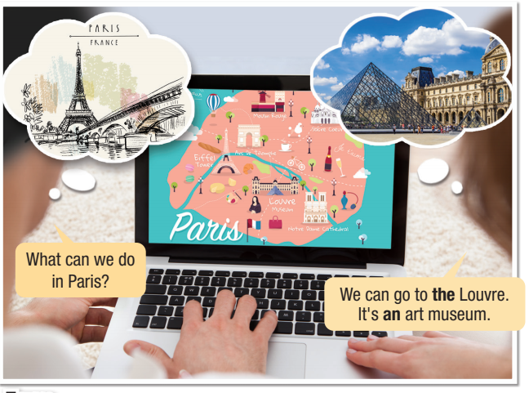

Look at the pictures
Answer more about Paris.
Example:
What can we do in Paris?
- We can go to the Louvre.
It is an art museum.
- ……………………
- ..………………….
Listen and repeat.

Slide 6

Presentation
Example:
Have you ever been to a basketball game?
Yes, I went to the basketball championship game last year.
Let go and play basketball in the park.
Meaning and Use:
Articles are the words a, an and the.
They come before nouns and are used to define if something is specific or general.
For some nouns or noun phrases, we don’t use an article. We call this the zero article.

Slide 7

Presentation
Form:
“The”: is used before singular, plural, or uncountable nouns:
It is clear from the situation which one(s) we mean or there is only one of that thing.
Example:
Let's eat at the restaurant.
(We can see only one restaurant.)
There are great views of the river.
(Usually, there's only one river in a town or city.)

Slide 8

Presentation
Form:
“The”: is used before singular, plural, or uncountable nouns:
We have mentioned it/them before.
Example:
I bought a ticket to see a concert in Brazil.
The concert was fantastic.

Slide 9

Presentation
Form:
“The”: is used before singular, plural, or uncountable nouns:
We say which ones we mean later in the sentence.
Example:
Tell Tom about the castle we visited yesterday

Slide 10
Presentation
Form:
“a/ an”: before singular, countable nouns
We can use this when we talk about one thing that isn't specific or we are mentioning for the first time.
Example:
There is a great museum in that town.
I visited an aquarium yesterday.

Slide 11

Presentation
Form:
“zero article”: before singular, countable nouns
When we talk about things in general.
Example:
I like castles.
(Use the plural or uncountable form when generalizing not a castle)

Slide 12

Presentation
Form:
“zero article”: before singular, countable nouns
When we talk about sports, games, meals, and school subjects.
Example:
Let's have dinner.
Let's play soccer.

Slide 13
Presentation
Form:
“zero article”: before singular, countable nouns.
When we use names of people, villages, cities, and countries.
Example:
I visited Paris yesterday.
I went to Japan last week.

Slide 14
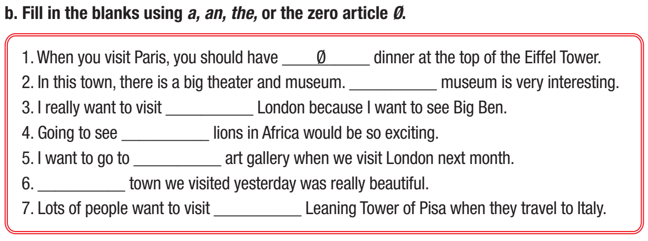


Practice
The
$$Ø$$
$$Ø$$
an
The
the

Slide 15
Practice
c. Match the articles in Task b. with their uses. Write the numbers 1–7 in the blanks.
7
___ there's only one
___ it was mentioned before
___ talking about things in general
___ before names of people, countries, cities, towns
___ talking about sports, games, meals, school subjects
___ saying which one we mean later in the sentence
___ one thing that isn't specific
2
4
3
1
6
5

Slide 16
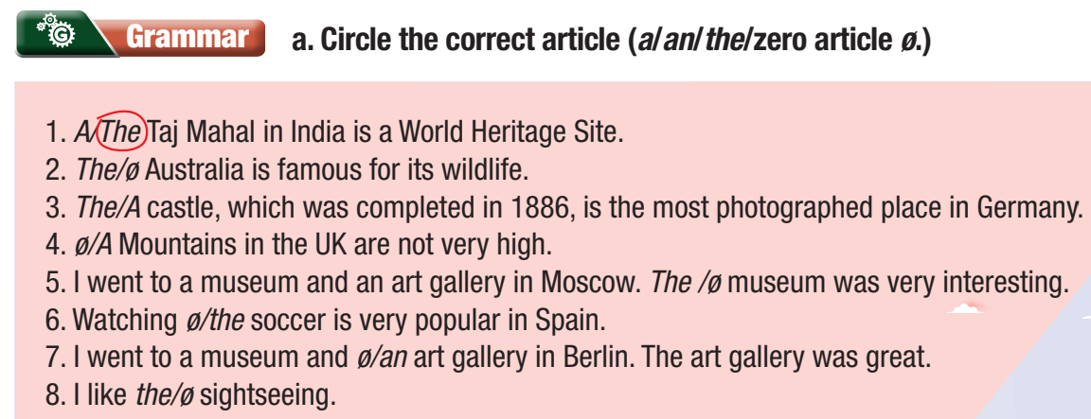
More Practice WB, P. 51
Notes:
Taken from TA 10 i-Learn Smart World WB, page 45, activity a

Slide 17
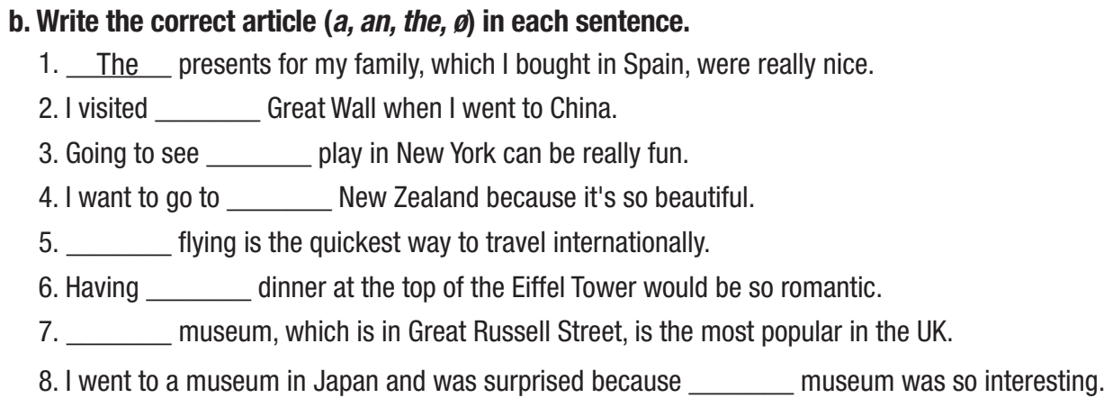



More Practice
WB, P. 51
the
a
$$Ø$$
$$Ø$$
$$Ø$$
The
the
Notes:
Taken from TA 10 i-Learn Smart World WB, page 45, activity b

Slide 18
Production
d. In pairs: Tell your partner about what you did on your last vacation.
Ex: On my last vacation, I went to…

Slide 19
Production
Suggested answers:
On my last vacation, I went to Ha Long Bay with my classmates. It is one of the most beautiful natural wonders in the world. We took 4 hours to get there by car. We stayed in a hotel in front of the beach. Ha Long Bay has a nice, clean, romance beach and there are many things to discover. After lunch, we took a short rest then we swam all afternoon. In the evening, we sat together on the beach to see the stars in the sky. It was so romantic and relax. We did so many activities included swimming, surfing, traveling on boat trip and shopping. We took a lot of photos. I also liked seafood in Ha Long Bay and I bought a lot of them as presents to my family when I came back. I really had a relax and wonderful time in Ha Long Bay.

Slide 20

Consolidation

Slide 21
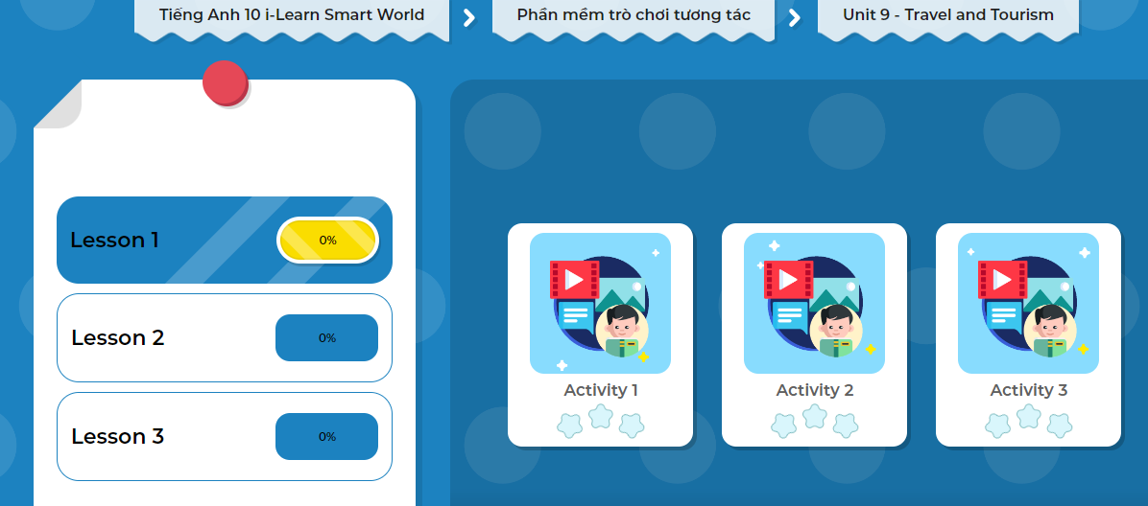
LET’S PLAY!
Click here to play the game!

Slide 22

Wrap-up
Today’s lesson
“The”: before singular, plural, or uncountable nouns | It is clear from the situation which one(s) we mean or there is only one of that thing.
 | We have mentioned it/them before.
 | We say which ones we mean later in the sentence.
“a/ an”: before singular, countable nouns | We talk about one thing that isn't specific or we are mentioning for the first time.
“zero article”: before singular, countable nouns | We talk about things in general.
 | We talk about sports, games, meals, and school subjects.
 | We use names of people, villages, cities, and countries.

Slide 23

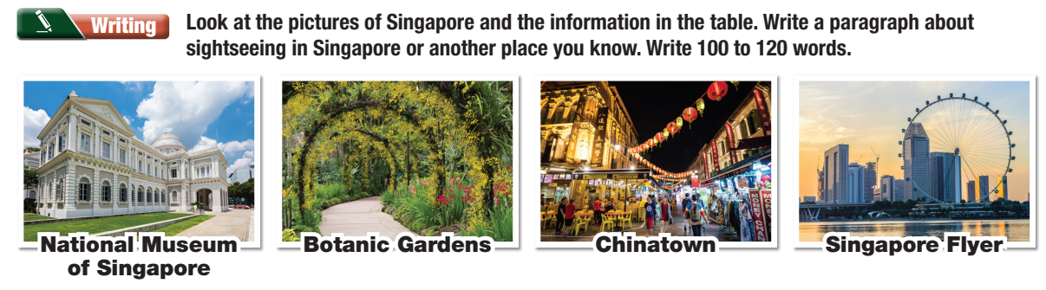
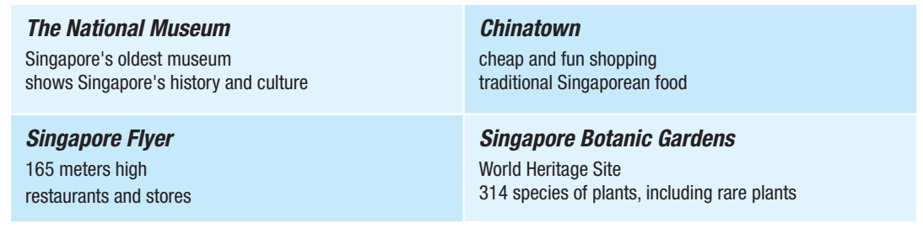
Notes:
Taken from TA 10 i-Learn Smart World WB, page 51, activity Writing

Slide 24

Complete the grammar notes in Tiếng Anh 10 i-Learn Smart World Notebook on page 51.
Prepare the next lesson - Speaking on page 76 in SB.
Play the consolidation games in Tiếng Anh 10 i-Learn Smart World DHA App on www.eduhome.com.vn

