Slide 1

UNIT 3: SHOPPING
Lesson 2.2 – Grammar
Page 21

Slide 2


Lesson 2.2
Unit 3 Lesson 2.2
LESSSON OUTLINE
Consolidation

Slide 3

Unit 3 Lesson 2.2
By the end of this lesson,
students will be able to:
- practice and use When clauses correctly.

Slide 4



Slide 5

Unit 3 Lesson 2.2
Work in pairs.
What do you do when your shoes were broken?
What do you do when your smartphone doesn’t work?
I takes them (it) to the ……..

Slide 6



Slide 7

Presentation

Slide 8



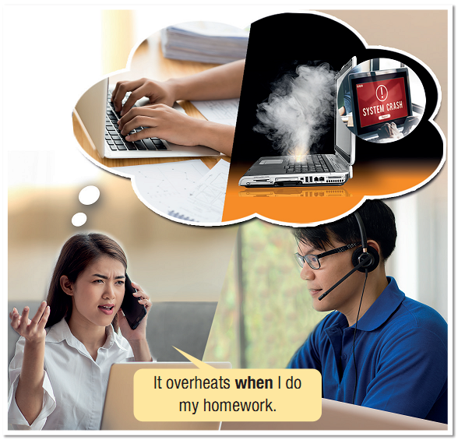
It overheats when I do my homework.
Notes:
Please, click on each phrase to hear the sound

Slide 9
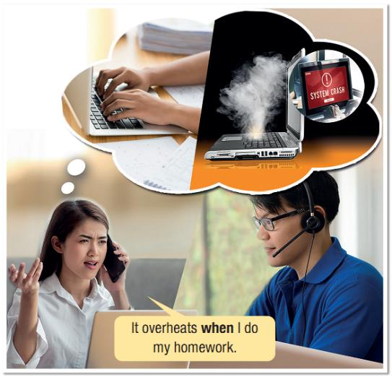
Unit 3 Lesson 2.2
1. What is the when- clause?
→ when I do my homework
2. How is the when- clause used?
→ to connect 2 clauses
Notes:
Please, click on each phrase to hear the sound

Slide 10
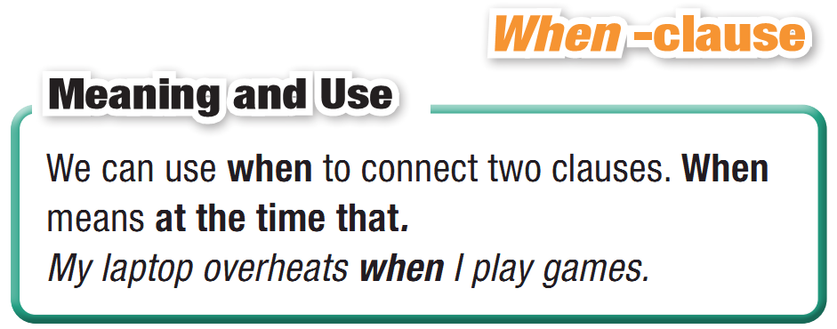
Unit 3 Lesson 2.2
Notes:
Please, click on each phrase to hear the sound

Slide 11
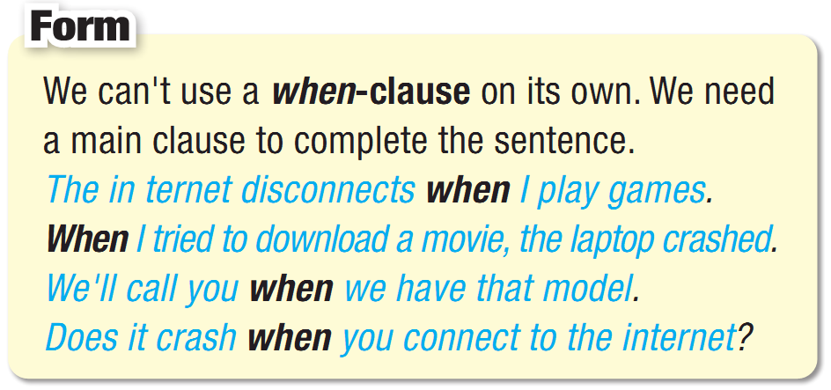
Unit 3 Lesson 2.2
When-clause
Notes:
Please, click on each phrase to hear the sound

Slide 12
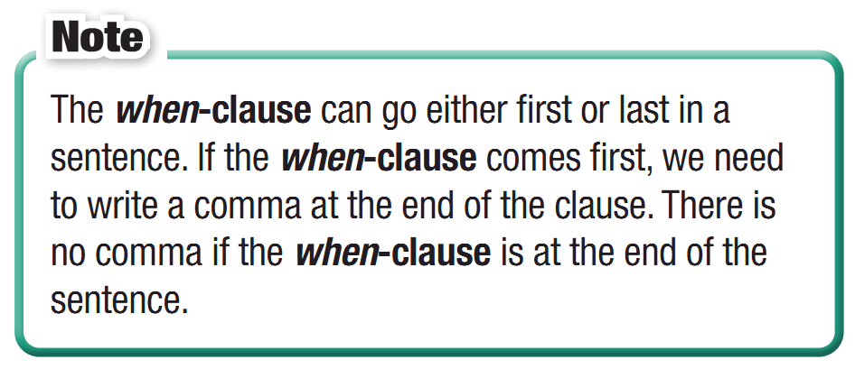
Unit 3 Lesson 2.2
When-clause
Notes:
Please, click on each phrase to hear the sound

Slide 13

Practice

Slide 14
Unit 3 Lesson 2.2
b. Unscramble the sentences.
1. photos,/overheats./it/When/I/edit _________________________________________________
2. when/crashes/games./I/play/It ________________________________________________
3. the/disconnects/when/internet./I/use/It _________________________________________________
4. you/We/when/let/it's/will/fixed./know _________________________________________________
5. ready./call/I’ll/it’s/you/when
_________________________________________________
When I edit photos, it overheats.
It crashes when I play games.
It disconnects when I use the internet.
We will let you know when it's fixed.
I'll call you when it's ready.
Notes:
Please, click on each phrase to hear the sound

Slide 15
Unit 3 Lesson 2.2
c. Join the sentences using when
to make two new sentences.
1. The computer didn't restart. I pressed the restart button.
when-clause first: _______________________________________________________________
when-clause last: _______________________________________________________________ 2. We have the battery for the camera. We'll call you.
when-clause first: _______________________________________________________________ when-clause last: _______________________________________________________________
When I pressed the restart button, the computer didn't restart.
The computer didn't restart when I pressed the restart button.
When we have the battery for the camera, we'll call you.
We'll call you when we have the battery for the camera.
Notes:
Please, click on each phrase to hear the sound

Slide 16
Unit 3 Lesson 2.2
c. Join the sentences using when
to make two new sentences.
3. The camera disconnected. I tried to copy photos to my laptop.
when-clause first: _______________________________________________________________
when-clause last: _______________________________________________________________ 4. My laptop crashed. I played games.
when-clause first: _______________________________________________________________ when-clause last: _______________________________________________________________
When I tried to copy photos to my laptop, the camera disconnected.
The camera disconnected when I tried to copy photos to my laptop.
When I played games, my laptop crashed.
My laptop crashed when I played games.
Notes:
Please, click on each phrase to hear the sound

Slide 17
Unit 3 Lesson 2.2
Extra Practice
WB, page 17
a. Unscramble the sentences.
1. computer,/crashes./When/disconnect/I/the/it _____________________________________________
2. when/open/It/I/restarts/an/app. _____________________________________________
3. under/warranty?/Is/phone/your _____________________________________________
4. keep/to/remember/your/Please/receipt. _____________________________________________
5. phone/when/My/charge/overheats/I/it. _____________________________________________
When I disconnect the computer, it crashes.
It restarts when I open an app.
Is your phone under warranty?
Please remember to keep your receipt.
My phone overheats when I charge it.
Notes:
Taken from TA 10 i-Learn Smart World WB, page 2

Slide 18
Unit 3 Lesson 2.2
Extra Practice
WB, page 17
b. Combine the two sentences using when.
1. I charged my phone. It crashed.
_________________________________________________
2. I disconnect the screen. It restarts.
_________________________________________________
3. I took my phone to the store. They asked for my receipt.
_________________________________________________
4. My phone crashed. I tried to play a new game.
_________________________________________________
5. Remember your receipt. Take your laptop to the store.
_________________________________________________
When I charged my phone, it crashed.
When I disconnect the screen, it restarts.
When I took my phone to the store, they asked for my receipt.
My phone crashed when I tried to play a new game.
Remember your receipt when you take your laptop to the store
Notes:
Taken from TA 10 i-Learn Smart World WB, page 2

Slide 19
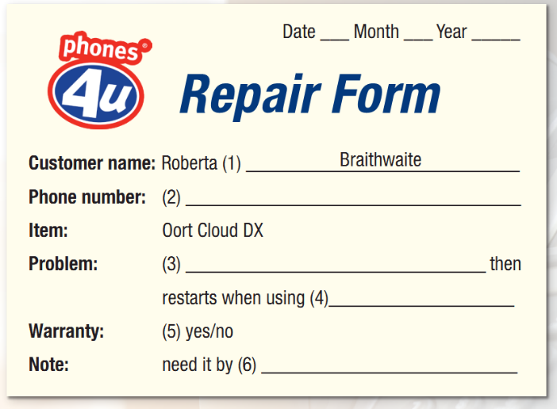
Unit 3 Lesson 2.2
Extra Practice
WB, page 17
Read the dialog and complete the form.
Assistant: Hello, can I help you?
Roberta: Yes, I bought this phone from you and it stopped working.
Assistant: I see. Can I take your details, please?
Roberta: Sure. My name is Roberta Braithwaite.
Assistant: Can you spell "Braithwaite" for me?
Roberta: Sure. It's B-R-A-I-T-H-W-A-I-T-E.
Notes:
Taken from TA 10 i-Learn Smart World WB, page 2

Slide 20
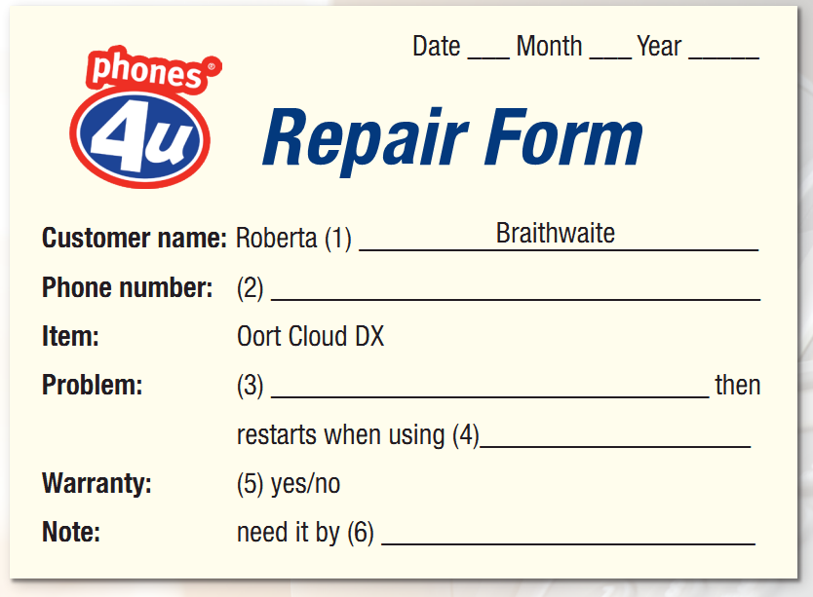
Unit 3 Lesson 2.2
Extra Practice
WB, page 17
Read the dialog and complete the form.
Assistant: What's your phone number?
Roberta: 0849652801.
Assistant: Thanks. And it's an Oort Cloud DX?
Roberta: That's right.
Assistant: What's wrong with the phone?
Roberta: I don't really know. When I try to use my camera, it crashes and then restarts
0849652801
it crashes
my camera
Notes:
Taken from TA 10 i-Learn Smart World WB, page 2

Slide 21
Unit 3 Lesson 2.2
Extra Practice
WB, page 17
Read the dialog and complete the form.
Assistant: Do you have a warranty?
Roberta: I think I lost my warranty card. I guess I'll have to pay for any repairs. When will it be ready?
Assistant: Well, we're not very busy right now. It can be ready by the weekend. Is Sunday OK?
Roberta: Actually, Saturday would be better. Can I pick it up that morning?
Assistant: Yes, that should be fine. I'll make a note of it.
0849652801
it crashes
my camera
Saturday
Notes:
Taken from TA 10 i-Learn Smart World WB, page 2

Slide 22

Production

Slide 23
Unit 3 Lesson 2.2
d. In pairs: Talk about your devices
using when-clauses.
When I do my homework, my laptop disconnects.
Notes:
Please, click on each phrase to hear the sound

Slide 24

Consolidation

Slide 25
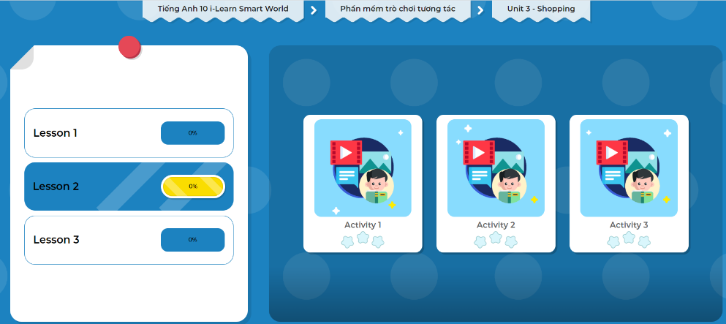
Let’s play!
Click here to play the games!

Slide 26

Imagine you have problems with your new mobile phone. Write a paragraph to describe the problems and your solutions. Write 100 to 120 words.

Slide 27

WRAP-UP

Slide 28
Unit 3 Lesson 2.2
Today’s lesson
Wrap-up
Grammar: When-clauses
Speaking: Talking about your devices

Slide 29


Slide 30
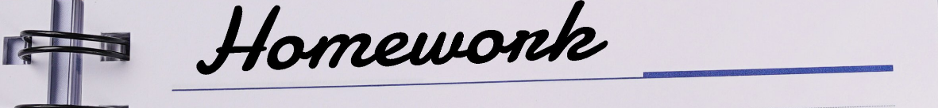
Unit 3 Lesson 2.2
Make 10 sentences, using when-clause.
Do the exercises in WB on page 17.
Complete the grammar notes in Tiếng Anh 10 i-Learn Smart World Notebook on page 17.
Prepare the next lesson – Pronunciation on page 25 in SB.
Play consolidation games in Tiếng Anh 10 i-Learn Smart World DHA App on www.eduhome.com.vn

Slide 31

Have a nice day!

