Slide 1

Unit 1: Free time
Lesson 2.1: Vocabulary & Listening
Page 7

Slide 2



LESSON OUTLINE
Consolidation

Slide 3

By the end of this lesson, students will be able to…
- talk about their free time activities.
- practice listening for general and specific details.
- know how to start a friendly conversation and practice using it.

Slide 4

New words
sports center
bowling alley
theater
ice rink
water park
market
fair

Slide 5

WARM-UP

Slide 6

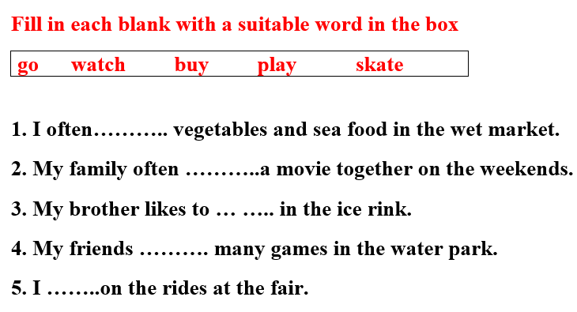
Work in pairs

Slide 7
Answer Keys
buy
watches
skate
play
go

Slide 8



Slide 9

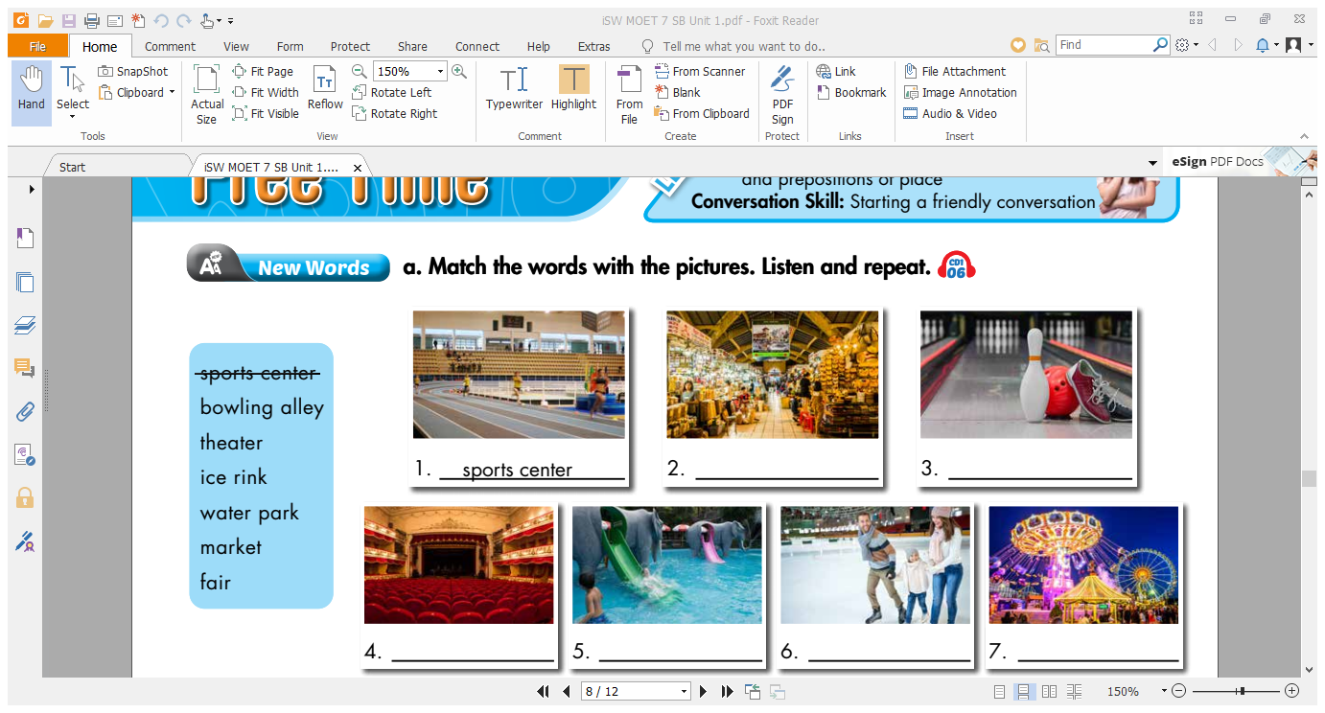
Work in pairs. Match the words with the picture.
market
bowling alley
theater
water park
ice rink
fair

Slide 10
Work in pairs. Match the words with the pictures.
market
bowling alley
theater
water park
ice rink
fair

Slide 11
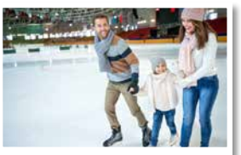
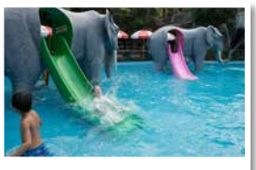
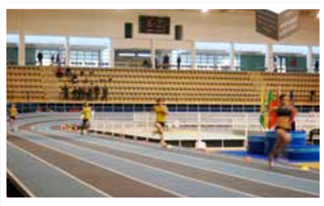
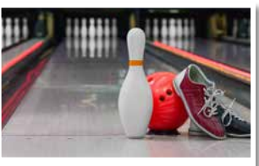
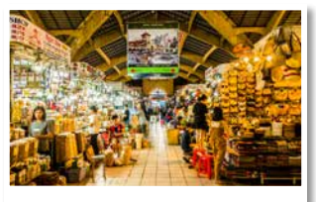
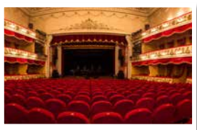
Work in pairs.
What places are for entertainment?
What places are for shopping?

Slide 12

Listen and repeat. Click each phrase to hear the sound.
sports center (n) /ˈspɔːrts sentər/ trung tâm thể thao
bowling alley (n) /ˈboʊlɪŋ æli/ sân chơi bowling :
theater (n) /ˈθiːətər/ nhà hát
ice rink (n) /ˈaɪs ˌrɪŋk/ sân trượt băng
water park (n) /ˈwɑːtər pɑːrk/ công viên nước
market (n) /ˈmɑːrkɪt/ chợ
fair (n) / fer/ hội chợ
Notes:
GV click vào từng cụm nghe âm thanh

Slide 13
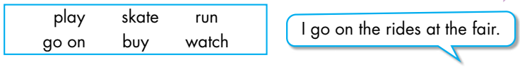
b. In pairs: Say what activities you can do at each place using the verbs in the box. Words
- I run in the sports center.
- I skate in the ice rink.
- I play bowling in the bowling alley.
- I watch movies in the movie theater.
- I buy things at the market.

Slide 14
Extra Practice
WB, page 4
Fill in the blanks using the words you have learned.
bowling alley
1. We like going to the ______________ to play ten-pin bowling.
2. She goes to the ____________ every weekend to play
badminton.
3. We enjoyed lots of rides at the __________.
sports center
fair

Slide 15
Extra Practice
WB, page 4
Fill in the blanks using the words you have learnt.
4. The __________ is a great place to go swimming in the summer.
5. Do you like to buy your clothes at the _________?
6. I like to watch plays at the __________.
7. The ___________ is very popular during the winter.
water park
market
theater
ice rink

Slide 16
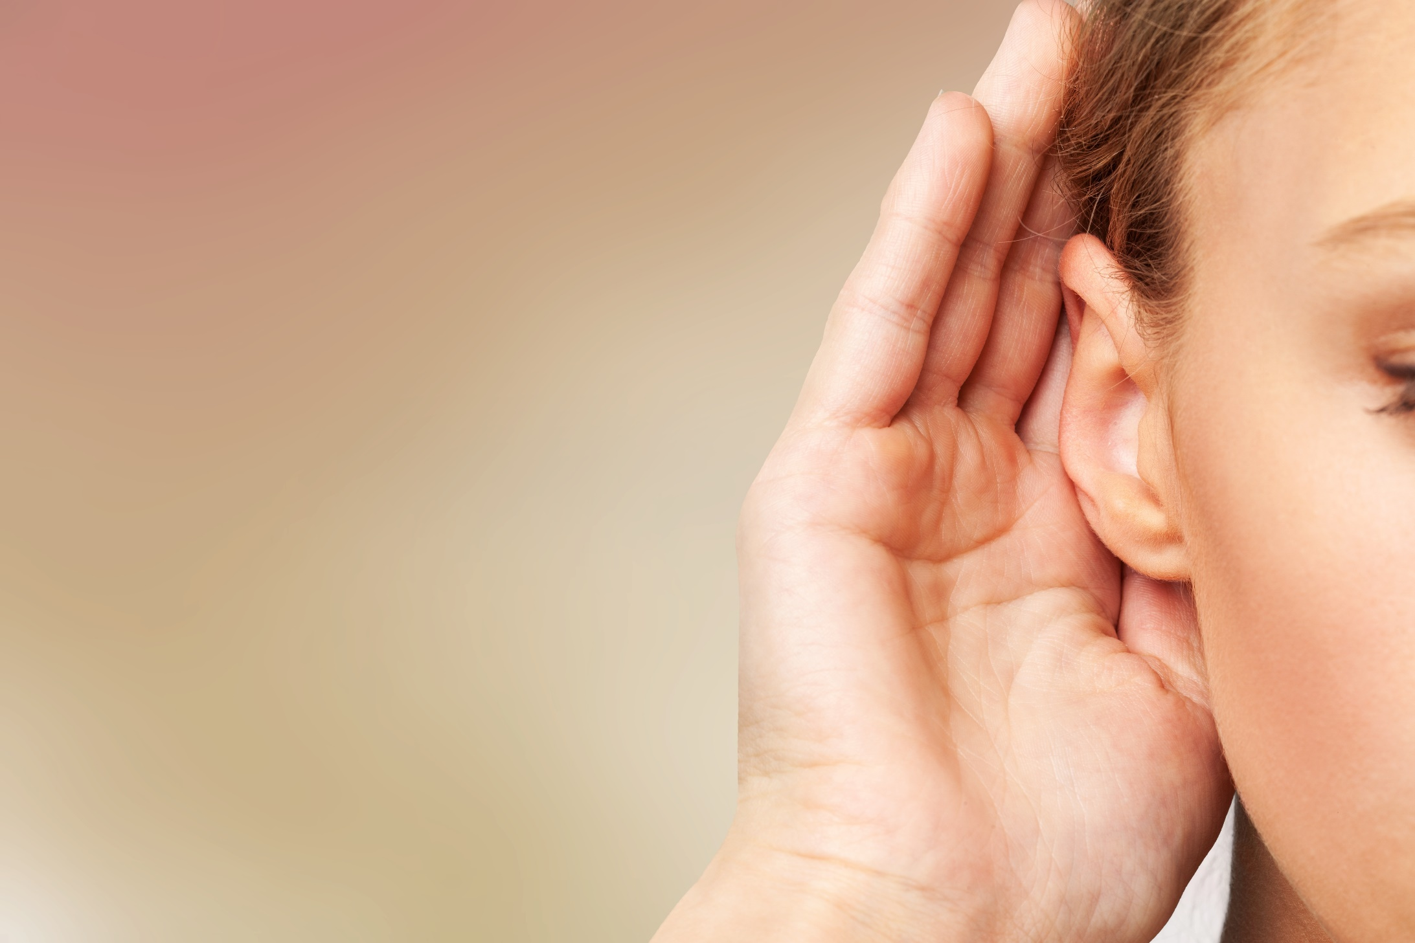

It’s listening time….

Slide 17
Pre - listening
Read the instruction quickly. Underline the key words. Which place will they visit together?
Listen and choose the correct answer.
a. Listen to Becky calling Toby to make plans to meet. Which place will they visit together?

Slide 18
While - listening
Now listen and choose the correct answer.  FIRST TIME
a. Listen to Becky calling Toby to make plans to meet. Which place will they visit together?
☞ YOUR ANSWER?
1. market
☞ WHY?

Slide 19
While - listening
Now listen again and check.  SECOND TIME
While you are listening, focus on what Toby and Becky ask.
Becky: Hey, I'm buying him a present at the market on Saturday afternoon. Do you want to come?
Toby: Sure. Where do you want to meet?
Becky: Let's meet at three behind the mall.
Toby: OK. Cool. See you then. Bye, Becky!
☞ YOUR ANSWER?
1. market
2. bowling alley 3.ice rink
☞ THE ANSWER IS …

Slide 20
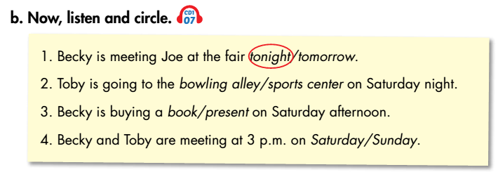
Pre - listening
Read the instruction and questions quickly. Underline the key words. When are they going meet?
Listen and circle.

Slide 21
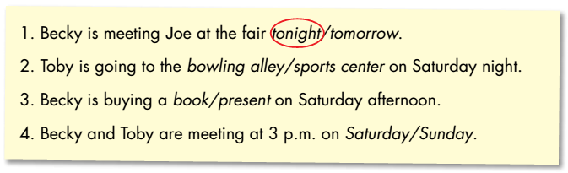
While - listening
Now listen and circle.  FIRST TIME
☞ WHAT ARE YOUR ANSWERS?

Slide 22
While - listening
Now listen again and check.  SECOND TIME
☞ WHY ARE THESE ANSWERS?

Slide 23
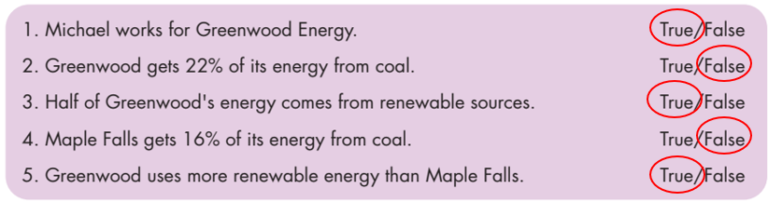
While - listening
Now listen again and check.  THIRD TIME
Becky: I'm meeting Joe at the fair tonight. It'll be fun. Do you want to come?
1. Becky is meeting Joe at the fair tonight.
Toby: We're going to the bowling alley on Saturday night. You should come.
2. Toby is going to the bowling alley on Saturday night.

Slide 24
Becky: Hey, I'm buying him a present at the market on
Saturday afternoon. Do you want to come?
3. Becky is buying a present on Saturday afternoon.
Becky: Hey, I'm buying him a present at the market on Saturday afternoon. Do you want to come?
Toby: Sure. Where do you want to meet?
Becky: Let's meet at three behind the mall.
4. Becky and Toby are meeting at 3 p.m. on Saturday.

Slide 25
Audio Scripts
Practice the conversation with a partner.
Becky: Hi Toby, it’s Becky. Can you talk now?
Toby: Hi Becky. Yeah, what's up?
Becky: I'm meeting Joe at the fair tonight. It'll be fun. Do you want to come?
Toby: Sorry, I can't. I'm doing my homework tonight.
Becky: Oh, that's too bad.
Toby: Yeah. Oh wait, do you like bowling?
Becky: Yeah, why?
Toby: We're going to the bowling alley on Saturday night. You should come.

Slide 26
Audio Scripts
Practice the conversation with a partner.
Becky: Saturday night? Oh no. It's my brother's birthday. We're going skating at the new ice rink. Sorry!
Toby: Ah! That’s OK.
Becky: Hey, I'm buying him a present at the market on Saturday afternoon. Do you want to come?
Toby: Sure. Where do you want to meet?
Becky: Let's meet at three behind the mall.
Toby: OK. Cool. See you then. Bye, Becky!
Becky: Bye!

Slide 27

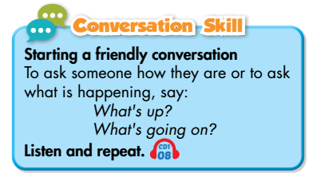
Work in pairs
Post - listening
Where do you like to meet your friends? What do you do there?

Slide 28

CONSOLIDATION

Slide 29
Write 5 sentences about a place you will meet together. You can begin with:
We are meeting………

Slide 30

WRAP-UP

Slide 31
Today’s lesson
Vocabularies
• sports center
• bowling alley
• theater
• ice rink
• water park
• market
• fair

Slide 32
Today’s lesson
Listening:
Listening for general and specific details.
Speaking:
Starting a friendly conversation.

Slide 33
Homework
Learn by heart the new vocabularies.
Practice making a plan.
Do the exercises in Workbook: New words and Listening (pages 4,5).
Practice vocabulary in Tiếng Anh 7 i-Learn Smart World Notebook (page 6).
Prepare: Lesson 2 – Grammar (page 8 – SB).
Play the consolidation games in Tiếng Anh 7 i-Learn Smart World DHA App on www.eduhome.com.vn

Slide 34

Lesson 3
Stay positive and have a nice day!

