Slide 2
Unit
8
BECOMING INDEPENDENT
Unit
FAMILY LIFE
LESSON I
GETTING STARTED
Earning your parents’ trust

Slide 3
LESSON I
GETTING STARTED
WARM-UP
GAME: Categorizing game
PRESENTATION
Vocabulary
Task 1: Listen and read.
Task 2: Decide who has the skills.
Task 3: Find words or a phrase.
Task 4: Match the two halves to make sentences.
PRACTICE
PRODUCTION
Role play
Wrap-up
Homework
CONSOLIDATION

Slide 4
WARM-UP
CATEGORIZING GAME
Work in 4 groups.
Each group is given pieces of paper about dependent and independent lifestyle.
- Classify them to correct columns.
- The first team to complete the task correctly is the winner.
- Go to the board and show the answers.

Slide 5
WARM-UP
Independent lifestyle
Dependent lifestyle
+ Cook for yourself
+ Have good time management
+ Know how to keep house
+ keep your body clean
+ Think twice before deciding
+ Get enough good sleep
+ Ask parents for money
+ Wait parents to cook
+ Don’t do your homework
+ Need mother to drop you off at school
+ Communicate badly with people
+ Eat instant noodles all the time

Slide 6
PRESENTATION
independent
/ˌɪn.dɪˈpen.dənt/
confident and free to do things without needing help from other people

Slide 7
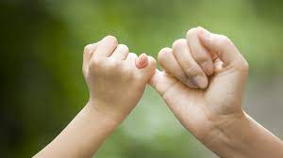
PRESENTATION
Trust (n)
/trʌst/
the belief that sb/sth is good, sincere, honest, etc.

Slide 8
PRESENTATION
(to) convince
/kənˈvɪns/
to make someone feel certain that something is true

Slide 9
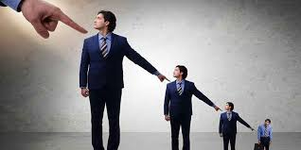
PRESENTATION
responsible (adj)
/rɪˈspɔnsɪbəl/
having the job or duty of doing sth or taking care of sb/sth

Slide 10
PRESENTATION
(to) encourage
/ɪnˈkʌr.ɪdʒ/
to give sb support, courage or hope

Slide 11
PRESENTATION
Form | Pronunciation | Meaning | Vietnamese equivalent
1. independent (adj) | /ˌɪn.dɪˈpen.d^{ə}nt/ | confident and free to do things without needing help | Tự lập
2. trust (earn sb’s trust) | /trʌst/ | the belief that sb/sth is good, sincere, honest, etc. | Niềm tin
3. (to) convince | /kənˈvɪns/ | to make someone feel certain that something is true | Thuyết phục
4. responsible (adj) | /rɪˈspɔnsɪbəl/ | having the job or duty of doing sth or taking care of sb/sth | Trách nhiệm
5. (to) encourage | /ɪnˈkʌr.ɪdʒ/ | to give sb support, courage or hope | Động viên

Slide 12
PRESENTATION
1
Listen and read.

Slide 13
PRESENTATION
1
Listen and read.
Nam: Mai, why don’t you answer your phone? It keeps ringing. Mai: It’s my mum who’s calling me again. She wants me to contact her from time to time while I’m out. Nam: My parents used to be like that. They thought I didn’t have the confidence to deal with difficult situations. Mark: I had the same experience. It was earning my parents’ trust that took a long time. But I managed to convince them that I’m responsible when I’m out and about. Mai: It’s my parents who still think I don’t have the skills to be independent. I’m not good at managing my time or money, but I’m independent at home – I can cook, clean the house, and do my laundry! Nam: That’s a good start! I use a time-management app to plan my weekly schedule including all my activities and responsibilities. Would you like me to help you install it? Mai: That’d be great. Thanks, Nam. Mark: I use a money-management app. It’s the app that taught me how to be responsible with money. Mai: Mark, can you show it to me? Mark: No problem. My parents also encourage me to take part-time jobs and pay me for doing certain chores around the house. Mai: Lucky you!

Slide 14
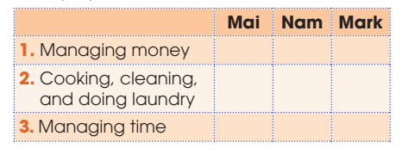
PRACTICE
2
Read the conversation again and decide who has these skills. Put a tick ( ) in the correct column.
✓
✓
✓
✓

Slide 15
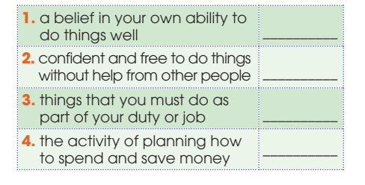
PRACTICE
3
Find words and a phrase in 1 that have the following meanings.
confidence
independent
responsibility
money-management

Slide 16
PRACTICE
4
Match the two halves to make sentences used in 1.
It’s my mum | that took a long time
2. It was earning my parents’ trust | b. Who still think I don’t have the skills to be independent.
3. It’s my parents | c. That taught me how to be responsible with money.
4. It’s the app | d. Who is calling me again.
1. D 2. A 3. B 4. C

Slide 17
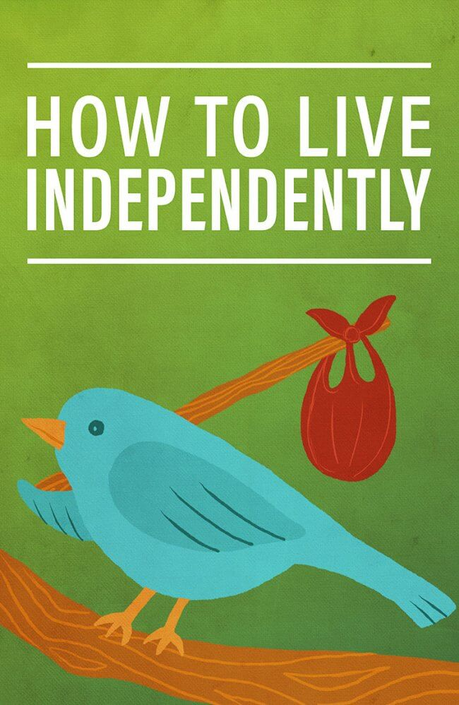
PRODUCTION
Role play
- Ss work in groups of 4.
- In each group, one student plays the role of a student. Others are advisors. Advisors are giving advice on how to live independently.
- 3 minutes to prepare for the role play.
- 2 minutes for a performance.

Slide 18
CONSOLIDATION
1
Wrap-up
What have you learnt today?
Some lexical items about becoming independent
Reading for specific information
Cleft sentence with “it is/was … who/ that…”

Slide 19
CONSOLIDATION
2
Homework
Do exercises in the workbook.
Prepare for Lesson 2 - Unit 8.
Prepare materials for the project in lesson 8

Slide 20
Website: hoclieu.vn
Fanpage: facebook.com/sachmem.vn/

