Slide 1


Slide 2




Unit
10
ENERGY SOURCES
LESSON 3: A CLOSER LOOK 2
GRAMMAR:
PRESENT CONTINUOUS
Unit
HOBBIES

Slide 3

OBJECTIVES
By the end of the lesson, students will be able to:
Know how to use: THE PRESENT CONTINUOUS

Slide 4
LESSON 3: A CLOSER LOOK 2
WARM-UP
JUMBLE SENTENCES
PRESENTATION
THE PRESENT CONTINUOUS
Task 1: Work in pairs. Tell your partner what the people in the pictures are doing
Task 2: Complete the sentences, using the present continuous form of the verbs in brackets.
Task 3: Circle the correct form of the verb in each sentence.
Task 4: Write sentences about what the people are doing or not doing, using the suggestions.
PRACTICE
PRODUCTION
Task 5: Work in pairs. Ask and answer the following questions.
CONSOLIDATION
Wrap-up
Home work

Slide 5

LESSON 3: A CLOSER LOOK 2
WARM-UP
JUMBLED SENTENCES
Aims of the stage:
To activate students’ knowledge on the targeted grammar
To enhance students’ skills of cooperating with team mates

Slide 6
WARM-UP
1. She is learning English now.
2. They are not using solar energy.
3. Are you working on your Project?
4. Where is your brother studying?
5. She is playing basketball in the school yard.

Slide 7
LESSON 3: A CLOSER LOOK 2
WARM-UP
JUMBLE SENTENCES
PRESENTATION
THE PRESENT CONTINUOUS

Slide 8
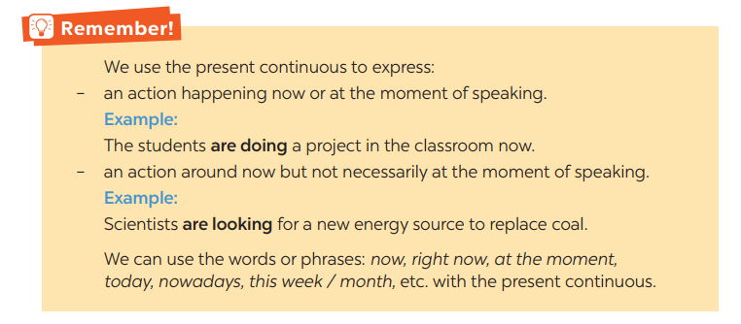

PRESENTATION
THE PRESENT CONTINUOUS

Slide 9
LESSON 3: A CLOSER LOOK 2
WARM-UP
JUMBLE SENTENCES
PRESENTATION
THE PRESENT CONTINUOUS
Task 1: Work in pairs. Tell your partner what the people in the pictures are doing
Task 2: Complete the sentences, using the present continuous form of the verbs in brackets.
Task 3: Circle the correct form of the verb in each sentence.
Task 4: Write sentences about what the people are doing or not doing, using the suggestions.
PRACTICE

Slide 10
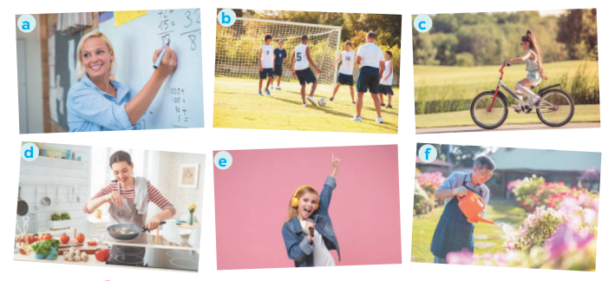
PRACTICE
1
Aim of the task:
To get students practice using the form
Work in pairs. Tell your partner what the people in the pictures are doing

Slide 11
PRACTICE
1
Aim of the task:
To get students practice using the form
Work in pairs. Tell your partner what the people in the pictures are doing
ANSWERS:
a- She is teaching maths/ is writing on the board.
b- They are play football/soccer.
c- She is riding her bike/bicycle.
d- She is cooking.
c- She is singing.
f- He is watering the flowers/plans/is doing gardening.

Slide 12
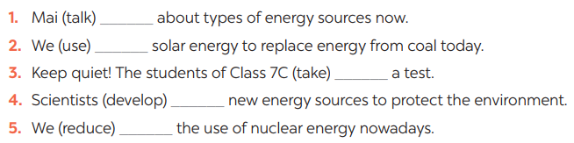

PRACTICE
2
Complete the sentences, using the present continuous form of the verbs in brackets.
ANSWER:
1, is talking 2, are using 3, are taking
4, are developing 5, are reducing

Slide 13
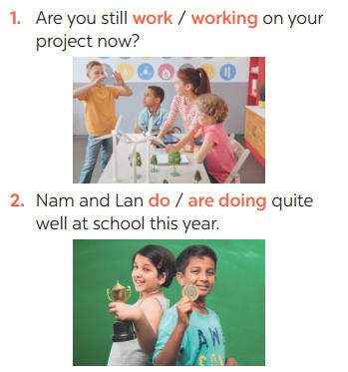
PRACTICE
3
Circle the correct form of the verb in each sentence
Aim of the task:
To practise using the present continuous forms

Slide 14
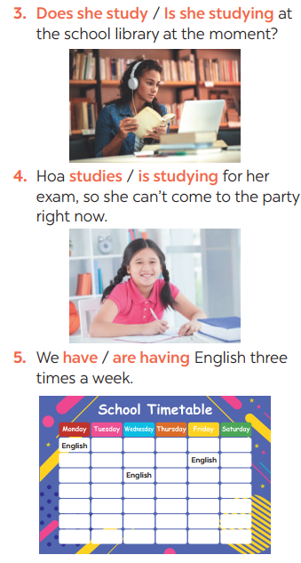
PRACTICE
3
Circle the correct form of the verb in each sentence

Slide 15
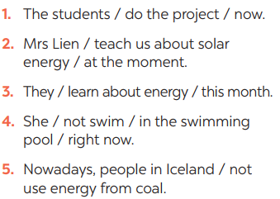
PRACTICE
4
Write sentences about what the people are doing or not doing, using the suggestions.
Aim of the task:
To practise making sentences using the present continuous
Answers:
1- The students are doing the project now.
2- Mrs. Lien is teaching us about solar energy at the moment.
3- They are learning about energy this month.
4- She isn’t swimming in the swimming pool right now.
5- Nowadays, people in Iceland aren’t using energy from coal.

Slide 16
LESSON 3: A CLOSER LOOK 2
WARM-UP
JUMBLE SENTENCES
PRESENTATION
THE PRESENT CONTINUOUS
Task 1: Work in pairs. Tell your partner what the people in the pictures are doing
Task 2: Complete the sentences, using the present continuous form of the verbs in brackets.
Task 3: Circle the correct form of the verb in each sentence.
Task 4: Write sentences about what the people are doing or not doing, using the suggestions.
PRACTICE
PRODUCTION
Task 5: Work in pairs. Ask and answer the following questions.

Slide 17
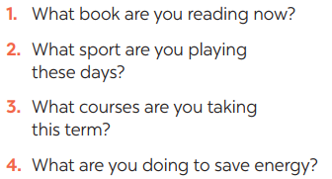

PRODUCTION
5
Work in pairs. Ask and answer the following questions.

Slide 18
LESSON 3: A CLOSER LOOK 2
WARM-UP
JUMBLE SENTENCES
PRESENTATION
THE PRESENT CONTINUOUS
Task 1: Work in pairs. Tell your partner what the people in the pictures are doing
Task 2: Complete the sentences, using the present continuous form of the verbs in brackets.
Task 3: Circle the correct form of the verb in each sentence.
Task 4: Write sentences about what the people are doing or not doing, using the suggestions.
PRACTICE
PRODUCTION
Task 5: Work in pairs. Ask and answer the following questions.
CONSOLIDATION
Wrap-up
Home work

Slide 19
CONSOLIDATION
1
WRAP-UP
GRAMMAR:
THE PRESENT CONTINUOUS

Slide 20
CONSOLIDATION
2
HOMEWORK
Exercises in the workbook.

Slide 21


