Slide 1




………………….. Secondary School
WELCOME TO OUR CLASS!
Presented by ………..………….

Slide 2


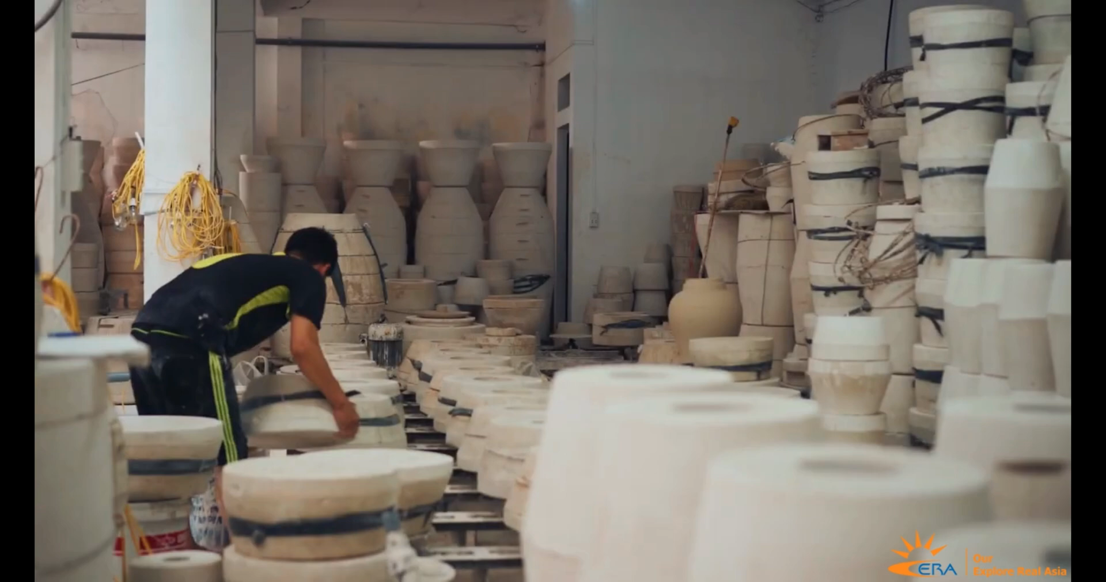
WATCHING A VIDEO
BAT TRANG POTTERY VILLAGE

Slide 3
Unit 1:
LOCAL COMMUNITY
Lesson 5: Skills 1

Slide 4


READING

Slide 5
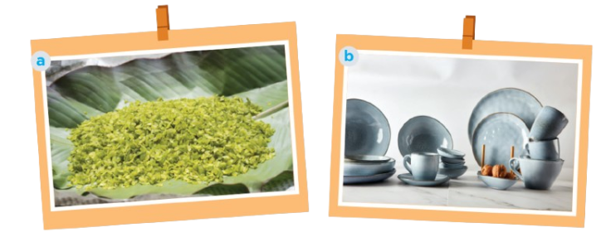

1. Work in pairs. Answer the questions.
1. What can you see in each picture? 2. Do you know any place(s) where people make the thing(s) in each picture?

Slide 6

CỐM - YOUNG STICKY RICE
Vong Village , Ha Noi
Tu Le Commune in Yen Bai Province

Slide 7
GỐM - POTTERY
Denby, England
Some pottery village: Bat Trang, Bau Truc, Phu Lang,…

Slide 8

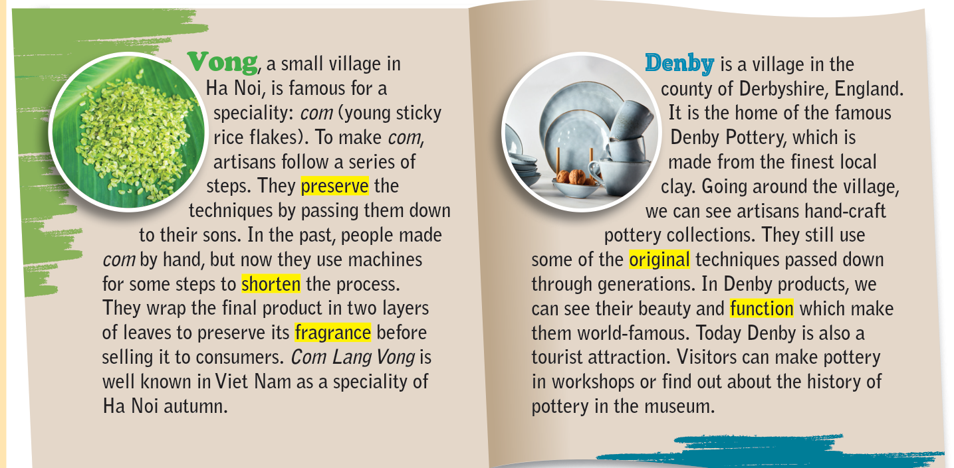

2. Read the brochure introducing different places with special products. Match each highlighted word with its definition.

Slide 9


Match each highlighted word with its definition
1. preserve
a. existing since the beginning
2. shorten
b. to keep something as it is
3. fragrance
c. to make something shorter
4. original
d. a special purpose of a thing
5. function
e. a pleasant smell

Slide 10


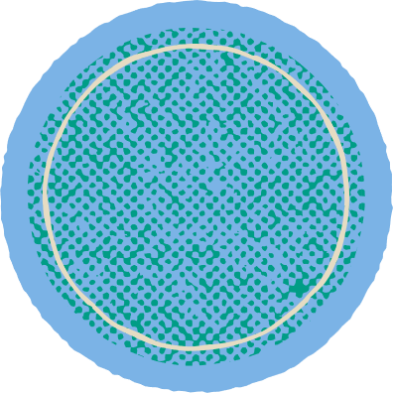
Check your answer
a. existing since the beginning
1. preserve
b. to keep something as it is
c. to make something shorter
d. a special purpose of a thing
bảo tồn
e. a pleasant smell

Slide 11
Check your answer
a. existing since the beginning
2. shorten
b. to keep something as it is
c. to make something shorter
d. a special purpose of a thing
rút ngắn
e. a pleasant smell

Slide 12
Check your answer
a. existing since the beginning
3. fragrance
b. to keep something as it is
c. to make something shorter
hương thơm
d. a special purpose of a thing
e. a pleasant smell

Slide 13
Check your answer
a. existing since the beginning
4. original
b. to keep something as it is
c. to make something shorter
nguồn gốc
d. a special purpose of a thing
e. a pleasant smell

Slide 14
Check your answer
a. existing since the beginning
5. function
b. to keep something as it is
c. to make something shorter
chức năng
d. a special purpose of a thing
e. a pleasant smell

Slide 15
Look at the answers again
1. preserve
b. to keep something as it is
bảo tồn
2. shorten
c. to make something shorter
rút ngắn
3. fragrance
e. a pleasant smell
hương thơm
4. original
a. existing since the beginning
nguồn gốc
5. function
d. a special purpose of a thing
chức năng

Slide 16
3. Read the brochure again. Decide which place each detail below belongs to
 | Vong | Denby
1. people make the speciality from local material
2. people make the product from plants
3. people make the product with some traditional techniques
4. the product is famous worldwide
5. the product symbolizes a season

Slide 17


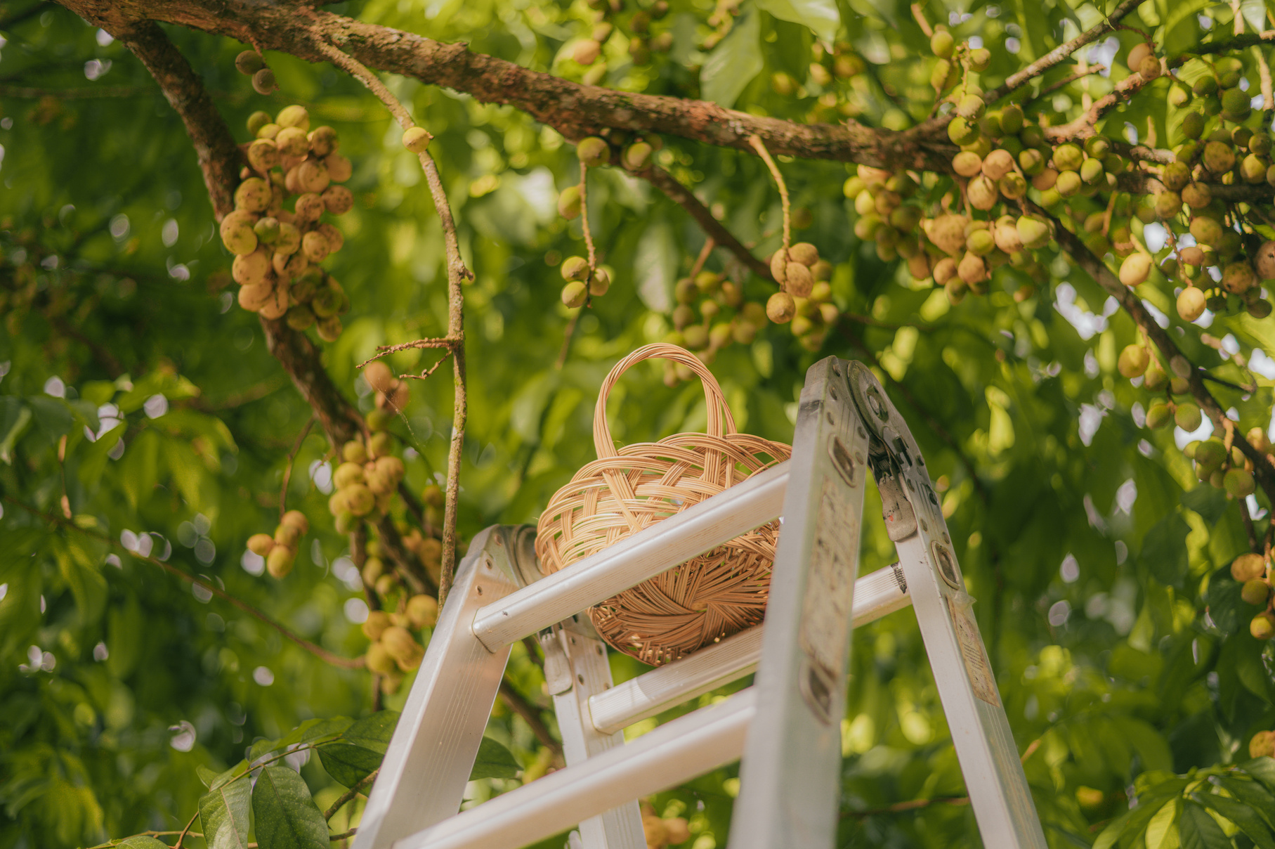


Check your answers
 | Vong
1. people make the speciality from local material
2. people make the product from plants
3. people make the product with some traditional techniques
4. the product is famous worldwide
5. the product symbolizes a season

Slide 18
Check your answers
 | Denby
1. people make the speciality from local material
2. people make the product from plants
3. people make the product with some traditional techniques
4. the product is famous worldwide
5. the product symbolizes a season

Slide 19
Look at the answers again
 | Vong | Denby
1. people make the speciality from local material
2. people make the product from plants
3. people make the product with some traditional techniques
4. the product is famous worldwide
5. the product symbolizes a season

Slide 20
SPEAKING

Slide 21

Match the questions with the correct answers
1. What speciality is it? 2. What do people make it from? 3. Do people make it in the traditional way? 4. What can people do with it? 5. Is it well known in only your country or around the world?
a. It is well known all over the country. b. People make it from goi leaves.
c. Yes, they do.
d. It is a conical hat.
e. A conical hat protects us from the sun and the rain as well as makes us more graceful.

Slide 22
Check your answers
1. What speciality is it?
d. It is a conical hat.
2. What do people make it from?
b. People make it from goi leaves.
c. Yes, they do.
3. Do people make it in the traditional way?
e. A conical hat protects us from the sun and the rain as well as makes us more graceful.
4. What can people do with it?
5. Is it well known in only your country or around the world?
a. It is well known all over the country.

Slide 23


4. Ask and answer about a speciality in your neighbourhood, your hometown, or the area you know. Use the questions below.
1. What speciality is it? 2. What do people make it from? 3. Do people make it in the traditional way? 4. What can people do with it? 5. Is it well known in only your country or around the world?

Slide 24

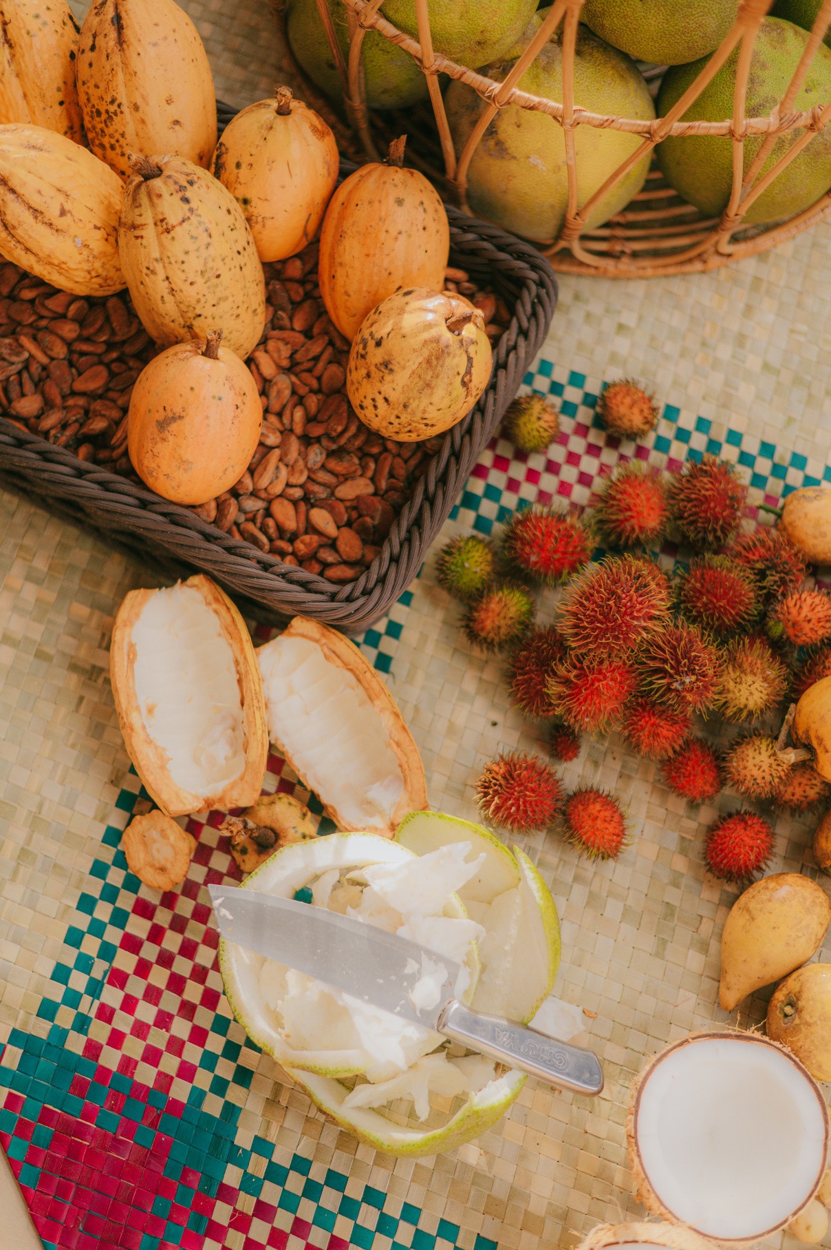

5. Work in groups. Give a short presentation about the speciality you discussed in 4.
I live in Tay Ho Village, 12 kilometres from Hue City. My village is famous for its conical hats. We make conical hats from goi leaves. We still follow 15 traditional steps to make a hat. A conical hat protects us from the sun and the rain as well as makes us more graceful. What is special about our conical hats is that each of them carries a poem. Tay Ho conical hats are not only famous in Hue but all over Viet Nam.

Slide 25
WRAP UP
What have we learnt in this lesson?
Read for specific information about special products in some areas.
Give a short presentation about a speciality.

Slide 26
HOMEWORK
- Learn by heart vocabulary
- Do exercises in the workbook
- Prepare: Skills 2

Slide 27


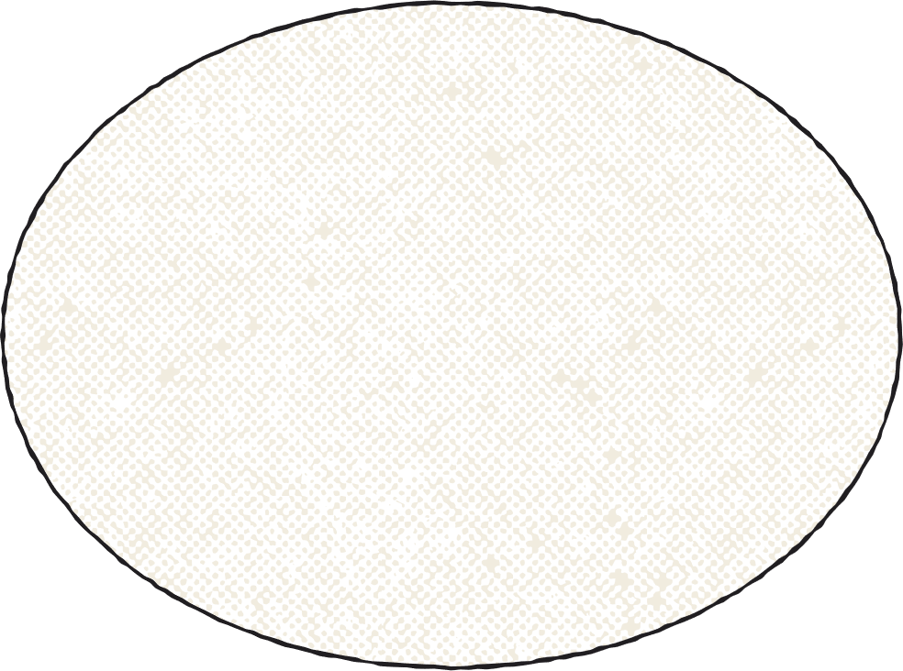

THANK YOU!

