Slide 2
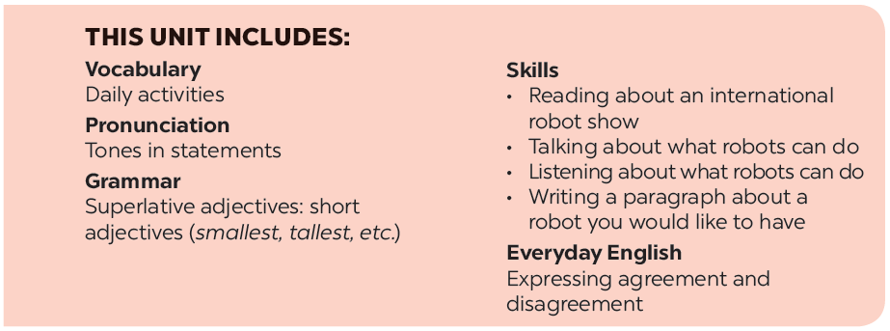

Slide 3
At an International Robot Show
Listen and read.
Match the following activities with the pictures.
Read the conversation again and tick () T (True) or F (False).
Miming
Work in groups. A student mimes one of the activities in 4 and the others try to guess. Then swap.
Complete the following sentences, using the adjectives in the box.

Slide 4
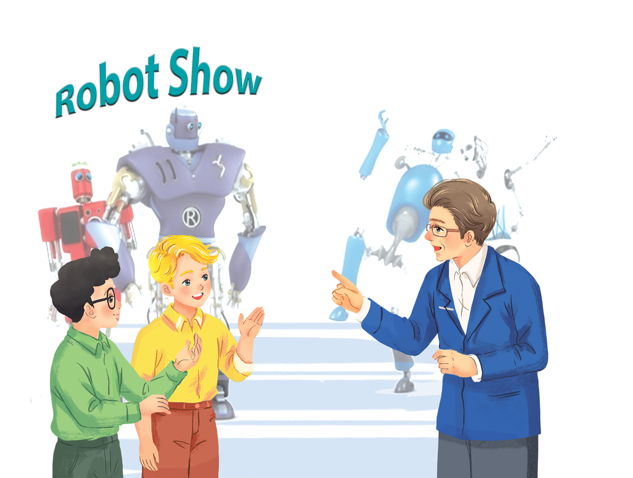
Listen and read.
At an International Robot Show

Slide 5
At an International Robot Show
Nick: Dr Adams! Can you tell us about the robots in the show, please?
Dr Adams: Sure. This is H8, a home robot. It can do the dishes, iron clothes, put toys away …
Nick: It looks very useful!
Dr Adams: Yes, it can even make meals.
Phong: Look! That’s the biggest robot in the show.
Dr Adams: Right, it’s WB2, a worker robot. It’s the strongest and fastest robot here.
Nick: What can it do?
Dr Adams: It can move heavy things or repair broken machines.
Nick: And what is this?
Dr Adams: It’s Shifa, a doctor robot. It’s the smartest robot. It can help sick people and do many things like humans.

Slide 6
Read the conversation again and tick () T (True) or F (False).
 | T | F
1. H8 is a very useful robot.
2. WB2 can’t repair broken machines.
3. Shifa is a doctor robot.
4. H8 is the fastest in the robot show.
5. Shifa is very smart.






Slide 7
Complete the following sentences, using the adjectives in the box.
fast
smart
useful
heavy
strong
My dad bought me a very
week. It helps me to do many household chores.
_______ home robot last
1.
useful home robot last
This is a very
300 km per hour.
2.
_______ car. It can travel at a speed of
fast car. It can travel at a speed of
3.
_______. He can move a big car!
He’s very
strong. He can move a big car!
4.
They’re making a very
30 languages.
_______ robot. It can understand
smart robot. It can understand
_______ for me to move on my own.
5.
The table is too
heavy for me to move on my own.

Slide 8
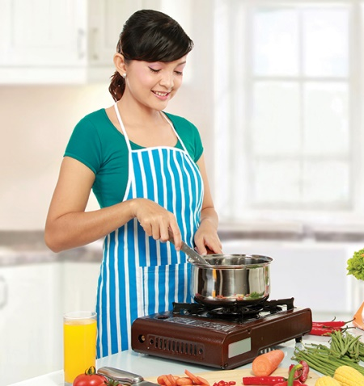
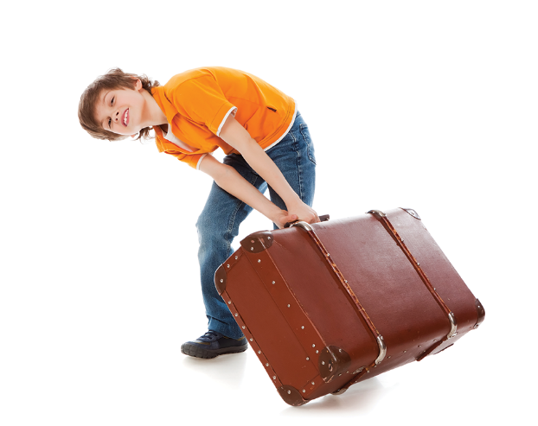
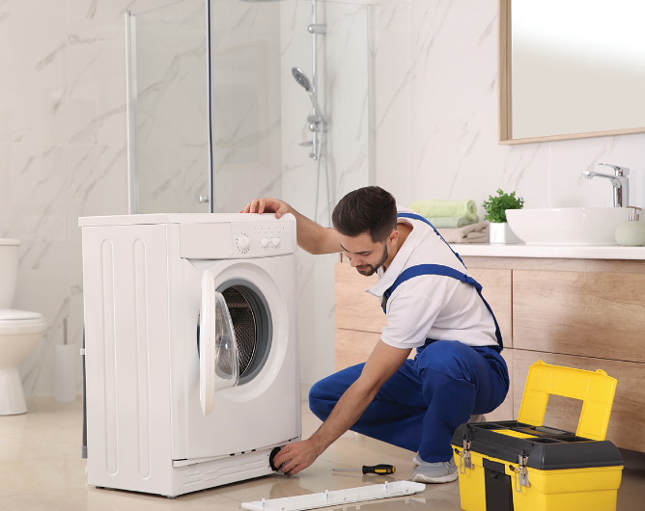
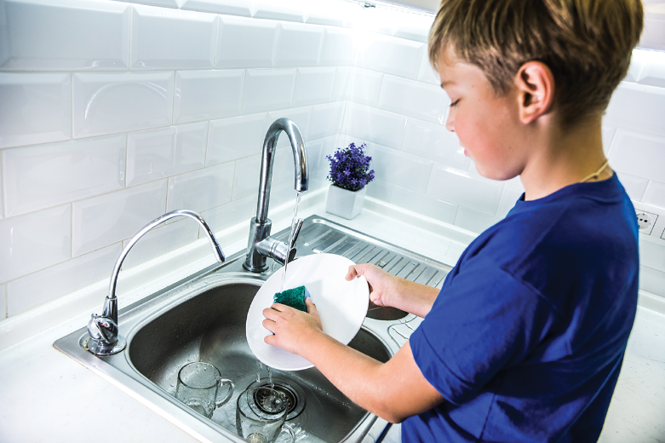
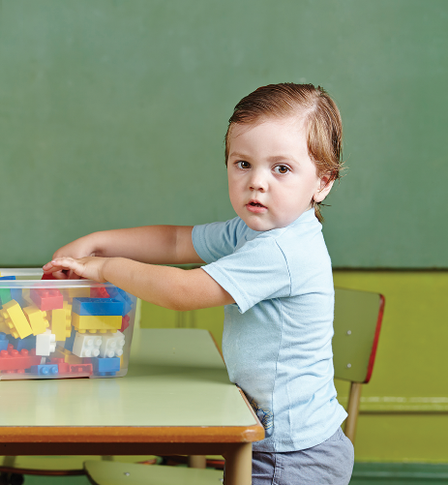
Match the following activities with the pictures.
a.
iron clothes
c.
move heavy things
e.
repair a broken machine
b.
make meals
d.
do the dishes
f.
put toys away
1
2
3
4
5
6

Slide 9
a.
iron clothes
c.
move heavy things
e.
repair a broken machine
b.
make meals
d.
do the dishes
f.
put toys away
1
2
3
b.
make meals
c.
move heavy things
e.
repair a broken machine
4
5
6
d.
do the dishes
f.
put toys away
a.
iron clothes

Slide 10
Miming
Work in groups. A student mimes one of the activities in 4 and the others try to guess. Then swap.
Example:
A: What am I doing?
B: You’re doing the dishes.
A: Yes, that’s right. / No, try again.

Slide 11
Website: hoclieu.vn
Fanpage: facebook.com/www.tienganhglobalsuccess.vn/

