Slide 1


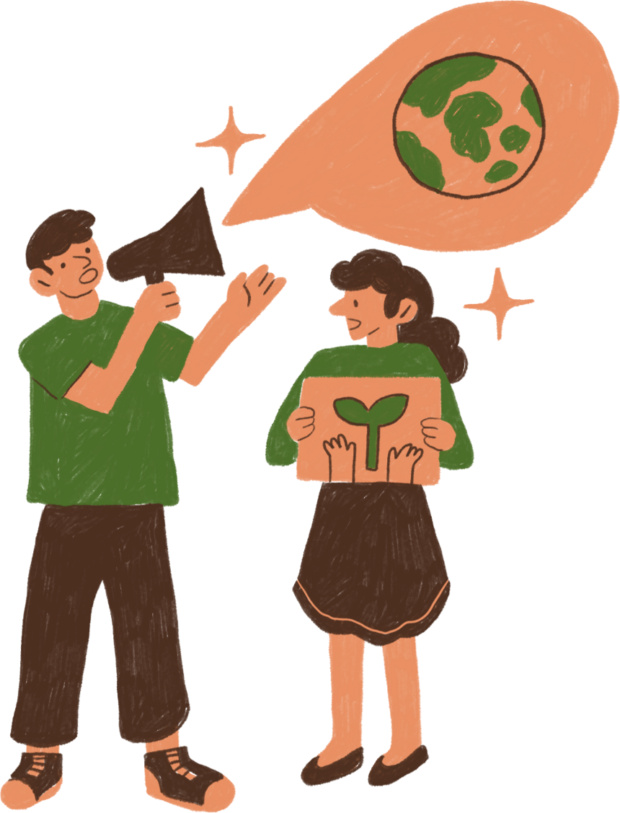
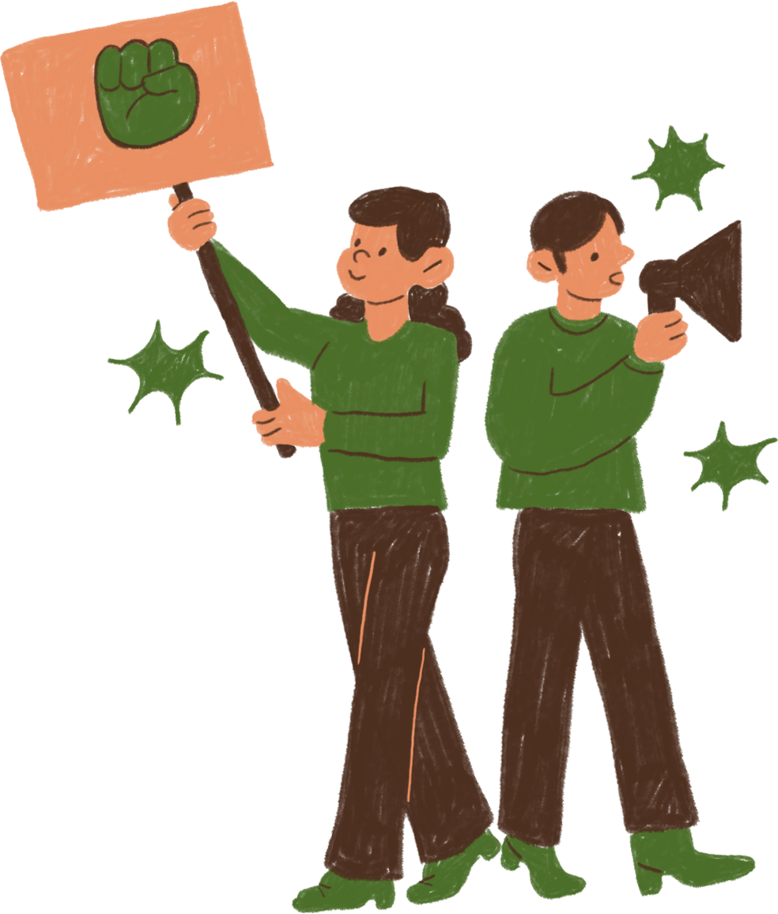
WELCOME TO OUR CLASS!
Presentation by ………….

Slide 2




Bee & beehive

Slide 3
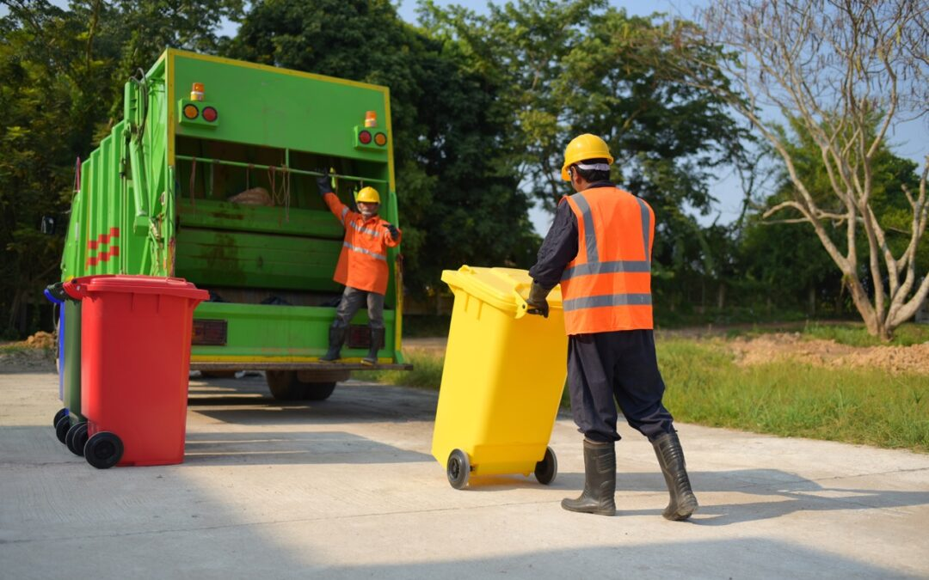
garbage collector

Slide 4
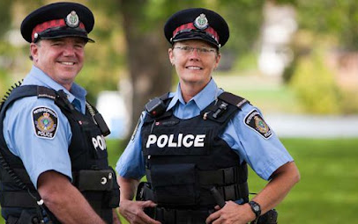
police officer

Slide 5
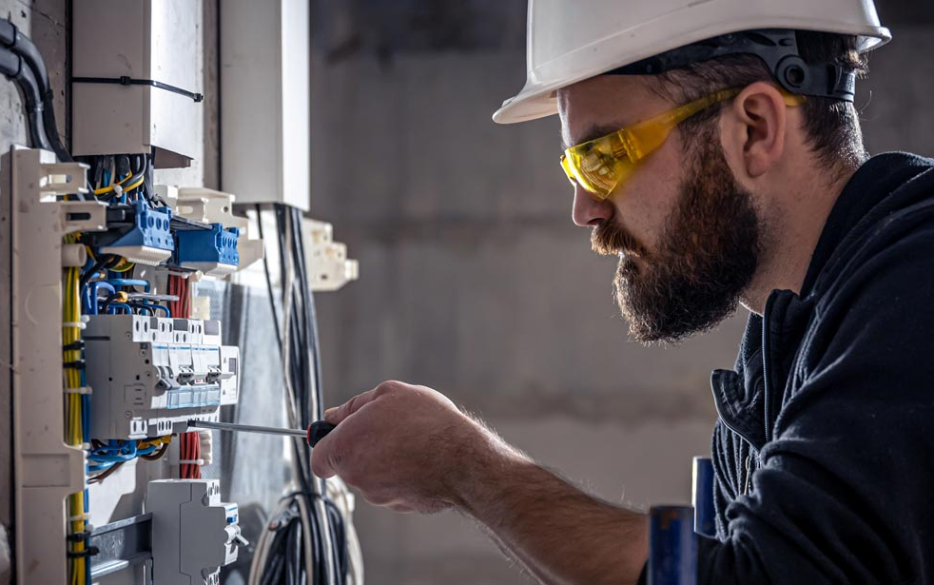
electrician

Slide 6
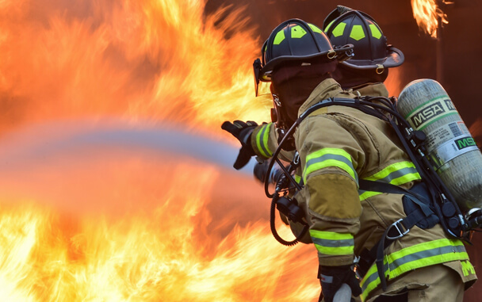
firefighter

Slide 7
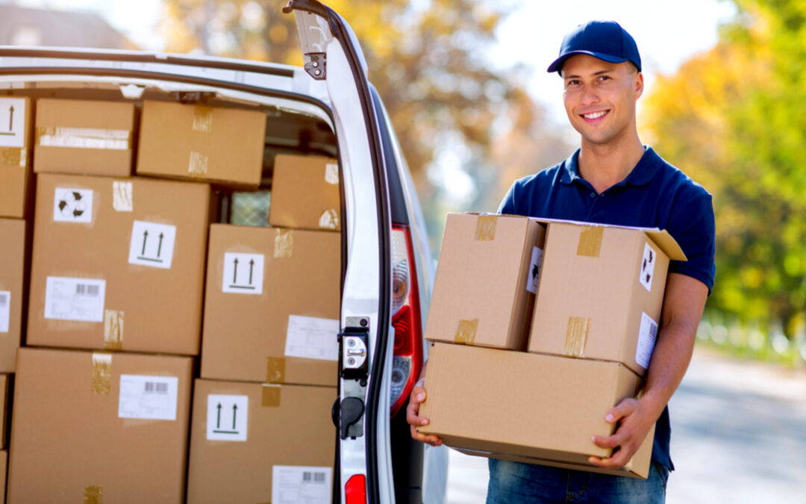
delivery person

Slide 8
Who is your favourite community helper?
Why?

Slide 9
Unit 1:
LOCAL COMMUNITY
Lesson 6: Skills 2

Slide 10
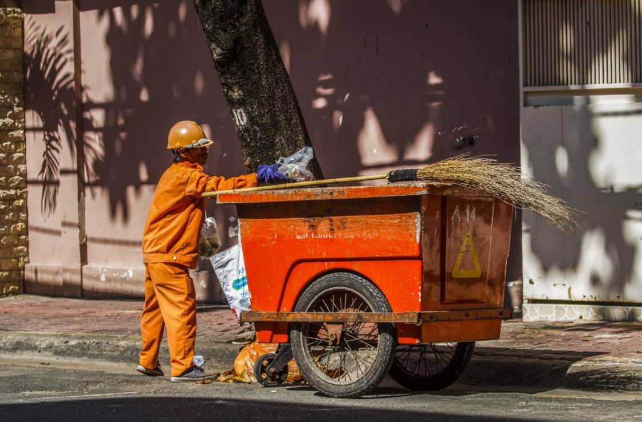
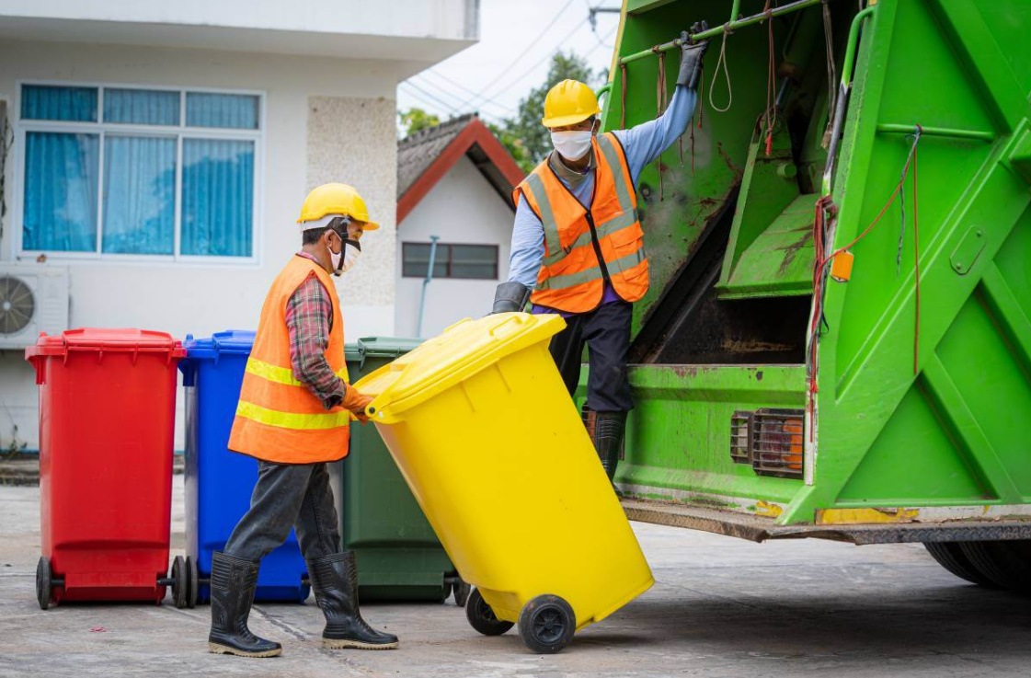
1. Work in pairs. Discuss the questions.
1. Who can you see in the pictures?
2. What are they doing?
We can see garbage collectors.
They are taking the garbage away.

Slide 11

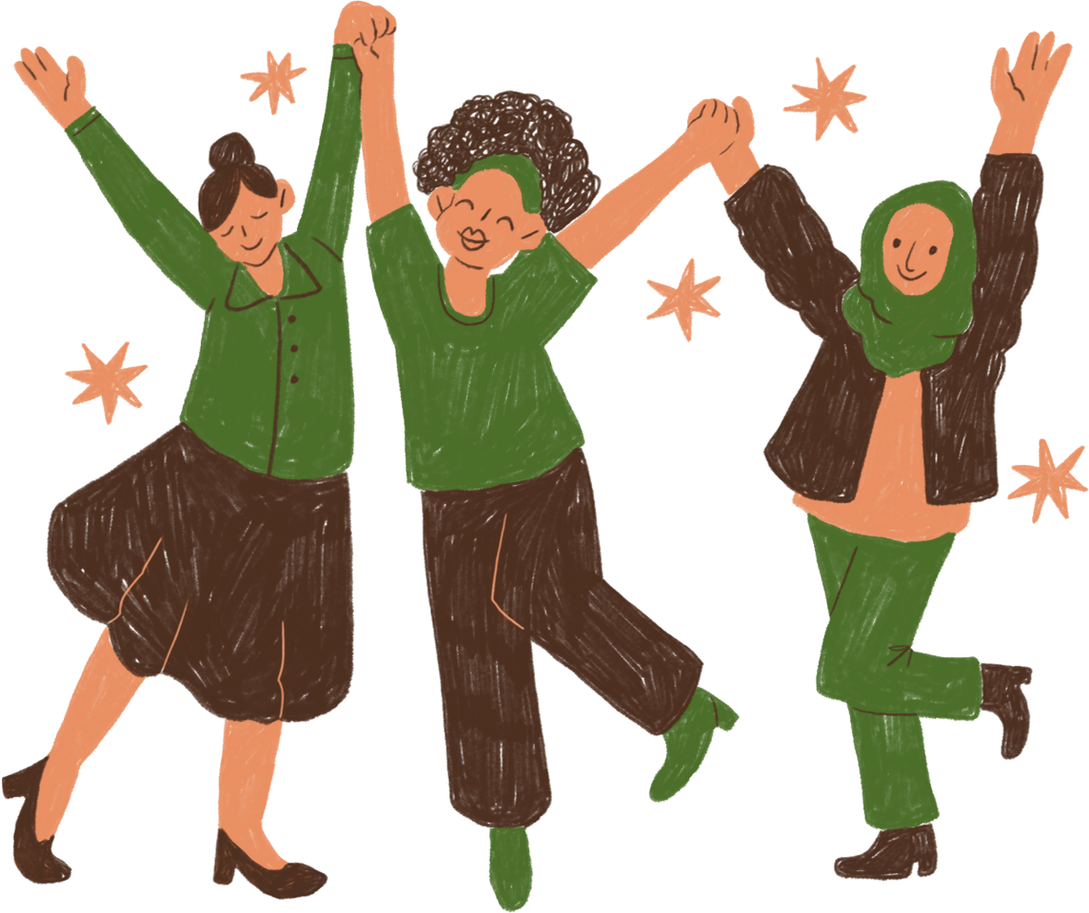
2. Listen and fill in each blank with no more than two words.
1. The name of the writing contest is “My Favourite ______________”. 2. Mr Vinh is a _______________. 3. He is tall and __________________. 4. He is hard-working, responsible, and _______________.
Community Helper
garbage collector
slim
friendly
1
2
3
4

Slide 12

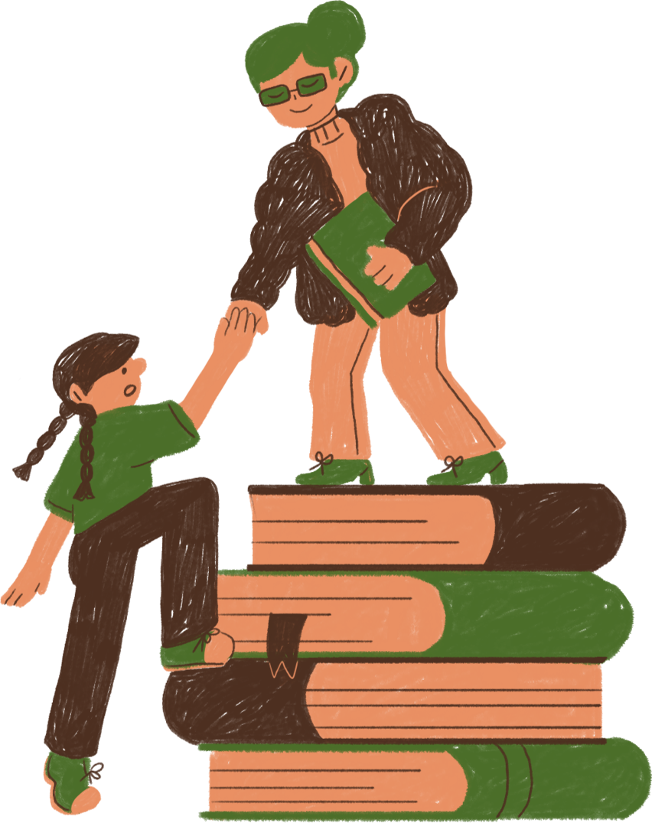
3. Listen again and tick T (True) or F (False)
 | T | F
1. Mr. Vinh wears an orange uniform.
2. He arrives at Mi’s neighbourhood at 9 p.m. everyday.
3. He instructs people to put rubbish in two types of bins.
4. He shares information about his work and the importance of sorting rubbish.
green
6 p.m.
1
2
3
4

Slide 13
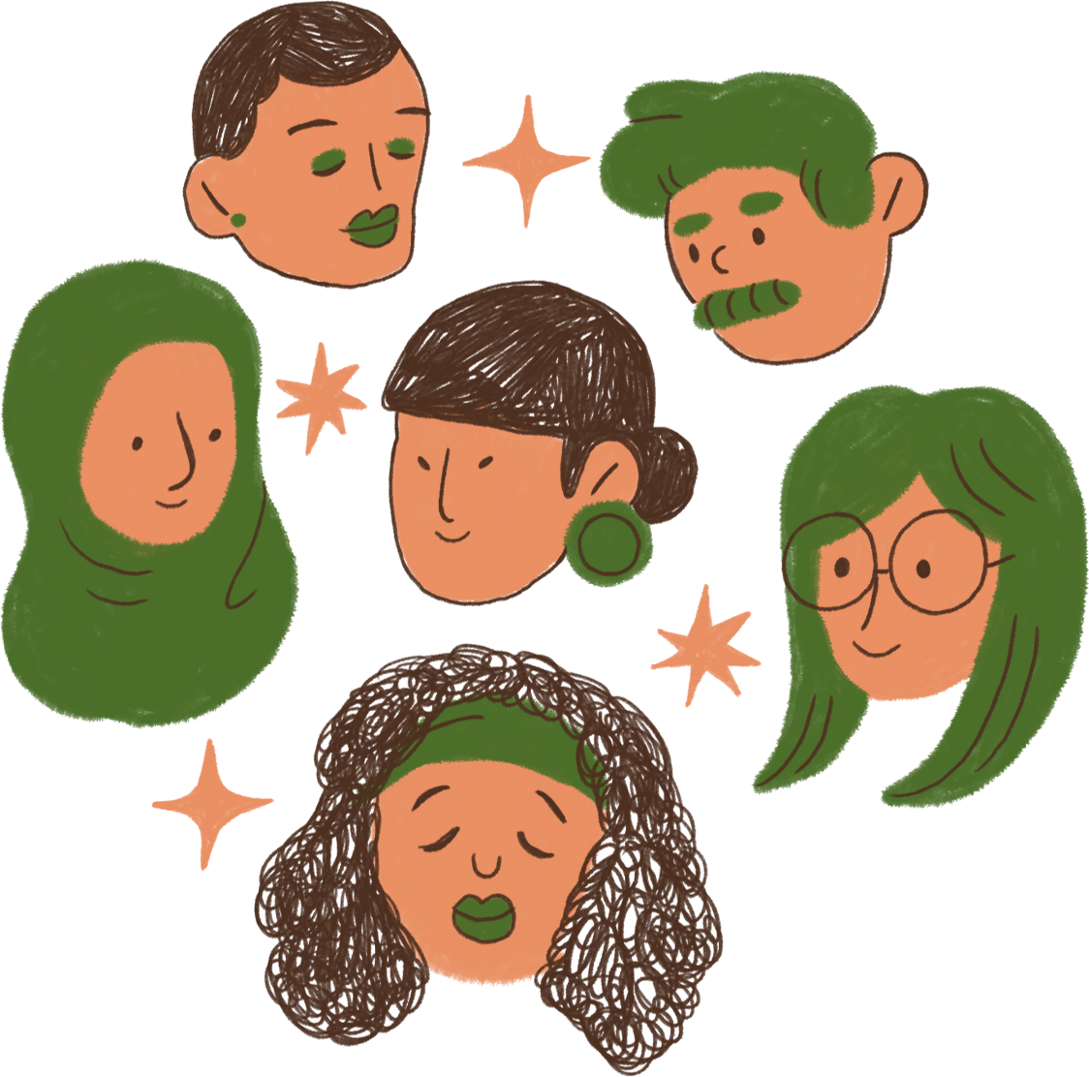
4. Work in pairs. Choose a community helper you like and answer the following questions.
– What is his / her job?
– What does he / she look like?
– What is he / she like?
– What does he / she do for the community?
– How do you feel about him / her?

Slide 14
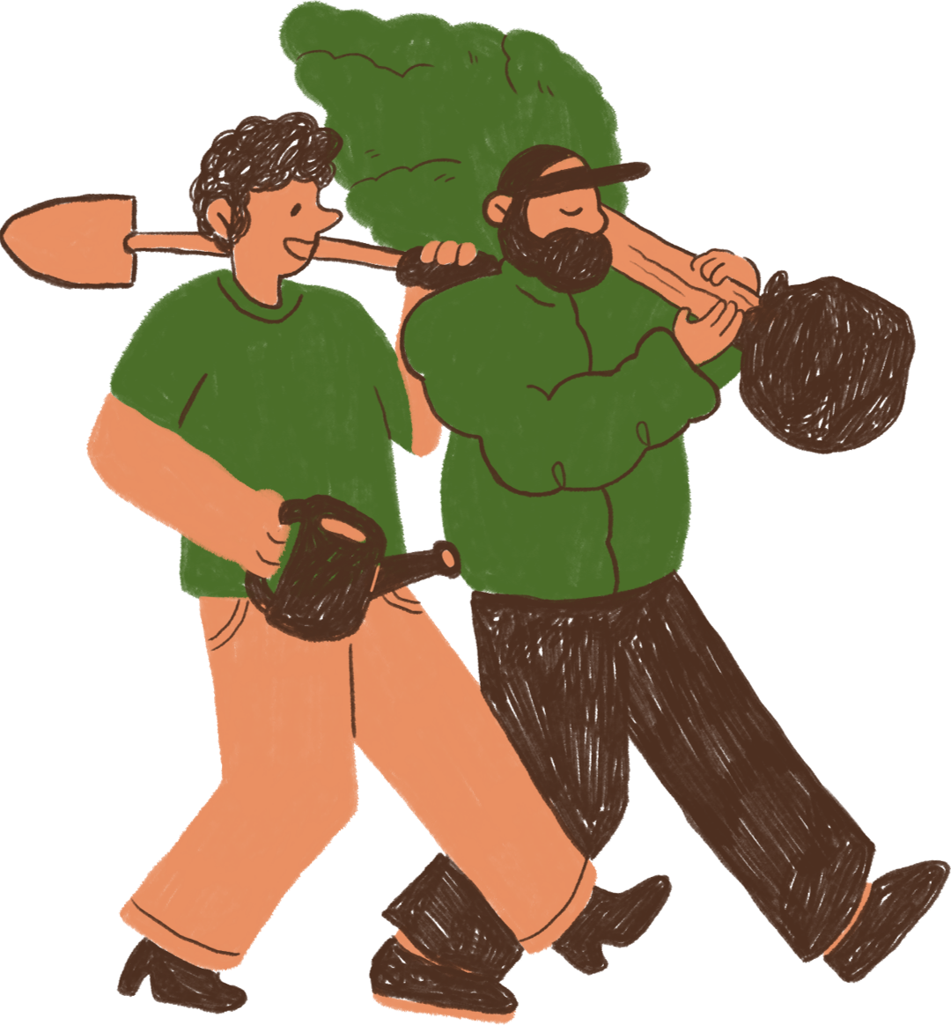
5. Write a paragraph (about 100 words) about your favorite community helper. Use the answers to the questions in 4 to help you.
My favourite community helper is Mr Nam. He is a delivery person in my neighbourhood. He is a friendly person. Whenever he delivers something to us, he smiles happily. He sometimes asks me about my study. In addition, he is hard-working and responsible. He delivers goods to my family and other families in the neighbourhood despite the weather. Sometimes he has to return twice to deliver us a parcel because we are not at home. I really appreciate his manner. In general, Mr Nam is a very dedicated community helper who makes our life easy and comfortable.

Slide 15
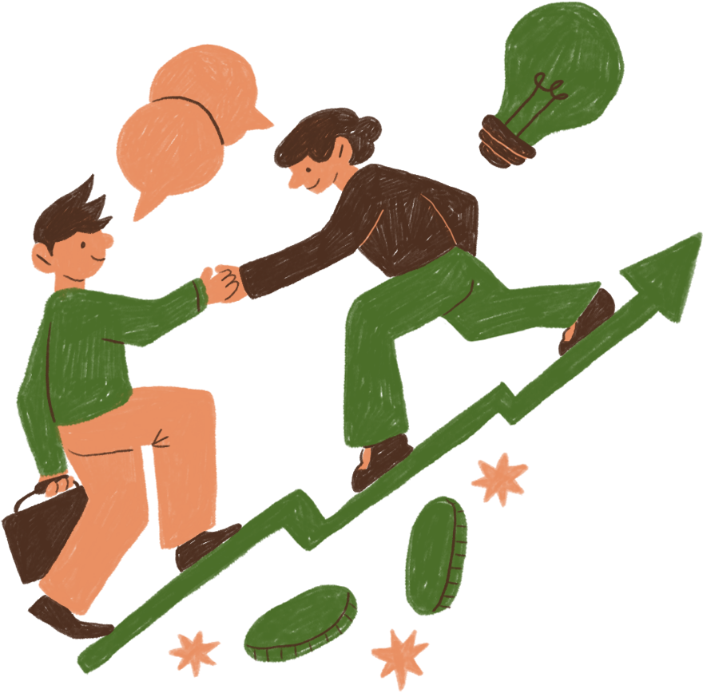
WRAP UP
What have we learnt in this lesson?
Listen for specific information about a community helper.
Write a paragraph about a community helper.

Slide 16
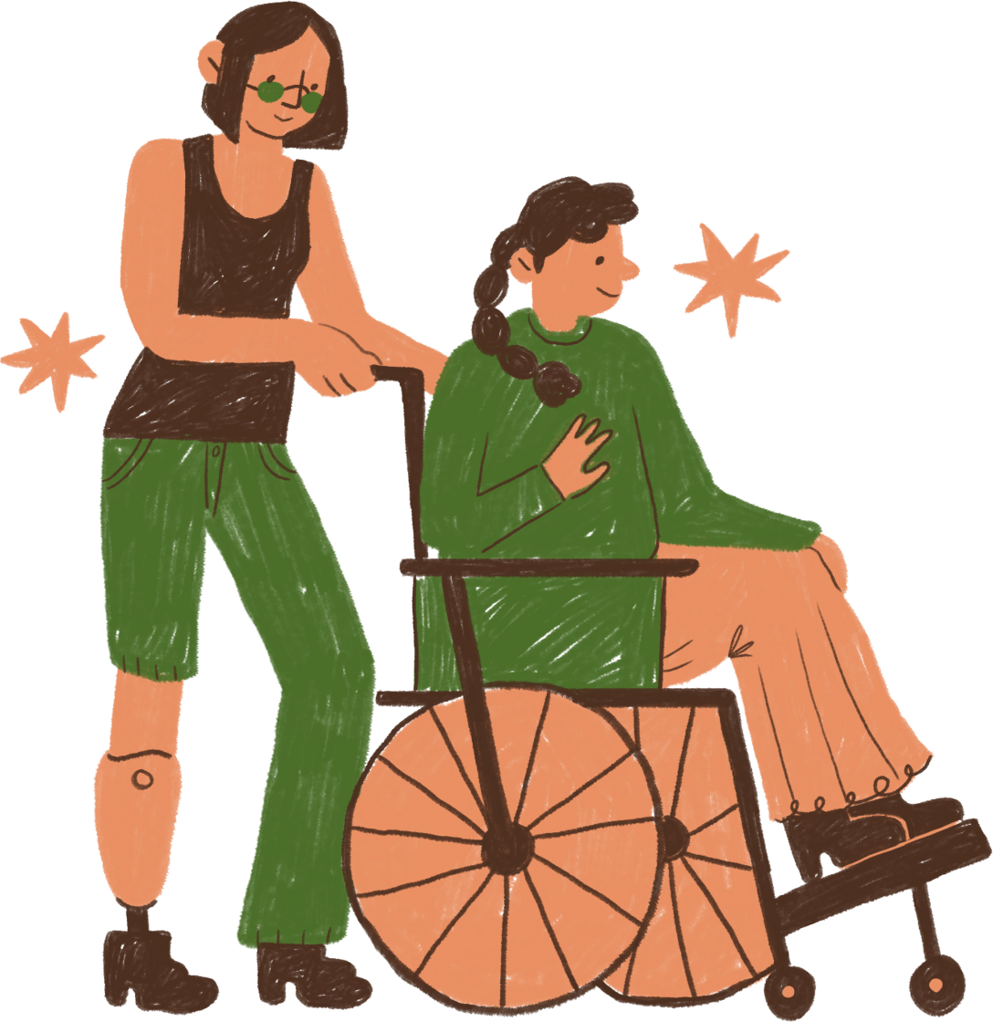
HOMEWORK
- Complete the writing task by yourself
- Do exercises in the workbook
- Prepare: Looking back + Project

Slide 17
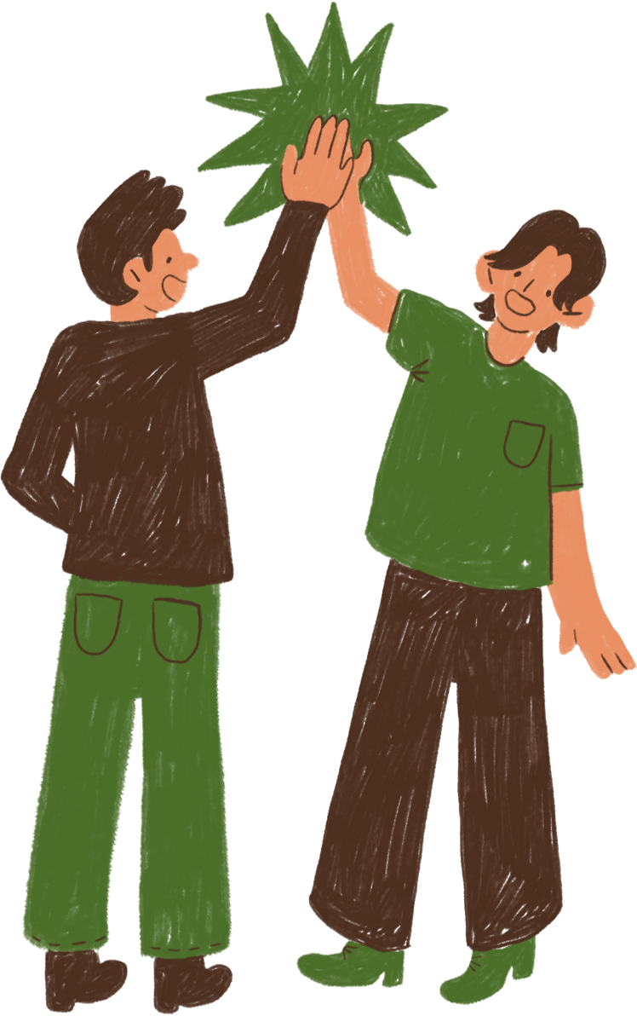
THANK YOU!

