Slide 1

Unit 6: Entertainment
Lesson 6d:
Everyday English
Page 109

Slide 2
Lesson Outline
Warm-up
Speaking
Pronunciation
Consolidation
Wrap-up

Slide 3
Objectives
By the end of this lesson, students will be able to…
- act out a dialogue choosing a TV programme/film to watch. - practise pronouncing diphthongs.

Slide 4

WARM-UP

Slide 5
Match the adjectives to describe types of TV programmes/films in the correct columns
Documentary
exciting
amusing
Action film
educational
Cartoon
frightening
Thriller
fantastic
Science fiction

Slide 6

It’s time to learn …

Slide 7

Pre-speaking

Slide 8

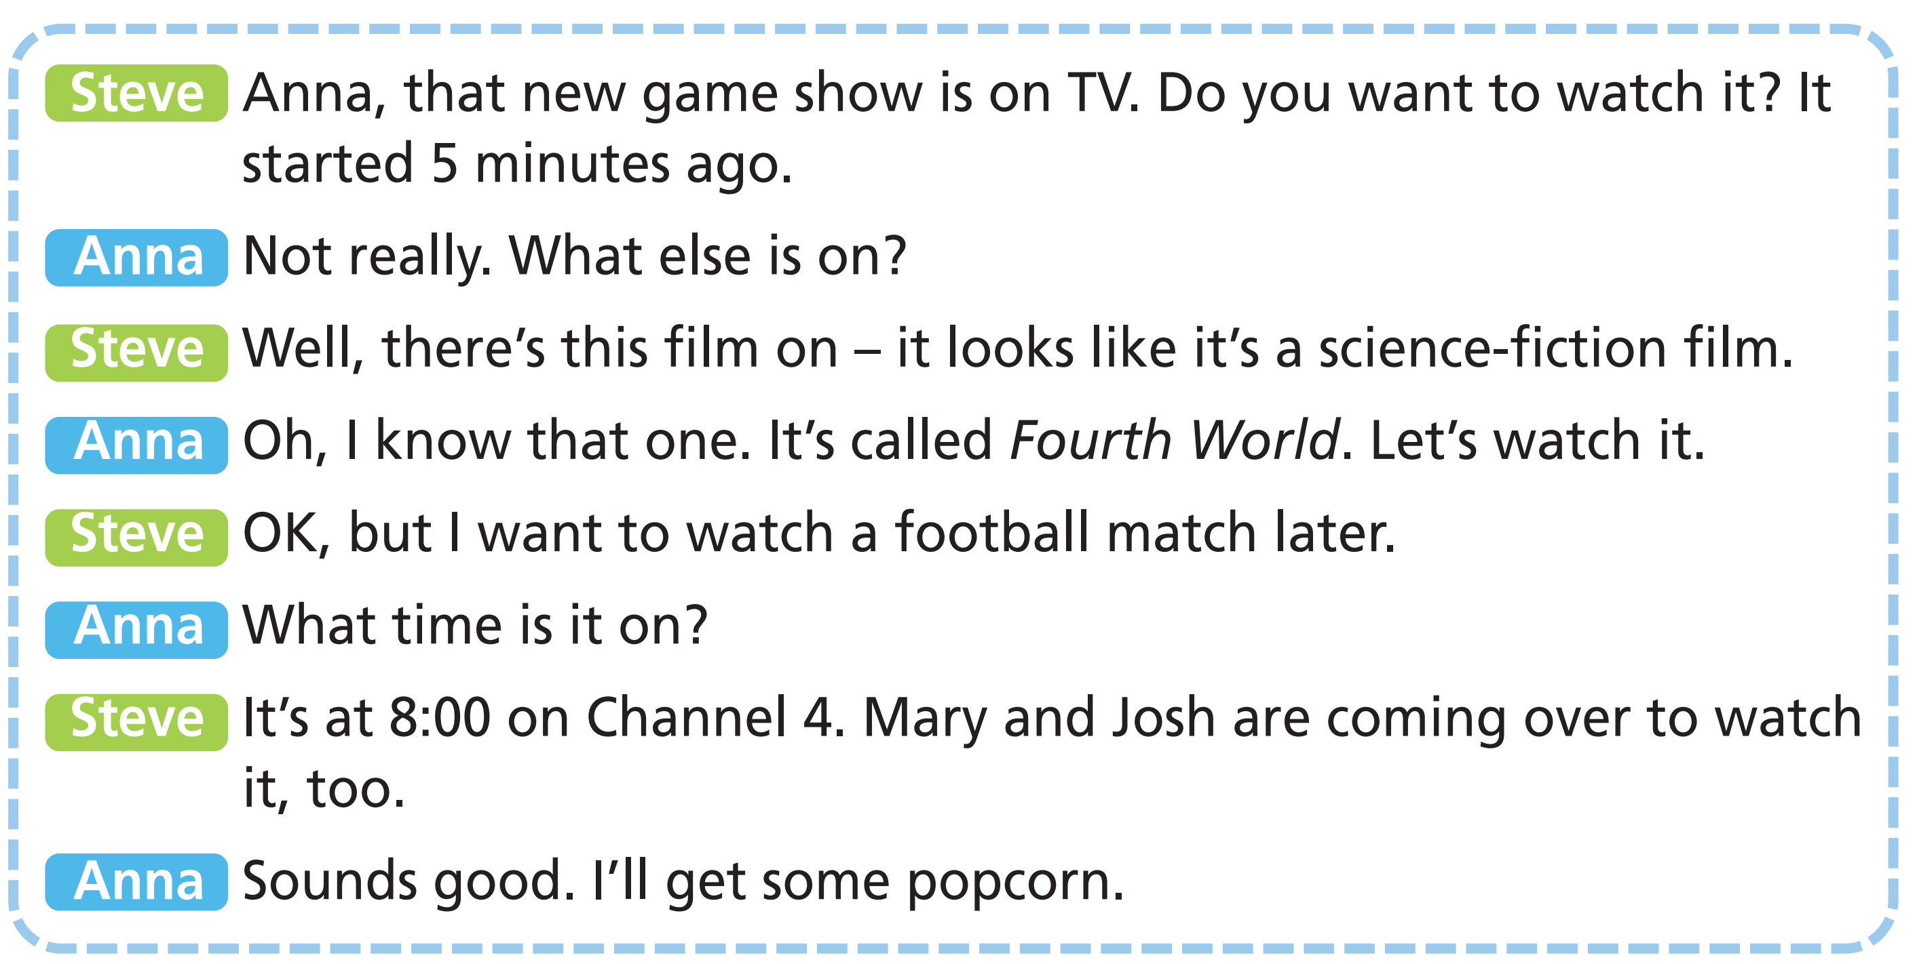
1 Steve and Anna are trying to decide what to watch on TV. What do they choose to watch? Listen and read to find out.
Science fiction
a football match at 8:00 on Channel 4

Slide 9
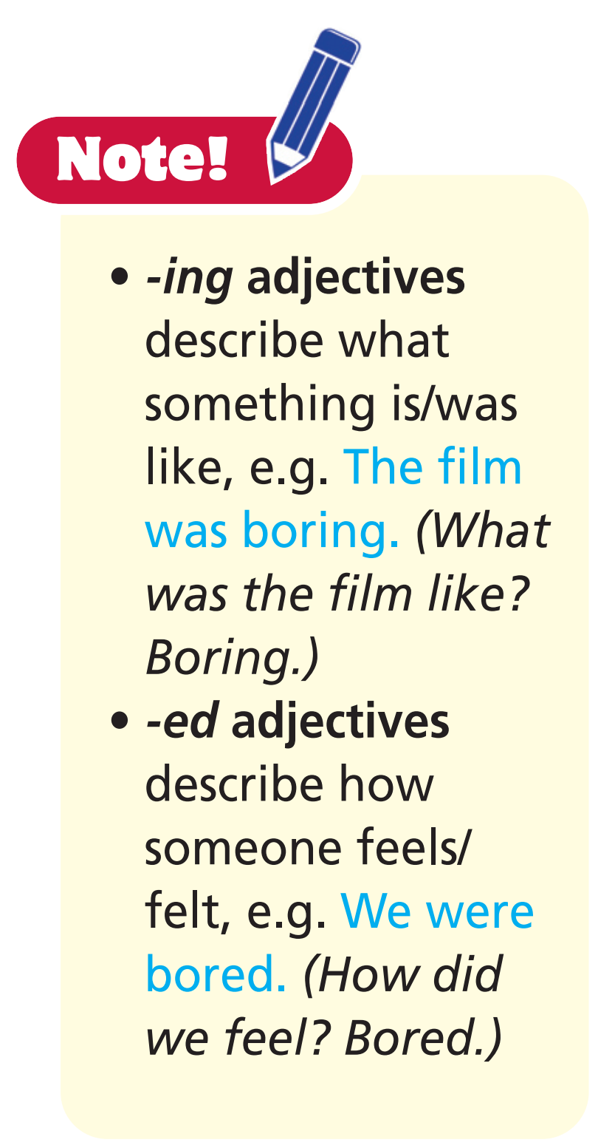
2 Complete the gaps with -ing or -ed adjectives of the verbs in brackets.
1 The action film is really ______________ (excite). 2 They are ______________ (interest) in watching the documentary. 3 You’ll be ______________ (disappoint) by the acting. 4 The special effects are ______________ (amaze).
exciting
interested
disappointed
amazing

Slide 10
Extra Activity
Ss play in teams. Say an -ing/-ed adjective. Ss say a sentence using the other form. Each correct answer gets 1 point. The team with the most points is the winner.
Example
T: interesting Team A S1: I am interested in documentaries.
T: bored Team B S1: I think soap operas are boring.

Slide 11

Practice

Slide 12

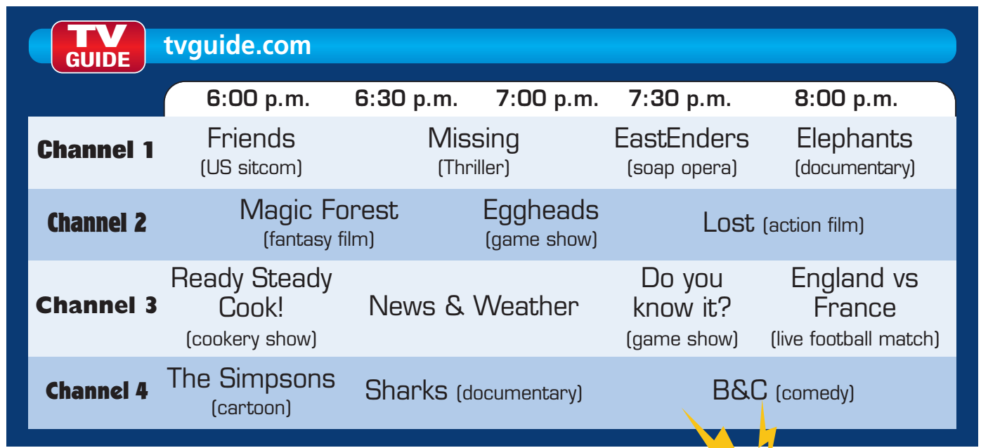
3 Act out a dialogue choosing a TV programme/film to watch. Use the online TV guide below and the dialogue in Exercise 1 as a model. Mind the sentence stress.

Slide 13
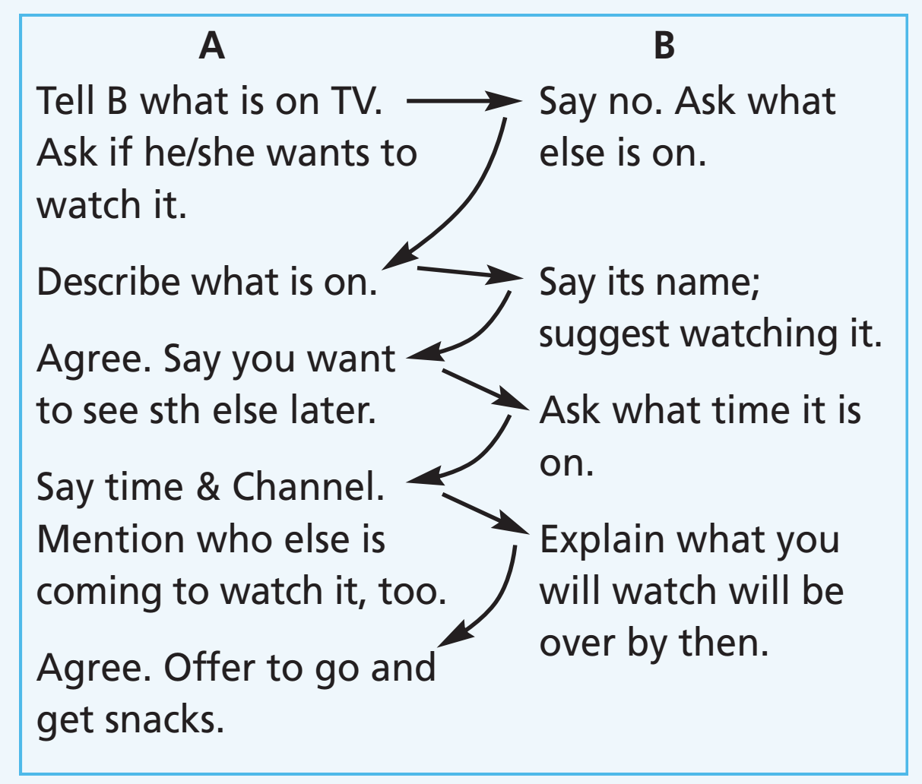
Example
A: Jim, your favourite sitcom is on TV. Do you want to watch it?
B: ‘Friends’? No, not really. What else is on?
A: Well, there’s this show on - it looks like it’s a fantasy show.
B: Oh, I know that one. It’s called ‘Magic Forest’. Let’s watch it.
A: OK, but I want to watch a comedy film later.
B: What time is it on?
A: It’s at 7:30 on Channel 4. Henry and Laura are coming over to watch it, too.
B: Don’t worry. The show will be over before it starts.
A: Great. I’ll go and get some snacks, then!

Slide 14

Post-speaking

Slide 15
Act out the dialogue in front of class.

Slide 16

Pronunciation

Slide 17
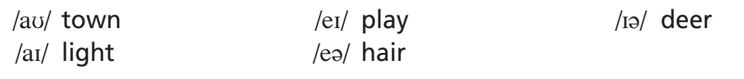
Diphthongs (sound that combines two vowels – when pronounced sound like one)
Listen and repeat.
Can you think of more words with these sounds?

Slide 18
Further practice
Listen and put the words in the correct columns.
brown
make
near
sky
fair
hear
share
say
out
bye
/aʊ/ | /ei/ | /ɪə/ | /ai/ | /eə/
Click the words to hear the sound.

Slide 19

CONSOLIDATION

Slide 20
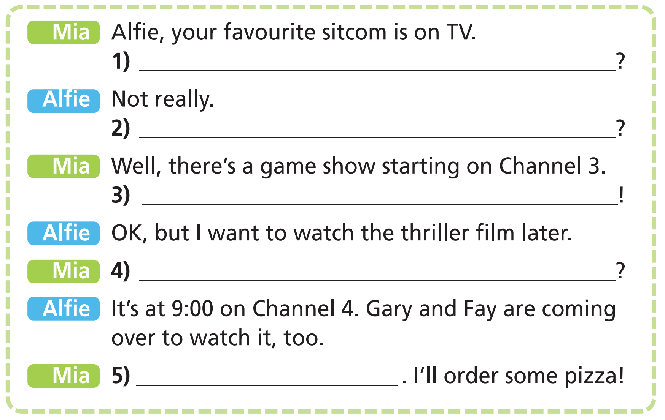
Complete the dialogue. Use these sentences. Three sentences are extra. Read the dialogue aloud.
Do you like them
Do you want to watch it
Let’s watch that
What time is it on
Sounds good
What else is on
I don’t think so
What’s it called

Slide 21

WRAP-UP

Slide 22
Today’s lesson
Vocabularies
TV programmes/films
-ing adjectives
-ed adjectives
Speaking
- Choose a TV/programme to watch.
- Pronunciation: diphthongs.

Slide 23
Homework
Practise the vocabularies and make sentences using them.
Do the exercises in TA 6 Right on WB (p. 57).
Prepare the next lesson (p. 110 SB).

Slide 24

Enjoy your day!

