Slide 2
Unit
5
1
Unit
FAMILY LIFE
INVENTIONS
LESSON 8
LOOKING BACK AND PROJECT

Slide 3
Unit
1
1
FAMILY LIFE
Family Life
Unit
OBJECTIVES
Review the vocabulary, pronunciation and grammar of Unit 5;
Apply what students have learnt into practice through a project.

Slide 4
LESSON 8
LOOKING BACK AND PROJECT
WARM-UP
Brainstorming
Pronunciation and vocabulary
Solve the crossword.
Grammar
Circle the correct answers.
LOOKING BACK
PROJECT
Inventions for the classroom
CONSOLIDATION
Wrap-up
Homework

Slide 5
LESSON 8
LOOKING BACK AND PROJECT
WARM-UP
Brainstorming

Slide 6
BRAINSTORMING
Brainstorm three-syllable nouns about topic Inventions
Camera
Inventor
Submarine
Invention
Telegraph
Computer
Telescope
Telephone
Beverage
Typewriter

Slide 7
LESSON 8
LOOKING BACK AND PROJECT
WARM-UP
Brainstorming
Pronunciation and vocabulary
Solve the crossword.
Grammar
Circle the correct answers.
LOOKING BACK

Slide 8
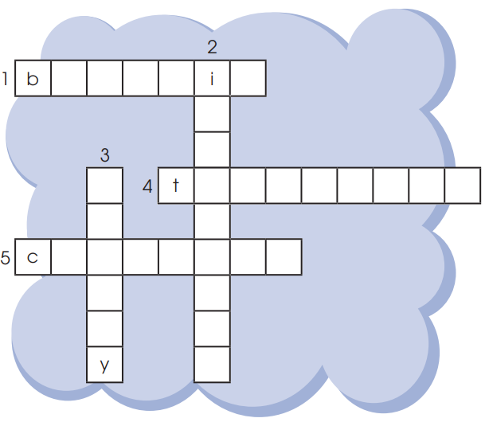
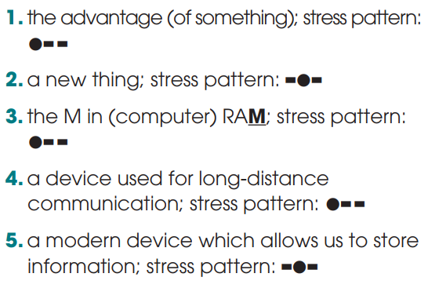
PRONUNCIATION & VOCABULARY
Solve the crossword.
benefit
invention
memory
telephone
computer

Slide 9
GRAMMAR
Circle the correct answers.
1. They just installed / have just installed some interesting software on the school computers. The programs are working very well and everyone enjoys to use / using them.
2. Smartphones allow people sending / to send information over long distances. Learn / To learn with a smartphone is fun as well.
3. Since television was invented / has been invented, TV designs changed / have changed a lot.

Slide 10
LESSON 8
LOOKING BACK AND PROJECT
WARM-UP
Brainstorming
Pronunciation and vocabulary
Solve the crossword.
Grammar
Circle the correct answers.
LOOKING BACK
PROJECT
Inventions for the classroom

Slide 11
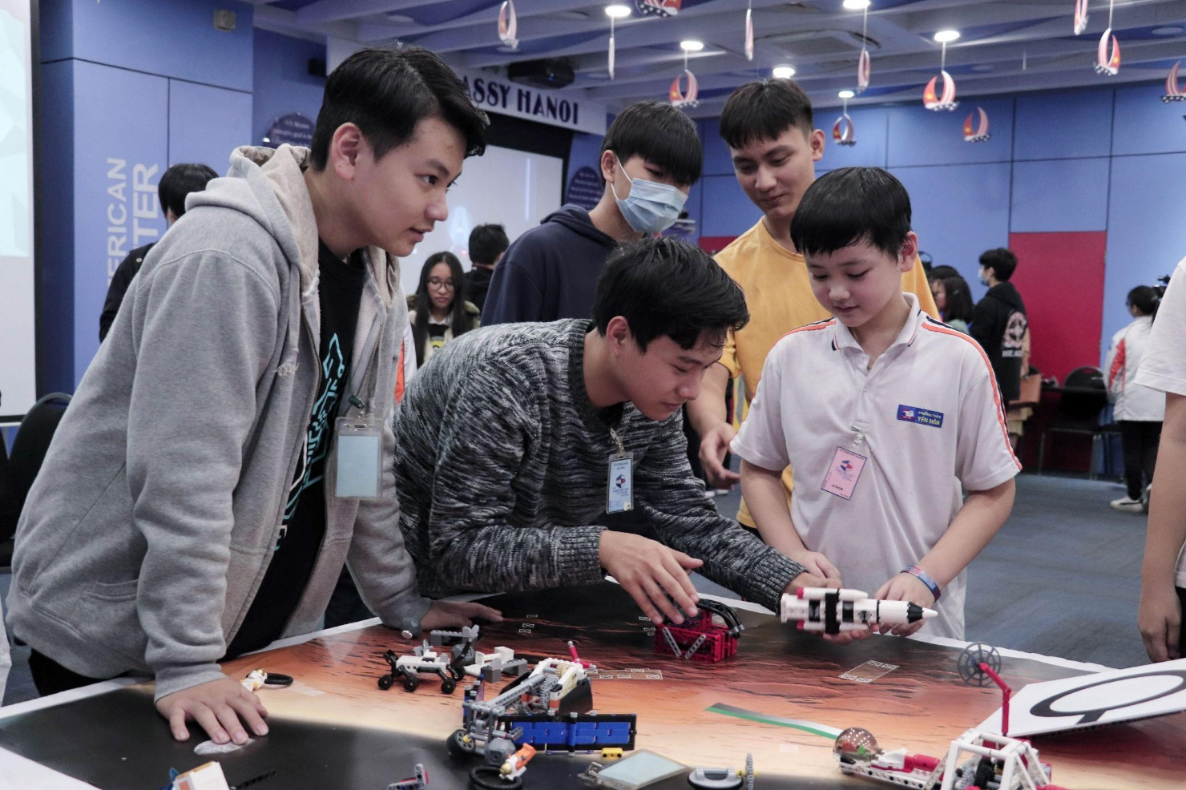
PROJECT
Inventions for the classroom

Slide 12
LESSON 8
LOOKING BACK AND PROJECT
WARM-UP
Brainstorming
Pronunciation and vocabulary
Solve the crossword.
Grammar
Circle the correct answers.
LOOKING BACK
PROJECT
Inventions for the classroom
CONSOLIDATION
Wrap-up
Homework

Slide 13
CONSOLIDATION
1
Wrap-up
Review the vocabulary, pronunciation and grammar of Unit 5;
Apply what students have learnt into practice through a project.

Slide 14
CONSOLIDATION
2
Homework
Prepare for the next lesson: Unit 6_Getting started
Do exercises in the workbook

Slide 15
Website: hoclieu.vn
Fanpage: facebook.com/www.tienganhglobalsuccess.vn

