Slide 1


Slide 2



Unit
9
WORLD ENGLISHES
LESSON 4: COMMUNICATION

Slide 3

OBJECTIVES
By the end of the lesson, students will be able to:
Say good luck and respond.
Talk about WORLD ENGLISHES and tourism

Slide 4
LESSON 4: COMMUNICATION
LESSON 1: GETTING STARTED
WARM-UP
Option 1: Brainstorm
Option 2: High Five Chain
Task 1: Listen and read the conversations. Pay attention to the highlighted parts.
Task 2: Work in pairs. Practise saying good luck and responding in the following situations
EVERYDAY ENGLISH
Task 3: Work in pairs. Read the interesting facts below about English. Order them from the most interesting to the least interesting.
Task 4: QUIZ: Work in groups. Work out the answers to the questions in the quiz.
Task 5: Share your group’s answers with the class. Which group has the most correct answers?.
INTERESTING FACTS ABOUT ENGLISH
CONSOLIDATION
Wrap-up
Homework

Slide 5
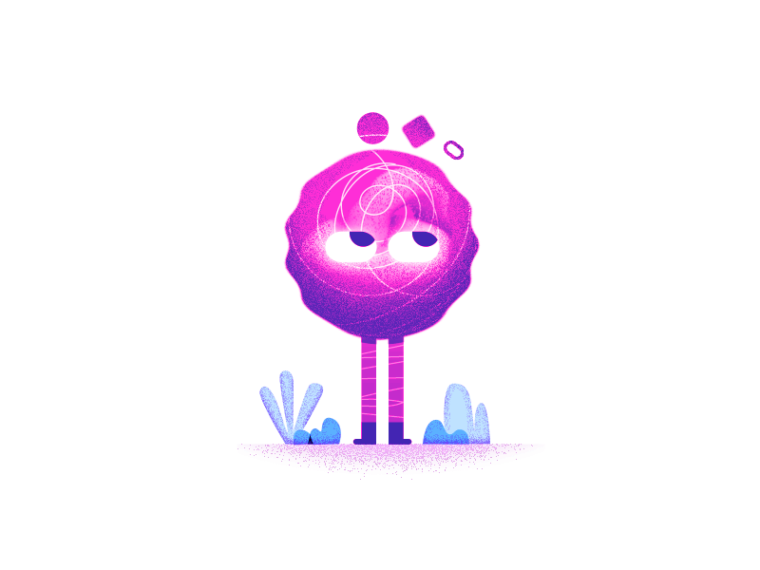
WARM-UP
OPTION 1
Brainstorm

Slide 6

WARM-UP
OPTION 1
- Look at the picture:
- What this gesture mean?
‘GOOD LUCK’

Slide 7

WARM-UP
OPTION 2
High Five chain

Slide 8
WARM-UP
OPTION 2
How to play:
- Form the class into a circle. (maybe many circles).
- Stand in a circle with your classmates, facing each other.
- The teacher (or a designated student) starts by raising their hand and saying, "Good luck on ..............!" while raising their hand for a high five.
- The person to the left of the person who started raises their hand, high fives them, adds their own "Good luck on..." statement and raises their hand for a high five with the next person in the circle.

Slide 9
WARM-UP
OPTION 2
Example:
- Good luck on your test. - Good luck on staying awake during today's lecture!

Slide 10

EVERYDAY ENGLISH
1
Listen and read the conversations below. Pay attention to the highlighted parts.
Tom: Good luck with your English exam.
Mi: Thanks. I’ll try my best.
Phong: I’ve heard that you’re moving to the US. I wish you all the best of luck.
Neighbour: Thank you so much.

Slide 11
EVERYDAY ENGLISH
Structures:
Saying Good Luck:
Good luck with + noun/noun phrase
I wish you + all the best of luck.
Respond:
Thanks / Thank you…
Some other ways to say good luck in English:
+ Best of luck with your....
+ Fingers crossed.
+ Break a leg

Slide 12
EVERYDAY ENGLISH
2
Work in pairs. Practise saying good luck and responding in the following situations.
- Study the instructions.
-Work in pairs to make similar dialogues, using the language you have learnt.
1. Your friend is giving a presentation in English this week.
2. Your cousin is taking the university entrance exam next week.
3. Your English teacher is going to the UK for further study.

Slide 13
EVERYDAY ENGLISH
2
Work in pairs. Make similar conversations to ask for permission and respond in the following situations.
Good luck with your English presentation this week
Situation:
1. Your friend is giving a presentation in English this week.
2. Your cousin is taking the university entrance exam next week.
3. Your English teacher is going to the UK for further study.

Slide 14
EVERYDAY ENGLISH
Good luck with your university entrance exam next week.
Suggested dialogues:
Good luck with your English presentation this week
Thanks. I’ll try my best.

Slide 15
EVERYDAY ENGLISH
Suggested dialogues:
I’ve heard that you’re going to the UK for further study. I wish you all the best of luck
Good luck with your university entrance exam next week.
Thanks. I’ll try my best.

Slide 16
EVERYDAY ENGLISH
Suggested dialogues:
I’ve heard that you’re going to the UK for further study. I wish you all the best of luck
Thank you so much.

Slide 17
Transition from Everyday English to Interesting facts about English
- Tell me any interesting facts about English.
Suggested answers:
- The English language borrows words from all over the world. This is why we have words like "pasta" from Italian, "gymnasium" from Greek, and "sushi" from Japanese.
- English is spoken by over 1.35 billion people around the world, making it the third most spoken language globally.

Slide 18
LESSON 4: COMMUNICATION
LESSON 1: GETTING STARTED
WARM-UP
Option 1: Brainstorm
Option 2: High Five Chain
1. The most common letter in English is ‘e’.
2. Only two English words in current use end in ‘-gry’. They are ‘angry’ and ‘hungry’
Task 1: Listen and read the conversations. Pay attention to the highlighted parts.
Task 2: Work in pairs. Practise saying good luck and responding in the following situations
EVERYDAY ENGLISH
Task 3: Work in pairs. Read the interesting facts below about English. Order them from the most interesting to the least interesting.
Task 4: QUIZ: Work in groups. Work out the answers to the questions in the quiz.
Task 5: Share your group’s answers with the class. Which group has the most correct answers?.
INTERESTING FACTS ABOUT ENGLISH
4. The longest English word without a true vowel (a, e, i, o, or u) is ‘rhythms
3. The word ‘uncopyrightable’ is the longest English word in normal use which contains no letter more than once.
CONSOLIDATION
Wrap-up
Homework
5. ‘Queueing’ and ‘cooeeing’ are the two words with five consecutive vowels(five vowels in a row).

Slide 19
INTERESTING FACTS ABOUT ENGLISH
Work in pairs. Read the interesting facts below about English. Order them from the most interesting to the least interesting.
3
1. The most common letter in English is ‘e’.
2. Only two English words in current use end in ‘-gry’. They are ‘angry’ and ‘hungry’
3. The word ‘uncopyrightable’ is the longest English word in normal use which contains no letter more than once.
4. The longest English word without a true vowel (a, e, i, o, or u) is ‘rhythms
5. ‘Queueing’ and ‘cooeeing’ are the two words with five consecutive vowels(five vowels in a row).

Slide 20
INTERESTING FACTS ABOUT ENGLISH
Work in pairs. Read the interesting facts below about English. Order them from the most interesting to the least interesting.
3
- Work in pairs to order them from the most interesting to the least interesting.
- Explain your order.
- Do you know any fun facts about English?

Slide 21
INTERESTING FACTS ABOUT ENGLISH
Some fun facts:
1.The most common vowel in English is "e", followed by "a".
2.The most common consonant in English is "r", followed by "t".
3.Every syllable in English must have a vowel (sound). Not all syllables have consonants.
4.More English words begin with the letter "s" than with any other letter.
5.The word "alphabet" comes from the first two letters of the Greek alphabet: alpha and bēta.

Slide 22
INTERESTING FACTS ABOUT ENGLISH
4
QUIZ:: Work in groups. Work out the answers to the questions in the quiz
1. Which of these languages has the highest number of native speakers?
A. English
B. Chinese
C. Spanish
2. Which language do people use the most at international events?
A. English
B. Chinese
C. Spanish

Slide 23
INTERESTING FACTS ABOUT ENGLISH
4
QUIZ:: Work in groups. Work out the answers to the questions in the quiz
3. Americans call it “truck”. What do the British call it?
A. Car
B. Bus
C. Lorry
4. The British call it “chemist’s”. What do Americans call it?
A. Shop
B. Drugstore
C. Store

Slide 24
INTERESTING FACTS ABOUT ENGLISH
4
QUIZ:: Work in groups. Work out the answers to the questions in the quiz
5. Which is the longest word in English which has only one vowel?
A. Length
B. Strengths
C. Depth

Slide 25
EXTRA ACTIVITY
QUIZ:
1. The four languages most spoken in the world are Chinese, ___________, English and Hindi.
A. Spanish
C. German
B. French
D. Arab
2. Apart from Wales, the Welsh is also spoken in _______.
A. Scotland
C. Ireland
B. Argentina
D. Sweden

Slide 26
EXTRA ACTIVITY
QUIZ:
3. Which European language gave us the words ‘cookie’, ‘nitwit’ and ‘sleigh’?
A. Norwegian
C. Czech
B. Dutch
D. German
4. What language is the most common one in Europe because of a number of native speakers?
A. French
C. Russian
B. German
D. English

Slide 27
EXTRA ACTIVITY
QUIZ:
5. What are the official languages of Canada?
A. French and English
C. English and German
B.German and French
D.English and Dutch

Slide 28
LESSON 4: COMMUNICATION
LESSON 1: GETTING STARTED
WARM-UP
Option 1: Brainstorm
Option 2: High Five Chain
1. The most common letter in English is ‘e’.
2. Only two English words in current use end in ‘-gry’. They are ‘angry’ and ‘hungry’
Task 1: Listen and read the conversations. Pay attention to the highlighted parts.
Task 2: Work in pairs. Practise saying good luck and responding in the following situations
EVERYDAY ENGLISH
Task 3: Work in pairs. Read the interesting facts below about English. Order them from the most interesting to the least interesting.
Task 4: QUIZ: Work in groups. Work out the answers to the questions in the quiz.
Task 5: Share your group’s answers with the class. Which group has the most correct answers?.
INTERESTING FACTS ABOUT ENGLISH
4. The longest English word without a true vowel (a, e, i, o, or u) is ‘rhythms
3. The word ‘uncopyrightable’ is the longest English word in normal use which contains no letter more than once.
CONSOLIDATION
Wrap-up
Homework
5. ‘Queueing’ and ‘cooeeing’ are the two words with five consecutive vowels(five vowels in a row).

Slide 29

CONSOLIDATION
1
Wrap-up
What have we learnt in this lesson?
Say good luck and respond.
Talk about WORLD ENGLISHES and tourism

Slide 30

CONSOLIDATION
2
Homework
- Do exercises in the workbook.

Slide 31
Website: hoclieu.vn
Fanpage: facebook.com/www.tienganhglobalsuccess.vn/

