Slide 2
Unit
6
Preserving our heritage
Unit
FAMILY LIFE
LESSON I
GETTING STARTED
Heritage sites in Vietnam

Slide 3
LESSON I
GETTING STARTED
WARM-UP
GAME: Name the places
Vocabulary
PRESENTATION
- Task 1. Listen and read
- Task 2. Where can we do the following? Write T for Trang An, H for Hoi An and M for Mekong River Delta.
- Task 3. Match the words to make phrases used in Task 1
- Task 4. Complete the sentences
PRACTICE
PRODUCTION
Role play
Wrap-up
Homework
CONSOLIDATION

Slide 4
WARM-UP
NAME THE PLACES
- Ss work in 2 groups.
- Teacher shows pictures on the screen and Ss have to say BINGO to grasp the chance to answer where it is.
- One point for each correct answer.
- The group which gains most points is the winner of the game.

Slide 5
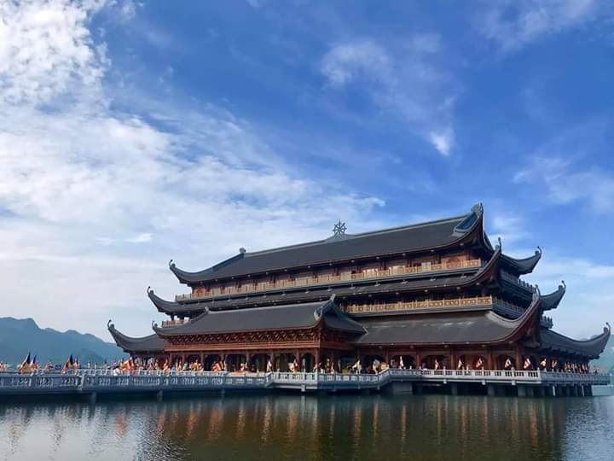
WARM-UP
Tam Chuc Pagoda

Slide 6
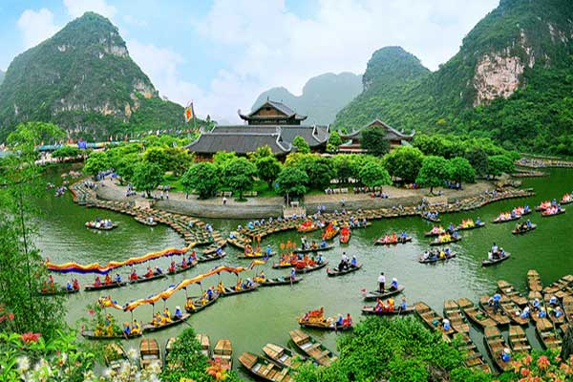
WARM-UP
Trang An Scenic Landscape Complex

Slide 7
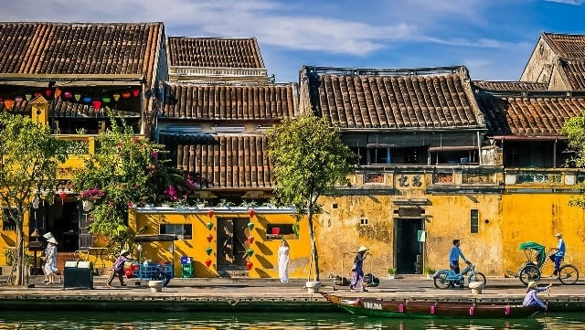
WARM-UP
Hoi An Ancient Town

Slide 8
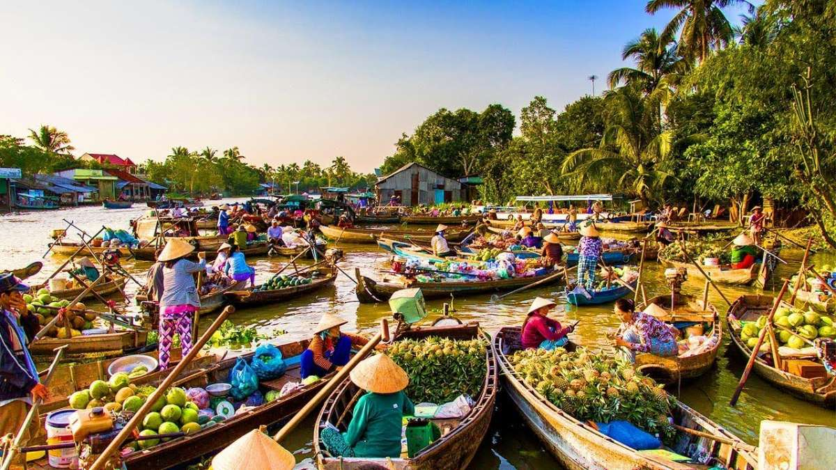
WARM-UP
Mekong River Delta

Slide 9
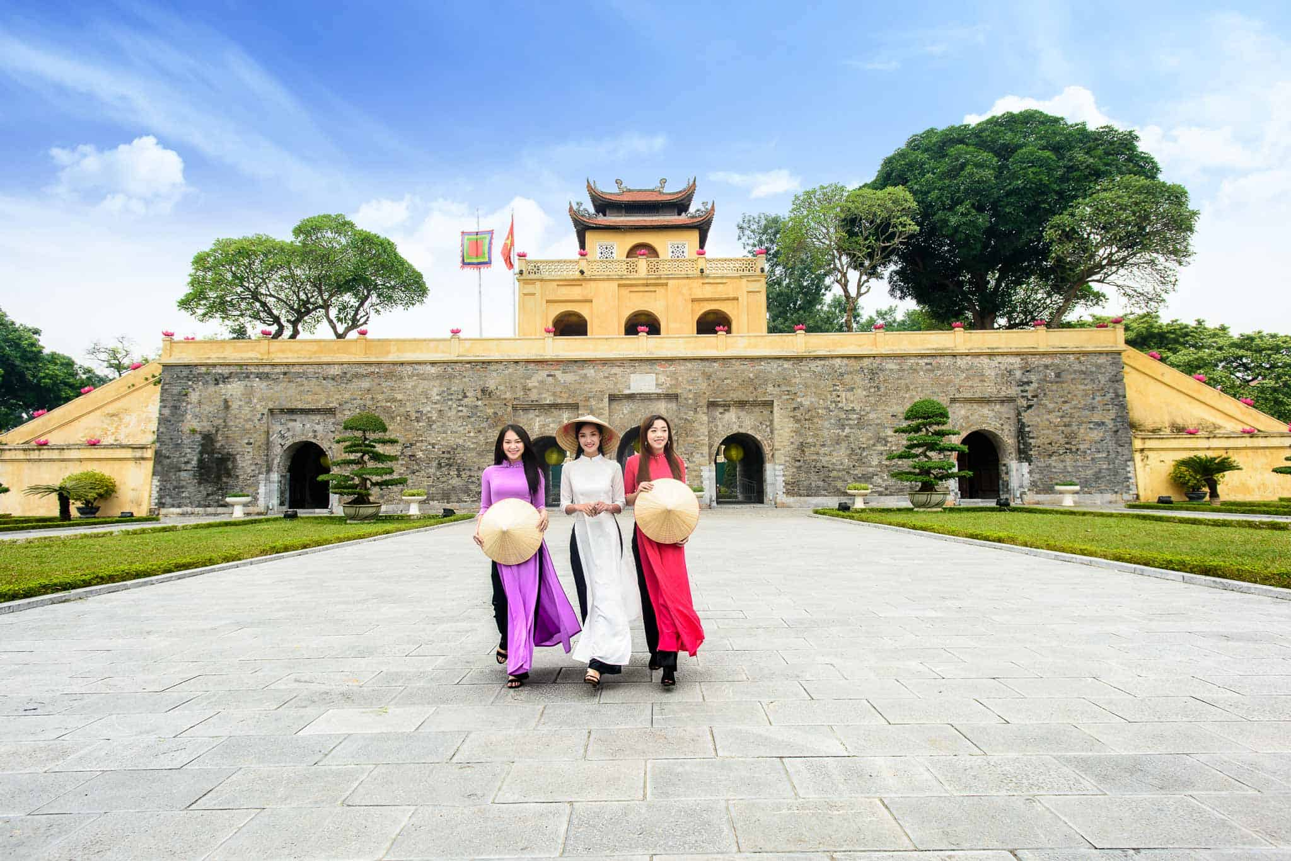
WARM-UP
Thang Long Imperial Citadel

Slide 10
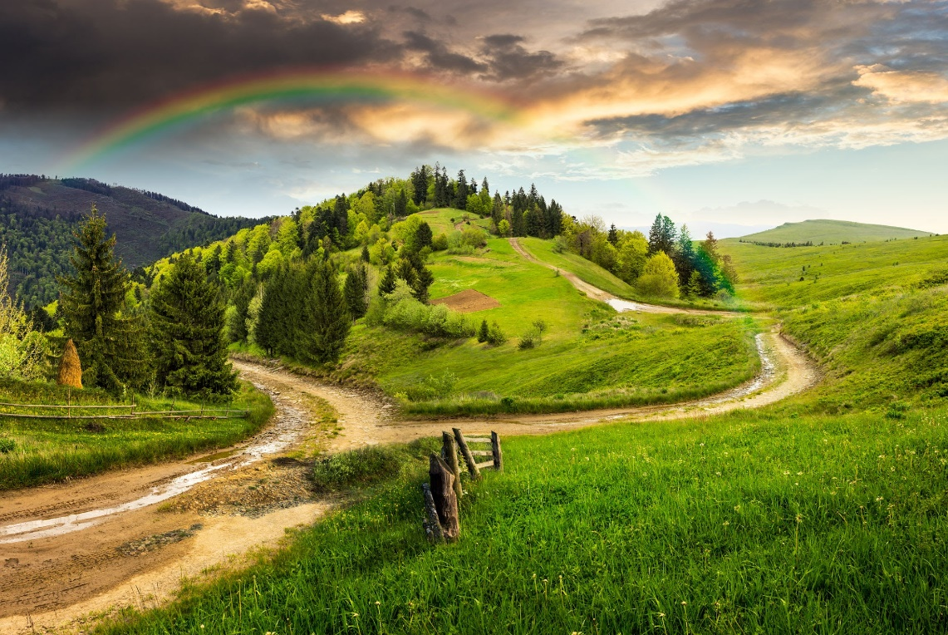
PRESENTATION
landscape (n)
/ˈlændskeɪp/
everything you can see when you look across a large area of land, especially in the country

Slide 11
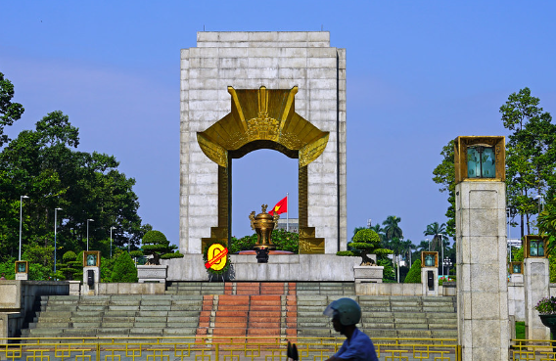
PRESENTATION
monument (n)
/ˈmɒnjumənt/
a building, column, statue, etc. built to remind people of a famous person or event

Slide 12
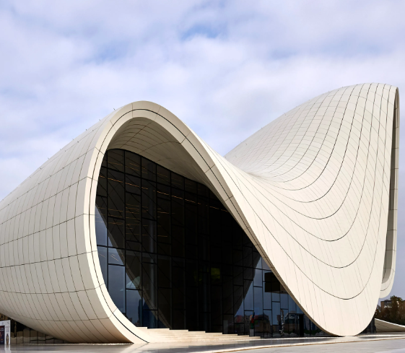
PRESENTATION
architecture (n)
/ˈɑːkɪtektʃə(r)/
the design or style of a building or buildings

Slide 13
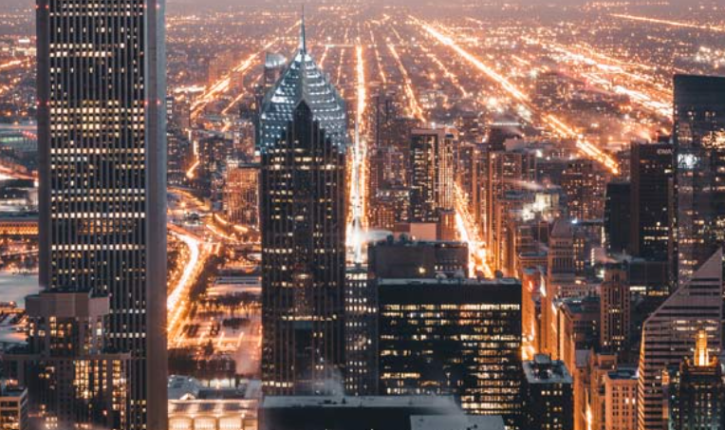
PRESENTATION
urban (adj)
/ˈɜːbən/
connected with a town or city

Slide 14
PRESENTATION
promote (v)
/prəˈməʊt/
to help something to happen or develop

Slide 15
PRESENTATION
Form | Pronunciation | Meaning | Vietnamese equivalent
1. landscape (n) | /ˈlændskeɪp/ | everything you can see when you look across a large area of land, especially in the country | Phong cảnh
2. monument (n) | /ˈmɒnjumənt/ | a building, column, statue, etc. built to remind people of a famous person or event | Công trình tưởng niệm
3. architecture (n) | /ˈɑːkɪtektʃə(r)/ | the design or style of a building or buildings | Kiến trúc
4. urban (adj) | /ˈɜːbən/ | connected with a town or city | Đô thị
5. promote (v) | /prəˈməʊt/ | to help something to happen or develop | Đẩy mạnh, phát triển

Slide 16
PRESENTATION
1
Listen and read.

Slide 17
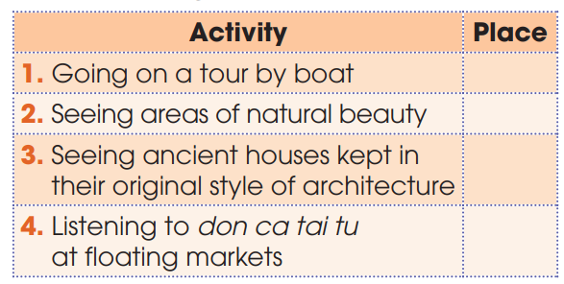
PRACTICE
2
Where can we do the following? Write T for Trang An, H for Hoi An and M for Mekong River Delta.
T
T
H
M

Slide 18
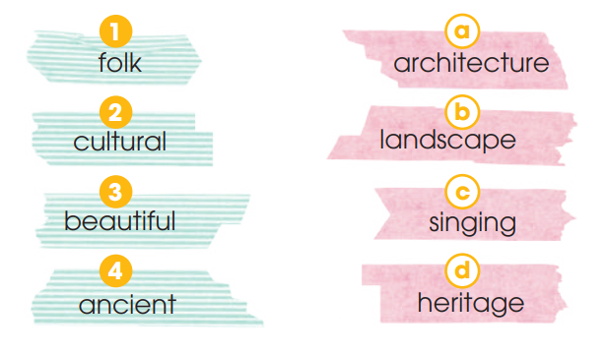
PRACTICE
3
Match the words to make phrases used in Task 1

Slide 19
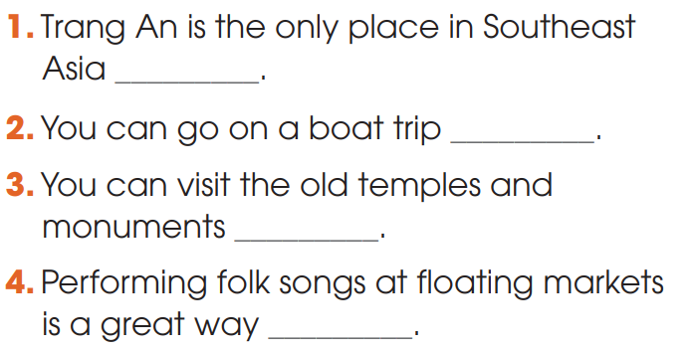
PRACTICE
4
Complete the sentences, using phrases from Task 1.
to be recognized as a mixed heritage by UNESCO.
to enjoy beautiful landscape.
to learn about Vietnamese history.
to promote Don ca Tai Tu to wider audience.

Slide 20
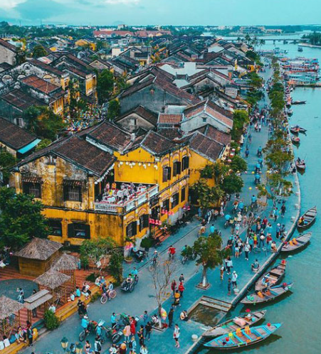
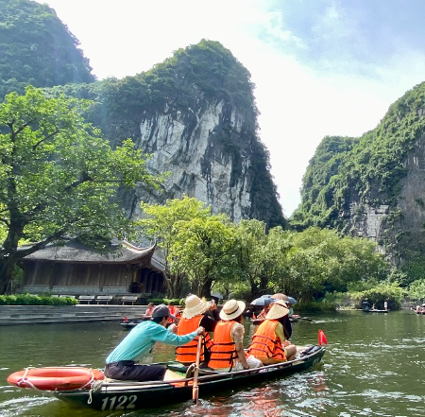
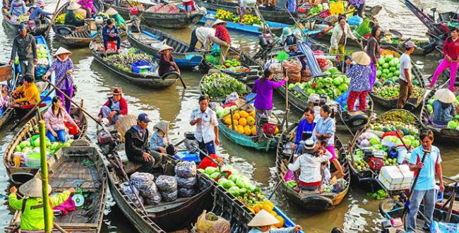
PRODUCTION
Role play
- 3 groups. Each group will come from one place: Trang An (Ninh Binh), Hoi An (Quang Nam), Mekong River Delta.
- Each group prepares an introduction about your home land (Where is it? What is the most special thing about their home land? What can visitors do there?)
- 3 minutes to prepare for the role play.
- 2 minutes for a presentation.

Slide 21
CONSOLIDATION
1
Wrap-up
What have you learnt today?
Some lexical items about heritage sites
Reading for specific information
To-infinitive clauses

Slide 22
CONSOLIDATION
2
Homework
Do exercises in the workbook.
Prepare for Lesson 2 - Unit 6.
Prepare materials for the project in lesson 8

Slide 23
Website: hoclieu.vn
Fanpage: facebook.com/sachmem.vn/

