Slide 2
Unit
5
1
Unit
FAMILY LIFE
INVENTIONS
LESSON 5
LISTENING
RoboVacuum

Slide 3
Unit
1
1
FAMILY LIFE
Family Life
Unit
OBJECTIVES
Listen for specific information about how to use an invention.

Slide 4
LESSON 5
LISTENING
WARM-UP
Guessing game
PRE-LISTENING
Vocabulary
Task 1: Complete the sentences.
Task 2: Fill in each gap of the diagram.
Task 3: Tick or cross.
WHILE-LISTENING
POST-LISTENING
Task 4: What other buttons do you want RoboVacuum to have?
CONSOLIDATION
Wrap-up
Homework

Slide 5
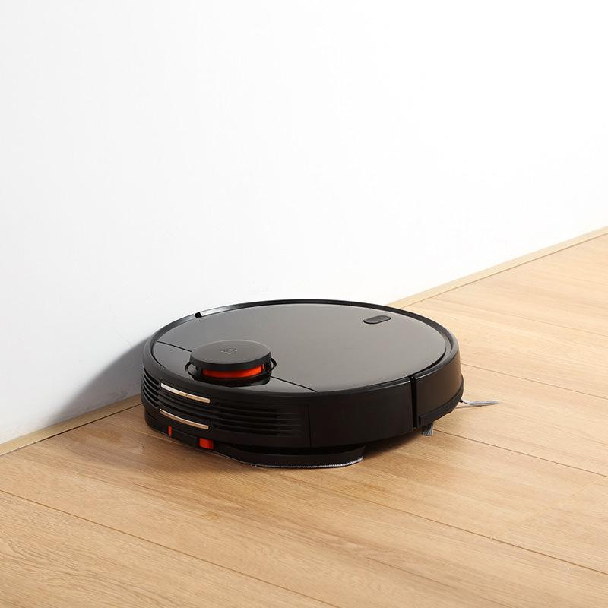
GUESSING GAME
What is it?
It is a household appliance.
It has wheels.
It sucks up dirt and dust.

Slide 6
LESSON 5
LISTENING
WARM-UP
Guessing game
PRE-LISTENING
Vocabulary
Task 1: Complete the sentences.

Slide 7
VOCABULARY
button (n)
/ˈbʌtn/
a small part of a machine that you press to make it work

Slide 8
VOCABULARY
charge (v)
/tʃɑːdʒ/
to pass electricity through something so that it is stored there; to take in electricity so that it is stored and ready for use

Slide 9
VOCABULARY
stain (n)
/steɪn/
a dirty mark on something which is difficult to remove.

Slide 10
PRE-LISTENING
1
Complete the sentences with the words in the box.
1. Press the ________to start the device.
2. There is a dirty ______ on your smartphone. Wipe it away.
3. You need to _______ your mobile phone. The battery is very low.
button
stain
charge

Slide 11
LESSON 5
LISTENING
WARM-UP
Guessing game
PRE-LISTENING
Vocabulary
Task 1: Complete the sentences.
Task 2: Fill in each gap of the diagram.
Task 3: Tick or cross.
WHILE-LISTENING

Slide 12
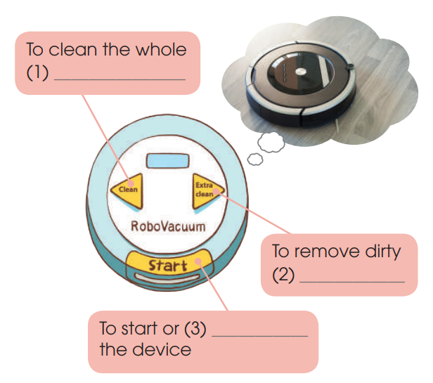
WHILE-LISTENING
2
Listen to a conversation about RoboVacuum. Fill in each gap in the diagram below with one word.
room
stains
stop

Slide 13
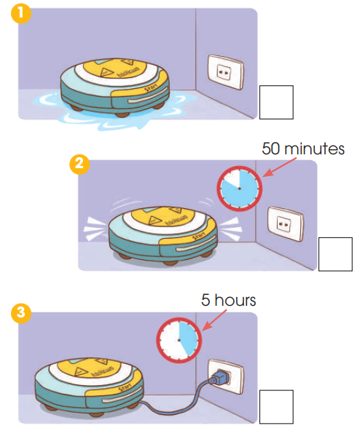
WHILE-LISTENING
3
Listen again. Put a tick next to the correct way and a cross next to the wrong way to use RoboVacuum.
🗶
✔
✔

Slide 14
LESSON 5
LISTENING
WARM-UP
Guessing game
PRE-LISTENING
Vocabulary
Task 1: Complete the sentences.
Task 2: Fill in each gap of the diagram.
Task 3: Tick or cross.
WHILE-LISTENING
POST-LISTENING
Task 4: What other buttons do you want RoboVacuum to have?

Slide 15
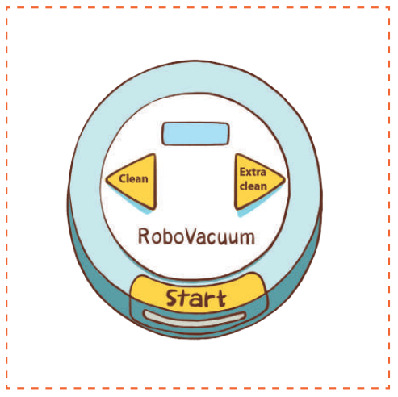
POST-LISTENING
4
What other buttons do you want RoboVacuum to have? Add them to the picture below and tell your friends about them.
I want my Robo Vacuum to have a Timer button on the top. First, you press it. Then, you set the time by pressing the minute and second buttons on the right.

Slide 16
LESSON 5
LISTENING
WARM-UP
Guessing game
PRE-LISTENING
Vocabulary
Task 1: Complete the sentences.
Task 2: Fill in each gap of the diagram.
Task 3: Tick or cross.
WHILE-LISTENING
POST-LISTENING
Task 4: What other buttons do you want RoboVacuum to have?
CONSOLIDATION
Wrap-up
Homework

Slide 17
CONSOLIDATION
1
Wrap-up
Listen for specific information about RoboVacuum.

Slide 18
CONSOLIDATION
2
Homework
Prepare for the next lesson: Unit 5 – Writing
2. Do exercises in the workbook

Slide 19
Website: hoclieu.vn
Fanpage: facebook.com/www.tienganhglobalsuccess.vn

