Slide 1

Unit 6: Be green
Lesson 6e: Grammar
Page 102

Slide 2
Lesson Outline
Warm-up
Grammar
Consolidation
Wrap-up

Slide 3

Objectives
By the end of this lesson, students will be able to:
know how to use:
and/or/but
so/because

Slide 4

WARM-UP

Slide 5
Choose the word whose main stress is placed differently from that of the others. Practise saying them.
1. A. pollution B. animal C. material D. banana
/pəˈluːʃən/ /ˈænɪməl/ /məˈtɪəriəl/ /bəˈnɑːnə/
2. A. corridor B. newspaper C. batteries D. attraction
/ˈkɒrɪdɔːr/ /ˈnjuːzˌpeɪpər/ /ˈbætəriz/ /əˈtrækʃən/
3. A. endangered B. efficient C. organic D. national
/ɪnˈdeɪndʒəd/ /ɪˈfɪʃənt/ /ɔːˈɡænɪk/ /ˈnæʃənəl/

Slide 6
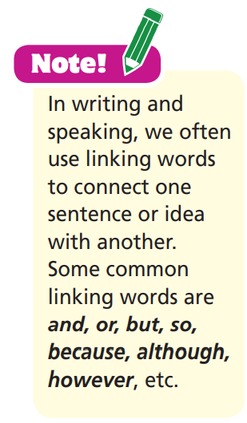
Work in groups and match the first part of the sentence to the second one.
Plastic bags are useful, but
you can take the bus.
Big cities are crowded and
they are noisy.
You can walk to the park or
they are not eco-friendly.
People cut down trees,
because we picked up litter last weekend.
Our neighbourhood is clean now
so our forests are in danger.

Slide 7

PRESENTATION

Slide 8
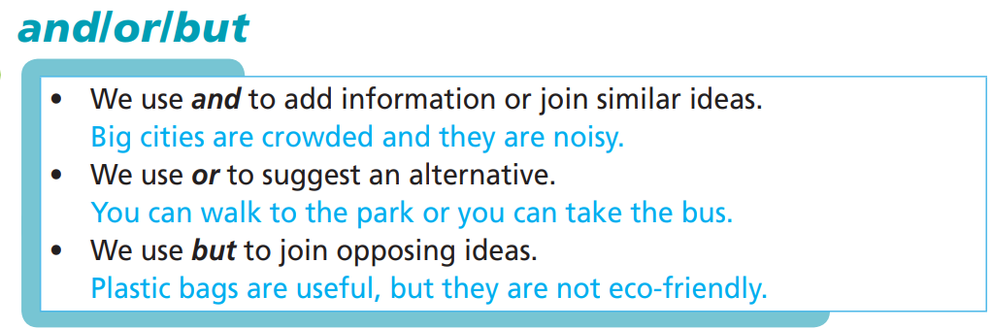
Fill in the blanks with the given phrases to complete the rules.
suggest an alternative
join opposing ideas
add information or join similar ideas
add information or join similar ideas.
suggest an alternative.
join opposing ideas.

Slide 9
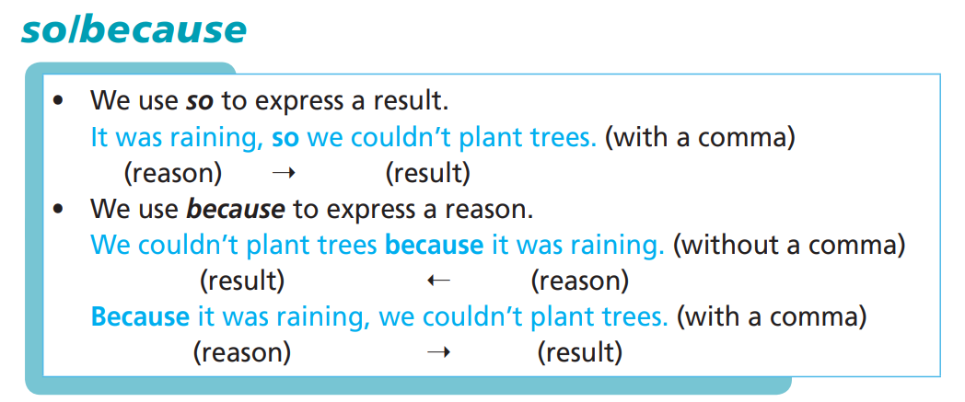
Fill in the blanks with the given phrases to complete the rules.
express a result
express a reason

Slide 10

PRACTICE

Slide 11
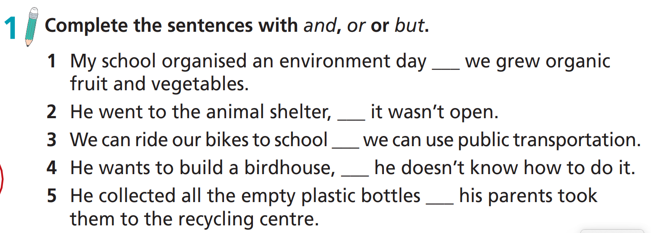
and
but
or
but
and

Slide 12
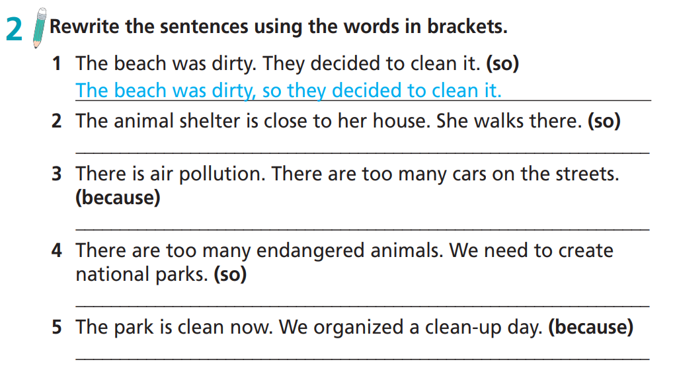
The animal shelter is close to her house, so she walks there.
There is air pollution because there are too many cars on the streets.
There are too many endangered animals, so we need to create national parks.
The park is clean now because we organised a clean-up day.

Slide 13
Extra Practice 2
WB p. 52
Choose the correct answer
Everyone should recycle at home so/because there is too much rubbish.
We built a birdhouse so/because we wanted to provide a safe place for birds.
The park was dirty so/because they decided to organise a clean-up day.
There is too much plastic pollution so/because people use too many plastic products.
There is too much plastic pollution so/because people use too many plastic products.

Slide 14
Extra Task
Correct a mistake in each sentence.
1. He went there so he wanted to recycle old newspapers.
2. She didn’t want to use her car so she rode a bike to work.
3. We couldn’t plant trees, because it was raining.
4. Because there are too many cars on the streets, so there is air pollution.
5. Because it rained I didn’t go to the park.
,
With a comma
,
With a comma
_
Without comma
__
,
With a comma

Slide 15
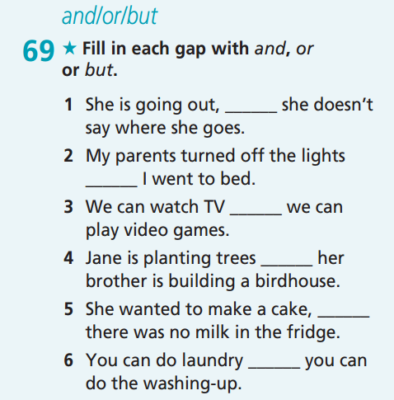
Extra practice
GB-p.77
but
and
or
and
but
or

Slide 16
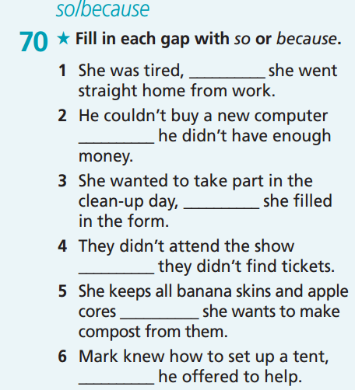
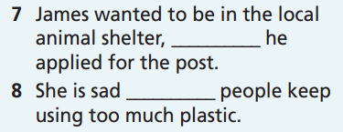
Extra practice
GB-p.77
so
so
because
because
so
because
because
so

Slide 17
PRODUCTION

Slide 18

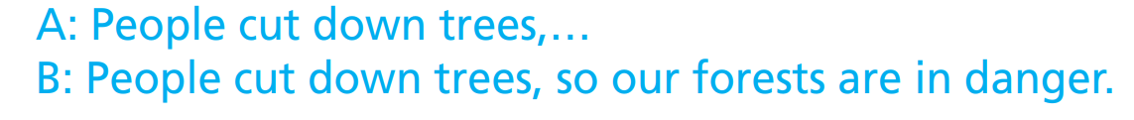
Work in pairs. Student A starts a sentence. Student B completes it using so or because. With each correct sentence they win a point. The pair with the most points wins.

Slide 19

CONSOLIDATION

Slide 20
Work with your partner. Think about how the environmental problems will be in the future. Then write sentences about those problems using and, but, so, because, or in each sentence.
Environmental Problems | How it will be in the future
Plastic pollution | It will be reduced because more and more people are recycling and reducing use of plastic items.
Air pollution
Deforestation
Endangered animals

Slide 21

WRAP-UP

Slide 22
Today’s lesson
Grammar
To learn how to use
and/or/but
so/because

Slide 23
Homework
Practise the grammar points and make sentences using them.
Prepare the next lesson (page 103 SB).
Complete the grammar notes in TA 7 Right On Notebook (page 48).
Do the exercise in TA 7 Right on WB (page 52).

Slide 24
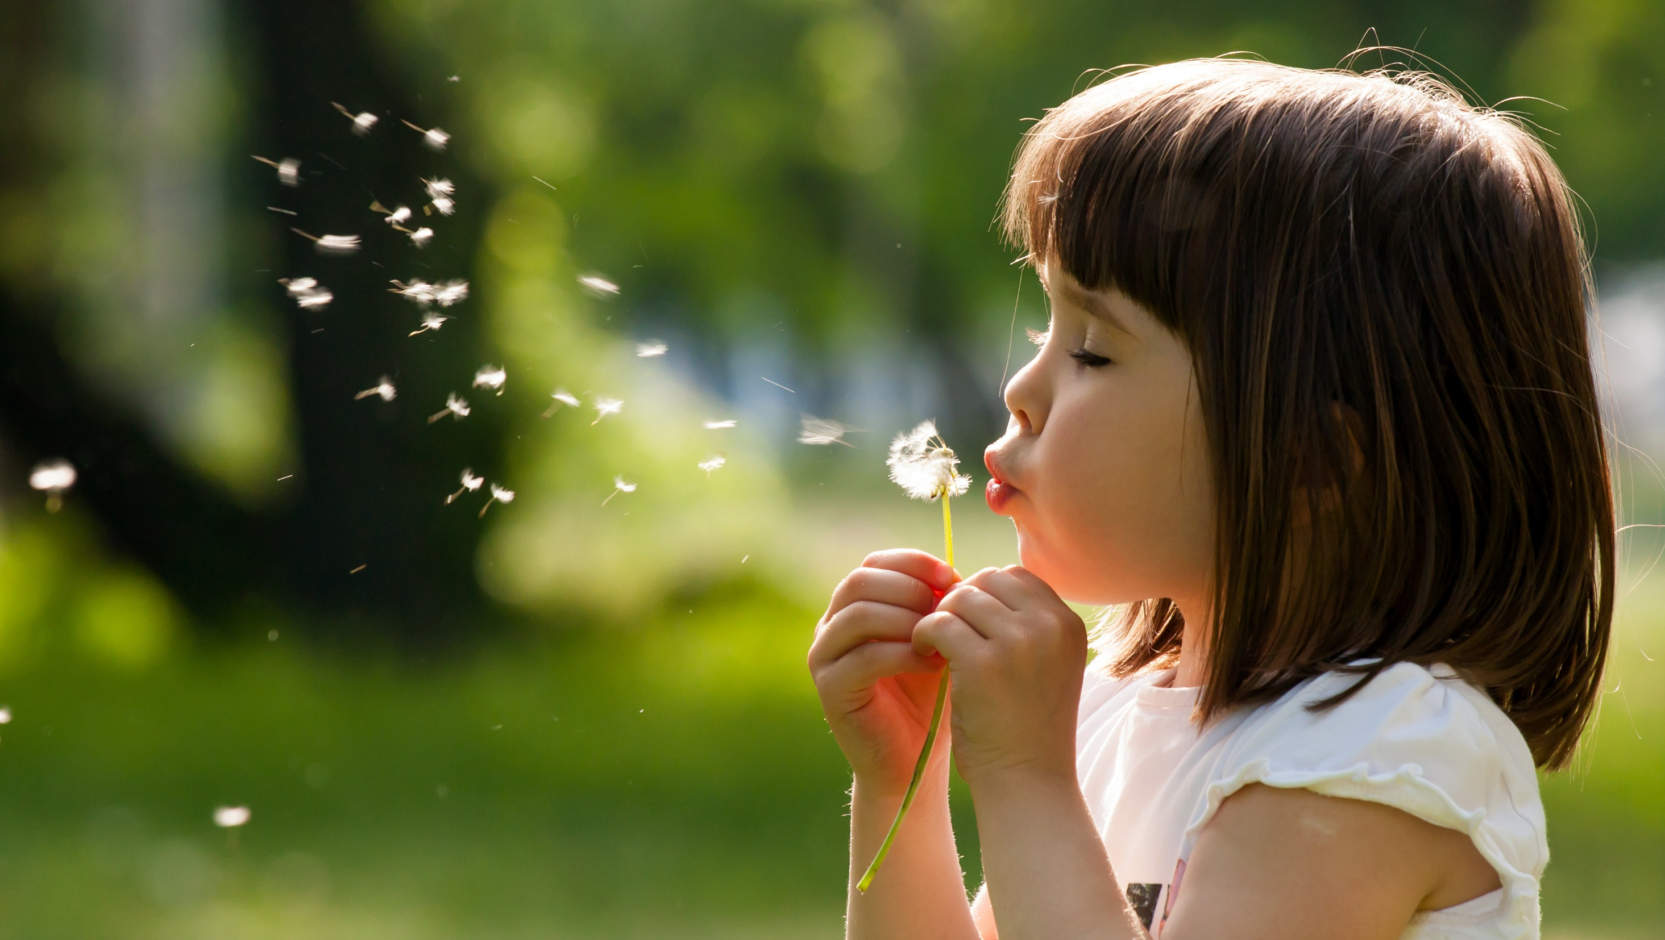
Enjoy your day!

