Slide 1
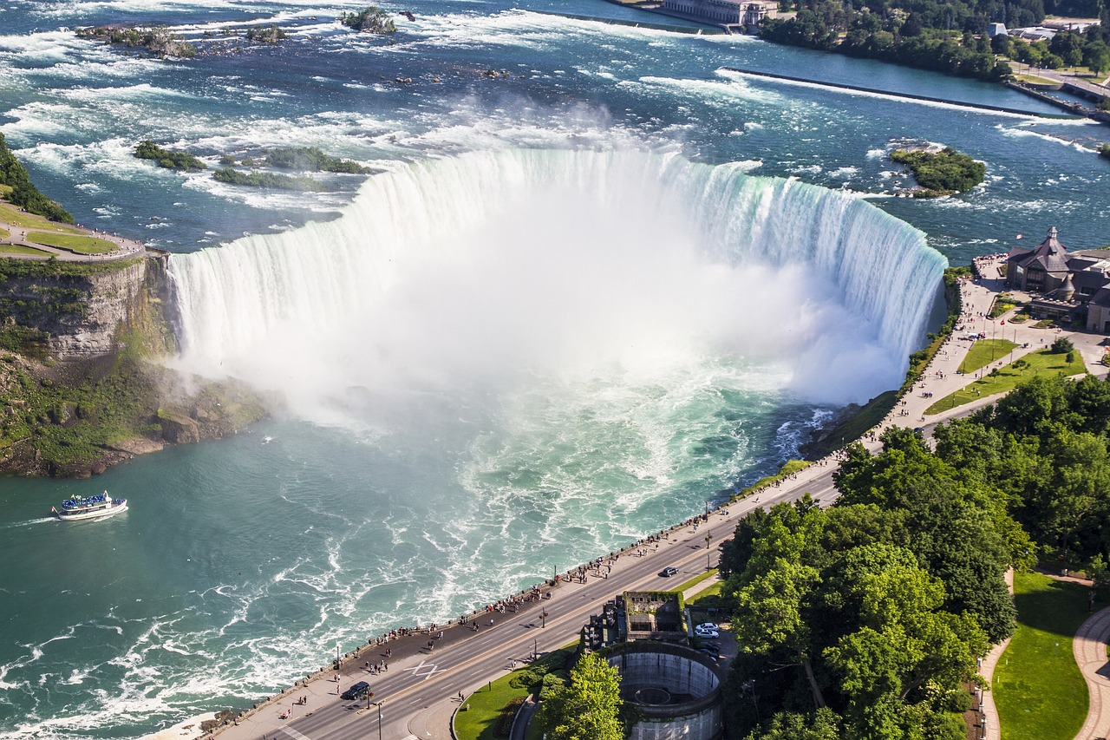
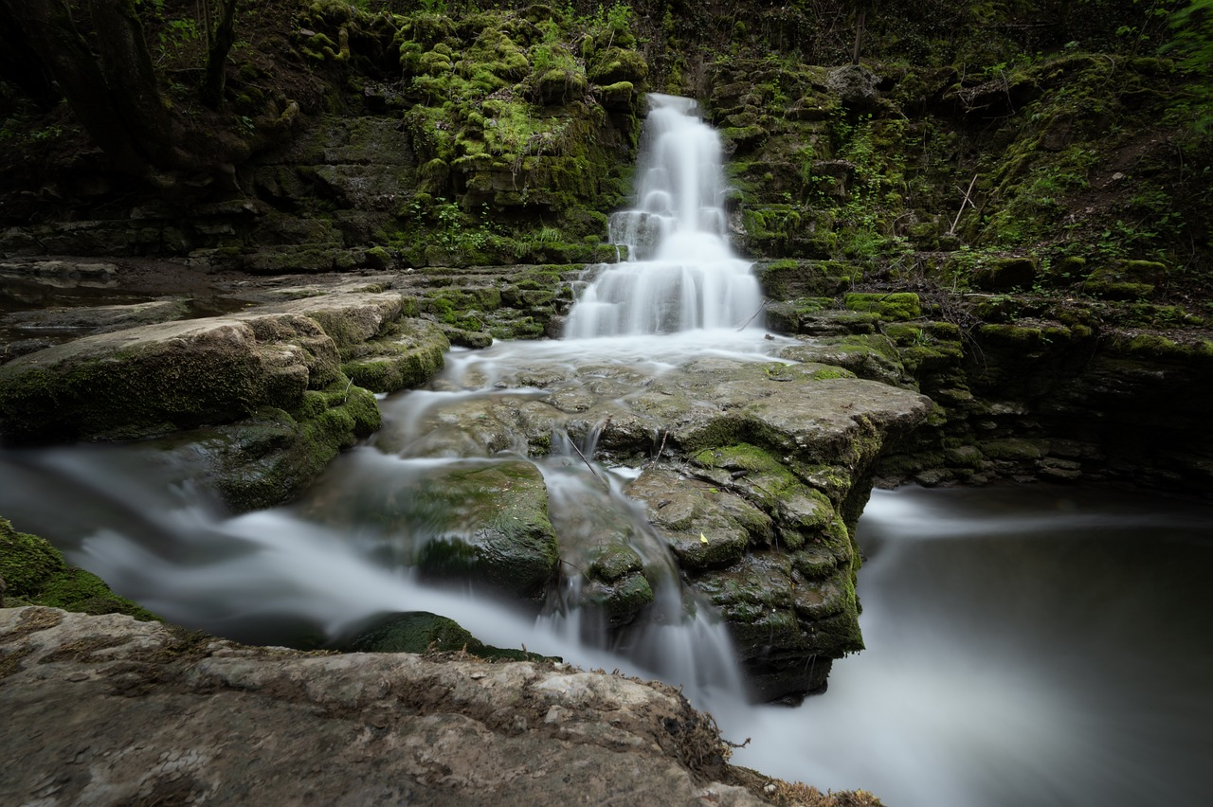
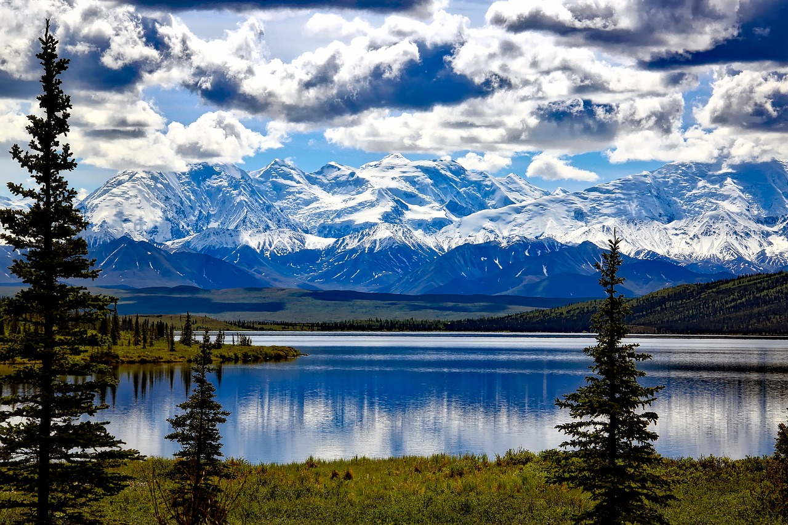
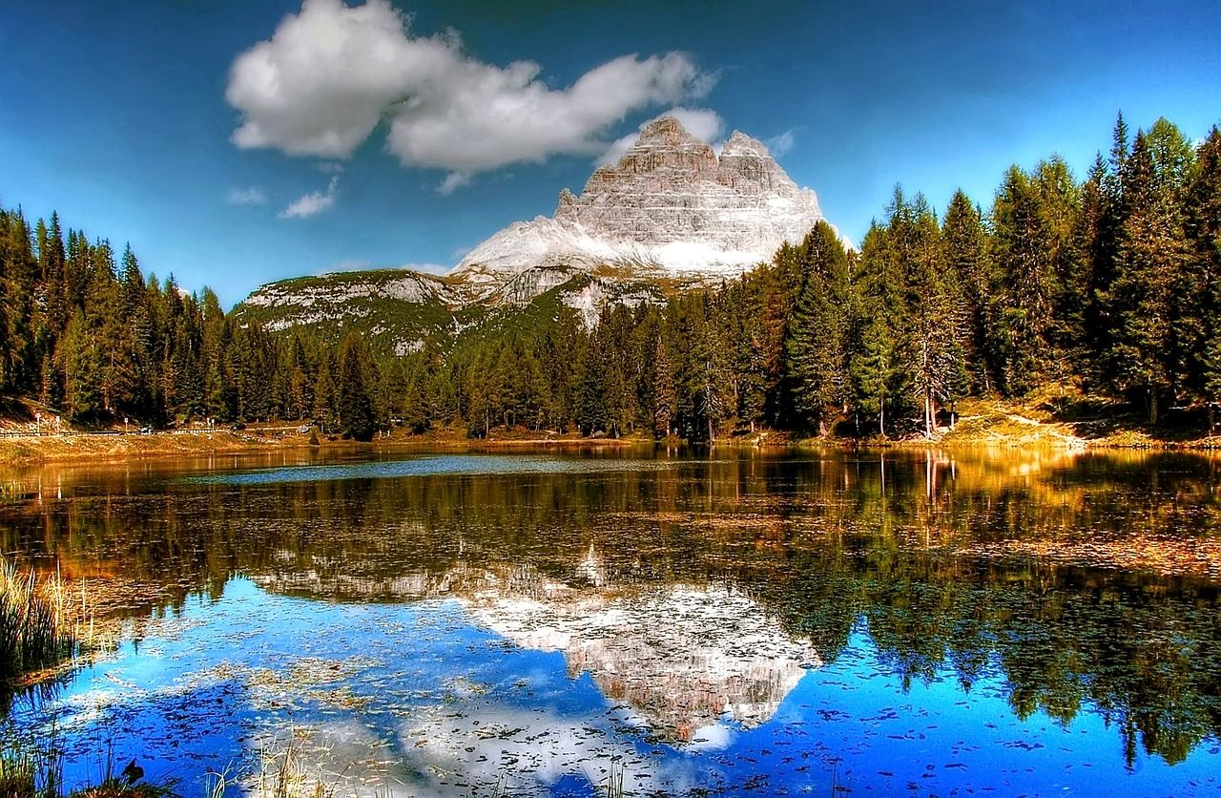


Unit
NATURAL WONDERS
6
LESSON 7: LOOKING BACK & PROJECT

Slide 2
Unit
NATURAL WONDERS OF THE WORLD
6
LESSON 7: LOOKING BACK & PROJECT

Slide 3

OBJECTIVES
By the end of the lesson, students will be able to:
Review the vocabulary and grammar of Unit 7;
Apply what they have learnt (vocabulary and grammar) into practice through a project.

Slide 4

LESSON 7: LOOKING BACK & PROJECT
LESSON 1: GETTING STARTED
WARM-UP
Brainstorming
Task 1: Choose A, B, C, or D to indicate the correct answer to each question.
Task 2: Give the correct forms of the words in brackets to complete the sentences.
VOCABULARY
Task 3: Underline the correct answers to complete the sentences.
Task 4: Rewrite the sentences in reported questions.
GRAMMAR
PROJECT
Poster presentation
CONSOLIDATION
Wrap-up
Homework

Slide 5
WARM-UP
BRAINSTORMING
- Work in teams.
- Members of each team take turns and write as many vocabulary in Unit 7 as possible in ................. minutes.
The group having more correct answers is the winner.

Slide 6
VOCABULARY
1
Choose A, B, C, or D to indicate the correct answer to each question.
1. I’m sure you will be amazed by the ______ of the Atacama Desert.
A. landscape
B. land
C. backdrop
D. territory
2. Can all of you ______ new ideas for improving our Geography Club?
A. explore
B. conserve
C. suggest
D. discover

Slide 7
VOCABULARY
1
Choose A, B, C, or D to indicate the correct answer to each question.
3. ______ is all the animals living in an area or in a period of history.
A. Species
B. Nature
C. Flora
D. Fauna
4. He ______ before sending the e-mail because he was afraid that she would not like it.
A. possessed
B. hesitated
C. accepted
D. admired

Slide 8
VOCABULARY
1
Choose A, B, C, or D to indicate the correct answer to each question.
5. When he reached the mountain ______, he found it covered with countless flags of climbers before him.
A. peak
B. bottom
C. height
D. side

Slide 9
VOCABULARY
2
Give the correct forms of the words in brackets to complete the sentences.
1. Natural wonders are one of our country’s valuable (possess) _______________________.
possessions
2. Our Central Highlands has (charm) ______________ sights: natural and wild landscapes amid magnificent forests.
charming
3. The Gobi is a very large desert (locate) ____________in China and Mongolia.
located

Slide 10
VOCABULARY
2
Give the correct forms of the words in brackets to complete the sentences.
4. The Amazon River was named by the Spanish (explore) _____________ Francisco de Orellana.
explorer
permission
5. You don’t need special (permit) ____________to visit Cuc Phuong National Park.

Slide 11
LESSON 7: LOOKING BACK & PROJECT
LESSON 1: GETTING STARTED
WARM-UP
Brainstorming
Task 1: Choose A, B, C, or D to indicate the correct answer to each question.
Task 2: Give the correct forms of the words in brackets to complete the sentences.
VOCABULARY
Task 3: Underline the correct answers to complete the sentences.
Task 4: Rewrite the sentences in reported questions.
GRAMMAR

Slide 12
GRAMMAR
3
Underline the correct answers to complete the sentences.
1. Minh asked me did I know / if I knew.much about the Amazon Rainforest.
2. I asked Frankie if he was living / he is living near the Grand Canyon.
3. Trang said / wanted to know whether Tom wanted to visit Mount Fansipan.

Slide 13
GRAMMAR
3
Underline the correct answers to complete the sentences.
4. My mum told / asked me whether I was studying or playing then.
5. The teacher asked Liam whether he wanted / did he want to visit Son Doong Cave.

Slide 14
GRAMMAR
4
4
Rewrite the sentences in reported questions.
1. “Do you know about the Shilin Stone Forest in China?” she asked me.
She asked me / wanted to know if / whether I knew about the Shilin Stone Forest in China.
2. “Do you enjoy having virtual tours of these natural wonders?” Mi said to Nam
Mi asked Nam / wanted to know if / whether he enjoyed having virtual tours of those natural wonders.

Slide 15
GRAMMAR
4
4
Rewrite the sentences in reported questions.
3. Are you interested in the natural wonders of your country?” David asked me.
David asked me / wanted to know if / whether I was interested in the natural wonders of my country.
4. “Can you manage to meet the deadline for the project?” I said to Linh.
I asked Linh / wanted to know if / whether she could manage to meet the deadline for the project.

Slide 16
GRAMMAR
4
4
Rewrite the sentences in reported questions.
5. “Will you visit some natural wonders overseas this summer?” she said.
She asked me / wanted to know if / whether I would visit some natural wonders overseas that summer.

Slide 17
LESSON 7: LOOKING BACK & PROJECT
LESSON 1: GETTING STARTED
WARM-UP
Brainstorming
Task 1: Choose A, B, C, or D to indicate the correct answer to each question.
Task 2: Give the correct forms of the words in brackets to complete the sentences.
VOCABULARY
Task 3: Underline the correct answers to complete the sentences.
Task 4: Rewrite the sentences in reported questions.
GRAMMAR
PROJECT
Poster presentation

Slide 18
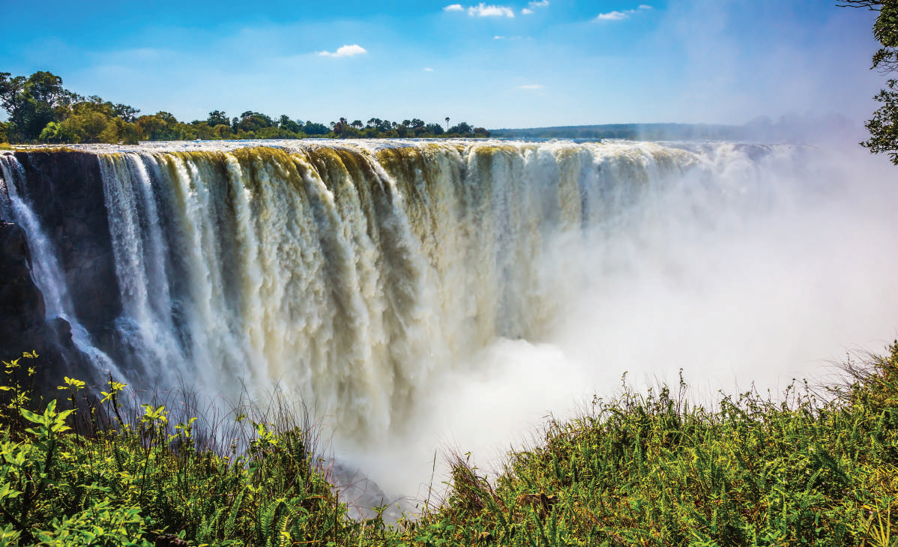
PROJECT
NATURAL WONDERS OF THE WORLD

Slide 19
PROJECT
Task 1: Find a natural wonder.
- Work in groups and decide on the natural wonder you want to talk about.
List of Natural Wonders:
- Ha Long Bay, Viet Nam
- The Great Barrier Reef, Australia
- The Grand Canyon, USA
- The Sahara Desert, Africa
- Mount Everest, border of Nepal and China
- Galápagos Islands, Ecuador
- Komodo Island, Indonesia
- Niagara Falls, Canada
...

Slide 20
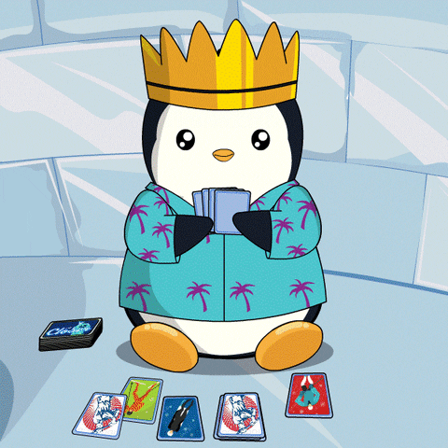
PROJECT
Task 2: Collect pictures of it.
- Work in groups to collect pictures of the wonder you have chosen.

Slide 21
PROJECT
Task 3: Look for information about it.
- Find information about the wonder.
Information:
+ Its location
+ Its special features / attractions
+ Threats to its existence
+ Ways / plans to preserve it
...

Slide 22

PROJECT
Task 4: Make a poster.
- Work in groups to make a poster.
- Decorate your poster and arrange the information in a way that it is informative and attractive.
PRESENTATION

Slide 23
PROJECT
PRESENTATION

Slide 24
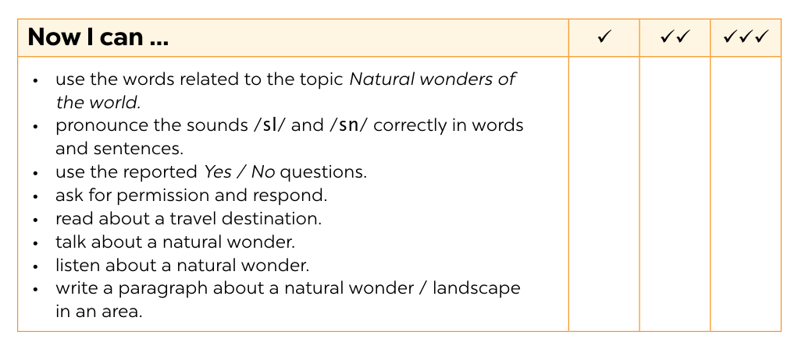
NOW I CAN...
Complete the self-assessment table.

Slide 25
LESSON 7: LOOKING BACK & PROJECT
LESSON 1: GETTING STARTED
WARM-UP
Brainstorming
Task 1: Choose A, B, C, or D to indicate the correct answer to each question.
Task 2: Give the correct forms of the words in brackets to complete the sentences.
VOCABULARY
Task 3: Underline the correct answers to complete the sentences.
Task 4: Rewrite the sentences in reported questions.
GRAMMAR
PROJECT
Poster presentation
CONSOLIDATION
Wrap-up
Homework

Slide 26

CONSOLIDATION
1
Wrap-up
What have we learnt in this lesson?
Review the vocabulary and grammar of Unit 7.
Apply what they have learnt (vocabulary and grammar) into practice through a project.

Slide 27

CONSOLIDATION
2
Homework
- Prepare for the next lesson.

Slide 28
Website: hoclieu.vn
Fanpage: facebook.com/www.tienganhglobalsuccess.vn/

