Slide 2


Unit
9
CITIES OF THE WORLD
LESSON 4: COMMUNICATION
1

Slide 3
LESSON 4: COMMUNICATION
LESSON 1: GETTING STARTED
WARM-UP
Warm-up
Expressing exclamations with What
Task 1: Look at the picture. Listen and read the exclamations.
Task 2: Work in pair. Look at the picture below and say what you think by using exclamations with What. You may use the suggestions below.
Everyday English
City landmarks
City landmarks
Task 3: Work in pairs. Write the names of the landmarks under the correct pictures.
Task 4: Write the names of the landmarks in 3 for the descriptions.
Task 5: Work in pairs. Read the questions and circle the correct answers.
PRODUCTION
CONSOLIDATION
Wrap-up
Homework

Slide 4

Everyday English
Expressing exclamations with What

Slide 5

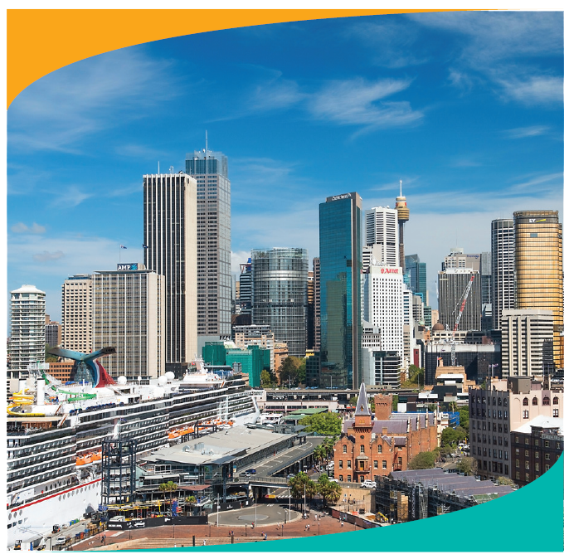
EVERYDAY ENGLISH
1
Look at the picture. Listen and read the exclamations.
1.
What a nice city!
2.
What a clear sky!
3.
What tall buildings!

Slide 6
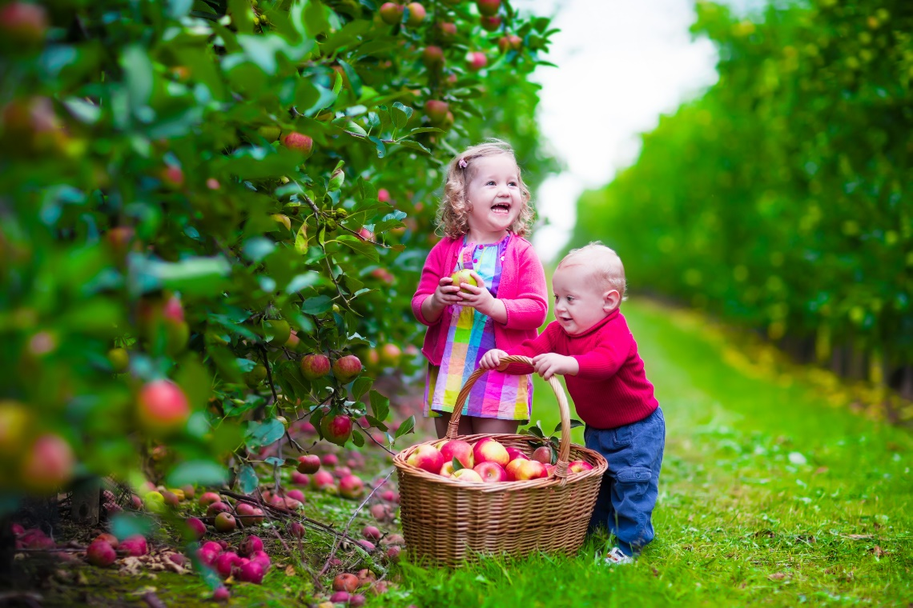
EVERYDAY ENGLISH
2
Work in pair. Look at the picture below and say what you think by using exclamations with What. You may use the suggestions below.
- happy / beautiful children
- colourful / nice picture
- sunny / beautiful weather
- small / cute boy
- beautiful / colourful apple trees

Slide 7

EVERYDAY ENGLISH
- happy / beautiful children
- colourful / nice picture
1.
- sunny / beautiful weather
2.
- small / cute boy
3.
- beautiful / colourful apple trees
4.
5.

Slide 8
City landmarks

Slide 9
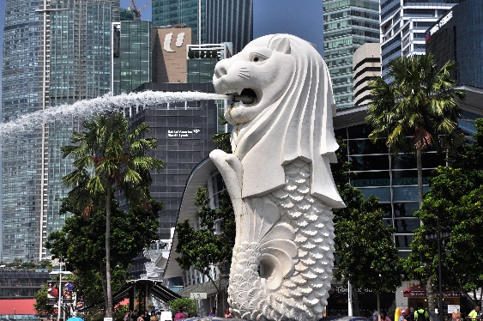
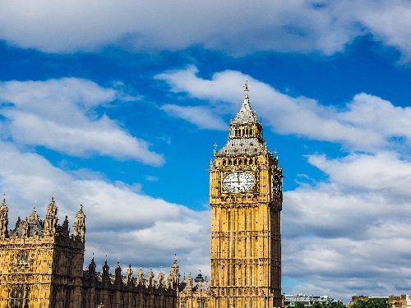
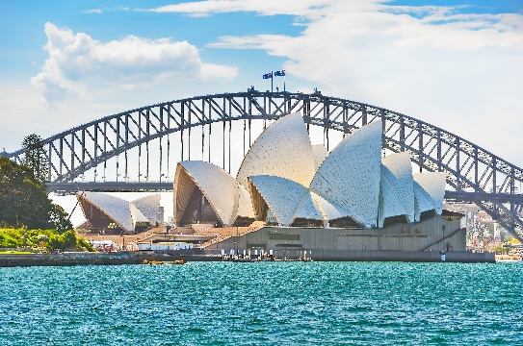
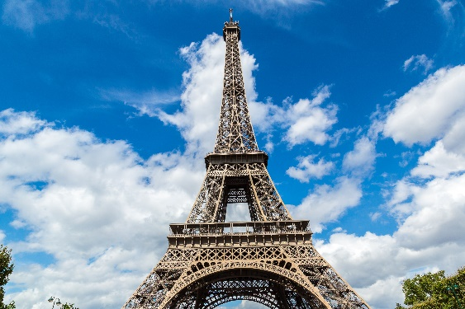
City landmarks
3
Work in pairs. Write the names of the landmarks under the correct pictures.
Eiffel Tower
Sydney Opera House
Big Ben
1.
Merlion
Big Ben
Merlion
2.
3.
Sydney Opera House
4.
Eiffel Tower

Slide 10


City landmarks
4
Write the names of the landmarks in 3 for the descriptions.
This tower is on the bank of the River Thames in London. In the tower, there’s a big clock and a bell.
This famous tower is in Paris. Every year, millions of visitors climb to its top to see the whole view of Paris.
3.
Eiffel Tower
Big Ben
1.
It’s a theatre on Sydney Harbour. Its roofs are white and look like shells. Visitors from all over the world come to see it.
Sydney Opera House
Merlion
2.
4.
It has the head of a lion and the body of a fish. It’s a famous landmark in Singapore.

Slide 11

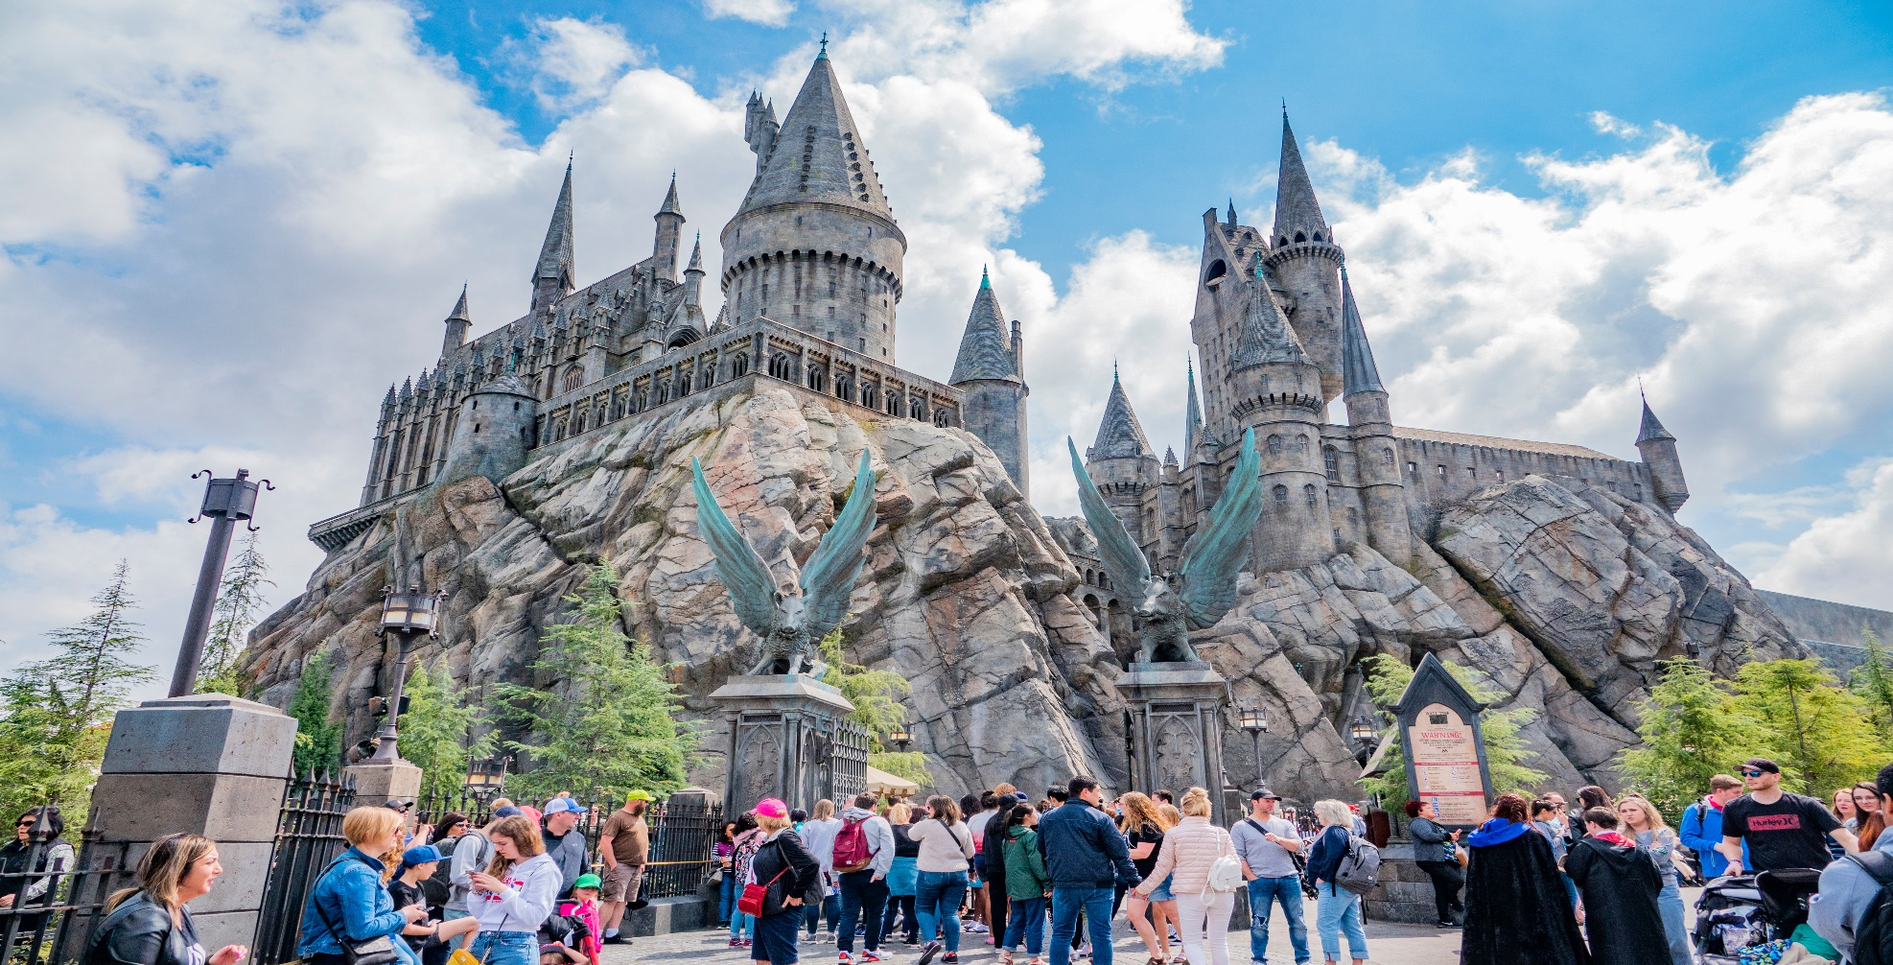
City landmarks
5
Work in pairs. Read the questions and circle the correct answers.

Slide 12
City landmarks
1.
Which city is nearer to Ha Noi than the others?
A.
Berlin
B.
Bangkok
C.
Tokyo
2.
The people of Quang Nam are proud of
their ancient town, ____.
A.
Hoi An
B.
Sa Pa
C.
Bach Ma
3.
Phnom Penh is the capital city of .
A.
Indonesia
B.
The Philippines
C.
Cambodia
4.
For children, California is famous for its ______ .
A.
Disneyland Park
B.
Golden Gate Bridge
C.
national parks

Slide 13

CONSOLIDATION
1
Wrap-up
What have we learnt in this lesson?
Expressing exclamations with What…
Practice to talk about city’s landmarks

Slide 14

CONSOLIDATION
2
Homework
Prepare for the next lesson

Slide 15

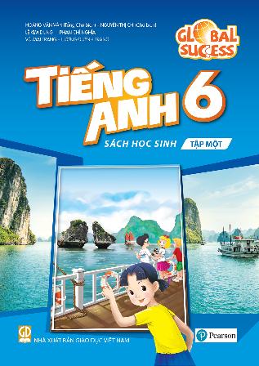
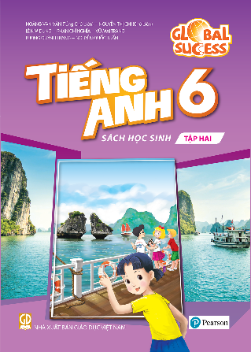
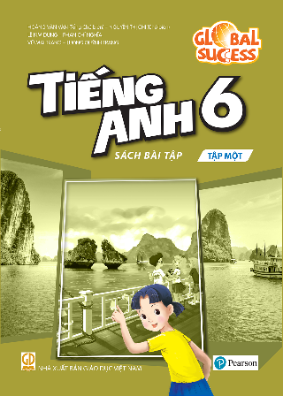
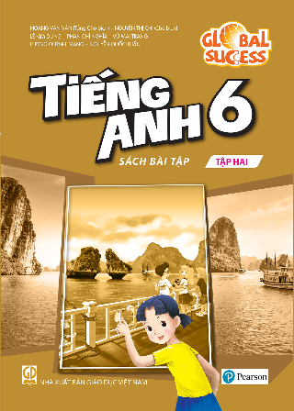

Website: hoclieu.vn
Fanpage: facebook.com/www.tienganhglobalsuccess.vn/

