Slide 1

UNIT 9: TRAVEL AND TOURISM
Lesson 3.1 – Listening and Reading
Page 80

Slide 2



Lesson 3.1
LESSSON OUTLINE

Slide 3

By the end of this lesson,
students will be able to:
practice listening and reading for main ideas and specific information.
talk about an eco-resort.
improve their listening and reading skills.
prepare them for the writing activity afterwards.

Slide 4
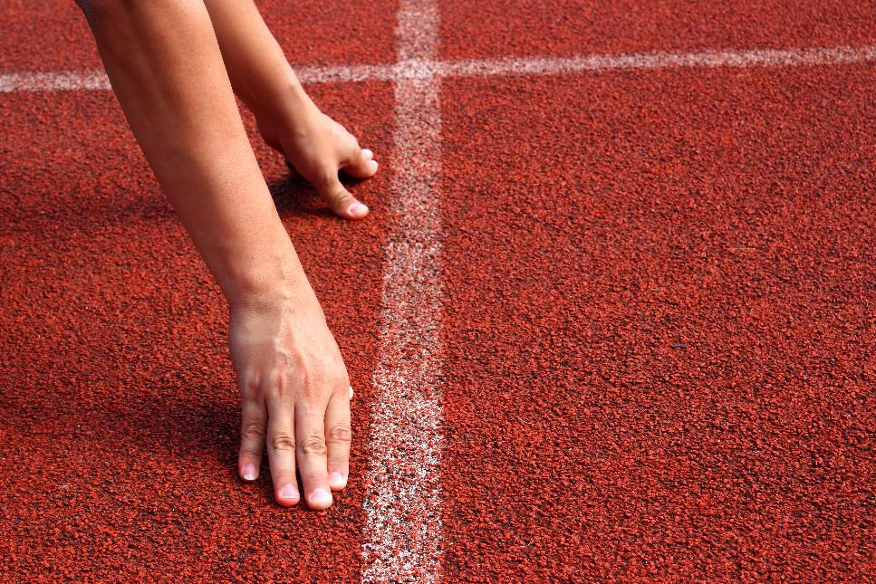


Slide 5
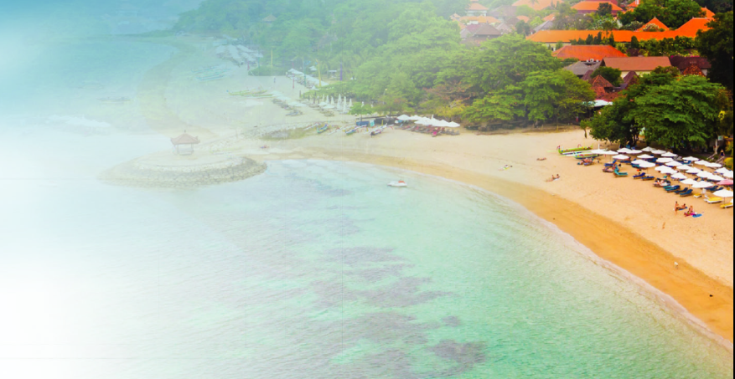
Work in pairs – Discuss.
Where do tourists go in your country?
What activities do they do?
What kind of places do they stay in?

Slide 6



Slide 7

Pre - Listening
a. Listen to the teacher. What is the main idea of the talk?
1. Modern vacations can have a bad effect on our environment.
2. Why more people choose to go on eco vacations.

Slide 8

While- Listening
Listen to the teacher.
What is the main idea of the talk?
1. Modern vacations can have a bad effect on our environment.
2. Why more people choose to go on eco vacations.

Slide 9

While - Listening
b. Now, listen and complete the notes.
1. Ecotourism can protect the environment and _________.
2. Modern vacations include activities like going to a beach or an ___________ park.
3. Eco tourists can learn more about a different _________.
4. Eco resorts use sustainable materials like wood and ________.
5. Eco tourism can be good for our _______.
wildlife
amusement
culture
bamboo
health

Slide 10
Audio Scripts
Good morning, class. Today we're going to start our project about tourism, so I want to talk about ecotourism. It's a kind of vacation where the tourists can enjoy staying in a natural environment without damaging it. This can help protect the natural environment and wildlife. So why are more people choosing to go to eco resorts? The first reason is that people want something different from the normal vacations they had before. The usual kind of vacations always include staying in a hotel and doing the same activities like going to the beach or an amusement park. Modern vacations can have a negative effect on our environment. Eco tourists can do something different like rice farming or learn about wildlife conservation. They can also learn more about a different culture. Another reason is that it gives people a chance to travel without hurting the environment. Eco resorts use materials like wood and bamboo to help protect the natural surroundings. Finally, tourists want to escape from the modern world and enjoy nature. Staying in a beautiful natural place is very relaxing. Ecotourism can be good for our health and teach us more about the natural world.

Slide 11
New words/ key words from the listening
Ecotourism (n) du lịch sinh thái
wildlife (n) (động vật) hoang dã
resort (n) nơi nghỉ dưỡng
unusual (adj) khác thường, đặc biệt
amusement (n) vui chơi giải trí
conservation (n) sự bảo tồn
culture (n) nền văn hóa
hurt (v) làm bị thương
material (n) nguyên vật liệu
bamboo (n) cây tre
escape (v) trốn thoát

Slide 12

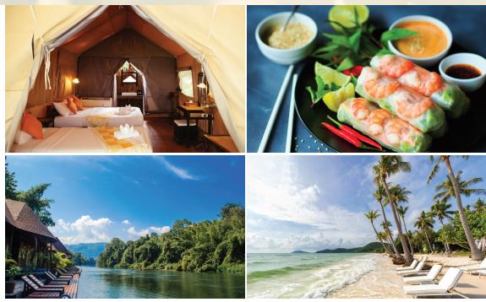
Read the description of an eco resort and answer the question. What does the text describe?
Pre Reading
1. The resort's location, accommodation, price, and activities
2. The resort's location, accommodation, restaurant, and activities

Slide 13
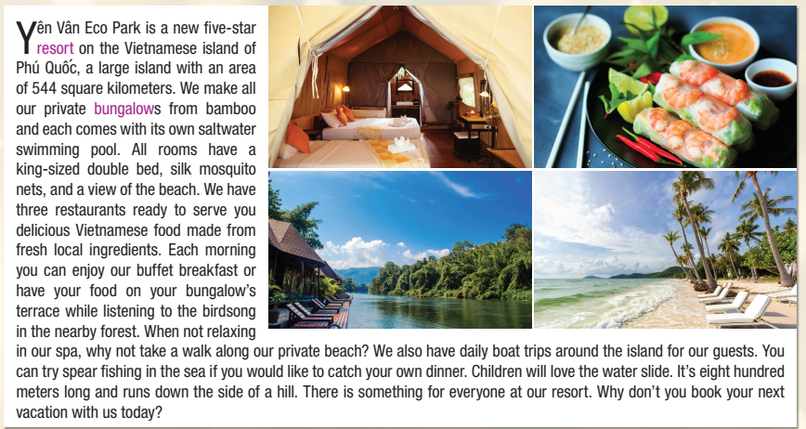

Slide 14
Read the description of an eco resort and answer the question. What does the text describe?
While Reading
The resort's location, accommodation, price, and activities
The resort's location, accommodation, restaurant, and activities

Slide 16
b. Now, read and fill in the blanks
While - Reading
1. Phú Quôc has an area of ______ square kilometers
2. The bungalows are made from ________.
3. You can take a walk along the _______.
4. There are ______ trips around the island.
5. You can catch a ______ for dinner
6. The water _______ is eight hundred meters long.
544
bamboo
beach
boat
fish
slide

Slide 17
1
2
3
4
5
6

Slide 18

Post- Reading
c. In pairs
What do you think you would like (or dislike) most about staying in the Yên Vân Eco Park?

Slide 19
Key ideas from the Reading
Name of the resort: Yên Vân Eco Park
Location: Phú Quốc island
What is the room like : All rooms have a king-sized double bed, silk mosquito nets, and a view of the beach
What is the restaurant like: three restaurants ready to serve delicious Vietnamese food made from fresh local ingredients
Activities guests can do: take a walk along our private beach, boat trips around the island, spear fishing in the sea, water slide, ……
Reasons guests should stay there: There is something for everyone at the resort
It’s special things: bungalows are made of bamboo and each comes with its own saltwater swimming pool

Slide 20

Consolidation

Slide 21
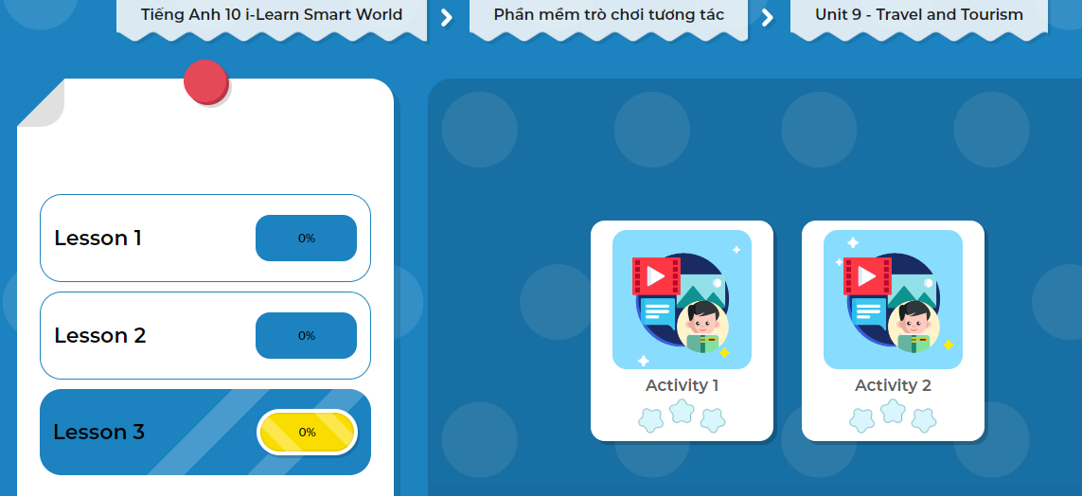
LET’S PLAY!
Click here to play the game!

Slide 22
Wrap-up
Today’s lesson
Key words and ideas for the Writing related to the topic: Description of an eco resort

Slide 23

Do the exercise in workbook on page 54.
Prepare the next lesson: Lesson 3.2 – Writing, (page 81).
Practice vocabulary in the Tiếng Anh 10 i-Learn Smart World DHA Notebook (page 54)
Play the consolidation games in Tiếng Anh 10 i-Learn Smart World DHA App on www.eduhome.com.vn

