Slide 1

Unit 3: Arts and Music
Lesson 3a: Reading
Page 46

Slide 2
Lesson Outline
Warm-up
Reading
Consolidation
Wrap-up

Slide 3
Objectives
By the end of this lesson, students will be able to…
- scan a text, to listen and read for gist and specific information.
- learn and use some vocabulary related to the topic.

Slide 4

WARM-UP

Slide 5

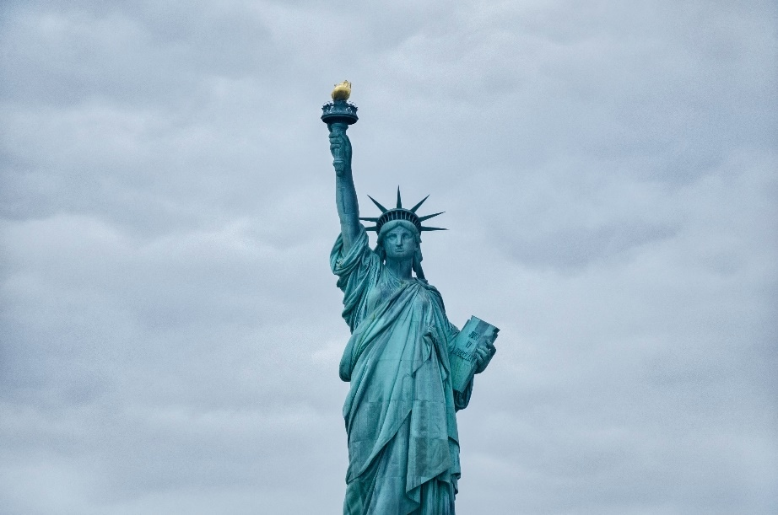

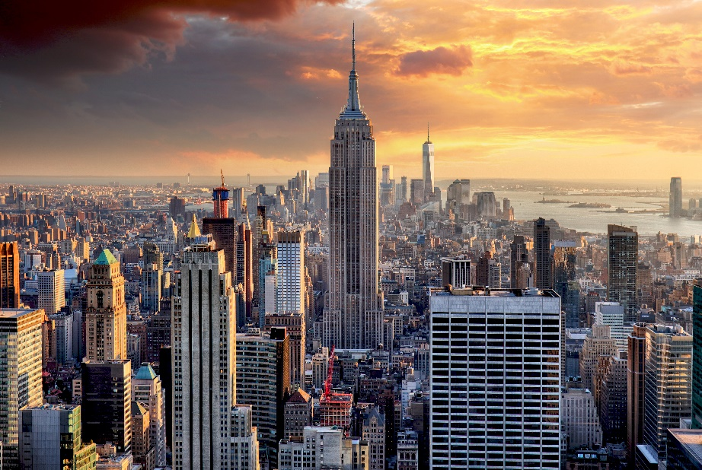
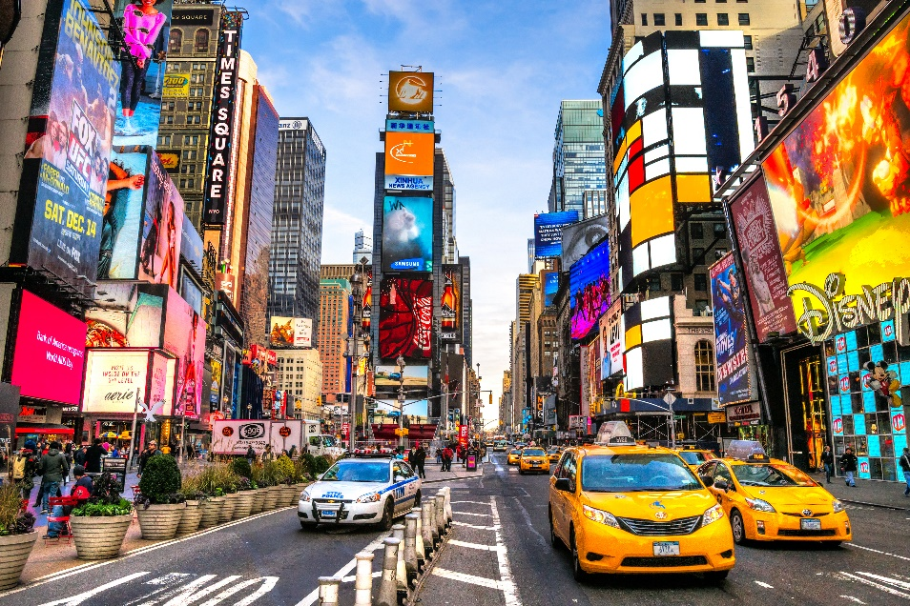
Work in pairs.
Look at the pictures and guess what city it is.

Slide 6
ANSWER
NEW YORK CITY

Slide 7

It’s time to learn …

Slide 8

Reading

Slide 9
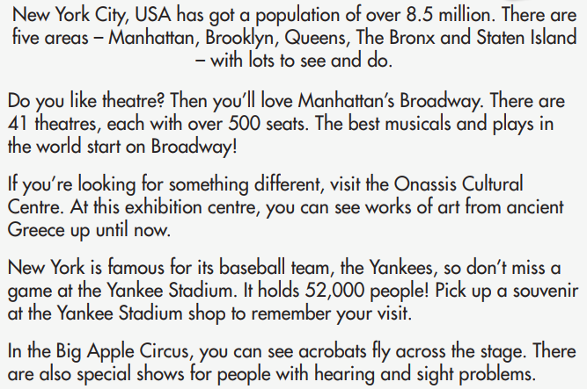

Pre-reading
Find these words in the text, try to guess what are their meanings.

Slide 10

Vocabulary
Listen and repeat. Click each phrase to hear the sound.
population /ˌpɒpjəˈleɪʃən/ (n) dân số
musical /ˈmjuːzɪkəl/ (n) vở nhạc kịch
acrobat /ˈækrəbæt/ (n) diễn viên biểu diễn nhào lộn (xiếc)
hearing /ˈhɪərɪŋ/ (n) thính lực
sight /saɪt/ (n) thị lực

Slide 11
Vocabulary
Look at the IPA and the meaning of each word to read out the word.
/ˌpɒpjəˈleɪʃən/ (n) dân số
/ˈmjuːzɪkəl/ (n) vở nhạc kịch
/ˈækrəbæt/ (n) diễn viên biểu diễn nhào lộn (xiếc)
/ˈhɪərɪŋ/ (n) thính lực
/saɪt/ (n) thị lực

Slide 12
While-reading
1. What can people do to have fun in New York City? Listen and read to find out.
New York City, USA has got a population of over 8.5 million. There are five areas – Manhattan, Brooklyn, Queens, The Bronx and Staten Island – with lots to see and do. Do you like theatre? Then you’ll love Manhattan’s Broadway. There are 41 theatres, each with over 500 seats. The best musicals and plays in the world start on Broadway! If you’re looking for something different, visit the Onassis Cultural Centre. At this exhibition centre, you can see works of art from ancient Greece up until now.
New York is famous for its baseball team, the Yankees, so don’t miss a game at the Yankee Stadium. It holds 52,000 people! Pick up a souvenir at the Yankee Stadium shop to remember your visit. In the Big Apple Circus, you can see acrobats ﬂy across the stage. There are also special shows for people with hearing and sight problems.

Slide 13
Answer
In New York City, people can:
watch a musical or play on Broadway,
see works of art at the Onassis Cultural Centre,
watch a baseball match at the Yankee Stadium,
watch acrobats at the Big Apple Circus.

Slide 14
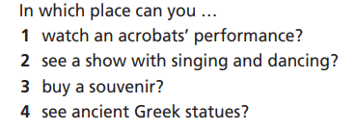
2. Read the advert again. Choose the correct places from the text to answer the questions.
What are you going to do?
Read again and choose the
correct places from the text.

Slide 15
Skim the advertisement again and underline the key words.
New York City, USA has got a population of over 8.5 million. There are five areas – Manhattan, Brooklyn, Queens, The Bronx and Staten Island – with lots to see and do. Do you like theatre? Then you’ll love Manhattan’s Broadway. There are 41 theatres, each with over 500 seats. The best musicals and plays in the world start on Broadway! If you’re looking for something different, visit the Onassis Cultural Centre. At this exhibition centre, you can see works of art from ancient Greece up until now.
New York is famous for its baseball team, the Yankees, so don’t miss agame at the Yankee Stadium. It holds 52,000 people! Pick up a souvenir at the Yankee Stadium shop to remember your visit. In the Big Apple Circus, you can see acrobats ﬂy across the stage. There are also special shows for people with hearing and sight problems.
(2)
(4)
(3)
(1)

Slide 16
Answer
In which place can you …
1. watch an acrobats’ performance? _____________
2. see a show with singing and dancing? _____________
3. buy a souvenir? _____________ 4. see ancient Greek statues? _____________
Big Apple Circus
Broadway
Yankee Stadium
Onassis Cultural Centre

Slide 17

3. What do these numbers refer to?
What are you going to do?
Read again and find out what above numbers refer to.

Slide 18
Skim the advertisement again and underline the key words.
(1)
(3)
New York City, USA has got a population of over 8.5 million. There are five areas – Manhattan, Brooklyn, Queens, The Bronx and Staten Island – with lots to see and do. Do you like theatre? Then you’ll love Manhattan’s Broadway. There are 41 theatres, each with over 500 seats. The best musicals and plays in the world start on Broadway! If you’re looking for something different, visit the Onassis Cultural Centre. At this exhibition centre, you can see works of art from ancient Greece up until now.
New York is famous for its baseball team, the Yankees, so don’t miss agame at the Yankee Stadium. It holds 52,000 people! Pick up a souvenir at the Yankee Stadium shop to remember your visit. In the Big Apple Circus, you can see acrobats ﬂy across the stage. There are also special shows for people with hearing and sight problems.
(5)
(2)
(4)

Slide 19
Answer
• 8.5 million _____________
• 500 _____________
• five _____________
• 52,000 _____________
• 41 _____________
people
seats
areas
people
theatres

Slide 20
Extra Practice
Read the text again and choose the correct option.
First, underline the key words, then choose the correct answers.
1. What is the population of New York City?
A. under 8.5 million B. over 8.5 million C. 8.5 million
2. What can you see at Manhattan’s Broadway?
A. works of art B. musicals and plays C. baseball
3. How many people can Yankee Stadium hold?
A. 500 B. 8.5 million C. 52,000
4. What can you see in In the Big Apple Circus?
A. acrobats B. souvenirs C. games

Slide 21
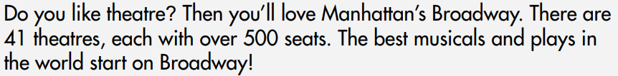
Extra Practice
Now, read again to check the answers.
1. What is the population of New York City?
A. under 8.5 million B. over 8.5 million C. 8.5 million
2. What can you see at Manhattan’s Broadway?
A. works of art B. musicals and plays C. baseball

Slide 22
Extra Practice
Now, read again to check the answers.
3. How many people can Yankee Stadium hold?
A. 500 B. 8.5 million C. 52,000
4. What can you see in In the Big Apple Circus?
A. acrobats B. souvenirs C. games

Slide 23


Post-reading

Slide 24
STUDENT A
STUDENT B
Hi, B. What would you like to do in New York City?
I would like to go to the theatres on Broadway.
Why?
Because I love watching plays and musicals. And you?
I love sports, so I would like to watch a baseball match at the Yankee Stadium.
That’s great.

Slide 25

CONSOLIDATION

Slide 26
Write a paragraph (60-80 words) about a visit to a city in your country.
Where do you visit?
When do you visit it?
What is the city famous for?
What can you do there?

Slide 27

WRAP-UP

Slide 28
Today’s lesson
Vocabularies
acrobat
hearing
musical
population
sight
Reading: for specific information.
Writing: a paragraph about a visit to a city.

Slide 29
Homework
Practise the vocabularies and make sentences using them.
Do the exercises in TA 7 Right on WB (page 26).
Prepare the next lesson (page 47 SB).

Slide 30

Enjoy your day!

