Slide 1
KET SPEAKING
Time allowed - 8-10 minutes
Normally you will do the speaking test with another candidate. The two of you will meet two examiners. One of the examiners will talk to you, the other does not particpate in the conversations.
There are two parts to the speaking test:
Speaking part 1: short questions and answers between you and the examiner
Speaking part 2: the examiner gives you some information or a card with some ideas for questions. You have to talk with the other candidate and ask or answer questions.
How to prepare for KET Speaking
Speak as much as you can, with your friends
Practise asking and asnwering questions about daily life
Practise giving information about yourself

Slide 2
KEY ENGLISH TEST 3
SPEAKING TEST 3

Slide 3
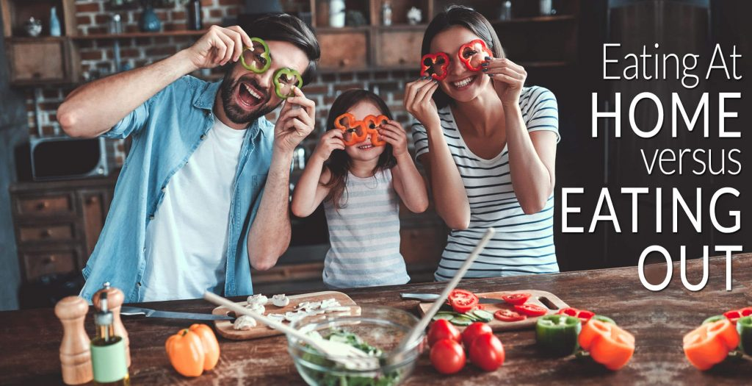
Part 1:
How often do you eat out?
Where do you usually go when you eat out?
Who do you usually go with when you eat out?
Have you tried food from other countries?
Do you like eating at buffets? Why or why not?
Talk about a restaurant you like

Slide 4
VOCABULARY
appetizer (noun): a dish that's eaten before the main course
course (noun): one part of a meal
cuisine (noun): a country or region's style of cooking
dessert (noun): sweet food eaten at the end of a meal
waiter (male) or waitress (female) (noun): a person who takes orders from guests and brings their food
make a booking (also "book a table") (phrase): to contact a restaurant and reserve a table for a meal

Slide 5
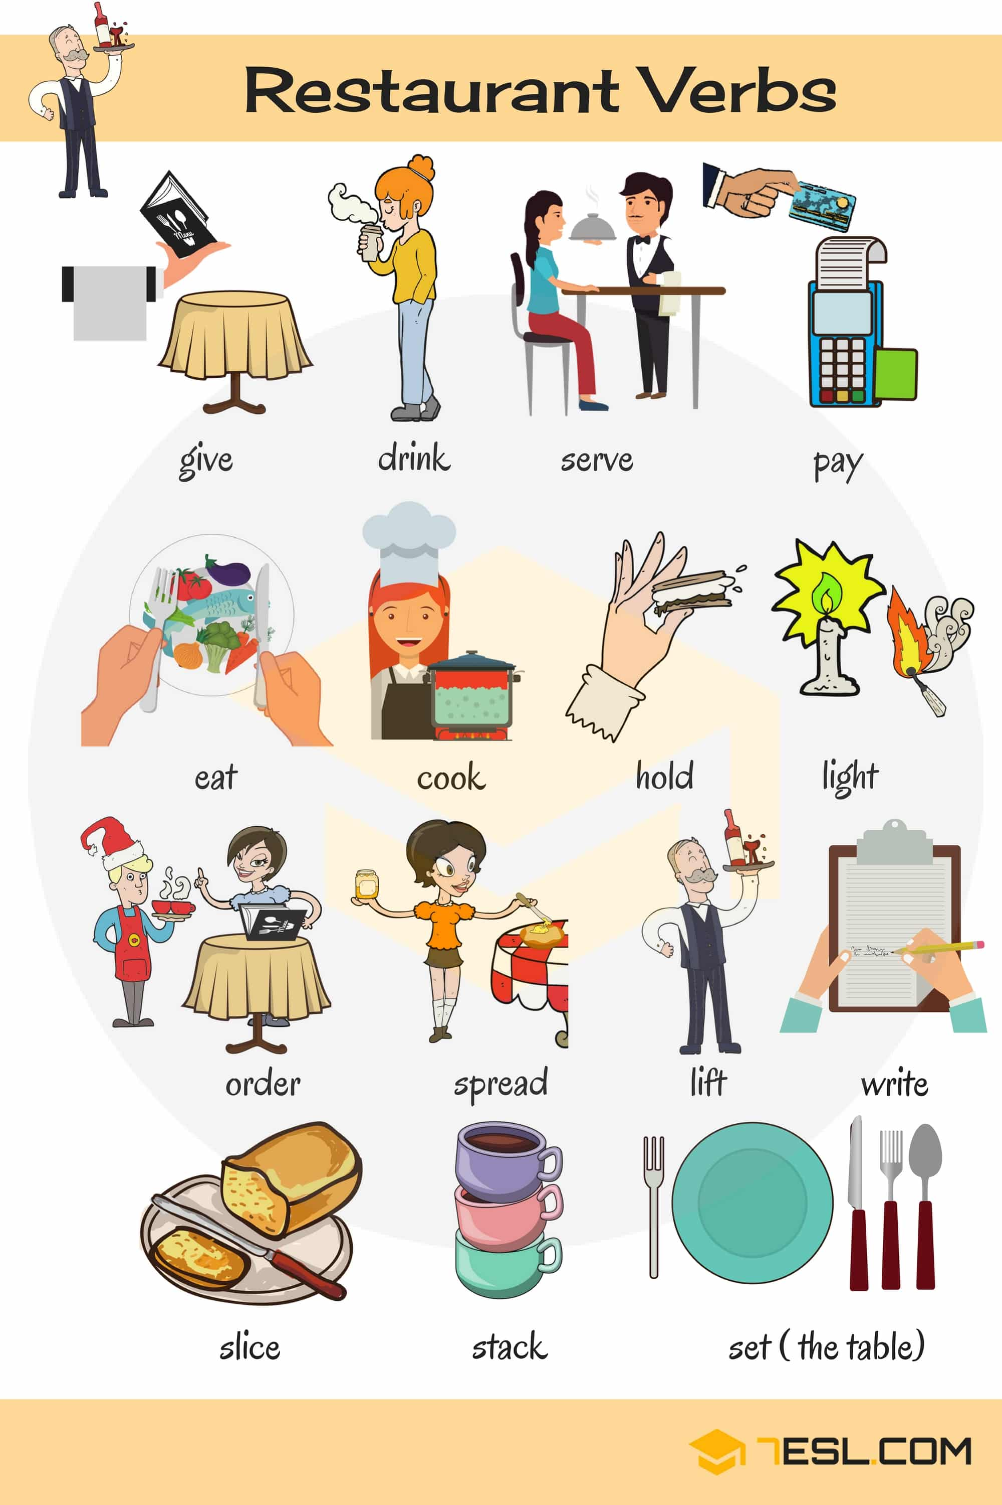

Slide 6
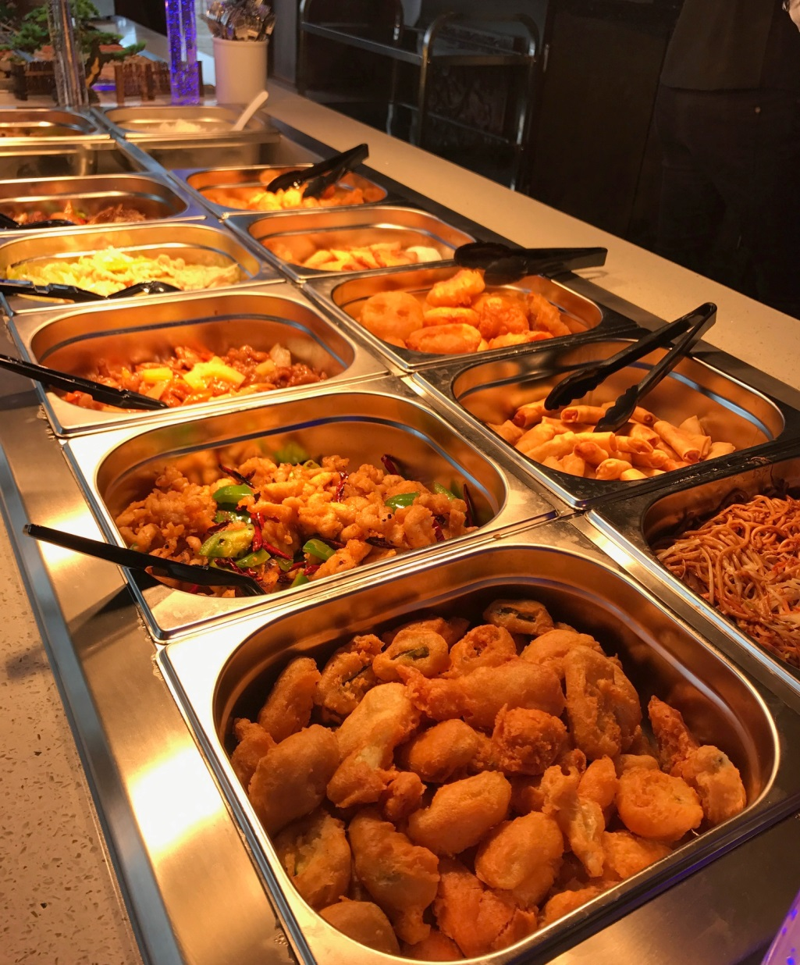
Have you ever tried eating at buffets?
Why ? Why not?

Slide 7
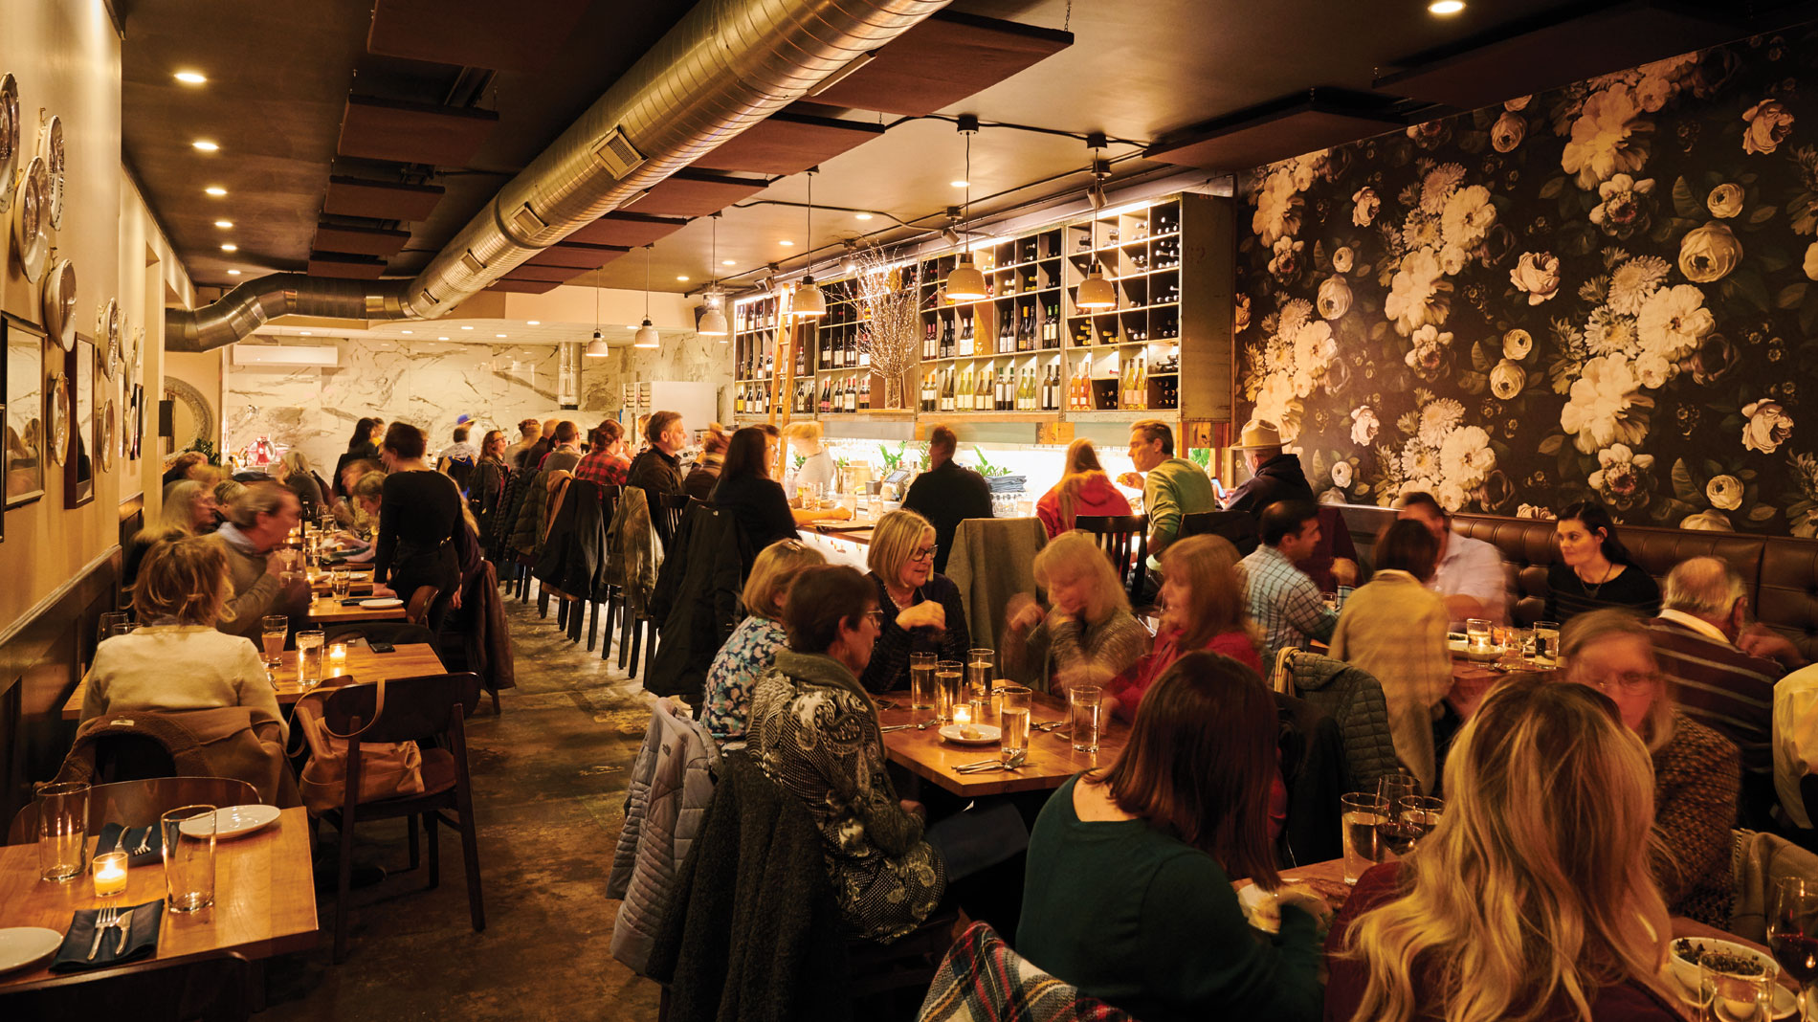
TALK ABOUT A RESTAURANT

Slide 8
Where is it
What food does it have
Name of the restaurant
How often do you go there
Who do you often go with

Slide 9
SPEAKING pART 2
Asking and answering questions using these prompt cards

Slide 10
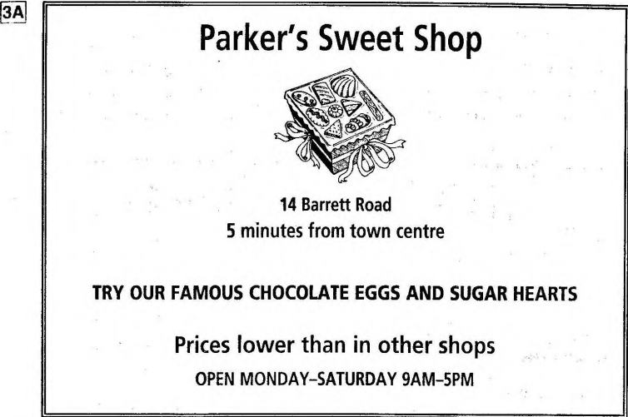
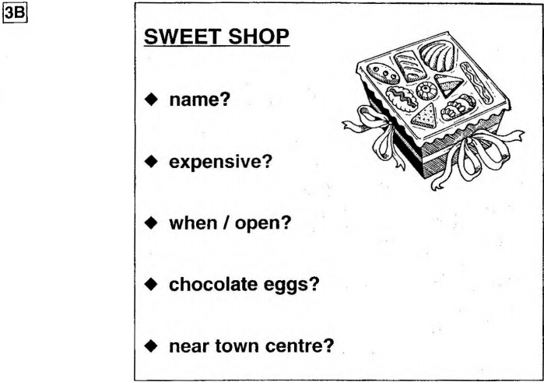
Practice asking and answering questions using the words given.
What are other questions and answers you can think of?

Slide 11
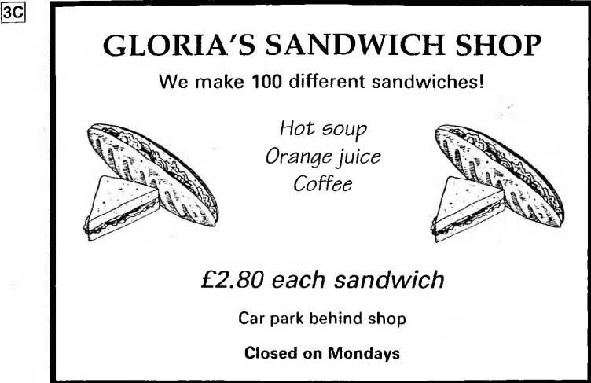
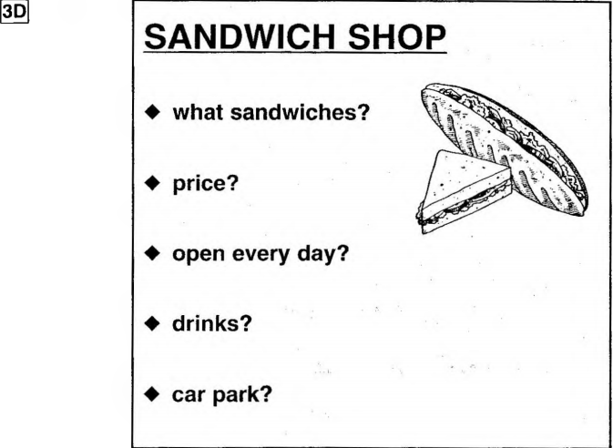
Ask and answer questions using the words given.

Slide 12
Based on the given information, talk about the sweet shop

