Slide 1
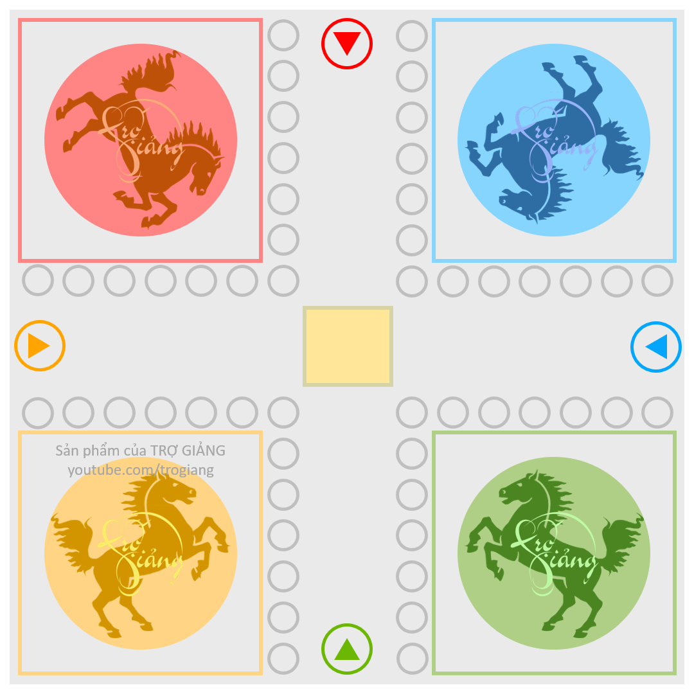
1
2
3
4
5
1
2
3
4
5
1
2
TRÒ CHƠI
CỜ CÁ NGỰA
3
4
5
1
2
3
4
5
5
4
3
2
1
Racehorses
PowerPoint game
5
4
3
2
1
1
2
3
4
5
1
2
3
4
5

Slide 2
Question 1?
A. wrong
B. right
C. wrong
D. wrong

Slide 3
Question 2?
A. right
B. wrong
C. wrong
D. wrong

Slide 4
Question 3?
A. wrong
B. wrong
C. right
D. wrong

Slide 5
Question 4?
A. wrong
B. wrong
C. wrong
D. right

Slide 6
Question 5?
A. right
B. wrong
C. wrong
D. wrong

Slide 7
Question 1?
A. wrong
B. wrong
C. right
D. wrong

Slide 8
Question 2?
A. right
B. wrong
C. wrong
D. wrong

Slide 9
Question 3?
A. wrong
B. wrong
C. right
D. wrong

Slide 10
Question 4?
A. wrong
B. right
C. wrong
D. wrong

Slide 11
Question 5?
A. wrong
B. wrong
C. right
D. wrong

Slide 12
Question 1?
A. wrong
B. wrong
C. wrong
D. right

Slide 13
Question 2?
A. wrong
B. right
C. wrong
D. wrong

Slide 14
Question 3?
A. right
B. wrong
C. wrong
D. wrong

Slide 15
Question 4?
A. wrong
B. wrong
C. right
D. wrong

Slide 16
Question 5?
A. wrong
B. wrong
C. right
D. wrong

Slide 17
Question 1?
A. right
B. wrong
C. wrong
D. wrong

Slide 18
Question 2?
A. wrong
B. right
C. wrong
D. wrong

Slide 19
Question 3?
A. wrong
B. wrong
C. wrong
D. right

Slide 20
Question 4?
A. wrong
B. wrong
C. right
D. wrong

Slide 21
Question 5?
A. wrong
B. wrong
C. right
D. wrong

Slide 22
Next lesson
Nội dung tiếp theo của bài học
Nếu bạn đọc được lời nhắn này, rất mong bạn đăng ký kênh để ủng hộ tinh thần cho mình nhé.
Xin chân thành cảm ơn !
Subscribe my channel, please !

