Slide 2
Unit
2
The generation gap
Unit
FAMILY LIFE
LESSON 2
LANGUAGE

Slide 3
LESSON 2
LANGUAGE
WARM-UP
Game: Quizizz
Task 1: Listen and repeat.
Task 2: Listen and circle.
PRONUNCIATION
Task 1: Match the words to make phrases.
Task 2: Complete the sentences using the correct forms of the phrases.
VOCABULARY
Task 1: Circle the correct answers to complete the sentences.
Task 2. Talk any rules in your family or things that you or your parents think are necessary.
GRAMMAR
CONSOLIDATION
Wrap-up
Homework

Slide 4
WARM-UP
QUIZIZZ
- Use your electronic devices to access to the link on quizizz and join the game.
- The whole class complete to answer the questions.
- After the game, Ss with the highest point is the winner.
Notes:
https://quizizz.com/admin/quiz/6384e7b420f73e001e34eec8?source=quiz_share

Slide 5
WARM-UP
https://quizizz.com/join?gc=314578

Slide 6
PRONUNCIATION
1
Listen and repeat. Pay attention to the contracted forms in the following sentences. What are their full forms?
1. Today, we’ll talk about the generation gap.
2. You’re right, Mark.
3. We can’t avoid daily arguments.
4. That’s a good point.
5. No, they don’t.
6. Now let’s continue our discussion with …
we will
You are
cannot
That is
do not
let us

Slide 7
PRONUNCIATION
2
Listen and circle what you hear: contracted or full forms. Then practise saying these conversations in pairs.
1. A: What’s/ What is the topic of today’s discussion?
B: We’ll/ We will talk about the generation gap.
2. A: Don’t you/ Do you not live with your grandparents?
B: No, I don’t/ do not.
3. A: I’m not sure who’ll/ who will be the next presenter? Will you speak next?
B: Yes, I’ll/ I will.

Slide 8
VOCABULARY
1
Match the words to make phrases that mean the following.
1. traditional
a. characteristics
special qualities that belong to a group of
people or things
2. common
b. conflict
a disagreement between different generations
3. generational
c. values
beliefs about what is important in the culture of a particular society
4. cultural
d. view
a belief or an opinion that has existed for a long time without changing

Slide 9
VOCABULARY
2
Complete the sentences using the correct forms of the phrases in 1.
cultural values
1. We all have ________________, and they can influence the way we treat other people.
2. When you live with your extended family, you have to deal with _____________________.
3. Each generation has its ______________________ that are influenced by social and economic conditions.
4. A _________________ is that men are the breadwinners in the family.
generational conflicts
common characteristics
traditional view

Slide 10
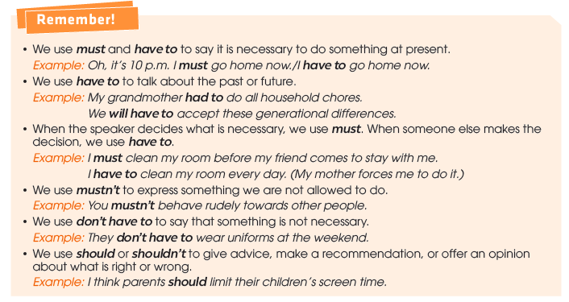
GRAMMAR
Modal verbs: must, have to, should

Slide 11
GRAMMAR
1
Circle the correct answers to complete the sentences.
1. You must/mustn’t respect older people. You can learn some valuable lessons from them.
2. We don’t have to/have to wear uniforms on weekdays. It’s the rule at our school.
3. You should/mustn’t ask your parents for permission if you want to colour your hair.
4. In the past, women had to/must do all housework. It was one of their duties.

Slide 12
GRAMMAR
2
Work in pairs. Are there any rules in your family or things that you or your parents think are necessary? Share them with your partner. Use must, have to, and should.
I have to be back home by 9 p.m.
Really? I don't have to. But my parents think I shouldn't stay out after 10 p.m.

Slide 13
CONSOLIDATION
1
Wrap-up
What have you learnt today?
Some lexical items about generational differences
Contracted forms
Modal verbs: must, have to, should

Slide 14
CONSOLIDATION
2
Homework
Do exercises in the workbook.
Prepare for Lesson 3 - Unit 2.

Slide 15
Website: hoclieu.vn
Fanpage: facebook.com/www.tienganhglobalsuccess.vn

