Slide 1
Unit 4: All things high-tech
Lesson 4a: Reading
Page 64

Slide 2
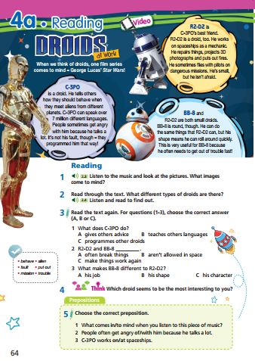
Lesson Outline
Warm-up
Reading
Consolidation
Wrap-up

Slide 3
Objectives
By the end of this lesson, students will be able to…
- scan a text, to listen and read for gist and specific information.
- learn and use some vocabulary related to the topic.

Slide 4
WARM-UP

Slide 5
Work in pairs.
Pick out one letter in each word to have the correct words.
1. deviece
2. realitay
3. plaeyer
4. viartual
5. preadiction

Slide 6
Pick out one letter in each word to have the correct words.
1. deviece
2. realitay
3. plaeyer
4. viartual
5. preadiction
1. device
2. reality
3. player
4. virtual
5. prediction
ANSWER

Slide 7
It’s time to learn …

Slide 8
Reading

Slide 9
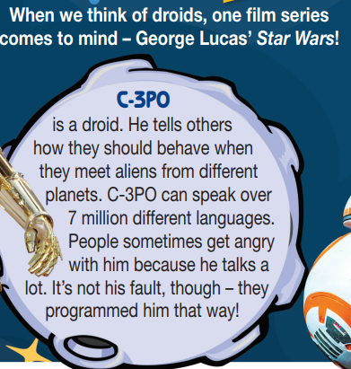
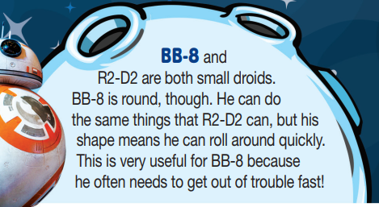
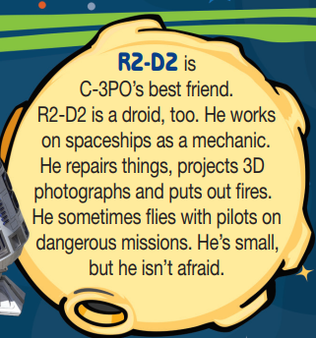
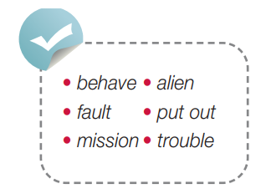
Pre-reading
Find these words in the text, try to guess what are their meanings.

Slide 10
Vocabulary
Listen and repeat. Click each phrase to hear the sound.
behave /bɪˈheɪv/ (v) cư xử
alien /ˈeɪliən/ (n) người ngoài hành tinh
fault /fɒlt/ (n) lỗi
mission /ˈmɪʃən/ (n) nhiệm vụ, sứ mệnh
put out /pʊt aʊt/ (phrasal v) dập tắt (lửa)
trouble /ˈtrʌbəl/ (n) tình trạng rắc rối

Slide 11
Vocabulary
Look at the IPA and the meaning of each word to read out the word.
/bɪˈheɪv/ (v) cư xử
/ˈeɪliən/ (n) người ngoài hành tinh
/fɒlt/ (n) lỗi
/ˈmɪʃən/ (n) nhiệm vụ, sứ mệnh
/pʊt aʊt/ (phrasal v) dập tắt (lửa)
/ˈtrʌbəl/ (n) tình trạng rắc rối

Slide 12
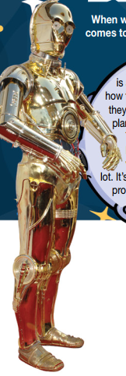
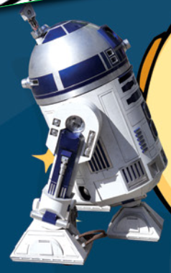
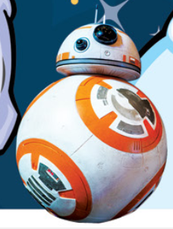
While-reading
1 Listen to the music and look at the pictures. What images come to mind?
When I hear the music and look at the pictures, I think of space travel and robots.

Slide 13
While-reading
Read through the text. What different types of droids are there?
Listen and read to find out.
C-3PO is a droid. He tells others how they should behave when they meet aliens from different planets. C-3PO can speak over 7 million different languages. People sometimes get angry with him because he talks a lot. It’s not his fault, though – they programmed him that way!
R2-D2 is C-3PO’s best friend. R2-D2 is a droid, too. He works on spaceships as a mechanic. He repairs things, projects 3D photographs and puts out fires. He sometimes ﬂies with pilots on dangerous missions. He’s small, but he isn’t afraid.
BB-8 and R2-D2 are both small droids. BB-8 is round, though. He can do the same things that R2-D2 can, but his shape means he can roll around quickly. This is very useful for BB-8 because he often needs to get out of trouble fast!

Slide 14
ANSWER KEY
In Star Wars, there are three types of droids: C-3PO, R2-D2 and BB-8.

Slide 15
While-reading
Read the text again. For questions (1-3), choose the correct
answer (A, B or C).
1. What does C-3PO do?
A. gives others advice
B. teaches other languages
C. programmes other droids
2. R2-D2 and BB-8 __________ .
A. often break things
B. aren’t allowed in space
C. make things work again
3. What makes BB-8 different to R2-D2?
A. his job
B. his shape
C. his character

Slide 16
While-reading
Skim the text and underline the key words.
(1)
C-3PO is a droid. He tells others how they should behave when they meet aliens from different planets. C-3PO can speak over 7 million different languages. People sometimes get angry with him because he talks a lot. It’s not his fault, though – they programmed him that way!
(2)
R2-D2 is C-3PO’s best friend. R2-D2 is a droid, too. He works on spaceships as a mechanic. He repairs things, projects 3D photographs and puts out fires. He sometimes ﬂies with pilots on dangerous missions. He’s small, but he isn’t afraid.
(3)
(2)
BB-8 and R2-D2 are both small droids. BB-8 is round, though. He can do the same things that R2-D2 can, but his shape means he can roll around quickly. This is very useful for BB-8 because he often needs to get out of trouble fast!

Slide 17
While-reading
Read the text again. For questions (1-3), choose the correct
answer (A, B or C).
1. What does C-3PO do?
A. gives others advice
B. teaches other languages
C. programmes other droids
2. R2-D2 and BB-8 __________ .
A. often break things
B. aren’t allowed in space
C. make things work again
3. What makes BB-8 different to R2-D2?
A. his job
B. his shape
C. his character
He tells others how they should behave.
R2-D2 is a droid. He repairs things. BB-8 ... can do the same things that R2-D2 can.
BB-8 is round, though.

Slide 18
Extra Practice
Read the text again and answer if statements are True or False.
First, underline the key words, then choose the correct answers.
1. C-3PO can speak more than 7 million different languages.
2. C-3PO is quiet.
3. R2-D2 works on spaceships as a mechanic.
4. BB-8 has the circular shape.

Slide 19
Extra Practice
Now, read again to check the answers.
1. C-3PO can speak more than 7 million different languages .
True
C-3PO can speak over 7 million different languages.
2. C-3PO is quiet.
False
People sometimes get angry with him because he talks a lot.
3. R2-D2 works on spaceships as a mechanic.
True
R2-D2 is a droid, too. He works on spaceships as a mechanic.
4. BB-8 has the circular shape.
True
BB-8 is round.

Slide 20
Post-reading
Which droid seems to be the most interesting to you?

Slide 21
STUDENT A
STUDENT B
Hi, B. Which droid seems to be the most interesting to you?
C-3PO seems to be the most interesting to me.
Why?
He can speak over 7 million different languages...
So?
… so he is useful for communicating with other
aliens from different planets.

Slide 23
CONSOLIDATION

Slide 24
Write a paragraph (60-80 words) about a droid.
What is its name?
What can it do?
What is its shape?

Slide 25
WRAP-UP

Slide 26
Today’s lesson
Vocabularies
alien
behave
fault
mission
put out
trouble
Reading: for specific information.
Writing: a paragraph about a droid.

Slide 27
Homework
Practise the vocabularies and make sentences using them.
Do the exercises in TA 7 Right on WB (page 32).
Prepare the next lesson (page 65 SB).
Do the exercise in TA 7 Right on Notebook (pages 20&21).

Slide 28
Enjoy your day!

