Slide 1
Unit 4B: OUR PLANET
Lesson B: Grammar

Slide 2
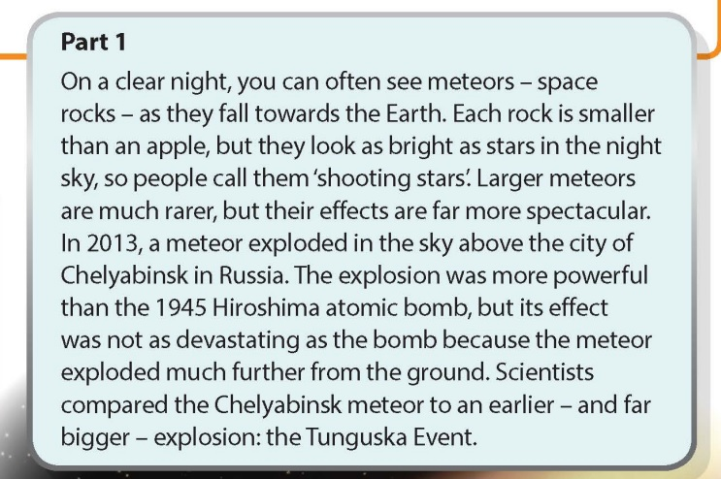
Answer: A shooting star is a meteor (a space rock) that is falling towards the Earth.
www.phuongnam.edu.vn

Slide 3
Find adjective that ends in -ER
www.phuongnam.edu.vn

Slide 4
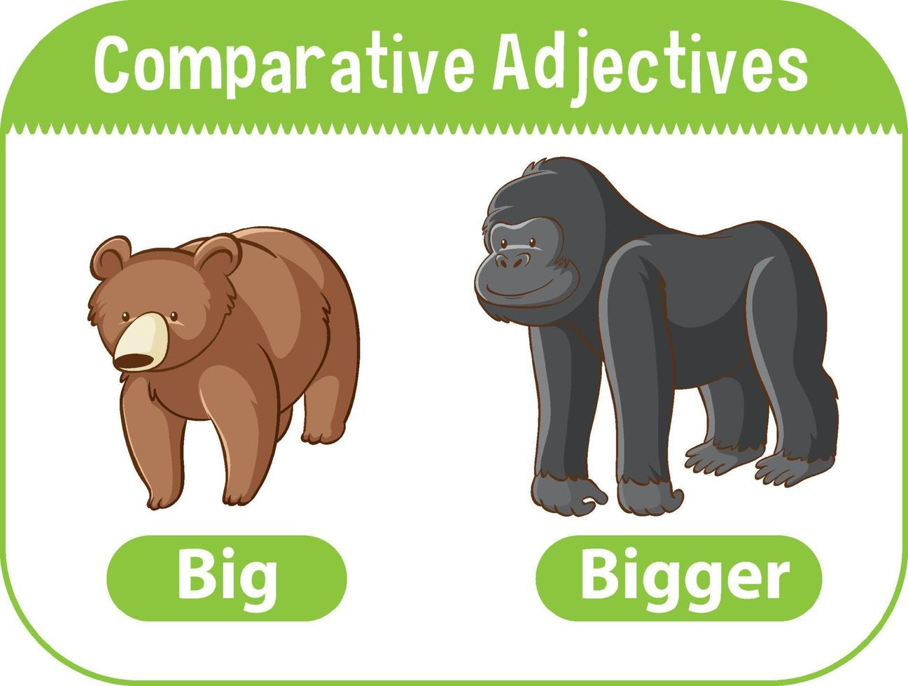
www.phuongnam.edu.vn

Slide 5
www.phuongnam.edu.vn

Slide 6
Short adjective | Comparative | Rule
small | 1.______ | + -er
large | 2.______ | + r
early | 3.______ | y => -ier
big | 4.______ | double consonant + -er
smaller
larger
earlier
bigger
www.phuongnam.edu.vn

Slide 7
Long adjective | Comparative | Rule
Powerful | 5.______________ | more + adjective
more powerful
www.phuongnam.edu.vn

Slide 8
Irregular adjective | Comparative | No rules
far | 6.______________
good | 7. better
bad | 8. worse
further/farther
www.phuongnam.edu.vn

Slide 9
www.phuongnam.edu.vn

Slide 10
www.phuongnam.edu.vn

Slide 11
www.phuongnam.edu.vn

Slide 12
www.phuongnam.edu.vn

Slide 13
further
fewer
more powerful
closer
brighter
more unsual
www.phuongnam.edu.vn

Slide 14
Ex 6: Work in pairs. Rearrange the sentences to make questions beginning with Which…? using the comparative form of the adjectives.
1. Which is more dangerous, a blizzard or a thunderstorm?
2. Which is more beautiful, a snowflake or a rainbow?
3. Which holiday venue is better, the mountains or the beach?
4. Which city has more seasons, Ha Noi or Ho Chi Minh City?
5. For you personally, which temperature is worse, -5○C or 35○C?
6. In Ha Noi, which month is hotter, June or August?
www.phuongnam.edu.vn

Slide 15
LET’S START
Work in groups
Volunteer to answer and explain why within in 1 minute

Slide 16
START TIMER
TIME’S UP!
TIME LIMIT:
1 minute
Example:
Which is more dangerous, a blizzard or a thunderstorm?
> A thunderstorm is more dangerous. Because they include lightning, high winds, and heavy rain that can cause flash floods.

Slide 17
START TIMER
TIME’S UP!
TIME LIMIT:
1 minute
Which is more beautiful, a snowflake or a rainbow?

Slide 18
START TIMER
TIME’S UP!
TIME LIMIT:
1 minute
Which holiday venue is better, the mountains or the beach?

Slide 19
START TIMER
TIME’S UP!
TIME LIMIT:
1 minute
Which city has more seasons, Ha Noi or Ho Chi Minh City?

Slide 20
START TIMER
TIME’S UP!
TIME LIMIT:
1 minute
For you personally, which temperature is worse, -5ºC or 35ºC?

Slide 21
START TIMER
TIME’S UP!
TIME LIMIT:
1 minute
In Ha Noi, which month is hotter, June or August?

Slide 22
01
Homework
02
03
1. Finish all the tasks
2. Prepare U4-C (P.49)
04
?
05
06

Slide 23
www.phuongnam.edu.vn

Slide 24
Thank you!
CTCP ĐẦU TƯ VÀ PHÁT TRIỂN GIÁO DỤC PHƯƠNG NAM

