Slide 1

Unit 9: English in the World
Review
Pages 108 & 109

Slide 2






LESSON OUTLINE
Consolidation

Slide 3
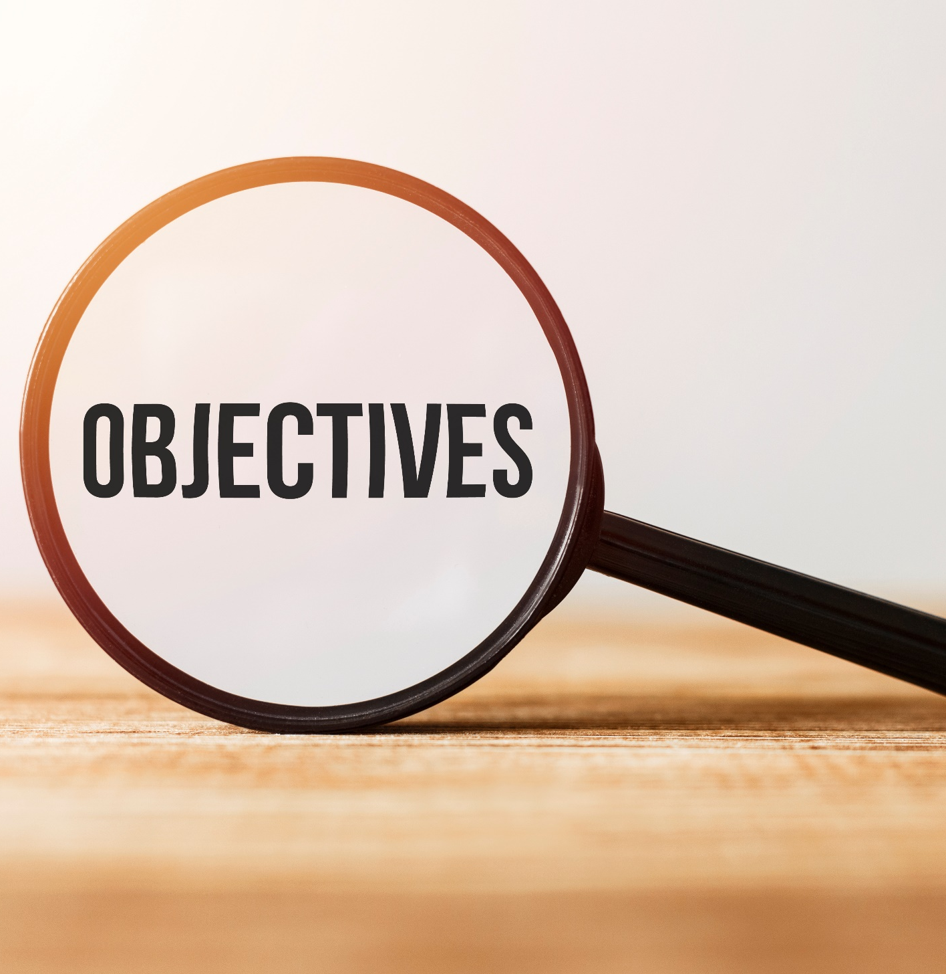
By the end of this lesson, students will be able to…
- review vocabularies and grammar points.
- talk about
• holiday plans
• last holiday
- practice listening, reading, and speaking skills.

Slide 4
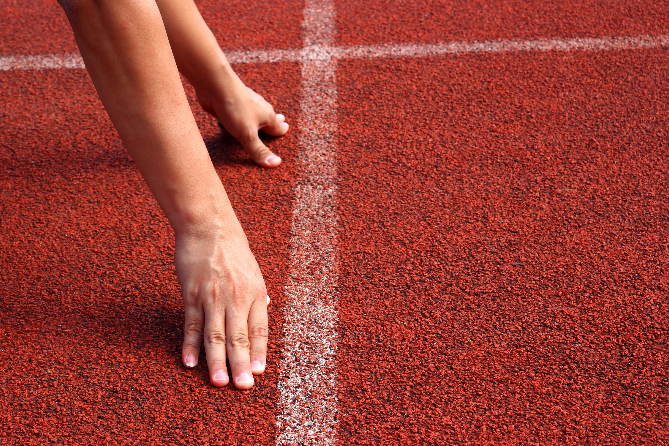
WARM-UP

Slide 5
Work in pairs. Answer the questions.
Where did you go on your holidays?
Which ways did you use English?

Slide 6

Read the instruction. What will you do? Underline the key words
You will hear Anna talking to her friend, Jamie, about her trip to the UK. Where's she going to visit on each day? For each question, write a letter (A-H) next to each day. You will hear the conversation twice.

Slide 7

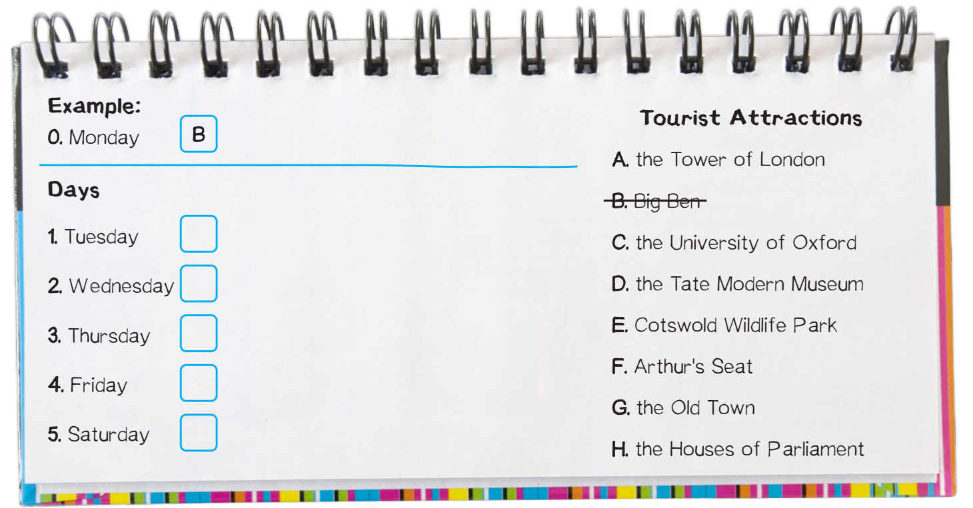
Click on the icon to hear the sound
Now, listen and write down your answers.

Slide 8
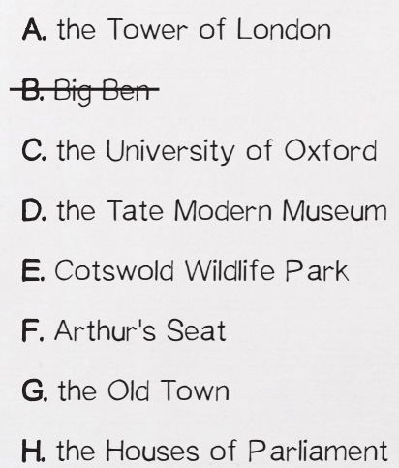




Listen again and check.
Click on the icon to hear the sound
1. Tuesday
A
2. Wednesday
C
3. Thursday
E

Slide 9



Listen again and check.
Click on the icon to hear the sound
4. Friday
G
F
5. Saturday

Slide 10
Extra Practice
Listen and read.
Click on the icon to hear the sound
Jamie: You're going to the UK next week, right?
Anna: Yes.
Jamie: Where are you going to visit?
Anna: On Monday, we're going to visit Big Ben and Buckingham Palace.
Jamie: Cool.
Anna: Then, we're going to visit the Tower of London and some museums on Tuesday.
Jamie: I heard that many ghosts are still in the tower.
Anna: I hope we don't meet any!
Jamie: Haha.
Anna: Then on Wednesday, we're going to the University of Oxford.
Jamie: Nice.
Anna: Then, we're going to Cotswold Wildlife Park on Thursday.
Jamie: That should be fun.
Anna: On Friday morning, we are flying to Scotland!
Jamie: What are you going to do?
Anna: We will explore the Old Town in Edinburgh on Friday.
Jamie: Are you going to visit Edinburgh Castle?
Anna: Of course!
Jamie: Is that the last day of your trip?
Anna: No, Saturday is the last day and we're going to climb Arthur's Seat.
Jamie: Sounds fantastic!
Anna: I know, I can't wait!

Slide 11
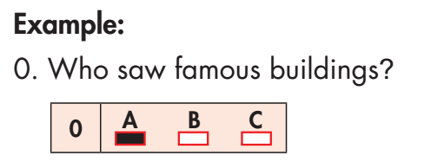
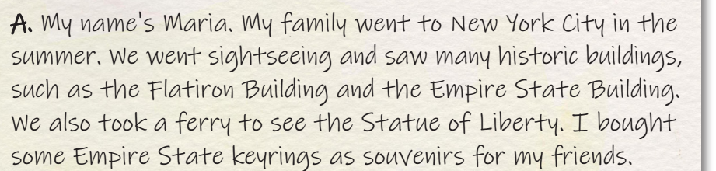

Slide 12
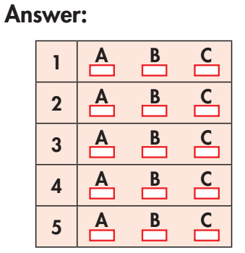
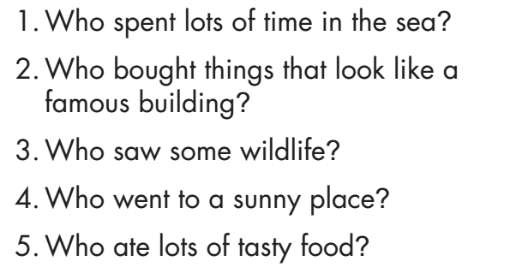
Read five questions, underline the key words and do the task.
WHAT ARE YOUR ANSWERS?

Slide 13
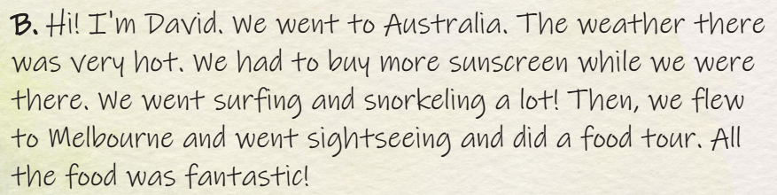
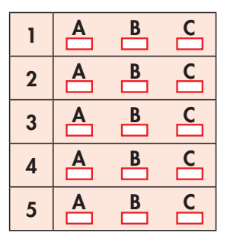
Read again and check the answers.
1. Who spent lots of time in the sea?

Slide 14
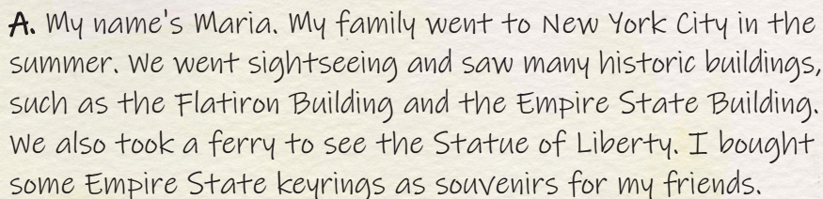
Read again and check the answers.
2. Who bought things that look like a famous building?

Slide 15
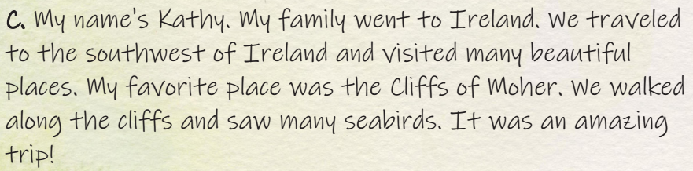
Read again and check the answers.
3. Who saw some wildlife?

Slide 16
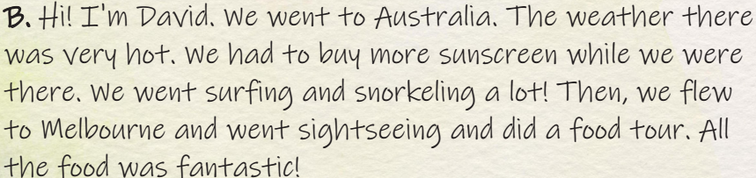
Read again and check the answers.
4. Who went to a sunny place?

Slide 17
Read again and check the answers.
5. Who ate lots of tasty food?

Slide 18

Read the sentences and underline the key words.
1. Our trip to New Zealand was great! We took so many _________________.
2. We went to the airport very early because our _____________ was at 6 a.m.
3. There are many _________________ buildings in Vienna. The oldest one is more than one thousand years old.
4. My brother forgot his _________________ so I had to pay for him.

Slide 19
Read the sentences and underline the key words.
5. We normally watch baseball games on TV, but it's my sister's birthday, so we're going to the _________________ on Saturday!
6. I like to decorate my room with the _________________ I bought from my trips. I have a doll from Japan, a small statue from Cambodia, and some paintings from Malaysia.
7. Our _________________ was great. She was very friendly and helpful. She told us a lot about the history of the town.
8. We went _________________ and then spent a few days by the sea.

Slide 20
Read again and fill in the blanks.
photos
sightseeing
wallet
historic
tour guide
flight
souvenirs
stadium
1. Our trip to New Zealand was great! We took so many _________________.
2. We went to the airport very early because our _____________ was at 6 a.m.
3. There are many _________________ buildings in Vienna. The oldest one is more than one thousand years old.
4. My brother forgot his _________________ so I had to pay for him.

Slide 21
Read again and fill in the blanks.
sightseeing
tour guide
souvenirs
stadium
5. We normally watch baseball games on TV, but it's my sister's birthday, so we're going to the _________________ on Saturday!
6. I like to decorate my room with the _________________ I bought from my trips. I have a doll from Japan, a small statue from Cambodia, and some paintings from Malaysia.
7. Our _________________ was great. She was very friendly and helpful. She told us a lot about the history of the town.
8. We went _________________ and then spent a few days by the sea.

Slide 22
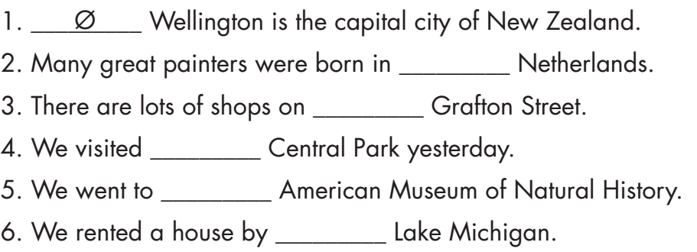
the
Ø
Ø
the
Ø

Slide 23
you/visit/Empire State Building?
2. we/take/ﬂight/Boston/the next day
3. I/buy/lots of new clothes
4. she/not have/swimsuit
5. he/lose/his ticket
6. they/eat/famous restaurant
Did you visit the Empire State Building?
We took a flight to Boston the next day.
I bought lots of new clothes.
She didn't have a swimsuit.
He lost his ticket.
They ate at a famous restaurant.

Slide 24

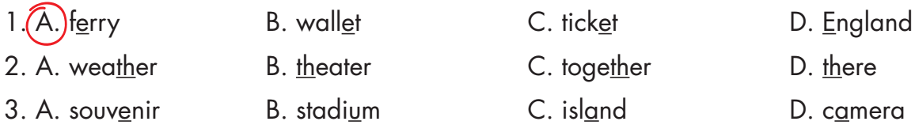

Slide 25
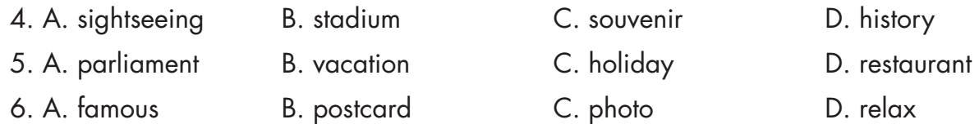
b. Circle the word that differs from the other three in the position of primary stress in each of the following questions.

Slide 26

CONSOLIDATION

Slide 27
Write a paragraph about your holiday. In the paragraph, you should:
use the Past Simple tense.
use at least 5 new words in Unit 9.
talk about the ways you used English.

Slide 28

WRAP-UP

Slide 29
Today’s lesson
Reading & Listening:
- Understand instructions.
Practice reading and listening for general and specific information.
Speaking:
- Talk about holidays.

Slide 30
Homework
Review all vocabularies and grammar points in Unit 9.
Practice speaking about holidays.
Play the consolidation games in Tiếng Anh 7 i-Learn Smart World DHA App on www.eduhome.com.vn
Prepare the next lesson (page 76 SB).

Slide 31

Lesson 3
Stay positive and have a nice day!

