Slide 1
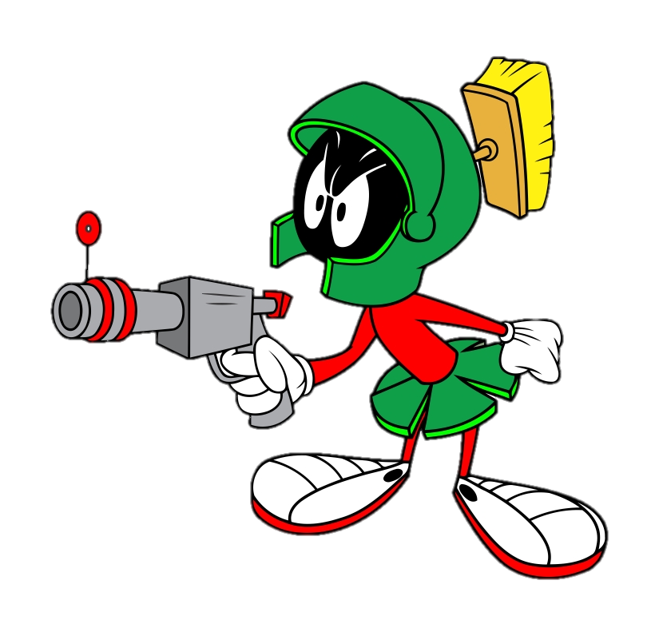
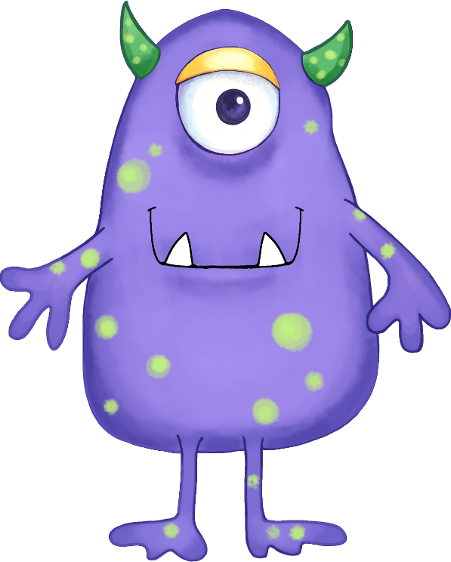
TIÊU DIỆT
QUÁI VẬT MỘT MẮT
PLAY

Slide 2
TIẾP
This is the car of Ben and Mary. It’s _________.
theirs

Slide 3
TIẾP
That is the bike he gave you. It’s _________.
yours

Slide 4
TIẾP
She bought this car last month. It’s _________.
hers

Slide 5
TIẾP
These are the books of Tom. They’re ________.
ours

Slide 6
TIẾP
Those are the toys of my dog. They’re ________.
its

Slide 7
TIẾP
Andy won this trophy last year. It’s ________.
his

Slide 8
TIẾP
These are the children’s sweets. They are _________.
theirs

Slide 9
TIẾP
Those are Mary’s rollerblades. They are _________.
hers

Slide 10
TIẾP
That is Ted’s raincoat. It’s ________.
his

Slide 11
HẾT
You gave me these sweets. They’re ________.
mine

