Slide 1
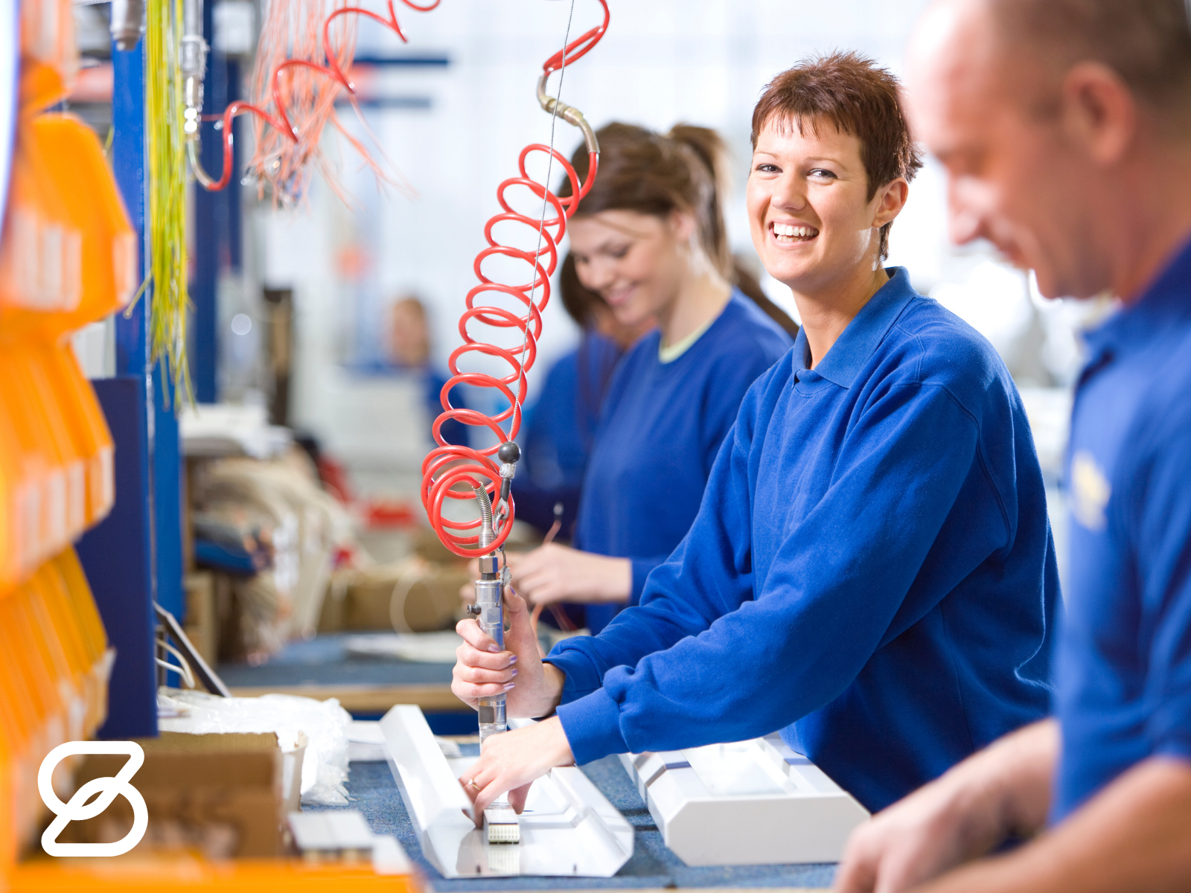

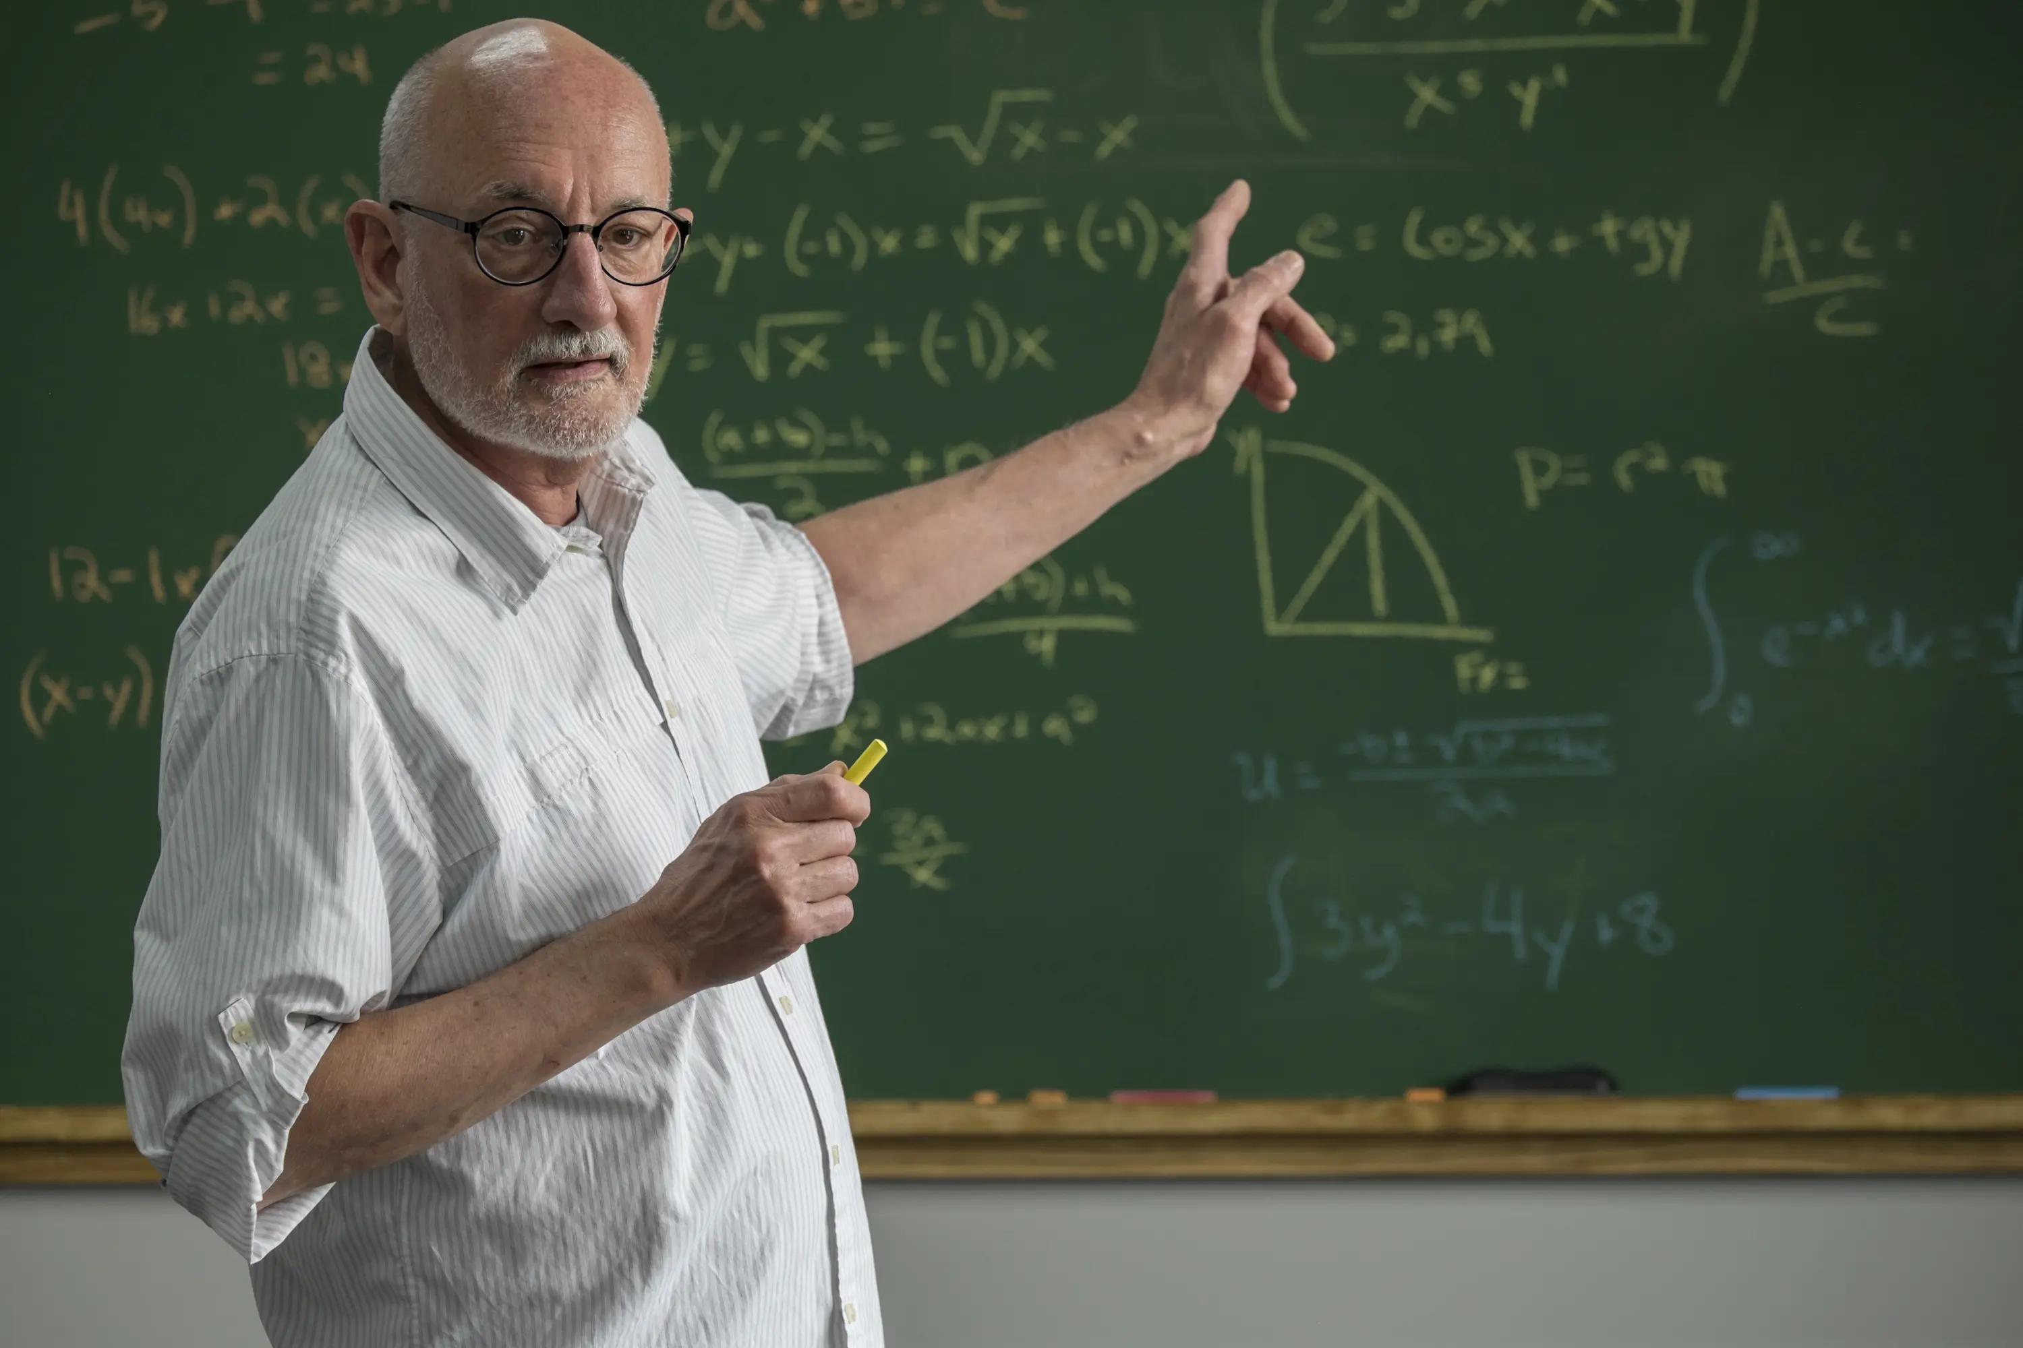


Unit
12
LESSON 7: LOOKING BACK & PROJECT

Slide 2
Unit
12
CAREER CHOICES
LESSON 7: LOOKING BACK & PROJECT

Slide 3

OBJECTIVES
By the end of the lesson, students will be able to:
Review the vocabulary and grammar of Unit 12
Apply what they have learnt (vocabulary and grammar) into practice through a project.

Slide 4

LESSON 7: LOOKING BACK & PROJECT
LESSON 1: GETTING STARTED
WARM-UP
Brainstorming
Task 1: Put the words and phrases in the appropriate column.
Task 2: Complete the sentences, using words/phrases from the box.
VOCABULARY
Task 3: Combine each pair of sentences into one, using the given word in the brackets.
Task 4: Fill in each gap in the text with a conjunction from the box.
GRAMMAR
PROJECT
Poster presentation
CONSOLIDATION
Wrap-up
Homework

Slide 5
hand-eye coordination
surgeon
demanding
well-paid
repetitive
teamwork
designing
assembly worker
software engineer
WARM-UP
BRAINSTORMING
- Work in teams
- Members of each team take turns and write as many vocabulary in Unit 12 as possible in ................. minutes.
- The group having more correct answers is the winner.
Jobs | Job Features | Job Skills

Slide 6
VOCABULARY
1
Put the words and phrases in the appropriate column.
job creative career
rewarding sewing
surgeon
demanding
repetitive
well-paid
designing
assembly worker
teamwork
software engineer
hand-eye coordination
Jobs | Job Features | Job Skills
My mum first learnt (1) ________ skills from my grandmother. She got her (2) _________ as a tailor when she was 16. Now she owns a small tailor shop in the village. She is (3) _________ and hardworking. She has such an excellent sense of style that many ladies love the clothes she makes. Though sometimes she has to work late at night, she finds her job (4) _________ because she can satisfy her customers. I think my mum has had a successful (5) _________ in tailoring

Slide 7
VOCABULARY
2
Complete the sentences, using words/phrases from the bo
job creative career
rewarding sewing
My mum first learnt (1) ________ skills from my grandmother. She got her (2) _________ as a tailor when she was 16. Now she owns a small tailor shop in the village. She is (3) _________ and hardworking. She has such an excellent sense of style that many ladies love the clothes she makes. Though sometimes she has to work late at night, she finds her job (4) _________ because she can satisfy her customers. I think my mum has had a successful (5) _________ in tailoring
sewing
job
creative
rewarding
career

Slide 8
LESSON 7: LOOKING BACK & PROJECT
LESSON 1: GETTING STARTED
WARM-UP
Brainstorming
Task 1: Put the words and phrases in the appropriate column.
Task 2: Complete the sentences, using words/phrases from the box.
VOCABULARY
Task 3: Combine each pair of sentences into one, using the given word in the brackets.
Task 4: Fill in each gap in the text with a conjunction from the box.
GRAMMAR

Slide 9
GRAMMAR
Combine each pair of sentences into one, using the given word in the brackets
3
1. The salary was low. She accepted the job. (though)
accepted the job though the salary was low
She________________________________________________.
2. My sister is too shy. She can’t be an MC. (such)
such a shy girl that she can’t be an MC.
My sister is__________________________________________.

Slide 10
GRAMMAR
Combine each pair of sentences into one, using the given word in the brackets
3
3. Life in the city was too demanding, so he came back to his village. (because)
back to his village because life in the city was too demanding.
He came___________________________________________.
4. Her backache was too painful. She had to stop working in the factory. (so)
was so painful that she had to stop working in the factory.
Her backache________________________________________.

Slide 11
although because since so such
GRAMMAR
Combine each pair of sentences into one, using the given word in the brackets
3
5. Clara didn’t like academic subjects. Her mum insisted that she go to university. (although)
insisted that she go to university although she didn’t like academic subjects.
Clara’s mum_________________________________________.
Making career choices is (1) ______ a difficult process that conflicts happen in many families when they discuss their teenager’s future career. (2) ______some parents consider their child’s dream job unrealistic, they try to stop him / her from pursuing it. Sometimes, the parents force their child to study for a job which is (3) ______ demanding that he / she feels stressed just (4) __________ they overestimate their child’s ability. (5) _________ parents want to help their children make good career decisions, they really need to understand their teenaged children’s passions and abilities.

Slide 12
GRAMMAR
4
4
Fill in each gap in the text with a conjunction from the box.
although because since so such
such
Making career choices is (1) ______ a difficult process that conflicts happen in many families when they discuss their teenager’s future career. (2) ______some parents consider their child’s dream job unrealistic, they try to stop him / her from pursuing it. Sometimes, the parents force their child to study for a job which is (3) ______ demanding that he / she feels stressed just (4) __________ they overestimate their child’s ability. (5) _________ parents want to help their children make good career decisions, they really need to understand their teenaged children’s passions and abilities.
Since
so
because
Although

Slide 13


LESSON 7: LOOKING BACK & PROJECT
LESSON 1: GETTING STARTED
WARM-UP
Brainstorming
Task 1: Put the words and phrases in the appropriate column.
Task 2: Complete the sentences, using words/phrases from the box.
VOCABULARY
Task 3: Combine each pair of sentences into one, using the given word in the brackets.
Task 4: Fill in each gap in the text with a conjunction from the box.
GRAMMAR
PROJECT
Poster presentation
CONSOLIDATION
Wrap-up
Homework

Slide 14
PROJECT
YOUR FUTURE JOBS

Slide 15
PROJECT
-Work in your groups. Give them a few minutes to prepare for the presentation.
- There are checklists for self and peer assessment.
- Check appropriate items while listening to your classmates’ presentations and write comments if you have any.

Slide 16
1/ Self-assessment
 | Tick where appropriate | Comments (in English or Vietnamese)
DELIVERY
1. I greeted the audience.
2. I spoke clearly and naturally.
3.I cooperated with my group members when delivering the talk.
4. I interacted with the audience.
5. I concluded the talk appropriately.
DESIGN OF THE POSTER
1. Our poster was clearly organised.
2. Our photos and drawings were suitable.
CONTENT: Our presentation includes the following information
What the jobs are
What type(s) of training the jobs require
What skills and personal qualities we need to do the jobs well
Whether the jobs will be popular in the future (and/or which job will be more popular in the future)

Slide 17

1/ Peer-assessment
 | Tick where appropriate | Comments (in English or Vietnamese)
DELIVERY
1. The presenter greeted the audience.
2. The presenter spoke clearly and naturally.
3.The presenter cooperated when delivering their talk
4. The presenters interacted with the audience.
5.The presenters concluded their talk appropriately.
DESIGN OF THE POSTER
1. Their poster is clearly organised.
2. Their photos and drawings are suitable.
CONTENT: The presentation includes the following information about the future city
What the jobs are
What type(s) of training the jobs require
What skills and personal qualities we need to do the jobs well
Whether the jobs will be popular in the future (and/or which job will be more popular in the future)
PRESENTATION

Slide 18
PROJECT
PRESENTATION

Slide 19
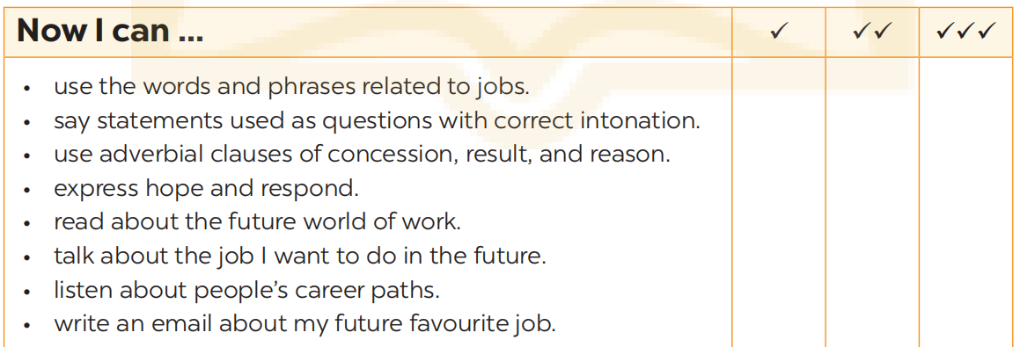
NOW I CAN...
Complete the self-assessment table.

Slide 20
LESSON 7: LOOKING BACK & PROJECT
LESSON 1: GETTING STARTED
WARM-UP
Brainstorming
Task 1: Put the words and phrases in the appropriate column.
Task 2: Complete the sentences, using words/phrases from the box.
VOCABULARY
Task 3: Combine each pair of sentences into one, using the given word in the brackets.
Task 4: Fill in each gap in the text with a conjunction from the box.
GRAMMAR
PROJECT
Poster presentation
CONSOLIDATION
Wrap-up
Homework

Slide 21

CONSOLIDATION
1
Wrap-up
What have we learnt in this lesson?
Review the vocabulary and grammar of Unit 12
Apply what they have learnt (vocabulary and grammar) into practice through a project.

Slide 22

CONSOLIDATION
2
Homework
- Prepare for the next lesson

Slide 23
Website: hoclieu.vn
Fanpage: facebook.com/www.tienganhglobalsuccess.vn/

