Slide 1

Unit 5: Food and Drinks
Lesson 2.2: Grammar
Page 40

Slide 2


LESSON OUTLINE
Consolidation

Slide 3

By the end of this lesson, students will be able to…
use definite and indefinite articles.

Slide 4

Definite and indefinite articles

Slide 5

WARM-UP

Slide 6

Look around the classroom. Draw an object and write about it.
This is a notebook.
The notebook is new.

Slide 7



Slide 8
PRESENTATION
Definite & indefinite articles

Slide 9

ARTICLES
An article is a word that is used to describe specific or unspecific nouns. A or An: indefinite article, The: definite article.
I need a stamp.
She is an accountant.
Can you turn on the TV?

Slide 10
Lead in
Read three sentences and complete the formation:
1. I can see a cat.
2. There’s an egg on the table.
3. Look at the moon.
Definite & indefinite articles
A + noun (consonant sound)
An + noun (vowel sound)
The + singular/plural noun

Slide 11

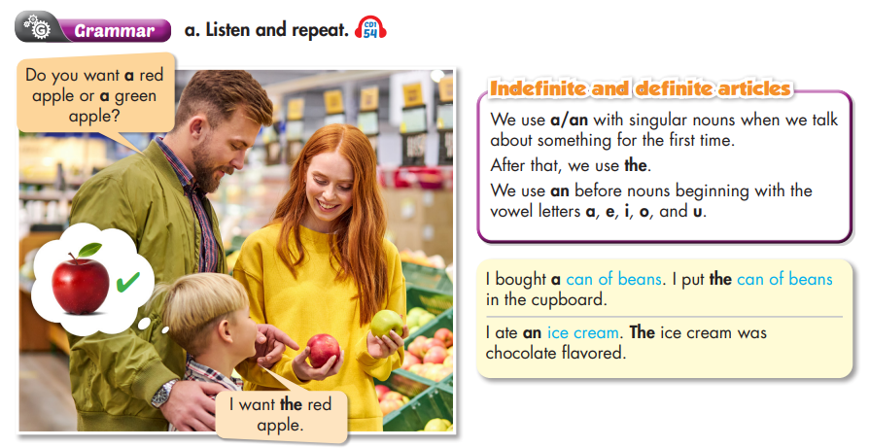

Slide 12
Read the sentences and give correct answers.
Which one do you prefer, a cup of tea or coffee?
What does your dad do?
Look at the sky. What can you see?
I would prefer …………….
He’s …………… architect.
I can see ………. moon, ……..
STUDENT A
STUDENT B

Slide 13

PRACTICE

Slide 14

Work in teams. Unscramble words to make sentences.
Example:

Slide 15

He ate an orange for breakfast.

Slide 16

This is a big bag of rice..

Slide 17

Can you get me a bag of tomatoes?

Slide 18

Put the eggs in the fridge, please.

Slide 19

I bought a bag of flour and two bottles of oil.

Slide 20
c. Read the paragraph and fill in the blanks with the correct articles.
Kelly went shopping to buy her groceries. She bought (1) _____________ packet of cookies, a bottle of cola, (2) ______________ apple pie, a carton of eggs, some potatoes, a can of beans, and a large carton of milk. She ate (3) _____________ cookies with her friend before lunch and used four of the eggs to make a cake for her sister's birthday. She ate some beans for lunch and added some of (4) ____________ milk to (5) ______________ cup of coffee. To make her dinner, she took (6) __________ bag of rice out of the cupboard. She cooked some of (7) _________________ rice with some vegetables. It was delicious! For dessert, she had an apple pie.
a
an
the
the
a
a
the

Slide 21
Extra Practice
WB p. 29
a. Fill in the blanks with a, an, or the.
1. He bought her _____ ice cream. _____ ice cream was chocolate. 2. There's _____ can of tomatoes in the cupboard. 3. There's _____ bottle of milk in the fridge. 4. I bought some coffee. _____ coffee was on sale in the market.
an
The
a
a
The

Slide 22
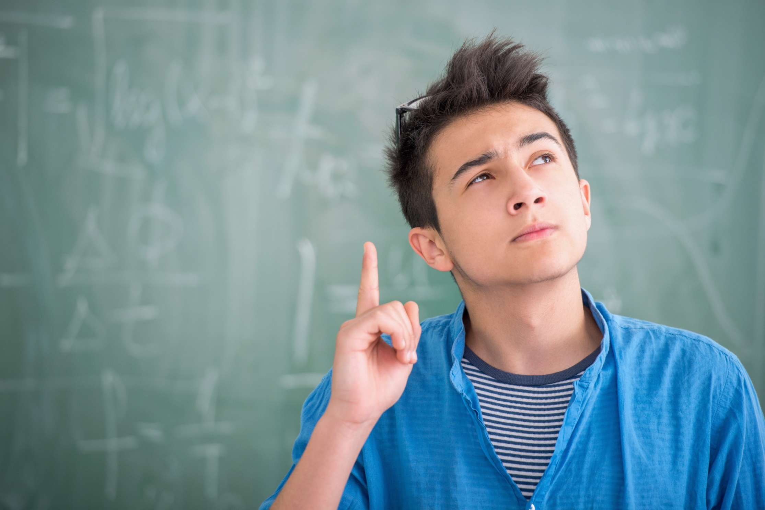
PRODUCTION

Slide 23
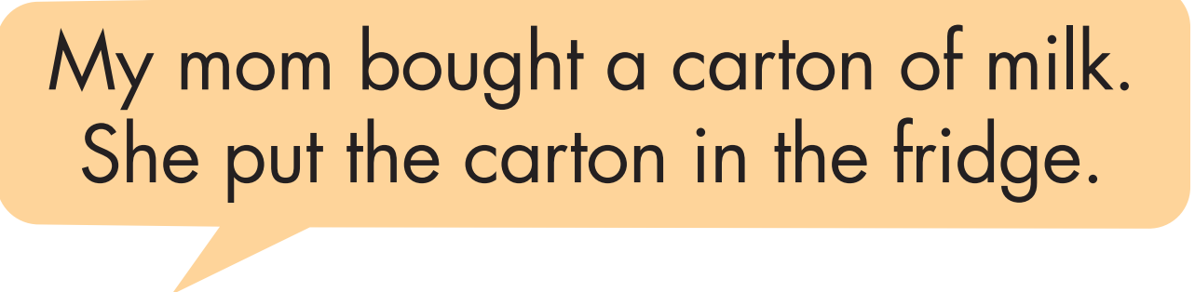
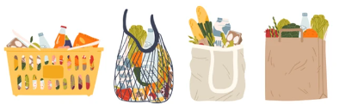
d. What did your mom buy from the supermarket last week? In pairs: Choose three things and tell your partner where she put them.

Slide 24

CONSOLIDATION

Slide 25
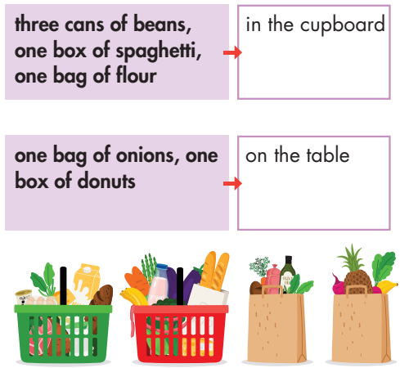
Extra Practice
WB p. 29
Writing. Look at the table and write.
There are three cans of beans.
Put the cans of beans in the cupboard.
2. _________________________________
____________________________________
3. ____________________________________
____________________________________
4. ____________________________________
____________________________________
5. _____________________________________
_____________________________________
There is one bag of flour.
Put the bag of flour in the cupboard.
There is one box of spaghetti.
Put the box of spaghetti in the cupboard.
There is one bag of onions.
Put the bag of onions on the table.
There is one box of donuts.
Put the box of donuts on the table.

Slide 26
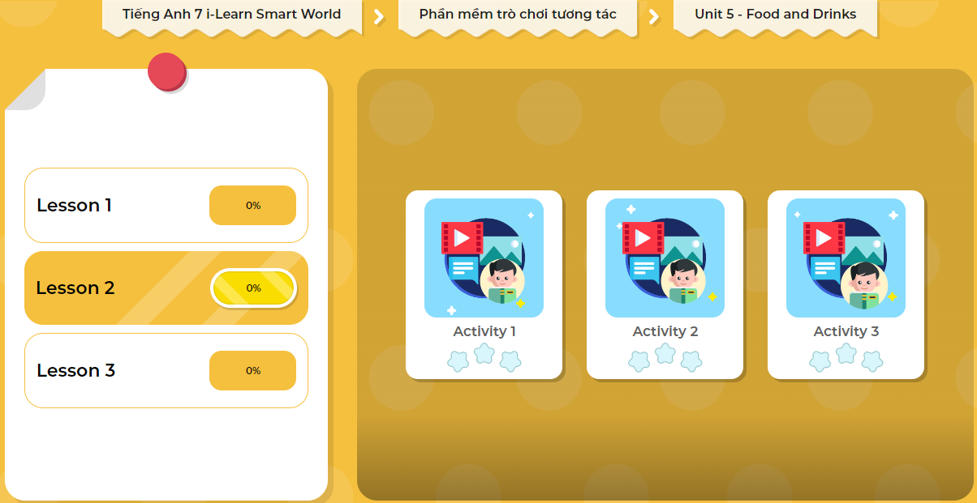
LET’S PLAY!
Click here to play the games

Slide 27

WRAP-UP

Slide 28
Today’s lesson
Grammar:
- Definite and indefinite articles.
Speaking & Writing:
- Talk and write about what your mom bought from the supermarket and where she put them.

Slide 29
Homework
Practice making sentences, using definite & indefinite articles.
Complete the grammar notes in Tiếng Anh 7 i-Learn Smart World Notebook on page 31.
Prepare the next lesson (page 41 SB).
Play the consolidation games in Tiếng Anh 7 i-Learn Smart World DHA App on www.eduhome.com.vn

Slide 30

Lesson 3
Stay positive and have a nice day!

