Slide 2
Unit
2
The generation gap
Unit
FAMILY LIFE
LESSON 8
LOOKING BACK AND PROJECT

Slide 3
LESSON 8
LOOKING BACK AND PROJECT
WARM-UP
Game: Lucky number
Pronunciation: contracted or full forms
Vocabulary: Solve the crossword
Grammar: Modal verbs
LOOKING BACK
PROJECT
Generational differences among us
CONSOLIDATION
Wrap up
Homework

Slide 4
LUCKY NUMBER
- Work in 2 teams.
- There are 7 numbers, 2 of which are lucky ones.
- Choose a lucky number ➔ 1 point without answering.
- Other numbers ➔ Pick a piece of paper.
- Use words or actions to describe the word (without saying it directly).
- Guess the word correctly ➔ 1 point
- The group having more points is the winner.

Slide 5
WARM-UP
Choose a number
1
2
3
4
5
6
7

Slide 6
WARM-UP

Slide 7
WARM-UP
Pick a word and explain it to your friends

Slide 8
LOOKING BACK
1
Listen and circle what you hear: contracted or full forms.
1. A: You (1) mustn’t/ must not be rude to your parents.
B: Yes, Grandma. But my parents (2) don’t/ do not listen to me.
2. A: (3) It’s/ It is 11 o'clock. Have you done your homework yet?
B: Yes, (4) I’ve/ I have.

Slide 9
LOOKING BACK
2
Solve the crossword.
DOWN
1. Lan lives in a ________ family that consists of her parents and younger sister.
2. The older ________ usually has more traditional views.
ACROSS
3. My father limits my ________. I can only use my laptop and smartphone to watch videos or check social media for two hours a day.
4. I live with my ________ family in a big house, and I'm very close not only to my parents, but also to my grandparents, aunt, and uncle.
5. Teenagers often come into ________ with their parents.
6. My sister is a true ________. She has used computers and smartphones since she was young and is very good at using them.

Slide 10
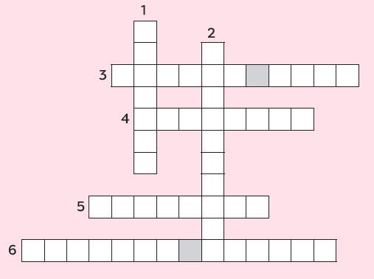
LOOKING BACK
2
Solve the crossword.
DOWN
1. nuclear
2. generation
ACROSS
3. screen time
4. extended
5. conflict
6. digital native

Slide 11
LOOKING BACK
3
Choose the correct answers A, B, C or D.
1. You ________ learn to keep your bedroom tidy. No one can clean it for you.
A. must B. had to C. mustn’t D. shouldn’t
2. Fifty years ago, my grandmother ________ stay at home and do all housework. She couldn’t go to school like her brothers.
A. must B. had to C. didn’t have to D. should
3. You ________ wear shorts to school. It’s against the school rules.
A. should B. have to C. mustn’t D. don’t have to

Slide 12
LOOKING BACK
3
Choose the correct answers A, B, C or D.
4. I think parents __________ compare their children to other’s. They will become less confident in their abilities.
A. should B. have to C. must D. shouldn’t
5. My parents respect my choices. I __________ follow in their footsteps.
A. don’t have to B. mustn’t C. should D. have to

Slide 13
PROJECT
GENERATIONAL DIFFERENCES AMONG US

Slide 14
CONSOLIDATION
1
Wrap-up
What have you learnt today?
- Review the vocabulary and grammar of Unit 2.
- Apply what you have learnt (vocabulary and grammar) into practice through a project.

Slide 15
CONSOLIDATION
2
Homework
Do exercises in the workbook.
Prepare for Unit 3.

Slide 16
Website: hoclieu.vn
Fanpage: facebook.com/tienganhglobalsuccess.vn/

