Slide 1

Unit 4: Holidays!
Lesson 4a: Reading
Page 73

Slide 2
Lesson Outline
Warm-up
Vocabulary
Speaking
Writing
Consolidation
Wrap-up

Slide 3
Objectives
By the end of this lesson, students will be able to…
use some vocabulary related to weather: cloudy, cold, hot, raining, snowing, sunny, warm.
talk about how people celebrate a festival.
write an instant message about a festival.

Slide 4

WARM-UP

Slide 5

Work in pairs.
Choose the word whose main stress is placed
differently from the others.
A. armchair B. island C. parade D. parent
2. A. delicious B. unhealthy C. exciting D. difficult
3. A. awareness B. envelope C. festival D. relative
/ˈɑːmtʃeə(r)/
/ˈaɪlənd/
/pəˈreɪd/
/ˈpeərənt/
/dɪˈlɪʃəs/
/ʌnˈhelθi/
/ɪkˈsaɪtɪŋ/
/ˈdɪfɪkəlt/
/əˈweənəs/
/ˈenvələʊp/
/ˈfestɪvl/
/ˈrelətɪv/

Slide 6
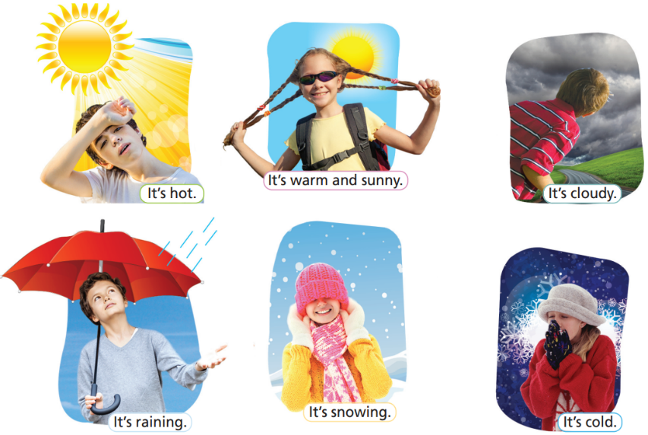
Work in pairs.
Match the pictures with the kinds of weather.
It’s cloudy.
It’s hot.
It’s raining.
It’s cold.
It’s snowing.
It’s warm and sunny.

Slide 7

It’s time to learn …

Slide 8


Slide 9
Vocabulary
Listen and repeat.
cloudy /ˈklaʊdi/ (adj): có mây, nhiều mây
cold /kəʊld/ (adj): lạnh
hot /hɒt/ (adj): nóng
raining /reɪnɪŋ/ (adj): có mưa
snowing /snəʊɪŋ/ (adj): có tuyết
sunny /ˈsʌni/ (adj): có nắng, nhiều nắng
warm /wɔːm/ (adj): ấm áp

Slide 10
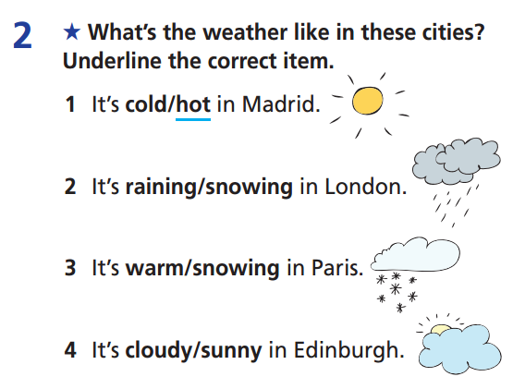
Extra Practice
WB page 38

Slide 11
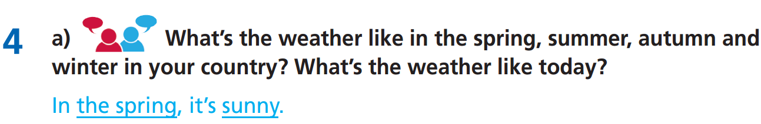
In the summer, it’s hot. In the autumn, it’s cloudy.
In the winter, it’s cold. Today, it’s raining here.

Slide 12
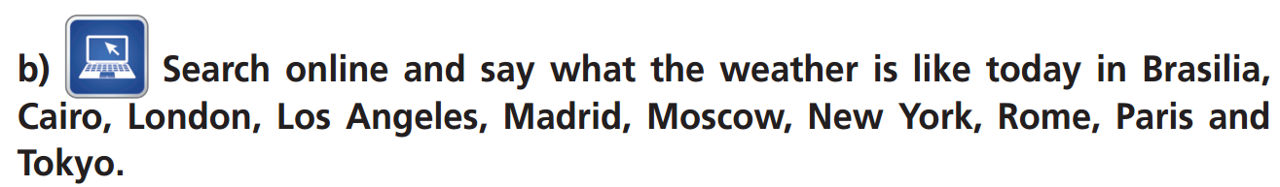
e.g.
In Brasilia, it’s cloudy. In Cairo, it’s hot. In London, it’s raining. In Los Angeles, it’s hot. In Madrid, it’s hot. In Moscow, it’s cold. In New York, it’s raining. In Rome, it’s warm and sunny. In Paris, it’s cloudy and in Tokyo, it’s warm and sunny.

Slide 13
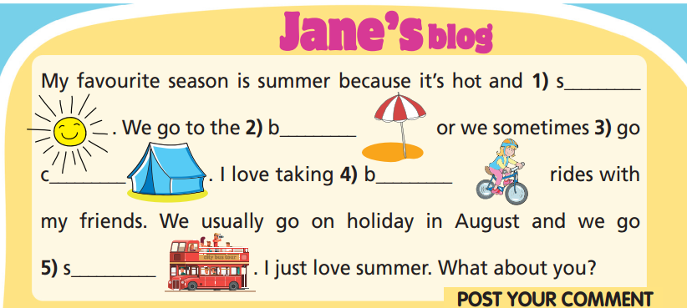
Extra Practice
WB page 38
unny
each
amping
icycle/bike
ightseeing

Slide 14
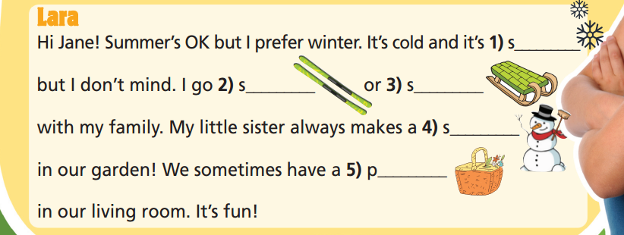
Extra Practice
WB page 38
nowing
/snowy
kiing
ledging
nowman
icnic

Slide 15

Speaking

Slide 16
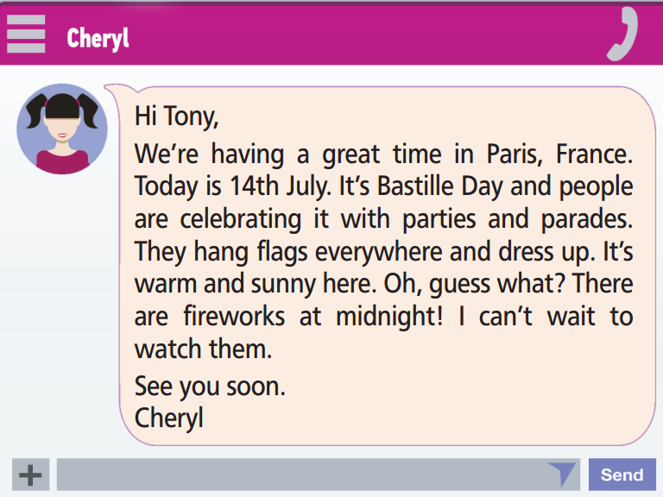
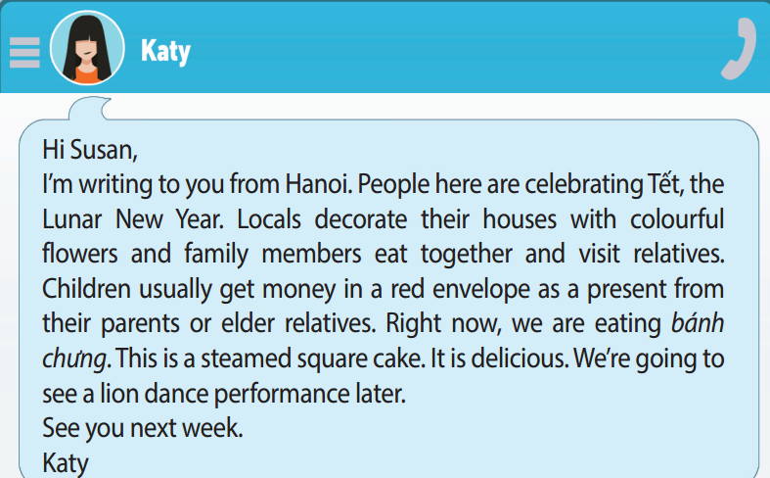
e.g.
On Bastille Day, the French have parties ….
In Hanoi, people eat bánh chưng….
- On Bastille Day, the French have parties and parades. They hang flags and dress up. There are fireworks, too.
- In Hanoi, people eat bánh chưng during Tết. There are lion dance performances. People decorate their houses with colourful flowers.

Slide 17

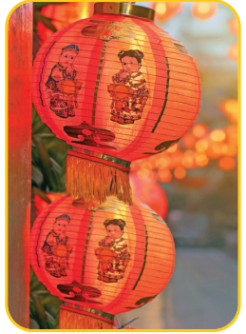
e.g.
Bastille Day sounds exciting to me because …….
Tết sounds exciting to me because ………..
- Bastille Day sounds exciting to me because I love
parades.
- Tết sounds exciting to me because there are lion
dance performances.

Slide 18

Writing

Slide 19
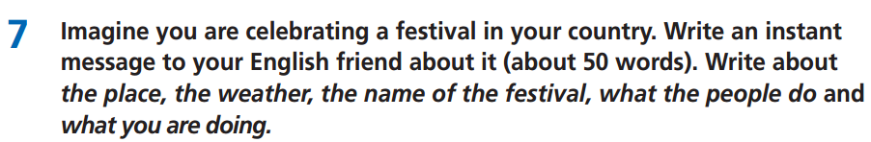

Slide 20
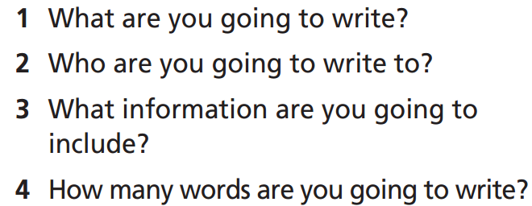
Underline the key words and answer the questions.
Write a letter.
Your English friend.
The information about a festival: the place, the weather, the name of the festival, what the people do, and what you are doing.
About 50 words.

Slide 21
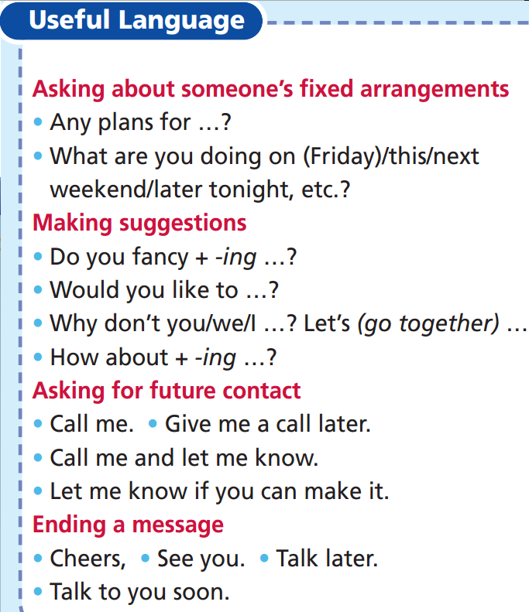
You can use the phrases from
the Useful Language box for writing your
instant message.

Slide 22
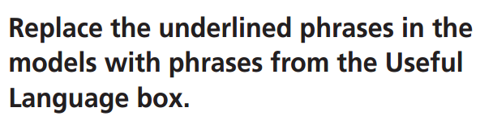
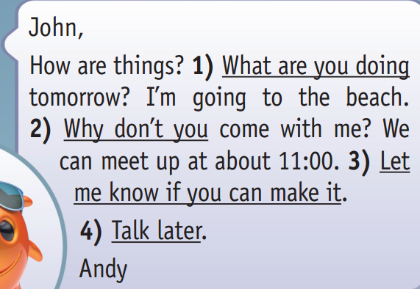
John,
How are things? 1) Any plans for tomorrow? I’m going to the beach. 2) Would you like to come with me? We can meet up at about 11:00. 3) Call me.
4) Cheers.
Andy

Slide 23
Hi (your friend’s name),
I’m having a great time in ……………................…………………….
………………………………………………………………………………………….
……………………………………………….
See you soon.
(Your name)

Slide 24
Hi Jordan!
I’m having a great time in Hanoi. It’s warm and sunny today. I’m here for the Hương Pagoda Festival. People visit the pagoda to pray for themselves and their families. Today we are going to Hương Pagoda on a boat. I can't wait to see it.
See you soon.
An

Slide 25

CONSOLIDATION

Slide 26
Write a paragraph (50-70 words) about different kinds of weather in a year in your area. You can include the following information:
Where do you live?
How many kinds of weather are there in different seasons in your area?
What activities do you do in those kinds of weather?
What is your favourite kind of weather? Why?

Slide 27
Write a paragraph (50-70 words) about different kinds of weather in a year in your area. You can include the following information:
E.g.
I live in Ho Chi Minh City. It’s hot and sunny in the dry season. It rains a lot in the rainy season. When it’s sunny, I often go to the movies, go shopping, and go to the park with my family and friends. When it’s raining, I stay at home and watch TV or play with toys. I like the sunny weather because I can go to many interesting places.

Slide 28

WRAP-UP

Slide 29
Today’s lesson
Vocabulary
cloudy
cold
hot
raining
snowing
sunny
warm
Speaking
talk about how people celebrate a festival
Writing
write an instant message about a festival

Slide 30
Homework
Practise vocabulary and grammar and make sentences using them.
Do the exercises in TA 6 Right on WB (p. 38).
Do the exercises in TA 6 Right on Notebook (pp. 38 & 39).
Prepare for the next lesson (p. 74 SB).

Slide 31
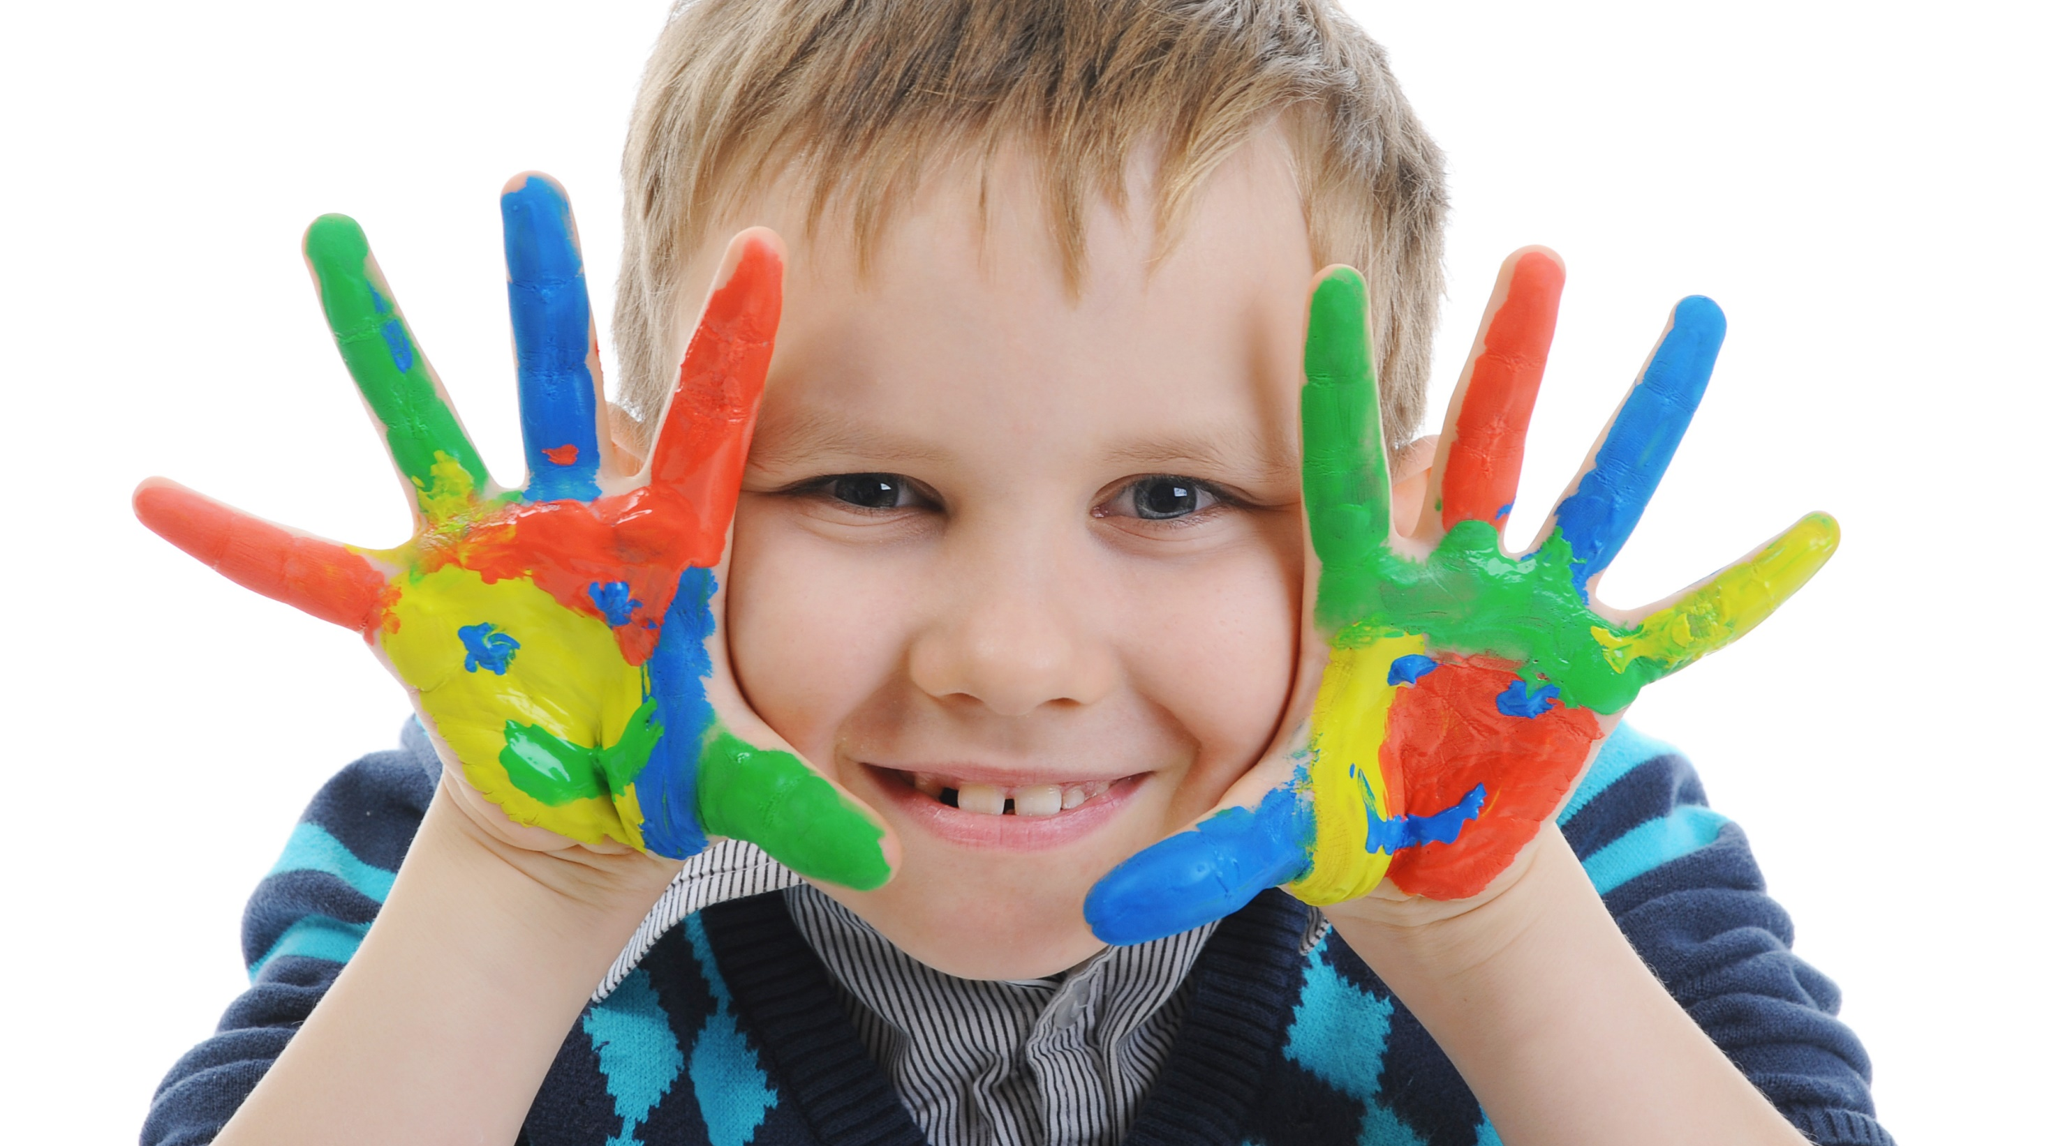
Enjoy your day!

